Slide 1
Friday
September 11, 2020

Slide 2
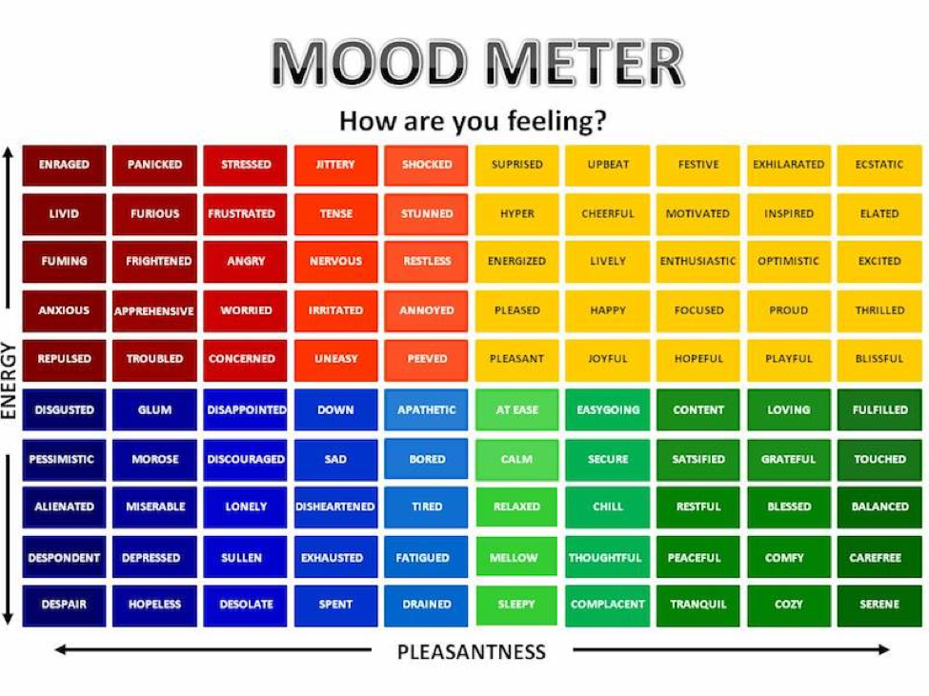

Slide 3
Today’s Weather
High of 71F
Cloudy. Welcome to Fall :/
https://weather.com/weather/hourbyhour/l/7789d4498b384397eabdaf712275ad732858c45b6a050f390989122ca69fe47d

Slide 4
Writing Prompt & Quick Discuss
Today is an incredible day in American history. 911 - September 11th is a day that forever changed the world.
Video
Think about what this means to you. Reflect on this in a breakout room. Have you heard of 9-11 before? Did this video teach you anything you haven’t heard, or didn’t know? What are your thoughts/feelings?
Remember to SLANT when discussing. Demonstrate empathy and respect.
Discuss in your breakout group - 3 minutes

Slide 5
Today’s Agenda & Goal Setting
Morning’s Objectives:
ELA
C.O: I can lift a line to reflect on reading and review the routines for ELA Working Time.
L.O.: I can orally and in writing lift a line and describe the routines for ELA Working Time
Math
C.O: I can complete mathematical problems demonstrating patterns with powers of ten.
L.O: I can orally and in writing describe the meaning of place value and power of ten patterns.
Today’s Agenda:
Morning Meeting (8:55 LOGIN)
ELA Whole Group
ELA Work Time
Math Whole Group (10:30 LOGIN)
Math Work Time
Writing Whole Group (12:25 LOGIN)

Slide 6
ELA Block (9:00-10:25)
Discuss Lift a Line from Day 3 on pages 11-13
Benchmark Rules and Routines Day 4
OYO - Listen to a story and complete questions on ReadWorks *Assigned story: Escape from the Mountains - take the quiz
OYO - Choice Reading for 30 minutes minimum - I-PICK books (your choice) on EPIC JUST RIGHT BOOKS! NOTHING TOO EASY (Class code: puk0847)
OYO - Sign into Freckle. Class Code: HEDKEX - asynchronous work assigned. Complete Friday’s assignment

Slide 7
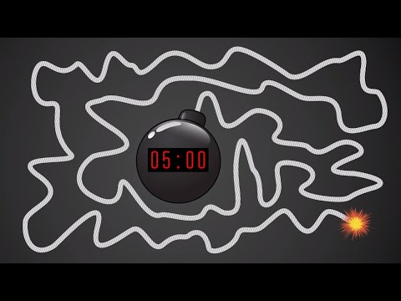
Break Time!

Slide 8
Math Block (10:30- 11:45)
Students will be working on:
Watch a hook video and take notes. Discuss exponents and powers of zero patterns
Video for M1L3
Whole group - application problem and practice (pgs 19 & 21 together).
Small group - breakout rooms (Learn Book practice problems page 22 & exit ticket page 23)
Whole group review exit ticket.
OYO - Succeed book Homework problems page 15 & 16
OYO - Log into Zearn and complete Mission 4.
Mrs. Kronk’s Schedule:
Here to help!
Additional math help found on Youtube

Slide 9
Afternoon Work Time (12:25-1:00)
Students will be working on:
Discuss the idea of Lift a Line (Thursday Benchmark)
OYO - Listen to the story, The Invisible Boy and a choice read, then complete the ELA response form.
OYO - Re-watch the BrainPop video on 9-11 from this morning. Take the quiz.
OYO - Complete Week 1 Survey.
Afternoon Objectives:
Complete ELA Writing Activities. Social Studies Quiz
C.O: I can practice Lift a Line
L.O: I can orally and in writing discuss what lifting a line means and how it is beneficial for writing details and increasing knowledge.

Slide 10
Have a wonderful day!

