Slide 1
Friday
September 18, 2020
Today is a Half-day

Slide 2
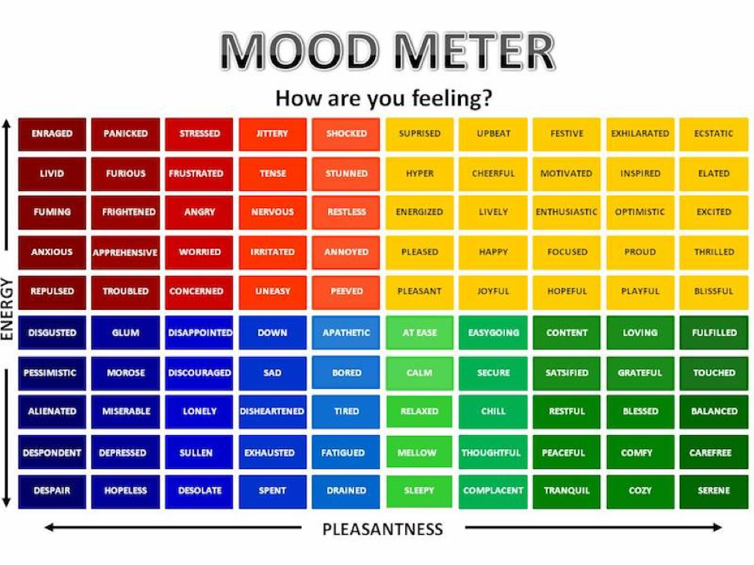

Slide 3
Today’s Weather
High of 61F
https://weather.com/weather/hourbyhour/l/7789d4498b384397eabdaf712275ad732858c45b6a050f390989122ca69fe47d

Slide 4
Today’s Agenda & Goal Setting
Morning’s Objectives:
ELA
C.O: I can make text connections
L.O.: I can orally and in writing explain the connections I have made from the readings we’ve had in class.
Math
C.O: I can fluently multiply
L.O: I can orally and in writing explain how to estimate and then multiple to find the answer.
Today’s Agenda:
Morning Meeting (8:55 LOGIN)
ELA Whole Group
ELA Work Time
Math Whole Group (10:30 LOGIN)
Math Work Time
HALF DAY!

Slide 5
ELA Block (9:00-10:25)
Benchmark Rules and Routines Day 9
Take notes on Informational writing
Read and use sticky notes to track connections, complete writing response from today’s lesson in writer’s notebook
OYO - Complete the Text Connection QUIZ from today’s reading (The Recess Queen)
OYO - Listen to a story and complete questions on ReadWorks *Assigned story: A Funny Old Ballpark - take the quiz

Slide 6
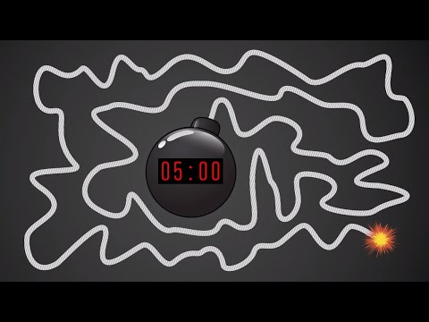
Break Time!

Slide 7
Math Block (10:30- 11:15)
Students will be working on:
Video for M1L8 (take notes)
Whole group - Application Problem & SOME Practice (pgs 57 & 59 together) use white boards
Small group - breakout rooms (practice & exit ticket pages 60 & 61)
Whole group review exit ticket.
OYO - Log into Zearn and complete Mission 9.
Mrs. Kronk’s Schedule:
Here to help!

Slide 8
Have a wonderful day!

