Slide 1
Thursday
September 17, 2020

Slide 2
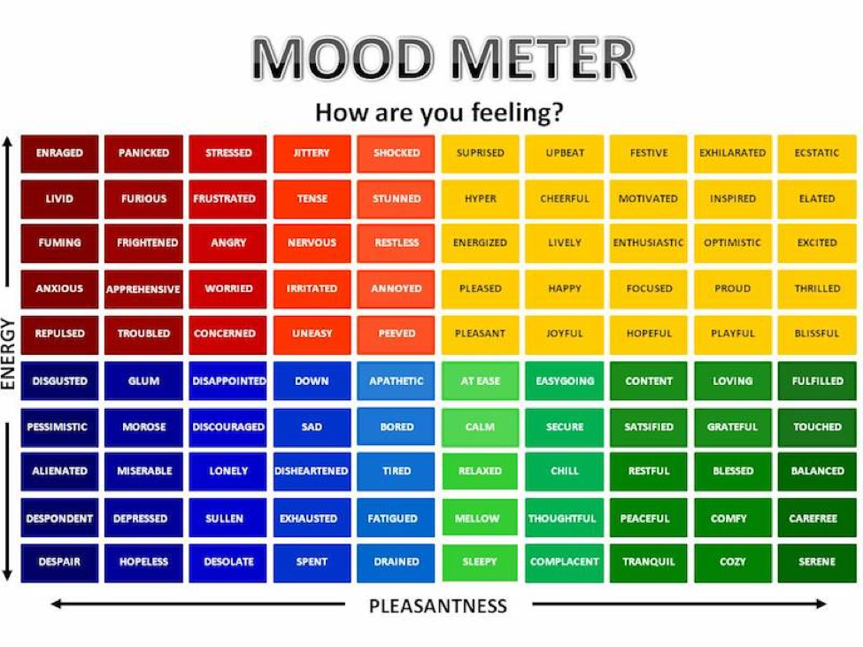

Slide 3
Today’s Weather
High of 68F
https://weather.com/weather/hourbyhour/l/7789d4498b384397eabdaf712275ad732858c45b6a050f390989122ca69fe47d

Slide 4
SEL Learning Activity
Watch the following BrainPop video on Digital Etiquette (Videos are Collaborative for Academic, Social, and Emotional Learning (CASEL) framework.
Breakout rooms - discuss 1 new thing that you learned with your group. Practice accountable speech.
Breakout Room - 2 minutes

Slide 5
Writing Prompt & Quick Discuss
Copy the prompt into your writer’s notebook and include the date. Write your answer.
9/17/20
What is the best thing about getting older?
Discuss in your breakout group - 3 minutes

Slide 6
Today’s Agenda & Goal Setting
Morning’s Objectives:
ELA
C.O: I can make text connections
L.O.: I can orally and in writing explain the connections I have made from the readings we’ve had in class.
Math
C.O: I can round decimal digits to various place values.
L.O: I can orally and in writing show how a decimal falls between two numbers and appropriately round.
Today’s Agenda:
Morning Meeting (8:55 LOGIN)
ELA Whole Group
ELA Work Time
Math Whole Group (10:30 LOGIN)
Math Work Time
Social Studies/Science Whole Group (12:25 LOGIN)

Slide 7
ELA Block (9:00-10:25)
Benchmark Rules and Routines Day 8
OYO - Complete your Text Connections exit slip to the story Ish
OYO - Listen to a story and complete questions on ReadWorks *Assigned story: The Branches of Government - take the quiz
OYO - Choice Reading for 20 minutes minimum - I-PICK books (your choice) on EPIC and practice LIFT a LINE OR… Complete research on Science or Social Studies topics and write a summary.

Slide 8
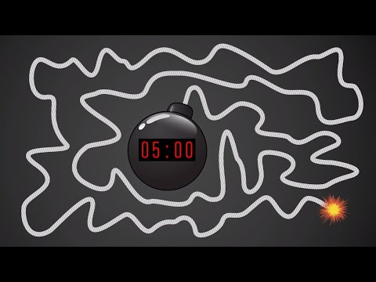
Break Time!

Slide 9
Math Block (10:30- 11:45)
Students will be working on:
Video for M1L7 (take notes)
Whole group - Application Problem & Practice (pgs 49 & 51 together) use white boards
Small group - breakout rooms (page 52 #4 & #5)
Independent Math Work
OYO - EXIT TICKET page 53
OYO - Log into Zearn and complete Mission 8.
Mrs. Kronk’s Schedule:
Here to help!

Slide 10
Afternoon Work Time (12:25-1:00)
Students will be working on:
Today is Constitution Day - watch video
Watch the hook video on the branches of government
Click on the link and review the big idea - take notes in SS notebook
Watch the video on government - take notes.
OYO - Complete the Exit Ticket form
Afternoon Objectives:
Social Studies
C.O: I can analyze how our government is organized.
L.O: I can orally and in writing explain the organization of government branches and power distribution (checks and balances).

Slide 11
Have a wonderful day!

