Slide 1
Wednesday
September 9, 2020

Slide 2
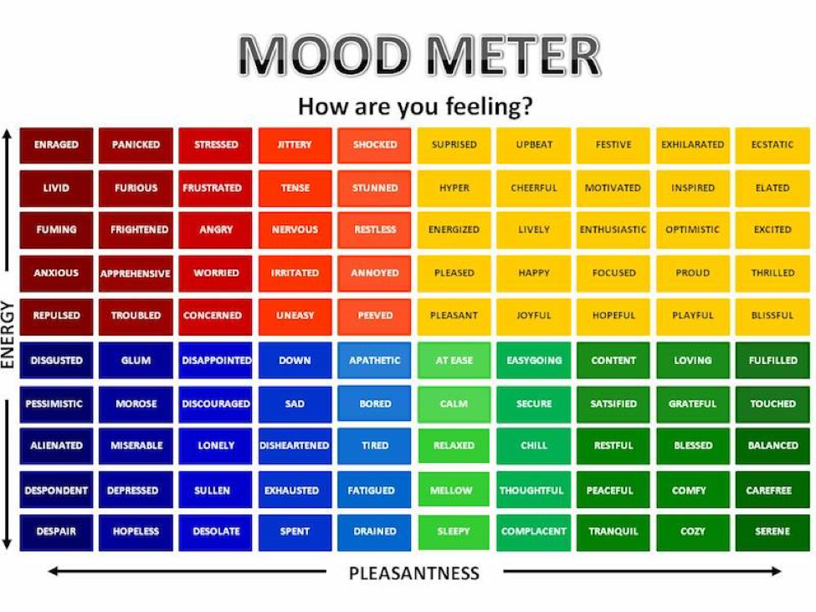

Slide 3
Today’s Weather
High of 73F
Thunderstorms expected.
https://weather.com/weather/hourbyhour/l/7789d4498b384397eabdaf712275ad732858c45b6a050f390989122ca69fe47d

Slide 4
Discuss your first day
What worked for you, and what did you have trouble with? Someone from your group might be able to help!
Discuss in your breakout group - 6 minutes

Slide 5
Today’s Agenda & Goal Setting
Morning’s Objectives:
ELA
C.O: I can review the routines for ELA Working Time.
L.O.: I can orally describe the routines for ELA Working Time
Math
C.O: I can log into Zearn and begin practicing the meaning of place value.
L.O.: I can orally describe the meaning of place value.
Today’s Agenda:
Morning Meeting (8:55 LOGIN)
ELA Whole Group
ELA Work Time
Math Whole Group (10:30 LOGIN)
Math Work Time
Social Studies/Science Whole Group (12:25 LOGIN)

Slide 6
ELA Block (9:00-10:25)
Benchmark Rules and Routines Day 2
OYO - Listen to a story and complete questions on ReadWorks *Assigned story: Drip-Tips and Other Adaptations in the Rainforest
OYO - Choice Reading for 20 minutes minimum - IPICK books (your choice) on EPIC (Class code: PUK0847)
OYO - Sign into Freckle. Class Code: HEDKEX - asynchronous work assigned. Complete WEDNESDAY Baseline Assessment ELA #2

Slide 7
Break Time!

Slide 8
Math Block (10:30- 11:45)
Mrs. Kronk’s Schedule:
Here to help!
Additional math help found on Youtube
Students will be working on:
Review video for M1L1
Whole group - application problem (pgs 3, 5, & 6).
Small group - breakout rooms (Learn Book practice problems page 7 & Exit Ticket 9)
Whole group review.
OYO - Succeed book Homework problems.
OYO - Log into Zearn and complete Mission 2.

Slide 9
Afternoon Work Time (12:25-1:00)
Afternoon Objectives:
Science
C.O: I can review that Science is the process of learning about the natural world through observation and experimentation
L.O: I can listen to the generation genius video by completing a response form and a quiz to demonstrate my knowledge.
Students will be working on:
Review the vocabulary and questions assigned
Watch the video and review the Q&As
OYO - Complete the Exit Ticket form
OYO - Complete the Online Quiz. Play independently

Slide 10
Have a wonderful day!

