Slide 1
Tuesday
September 8, 2020

Slide 2
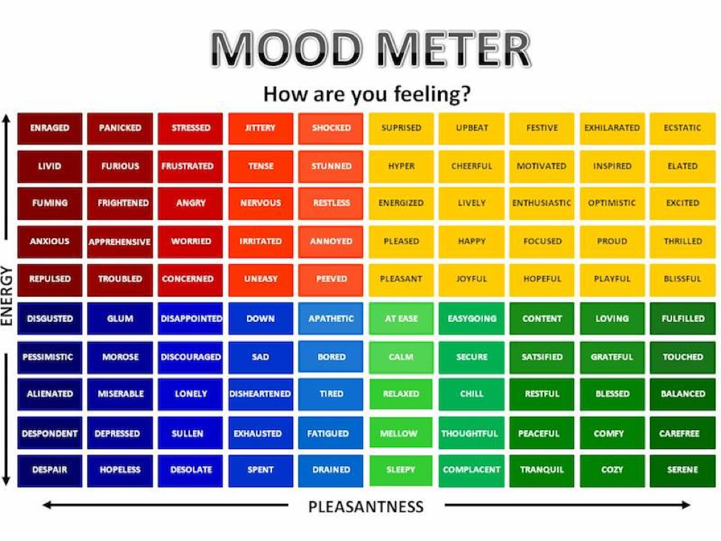

Slide 3
Today’s Weather
High of 78F
Thunderstorms expected.
https://weather.com/weather/hourbyhour/l/7789d4498b384397eabdaf712275ad732858c45b6a050f390989122ca69fe47d

Slide 4
Current Events & Quick Discuss
https://www.timeforkids.com/g34/new-covid19-data/
Stop and Think! Who are the people quoted in the article? What makes them reliable sources? What other sources might the author have included in this story, and why?
Discuss in your breakout group - 3 minutes

Slide 5
Today’s Agenda & Goal Setting
Morning’s Objectives:
ELA
C.O: I can review the routines for ELA Working Time.
L.O.: I can orally describe the routines for ELA Working Time
Math
C.O: I can log into Zearn and begin practicing the meaning of place value.
L.O.: I can orally describe the meaning of place value.
Today’s Agenda:
Morning Meeting (8:55 LOGIN)
ELA Whole Group
ELA Work Time
Math Whole Group (10:30 LOGIN)
Math Work Time
Social Studies/Science Whole Group (12:25 LOGIN)

Slide 6
ELA Block (9:00-10:25)
Benchmark - Day 1
Sign up for ReadWorks.
1. Students go to www.readworks.org/student
2. Students should sign in with their Google account.
3. Students enter class code 66V3ZQ
Listen to a story and complete questions on ReadWorks *Assigned story: Solar Absorbers and the Future of Electricity
Complete the Reading Survey.
Choice Reading for 20 minutes minimum - choose inside Readworks (choice reading).
Sign up for Freckle. Class Code: HEDKEX - asynchronous work assigned. Baseline ELA Test #1

Slide 7
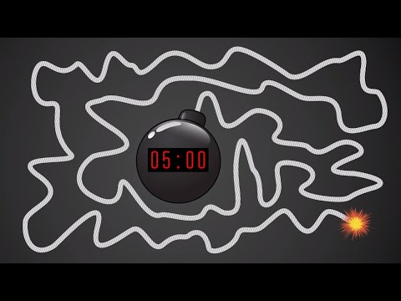
Break Time!

Slide 8
Math Block (10:30- 11:45)
Mrs. Kronk’s Schedule:
Here to help!
Students will be working on:
Get Logged in to Zearn.
Complete Mission 1.
Complete the Pre-Assessment for Module 1.

Slide 9
Afternoon Work Time (12:25-1:00)
Afternoon Objectives:
Social Studies
C.O: I can review current events by watching CNN10.
L.O: I can listen to the news and respond in writing by completing a response form.
Students will be working on:
Write your response to the CNN10 video.

Slide 10
Have a wonderful day!

