Slide 1
Content Objectives : I can apply concepts and formulas of volume to design a sculpture using rectangular prisms within given parameters.
Language Objectives: I can in writing solve lesson 9 problems on my Succeed book by using a ruler or measuring tape.
Lesson 9

Slide 2
Lesson 8 Answer Key
The link below has the solution for number 1 only if you are not sure of problem #2 send me your answer to confirm it via Remind .
http://www.oakdale.k12.ca.us/cms/page_view?d=x&piid=&vpid=1428998217733
Check your lesson 8 answers and make the necessary corrections.

Slide 3
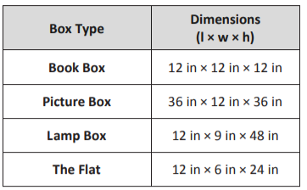
Application Problem Lesson 9 Submit your answer via Remind or text message
The chart to the right shows the dimensions of various rectangular packing boxes. If possible, answer the following without calculating the volume.
Which box will provide the greatest volume?
Which box has a volume that is equal to the volume of the book box? How do you know?
Which box is 1/3 the volume of the lamp box?

Slide 4
Lesson 9 Concept Development
Watch the video as many times as you need. Today’s lesson is fun, you can use any object in your house to find its volume. You need a ruler or measuring tape.
https://youtu.be/22eYA_LbujM

Slide 5
Succeed Problems
Work on your Succeed problems! Read the problems more than one time so you understand them. The problems are not hard!
If you do not have the book click on this link scroll to lesson 9

