Slide 1
Content Objectives : I can solve word problems involving the volume of rectangular prism with whole number edge lengths by using Read Draw and Write (RDW) strategy
Language Objectives: I can in writing solve lesson 7 problems on my Succeed book.
Lesson 7

Slide 2
Lesson 6 Answer Key
http://www.oakdale.k12.ca.us/cms/page_view?d=x&piid=&vpid=1428998217557
Watch the video ,and check your lesson 6 answers. Make the necessary corrections.

Slide 3
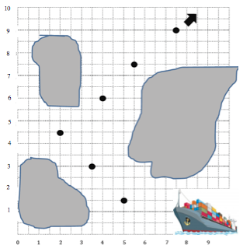
Application Problem Lesson 7 Submit your answer via Remind or text message
The captain of a ship has a chart to help him navigate through the islands. He must follow points that show the deepest part of the channel. List the coordinates the captain needs to follow in the order he will encounter them.
1. (_____,_____) 2. (_____,_____)
3. 4.
5. 6.

Slide 4
Lesson 7 Concept Development
Watch the video as many times as you need. If you don't watch the video and understand it you will have hard time understanding the upcoming lessons
https://youtu.be/uFM2j-5_SMI
Click here to watch. WATCH the Whole Video ! I will know if you did not watch the whole thing.

Slide 5
Succeed Problems
Work on your Succeed problems! Read the problems more than one time so you understand them. The problems are not hard!
If you do not have the book click on this link

