Slide 1
Words with beginning s Blends

Slide 2
Some words begin with more than one consonant sound. These are called blends.

Slide 3
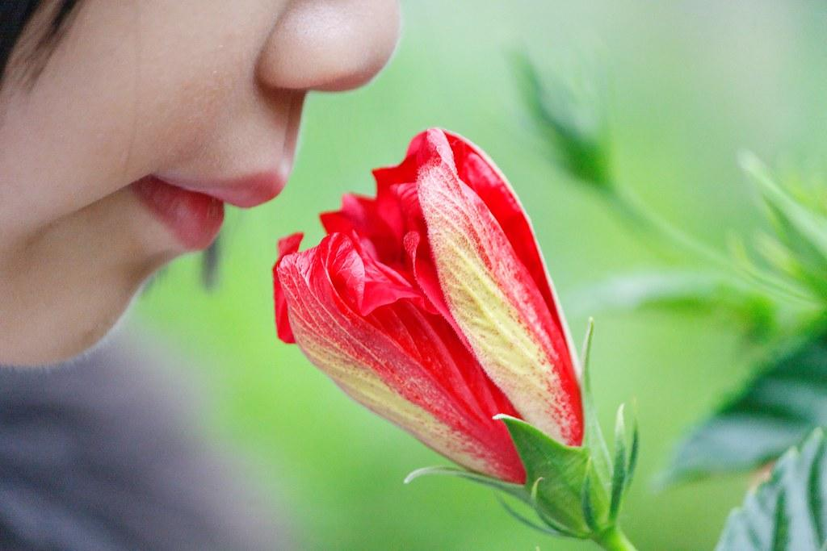
Choose the blend to complete the word that matches the picture.
__ell
sn
sm
sh

Slide 4
2. Choose the blend to complete the word that matches the picture.
__im
sy
sp
sw

Slide 5
3. Choose the blend to complete the word that matches the picture.
__ot
sp
sl
st

Slide 6
4. Choose the blend to complete the word that matches the picture.
__in
sep
sp
sk

Slide 7
5. Choose the blend to complete the word that matches the picture.
__ar
sl
sk
st

Slide 8
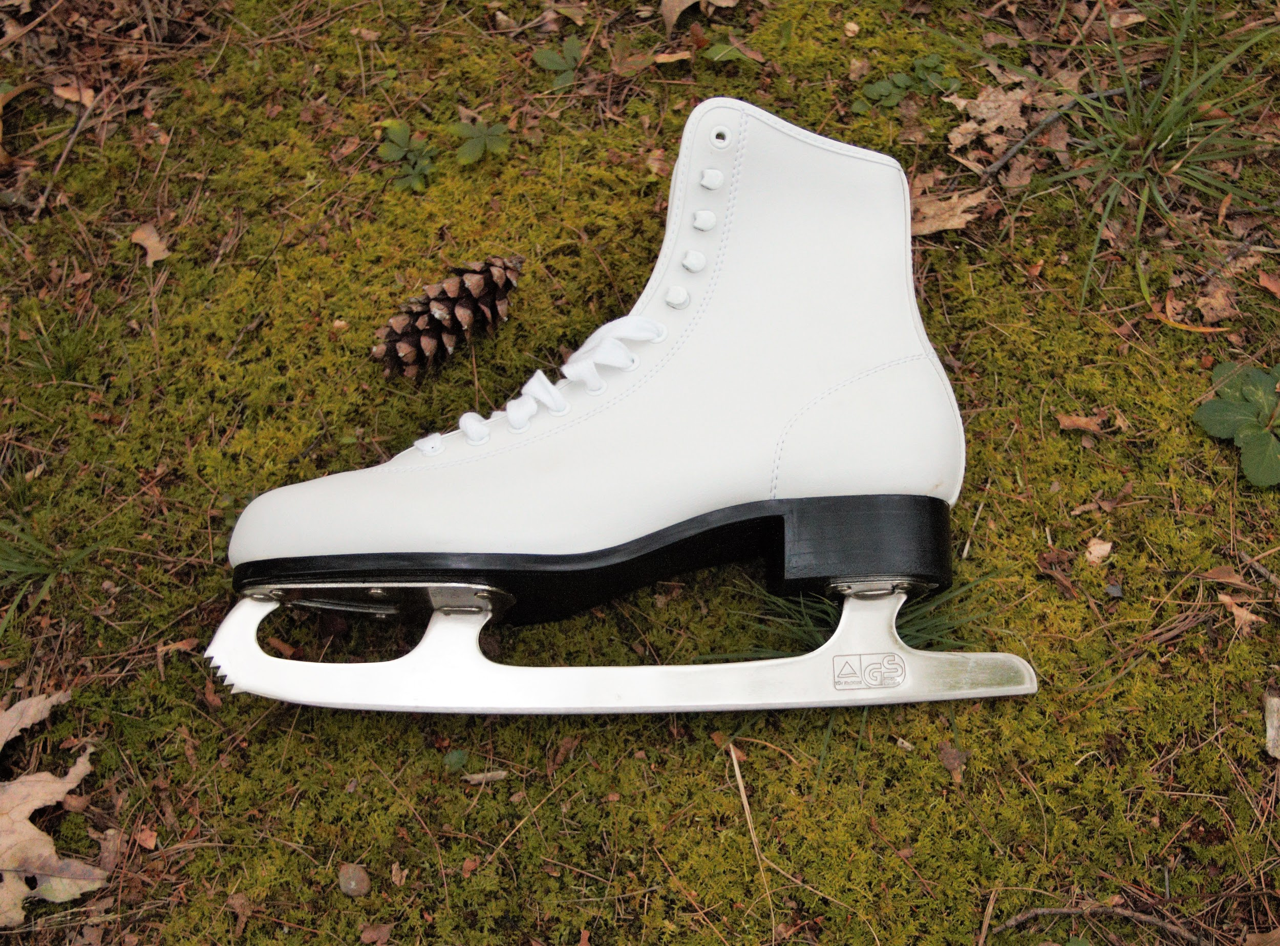
6. Choose the blend to complete the word that matches the picture.
__ate
sl
sk
sp

Slide 9
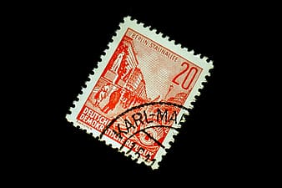
7. Choose the blend to complete the word that matches the picture.
__amp
st
sr
set

Slide 10
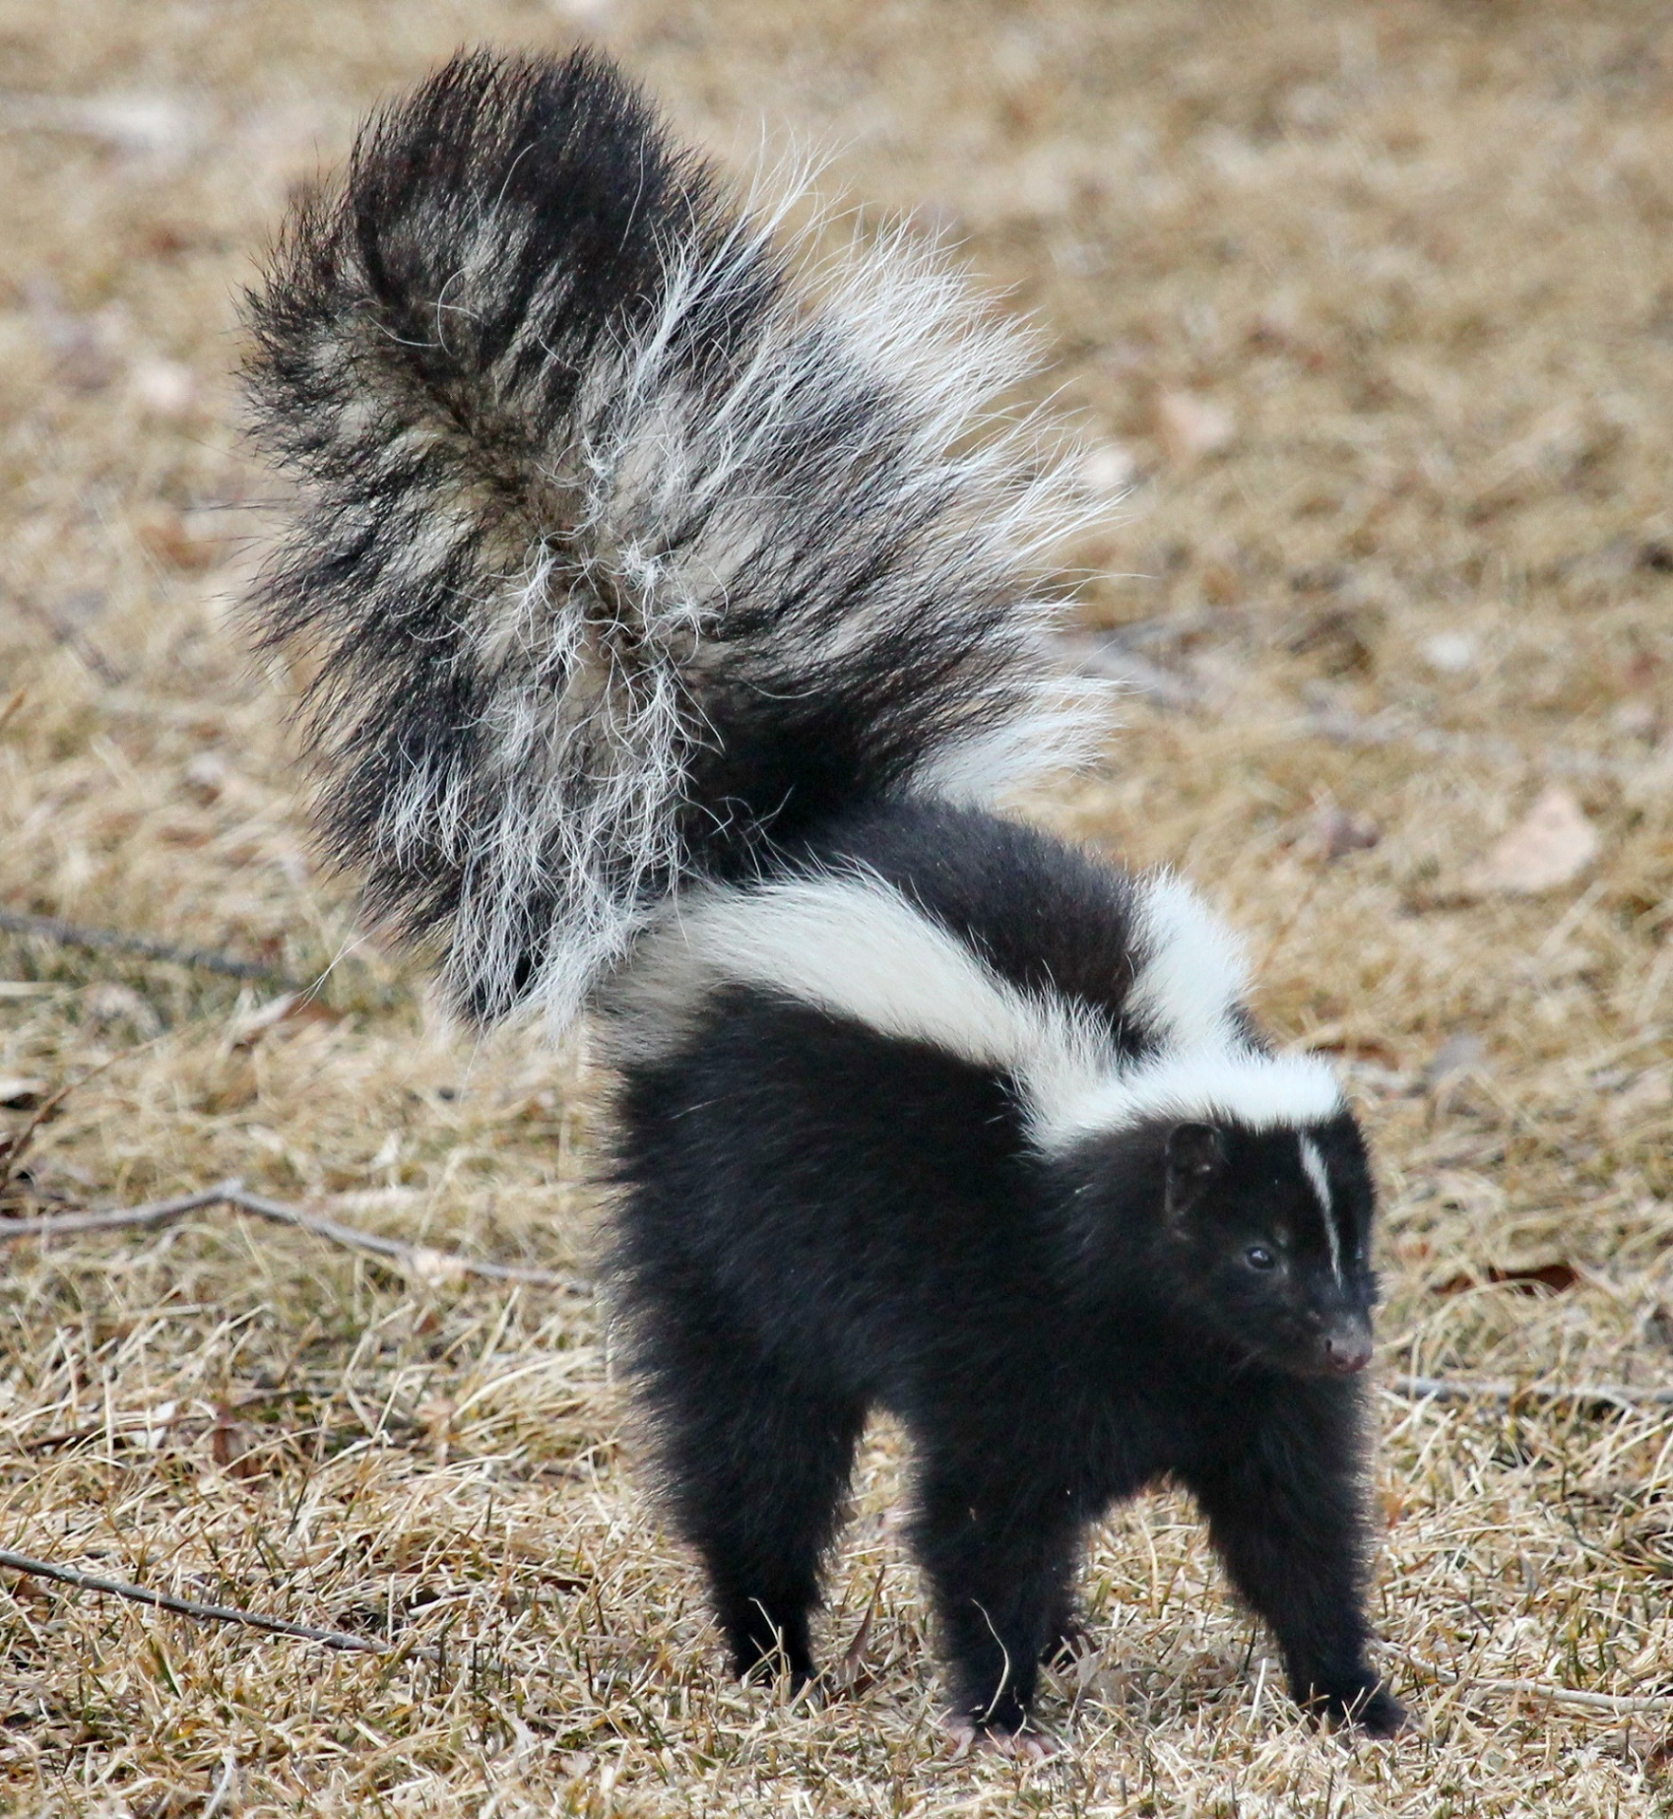
8. Choose the blend to complete the word that matches the picture.
__unk
sc
sh
sk

Slide 11
9. Choose the blend to complete the word that matches the picture.
__ile
st
sm
sy

Slide 12
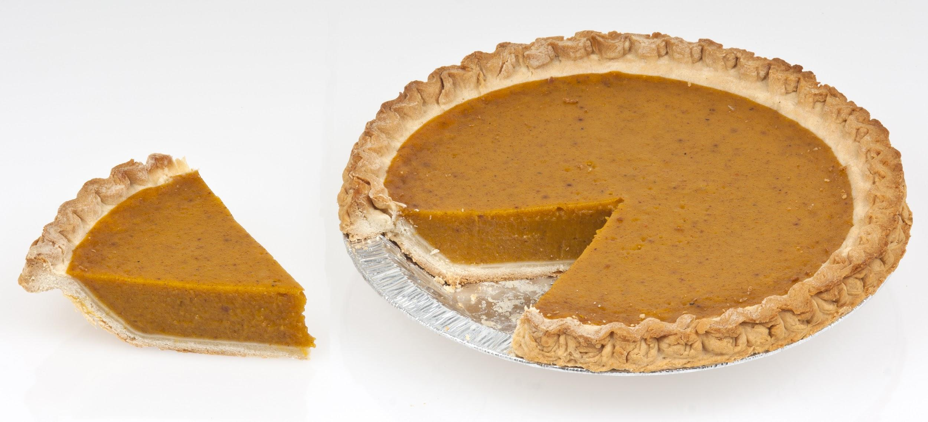
10. Choose the blend to complete the word that matches the picture.
__ice
sl
sel
si

