Slide 1
Ruby the Copycat Retell

Slide 2
I will remember how to retell a story by choosing the most important events from the beginning, middle, and end of the story.

Slide 3
Here are two events from the beginning of the story. Which one is more important? In other words, which event is necessary to help tell the story?

Slide 4
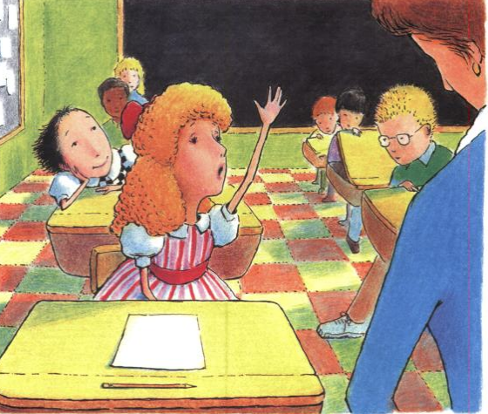
A.
Ruby went to a new school and sat behind a girl named Angela.

Slide 5
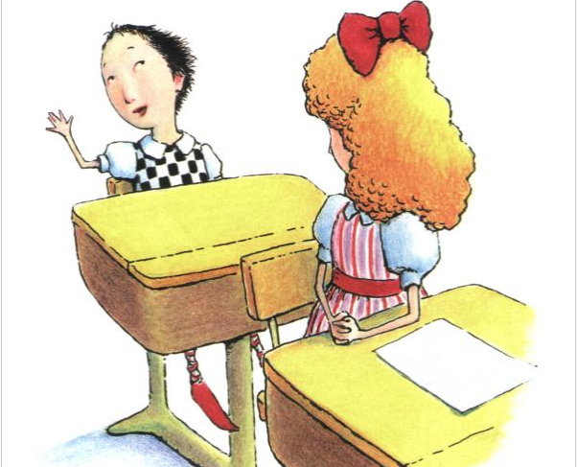
B.
Angela told the class that she was the flower girl in her sister’s wedding.

Slide 6
Here are two events from the middle of the story. Which one is more important? In other words, which event is necessary to help tell the story?

Slide 7
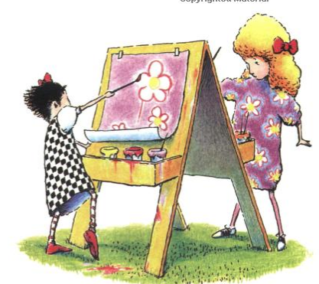
A.
Ruby painted a picture to match Angela’s dress.

Slide 8
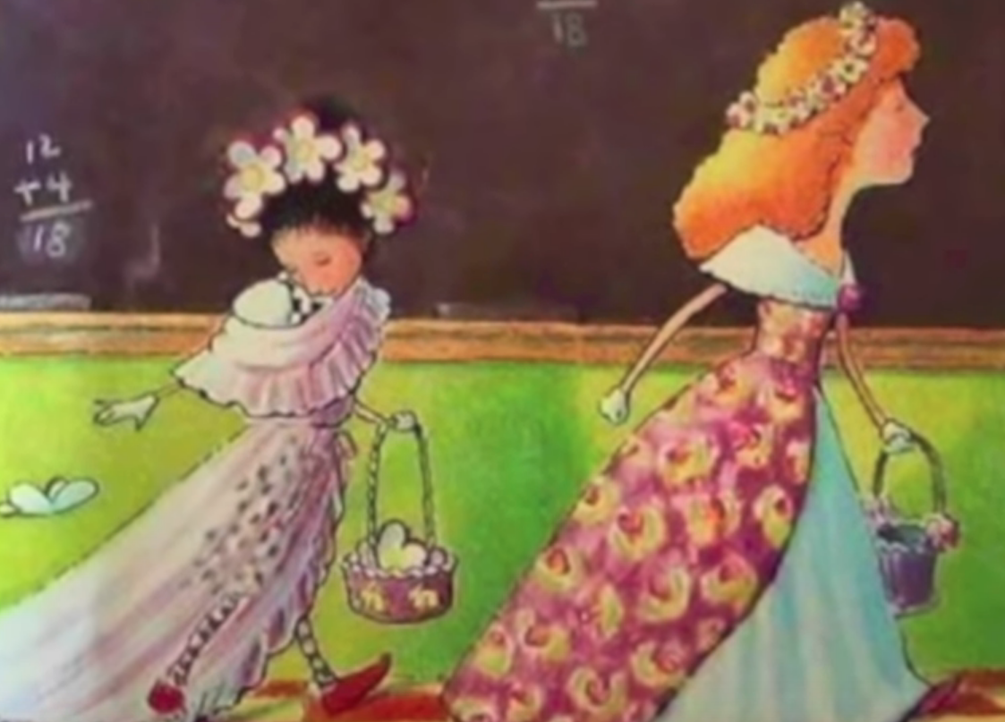
B.
Angela became annoyed with all of Ruby’s copying.

Slide 9
Here are two events from the end of the story. Which one is more important? In other words, which event is necessary to help tell the story?

Slide 10
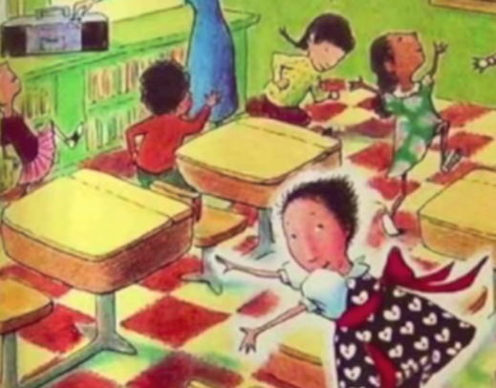
A.
Ruby showed the class what she could do.

Slide 11
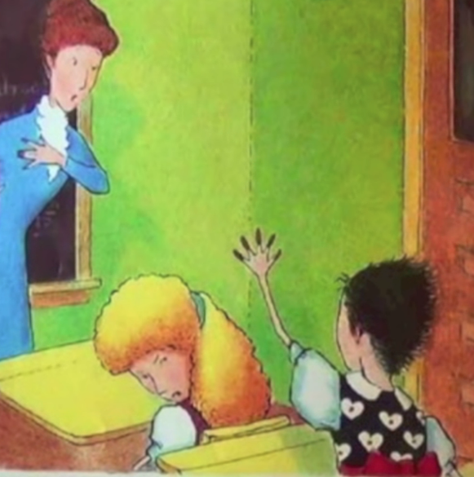
B.
Ruby copied Miss Hart by wearing long red nails.

