Slide 1
Long and Short e

Slide 2
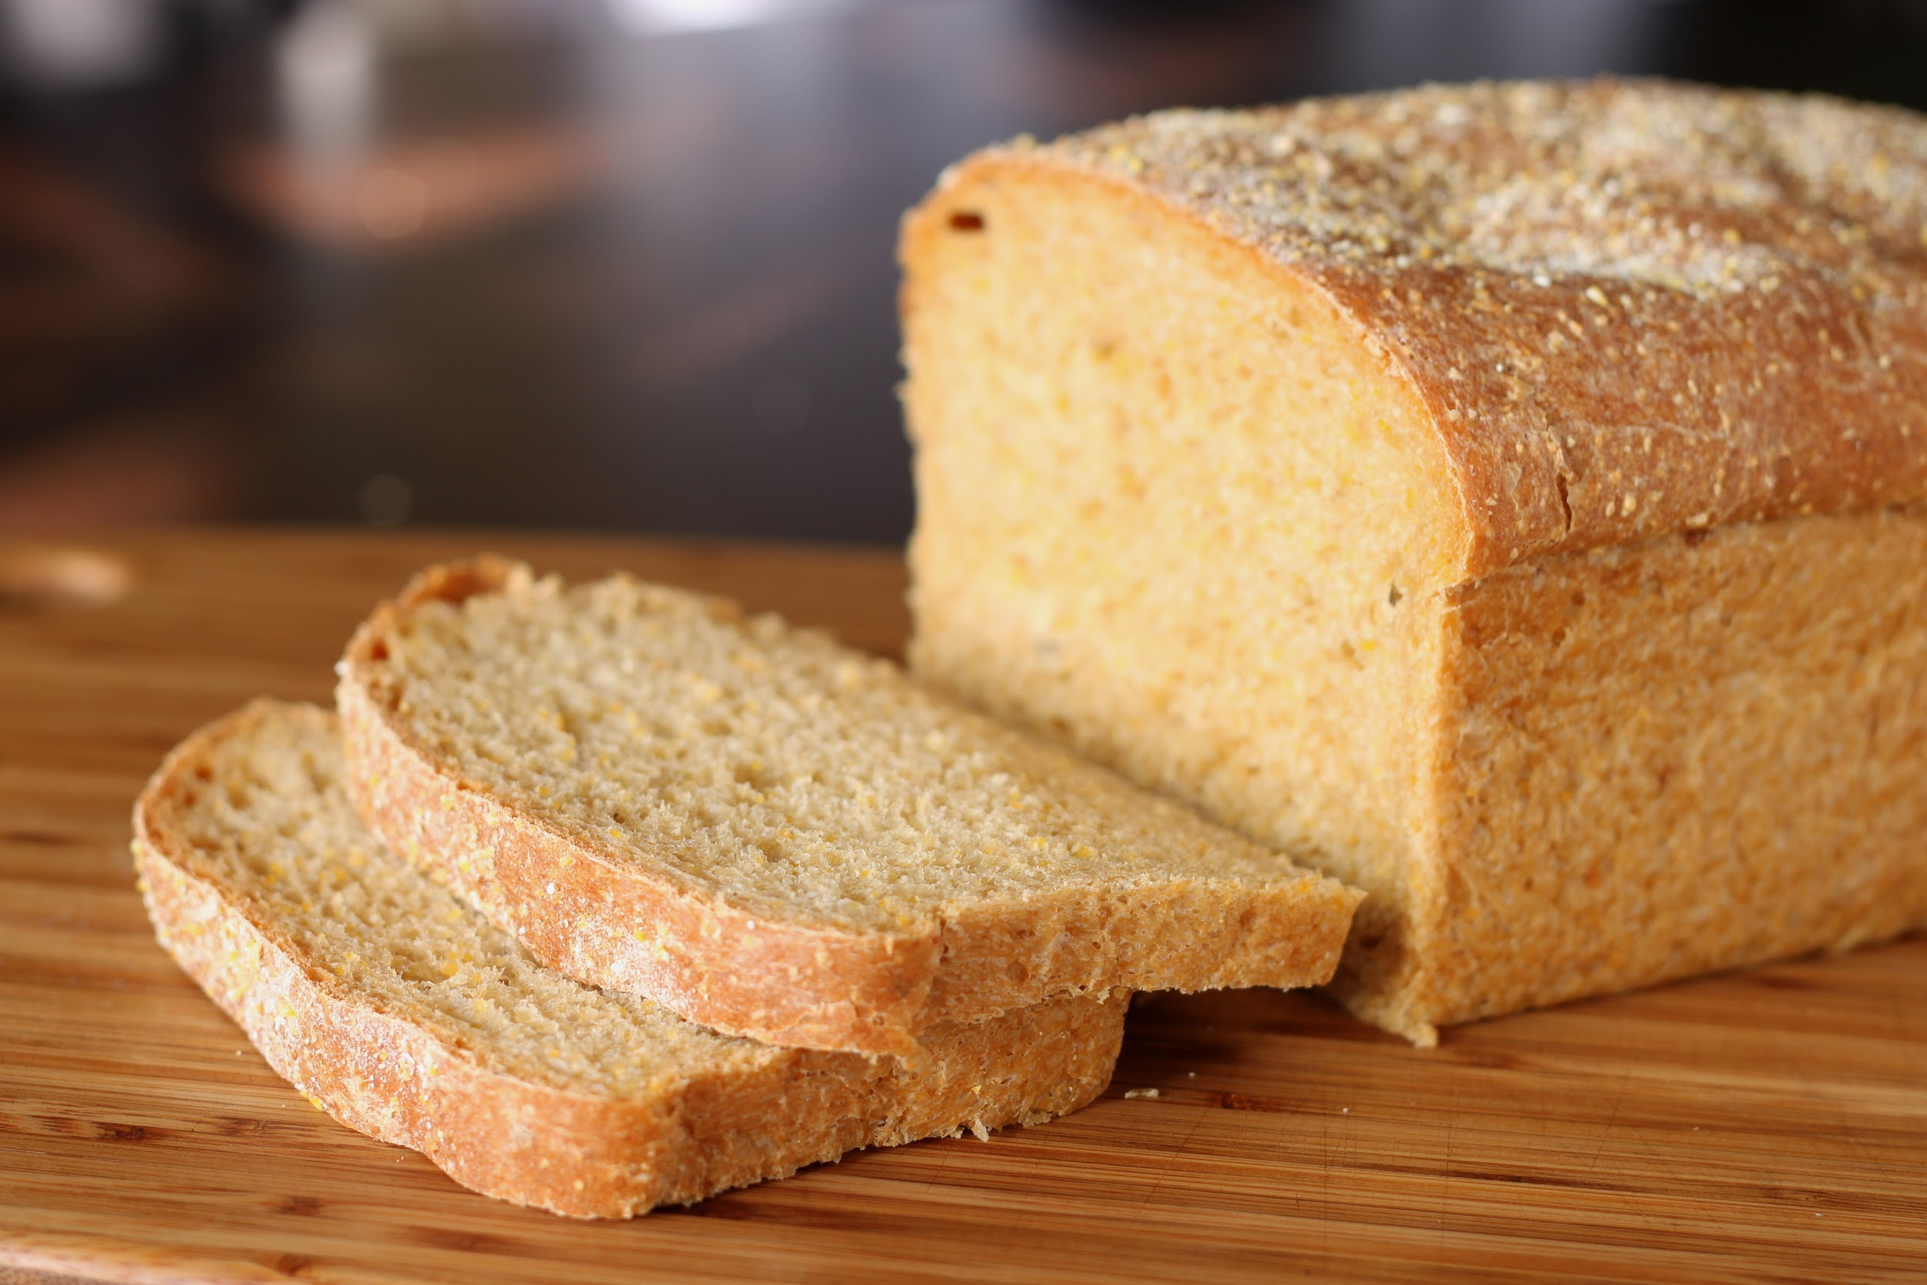
bread
This has the long e sound
This has the short e sound.

Slide 3
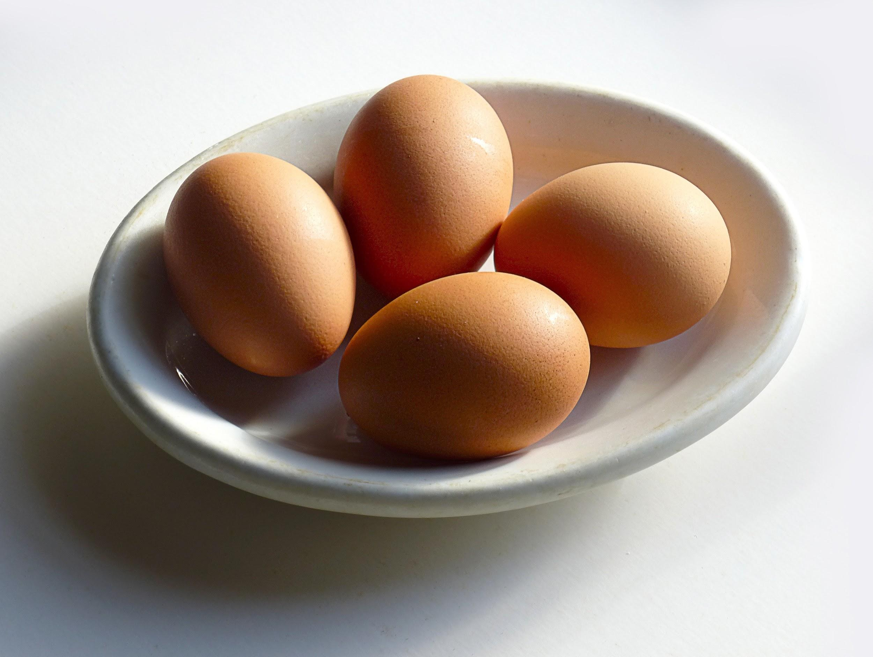
eggs
This has the long e sound
This has the short e sound.

Slide 4
feet
This has the long e sound
This has the short e sound.

Slide 5
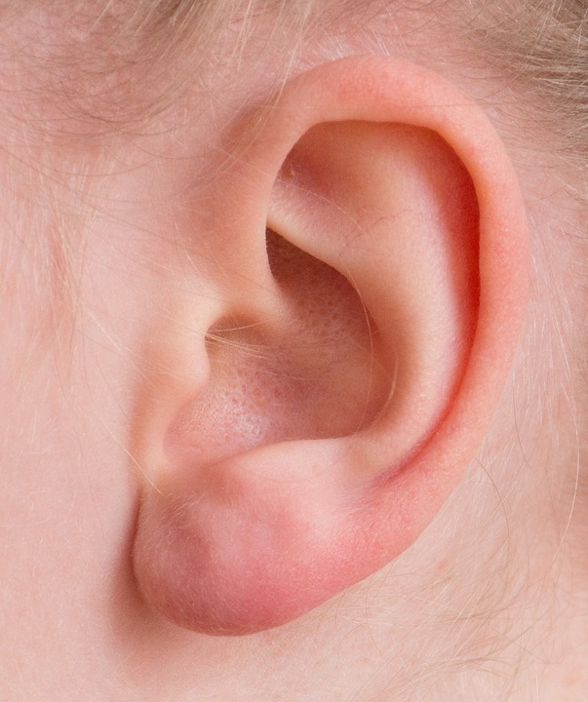
Ear
This has the long e sound
This has the short e sound.

Slide 6
red
This has the long e sound
This has the short e sound.

Slide 7
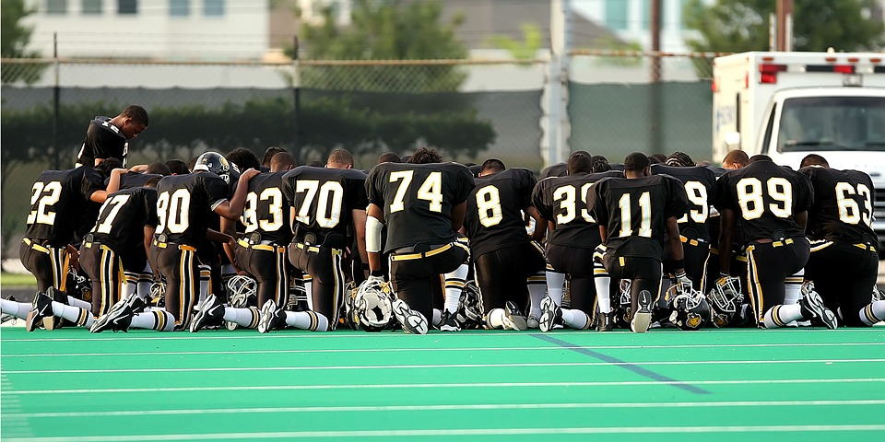
team
This has the long e sound
This has the short e sound.

Slide 8
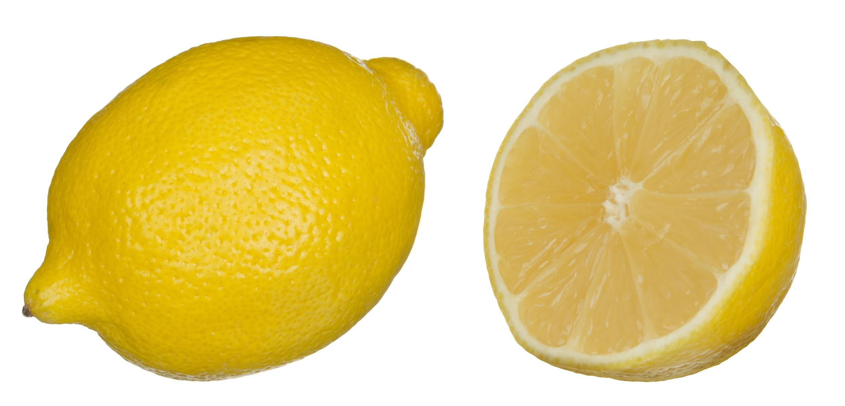
lemon
This has the long e sound
This has the short e sound.

Slide 9
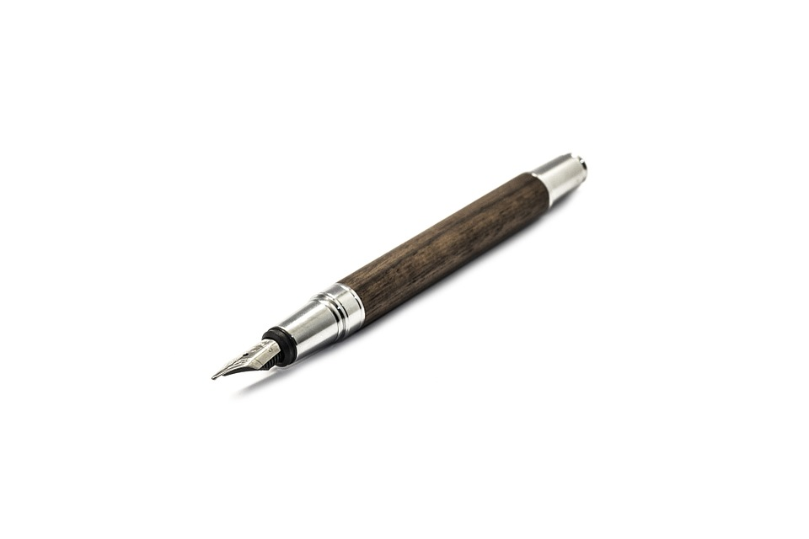
pen
This has the long e sound
This has the short e sound.

Slide 10
leaf
This has the long e sound
This has the short e sound.

