Slide 1
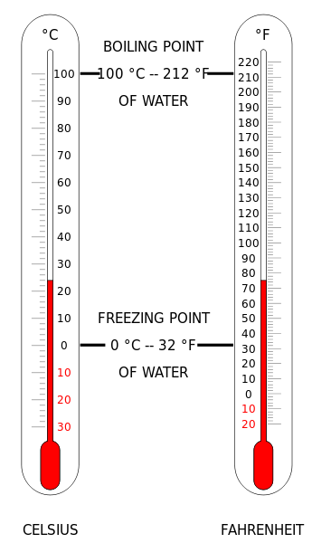
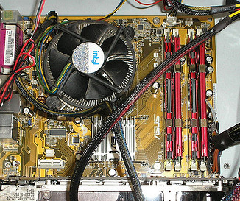
What Is Heat?
Notes:
*
(left) These two thermometers serve as hints that heat is a form of energy that is based on temperature.
(right) A computer processor cooling unit (the fan inside this CPU) is a great example of why heat is so important to engineering and the design of engineered systems.
Image sources: (left) 2010 Gringer, Wikimedia Commons https://commons.wikimedia.org/wiki/File:Thermometer_CF.svg; (right) 2008 atteSmythe, Flickr (CC) http://www.flickr.com/photos/attesmythe/2926574819/

Slide 2
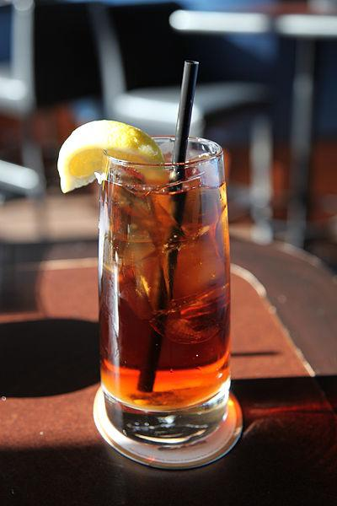
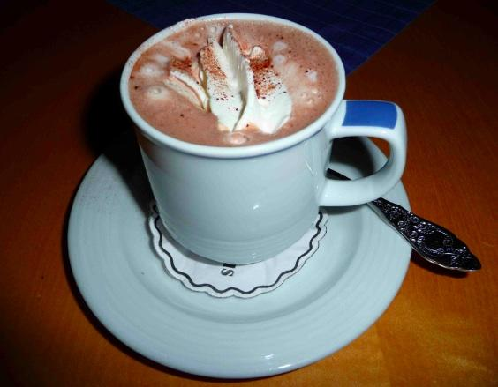
What Will Happen?
If you leave a hot drink on the table and wait for a while, does the drink heat up or cool off?
If you leave a cold drink on the same table and wait for a while, does the drink heat up or cool off?
Notes:
Have students share their answers with a partner, then with the class.
Ask students to think about why some things get warmer while some things get colder when they are left out.
Drinks do not know what temperature they should change to. Given time, both eventually become room temperature. The hot drink by releasing energy, and the cold drink by absorbing it.
Image sources: (left) 2009 4028mdk09, Wikimedia Commons http://commons.wikimedia.org/wiki/File:Becher_Kakao_mit_Sahneh%C3%A4ubchen.JPG; (right) 2010 Melissa Doroquez, Wikimedia Commons http://en.wikipedia.org/wiki/File:Iced_Tea_from_flickr.jpg

Slide 3

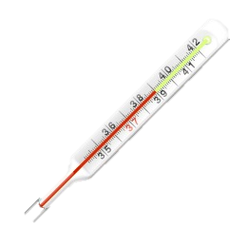
WHAT DOES IT MEAN?
- THE MOVEMENT OF THERMAL ENERGY.
HEAT
TEMPERATURE
- THE MEASURE OF THE AVERAGE SPEED OF ALL PARTICLES.
THERMAL ENERGY
    - THE TOTAL ENERGY OF ALL PARTICLES IN AN OBJECT
Notes:
Refer to the following definitions and relationships to help introduce the critical vocabulary words:
Thermal energy: the total energy of all particles in an object, which depends on the number of particles, temperature of the object and the arrangement of the particles.
Heat: the thermal energy moving from hot to cold. Basically, only when thermal energy is transferred, it is called heat. In other words, thermal energy is not in transit (rather remains part of the internal energy of the system), whereas heat is energy in transit (energy in the process of being transferred).
Temperature: the measure of the average speed of all particles.

Slide 4
WHAT DOES IT MEAN? Cont.
Heat is the transfer of thermal energy (a substance can not contain heat) where as Thermal Energy is the sum of the total energy of all particles in a substance. Temperature is the measure of the average speed of these particles that make up the substance.
 | HEAT | TEMPERATURE | THERMAL ENERGY
What Is It? | The transfer of energy between objects that are different temperatures. | A measure of the average kinetic energy of the particles in a substance. | The total kinetic energy of the particles in a substance.
How Is It Expressed? | Energy transferred in joules and calories. | Degrees Fahrenheit, Celsius, Kelvin. | Joules
Affected By Object’s Mass? | Varies with mass, specific heat capacity, and temperature change. | Does not vary with the mass of an object. | Varies with mass and temperature.

Slide 5
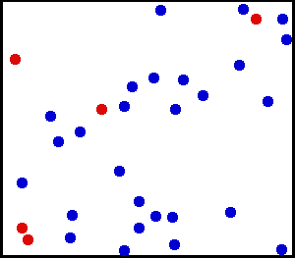
Thermal Energy
The atoms inside of everything are always jiggling and bouncing around. They have kinetic energy.
A thermometer can measure this kinetic energy and tell us the temperature of something.
The more jiggling, the higher the temperature.
cold water hot water
Notes:
*
The molecules/atoms of all matter are continually moving around; even the atoms of a solid are vibrating at terrifc speed (though they are stuck in one general position). The average measure of this kinetic energy is temperature. For a given substance, the faster the atomic jiggling, the higher its temperature. The well-known phenomenon of “hot” is a way our bodies tell us the amount of thermal energy (the average molecular jiggling kinetic energy) of the object we are touching.
This animation shows what might be air at a molecular level. The blue dots could be nitrogen and the red dots oxygen. At any temperature above -459 °F, these molecules bounce around much like in this animation. The real speed of air molecules at room temperature is far greater than shown here.
Animation source: 1995 Greg L at the English language Wikimedia http://commons.wikimedia.org/wiki/File:Translational_motion.gif; right gif is edited version of original

Slide 6
Let’s watch thermal energy
cold
water
hot
water
food coloring
Remember, the molecules in the hot water are jiggling around more than the cold water.
Notes:
Prepare separate clear cups of hot and cold water (ice water is best; remove the ice for the demo). Into each cup, place a drop of food coloring and direct students to observe what happens. Expect them to notice that the food coloring in the hot water spreads out more quickly than that in the cold water. After explaining this mechanism, repeat the experiment so students can watch it again.

Slide 7

What Happened?
The faster jiggling hot water molecules bounced around the dye molecules much more quickly.
Notes:
The faster jiggling hot water dispersed the dye more quickly. We can think of the small dots as water molecules, and the yellow dot as a much larger dye molecule being bounced around by the water molecules’ thermal jiggling.
This was discovered by Scottish botanist Robert Brown, who used a microscope to look at pollen samples in water. He could not see the water molecules, but noticed that pollen in hotter water jiggled around more than colder water. The phenomenon was named in his honor: Brownian Motion.
Animation source: 2012 Lookang, Wikimedia Commons http://commons.wikimedia.org/wiki/File:Brownian_motion_large.gif

Slide 8
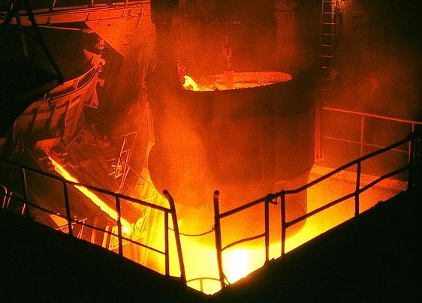
Thermal Energy
Everything in this room has thermal energy because it has mass and its temperature is above ABSOLUTE ZERO.
Absolute zero is the lowest temperature anything can ever be. It is -273 °C.
The coldest outside
temperature recorded on
Earth was -90 °C
in Antarctica.
This molten iron has a great amount of thermal energy. ➔
How would you know this?
Notes:
Everything on Earth has some thermal energy, even the coldest iceberg. Even Pluto is warmer than absolute zero, so everything in the universe has some thermal energy. Thermal energy can be detected just like other forms—thermal energy has the potential to “make stuff happen.” The most obvious (but stupid!) way to tell that energy exists in this crucible of hot metal would be to stick your hand in it. The thermal energy in the metal would cause the temperature in your hand to increase, proving the existence of energy. You could also measure the temperature with a suitable thermometer, or notice strong air currents blowing around, or see the glow of light—all signs of the energy contained in the molten metal, owing to its temperature.
Image source: 1976 Deutsche Fotohek, Wikimedia Commons http://commons.wikimedia.org/wiki/File:Fotothek_df_n-08_0000320.jpg

Slide 9
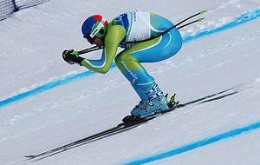
Heat
Energy flows “downhill.”
When you ski, you go down, not up.
Thermal energy does the same thing. It flows down a “temperature hill.”
Flowing thermal energy is called HEAT.
Heat ALWAYS flows from hot to cold.
Notes:
Balls roll down hill, paperclips move toward magnets, ruber bands snap back together when released, energy transfers always occur in this fashion—from higher to lower states of energy. We can see that a ball further up a hill has more energy. When gaguing thermal energy, the object with higher temeparature has higher energy, and it can be imagined as being higher up a hill. When thermal energy is flowing, engineers and scientists call it heat. This transfer of thermal energy always goes from the hotter object, to the cooler object.
Image source: 2010 Jon Wick, Wikimedia Commons http://commons.wikimedia.org/wiki/File:Andrej_%C5%A0porn_at_the_2010_Winter_Olympic_downhill.jpg

Slide 10
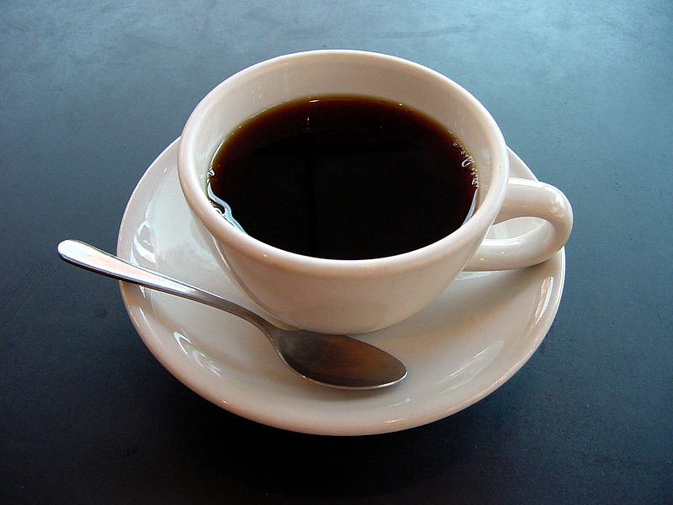
Heat Example
COLD room air
HOT coffee
Heat always flows from hot to cold!
Notes:
*
Three takeaway points for students to know by lesson end:
Heat is a form of energy that is transferred by a difference in temperature; a difference in temperature is needed for heat to flow.
Heat always flows from hot to cold. It is more accurate to say that heat flows “from higher temperature to lower temperature.”
The units of heat are Joules, just like kinetic energy
Note: The arrow is drawn in the up direction, but not because “hot air rises.” Heat flows from hot to cold no matter the direction of gravity.
Image source: 2005 Julius Schorzman, Wikimedia Commons http://commons.wikimedia.org/wiki/File:A_small_cup_of_coffee.JPG

Slide 11
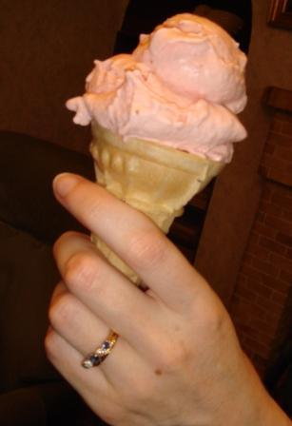
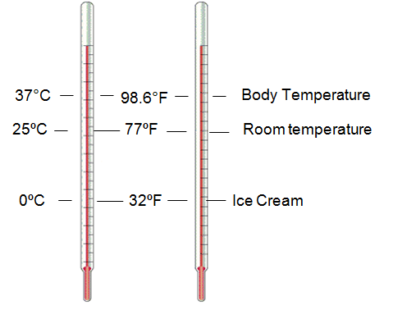
Heat Example
You are holding an ice cream cone in room temperature air.
How does heat flow between the ice cream, hand and air?
room air
body temperature
room temperature
ice cream temperature
body temperature
room temperature
ice cream
°C
°F
Notes:
*
Ask students: In this example, which way should arrows be drawn to show heat transfer, considering the air, ice cream and the hand. The human body is about 98.6 °F. We assume the hand is somewhat close to this temperature.
Answer: Heat flow is from the hand to air, from hand to ice cream, from air to ice cream. Clicking the slide displays the arrows that show the heat flow.
Imagine temperature like a hill and heat like a ball. If a ball is in a valley (low temperature) it will never roll up the side. If the ball starts on a hill (high temperature), it will roll down the side. Heat always flows “downhill” from higher temperatures, to lower temperatures.
Ask this question again with a slightly different scenario: Now, you are holding an ice cream cone in Antartica where the air is -90 °C. What is the heat flow in this case?
Answer: In this case, the ice cream is actually heating the air! At °C, the ice cream has a higher temperature than the air, so heat flows from the hotter ice cream, to the colder air.
Image sources: (left) 2007 ElinorD, Wikimedia Commons http://commons.wikimedia.org/wiki/File:StrawberryIce.jpg; (right) 2010 Gringer, Wikimedia Commons https://commons.wikimedia.org/wiki/File:Thermometer_CF.svg;

Slide 12
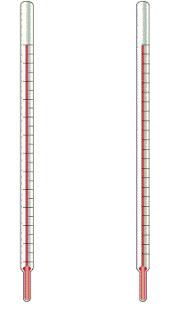
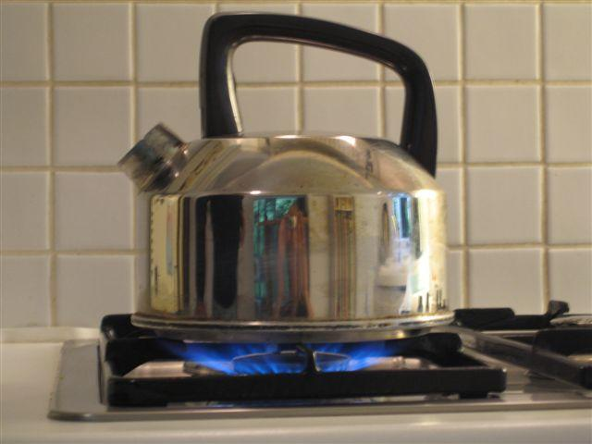
Heat Example
Water is boiled on the stove in a teapot.
How does heat flow in this picture?
A methane flame is off the charts at 1,000 °C
room air
100ºC
212ºF
water boils
25ºC
77ºF
room temperature
ºC
ºF
Notes:
*
Ask students: In this example, a kettle on a stove burner, which way do we show arrows in order to show heat transfer, considering the flame, kettle and air.
Answer: Heat flow is from flame to air, from kettle to air, and from flame to kettle. Clicking the slide displays the arrows that show the heat flow.
Heat ALWAYS flows from hot to cold (the more accurate, though less easy to chant mantra is from higher to lower temperature). The jiggling thermal energy is the “stuff” that is being transferred. No such thing as “cold” exists in the air, which is transferred to the kettle to cool it down.
Image source: 2010 P.wormer, Wikimedia Commons http://commons.wikimedia.org/wiki/File:Kettle.JPG

Slide 13
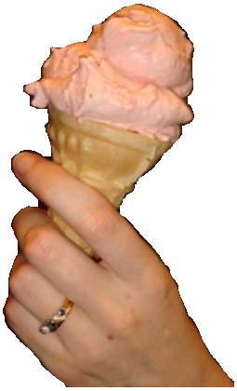
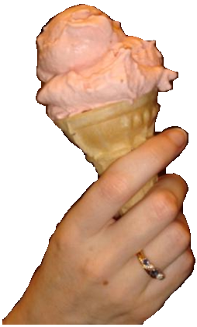
Heat Example
You are holding two ice cream cones together. They are both at exactly 0 °C.
Does any thermal
energy flow
between the
two ice cream
scoops?
Notes:
*
In order for heat to flow, a difference in temperature must exist. If both ice creams are the same temperature, nothing is forcing the heat to flow.
This is like a ball sitting on a flat hill (level ground). It will not start rolling because no downhill direction exists to start it to roll.
Image source: 2007 ElinorD, Wikimedia Commons http://commons.wikimedia.org/wiki/File:StrawberryIce.jpg;

Slide 14
Heat Transfer
What does it mean to “transfer” something?
In this case, we are talking about movement of thermal energy.
Three forms of heat transfer:
  conduction
  convection
  radiation
No matter what type of heat transfer, it always flows from
HOT to COLD
Notes:
Hopefully students already have the word “transfer” in their vocabulary, but if not, clarify it at this point.
The three types of heat transfer are: 1) conduction, 2) convection and 3) radiation.

Slide 15
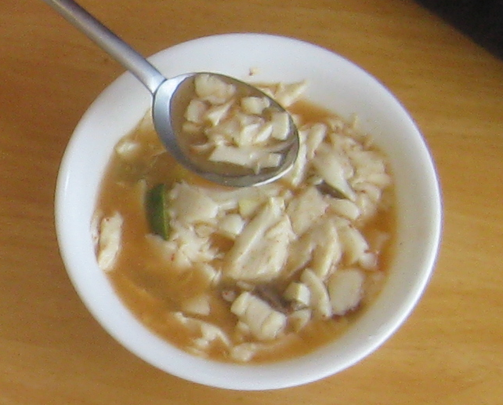
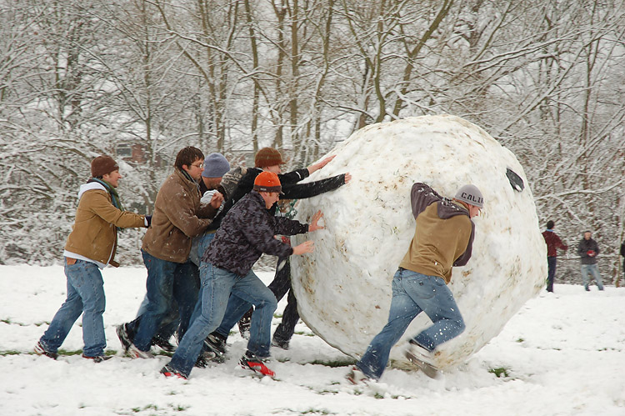
Thought Experiments
How would your hands feel if you held a bowl of hot soup?
How would your hands feel if you were holding a snowball?
What would happen if you touched an object that is the same temperature as your hand? Would any heat transfer happen? (…remember the ice cream)
Notes:
Answers:
Your hands will feel warm when touching the hot soup bowl because heat is transferring from the cup into your hands.
Your hands will feel cold when touching the ice because heat transfers away from your hands and into the snowball. Since the thermal energy leaves your hand, your hand’s temperature decreases.
The third question tests critical thinking. Have students first discuss their answers with a partner, then discuss as a class. Make sure that students understand that NO heat transfer will occur between objects of the same temperature. How can heat flow from hot to cold if both objects are the same temperature? This would is as if our heat “ball” was on flat ground; it would not roll at all.
Image sources: (left) 2009 BrokenSphere, Wikimedia Commons http://commons.wikimedia.org/wiki/File:Ping_SJ_hot_%26_sour_soup.JPG; (right) 2012 Denise W. Carlson. Used with permission.

Slide 16
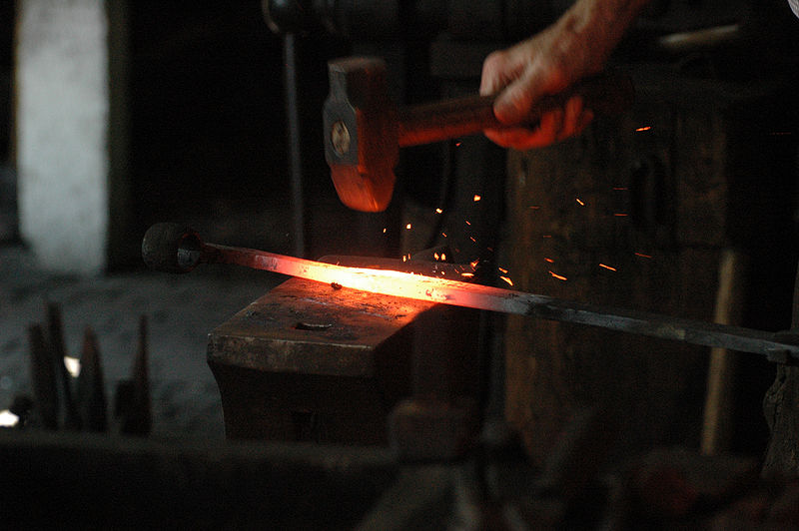
Conduction
Conduction is heat transfer within or between solid objects.
Can you think of another example? What is happening?
Notes:
*
Conduction is heat transfer within a single solid object, or between two touching solid objects. You can see the conduction in the metal rod the blacksmith is hitting. The metal is hottest in the middle, where it is the brightest. It gets cooler the further away from this spot, getting dimmer. The blacksmith is probably holding the end of the metal with tongs, because some of that thermal energy in the hot area is conducting to the end and would burn his hand.
Ask students: “Have you ever touched something hot and burned your hand? Conduction is the reason you burned yourself.” Why? The hot object’s temperature was higher than the hand, so energy flowed as heat from the object to the hand, increasing the temperature of the hand, burning it.
Ask students: Why does the heat flow from the hot object into your hand? (This tests their understanding that heat flows from hot to cold.)
What are some other examples of conduction?
Touching ice (such as in the snowball example)
Touching a cup of hot soup
Leaving a spoon in a cup of hot chocolate or soup; the spoon handle heats up
Possible confusion:
Point out that conduction can occur between two objects or within one object. For example, touching a cup of hot soup is conduction “between objects” (your hand and cup). Leaving the spoon in the soup is conduction within an object (one end of the spoon is hot, the other cold, so heat travels along the handle of the spoon by conduction, heating up the cold end of the spoon).
At this point, conduct a simple conduction demonstration that you have prepared in advance. Use drops of candle wax to "glue” two or three small nails or thumb tacks to a hacksaw blade or metal rod. Space the nails about 1 inch apart, with the first one located one to two inches from the end of the blade/rod. Hold the other end of the blade/rod with an oven mitt or nail it to a block of wood. Heat the end of the rod with a candle flame. As heat conducts down, the wax holding the nails melts and drops the nails, one by one, in sequence. This shows students the heat traveling down the rod.
Teacher background: Conduction is the movement of heat through a substance by the collision of molecules. When we heat an object the kinetic energy of the object increases. The atoms/molecules at the heated point start moving/vibrating. The fast moving molecules at the warmer part collide with the slower moving molecules at the cooler part. As they collide, the faster molecules give up some of their energy to the slower molecules. The slower molecules gain more thermal energy and collide with other molecules in the cooler object.
You experience heat transfer by conduction whenever you touch something that is hotter or colder than your skin.
Another class demonstration of heat conduction. Give each of five to 10 student volunteers an inflated balloon and have them hold them together, touching, in a line. Start to jiggle one end of the line and observe how this jiggling travels down the line of balloons.

Slide 17
More Heat Transfer
A cup of hot chocolate is in your hands and you really want to drink it now, but it is too hot.
How might you cool it without using ice or a refrigerator?
Notes:
Have students share answers with a partner, then the class. This is the first of two slides to get students thinking about the second type of heat transfer—convection—which will be explained in greater detail later on.
Tell the students: We’ll discuss convection in a minute, but here is what is going on:
Convection could help to cool the hot cocoa in two ways: 1) You could stir it up. Since the mug material is cooler than the cocoa in the middle of the mug, stirring pushes the hotter middle cocoa to the cooler edge of the mug. 2) You could also blow on the cocoa. The air near the mug is hotter than the air very far from the mug. By blowing on the mug, you move new cold air toward the mug and displace the hot air that is surrounding it. This increases heat transfer and makes the cocoa temperature decrease (get closer to the room temperature) faster.
Image source: 2009 4028mdk09, Wikimedia Commons http://commons.wikimedia.org/wiki/File:Becher_Kakao_mit_Sahneh%C3%A4ubchen.JPG
*

Slide 18
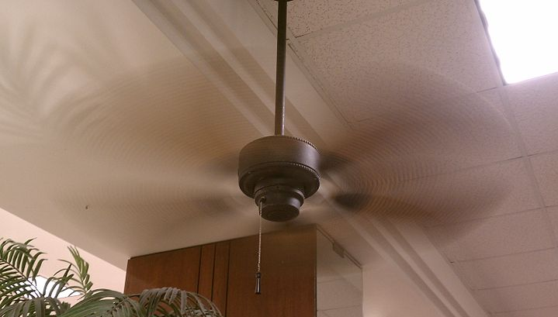
More Heat Transfer
On a hot summer day, would you feel cooler if you stood under a ceiling fan? Why?
Notes:
Have students share their answers with a partner, then with the class.
A person is about 98 degrees F. If you sit still on an 80 degree day, the air around you slowly heats up to almost 98 degrees. A fan moves that hot air from around your body and replaces it with cooler air. This is another example in which we have increased heat transfer by moving a fluid (in this case, air) over something. Interestingly, a fan can make you feel hotter IF the air temperature is higher than your body temperature. Fans do not magically know that they “cool” something, all they do is move air, which helps to increase the rate of heat transfer between the object they are blowing on and the air they are blowing.
Image source: 2012 Arbitrarily0, Wikimedia Commons http://commons.wikimedia.org/wiki/File:Spinning_Hampton_Bay_ceiling_fan.jpg?uselang=enblowing%20on%20hot%20drink
*

Slide 19
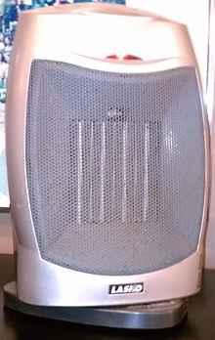
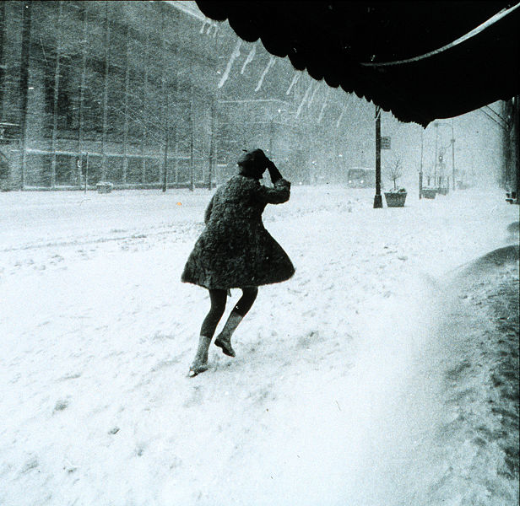
Convection
Convection is heat transfer into or out of moving fluids.
Notes:
Now that we have some ideas bouncing around, we can rigorously introduce the scientific principle at work in the previous two slides, that is, convection. Convection occurs when one of the things heat is transfering into or out of is a liquid or a gas (indicate either as a “fluid”).
Imagine a single layer of cold water molecules right against a hot rock. Just like with conduction, the jiggling rock molecules bump into the more slowly jiggling water molecules and transfers heat via conduction. Since the water molecules can freely move around (unlike the rock molecules), they heat up, then can move away from the rock. New cold water molecules move against the hot rock, and the process repeats. If the water was a fast moving stream, the rock transfers heat to the water even faster, and cools more quickly.
The space heater has a fan to help improve heat transfer with convection. The hot air, flowing because of the fan, will warm up something faster than if the air was not moving.
Ask the students if they have heard about windchill factor. This is how meteorologists inform you that even though it might be 5 °C outside, it might feel like -15 °C because it is windy. In this photograph, this lady probably feels really cold because the blowing wind causes her body heat to leave her body (and transfer to the cold air) much faster than if no wind was present. The faster the wind, the greater the convection, and faster the heat transfer.
Examples of convection:
Boiling water (water is moving, heat is transferred from the bottom of the pot to the top)
Air conditioner blowing on you (air is moving, heat is transferred away from you)
Taking a hot shower (water is moving, heat is transferred from the hot water to you).
Students may ask: “I am touching the moving water, why isn’t it conduction?”
Answer: To get very technical, both conduction and convection are occurring at the same time (this is almost always true). However, to keep things simple for students, we simply call it convection when a fluid is involved and heat transfer is occurring.
A simple question usually resolves the issue: “1) Is air, water or some other fluid blowing/ moving in the example? 2) Is heat transfer occurring?” If so, it is convection. If only solids are involved, then the mode of heat transfer is conduction.
Image sources: (left; fan heater) 2012 Arbitrarily0, Wikimedia Commons http://commons.wikimedia.org/wiki/File:Lasko_fan_heater.jpg?uselang=enblowing%20on%20hot%20drink; (right) 1969 NOAA via Wikimedia Commons http://commons.wikimedia.org/wiki/File:Miniskirts_in_snow_storm.jpg?uselang=enblowing%20on%20hot%20drink

Slide 20
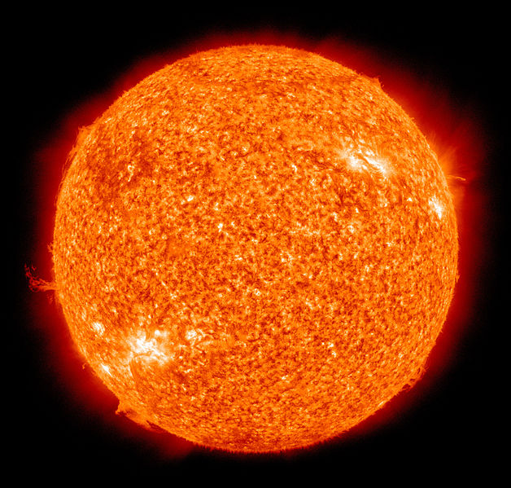
The Sun
No air exists between the Earth and the Sun—so how does solar energy get to the Earth to keep us warm?
Little packets of energy called photons zip through space, bringing the Sun’s energy to Earth.
Notes:
Have students share answers with a partner, then with the class.
The heat transfer mechanism that enables the Sun’s thermal energy to reach the Earth is called radiation (discussed on the next slide).
Image source: 2010 NASA/SDO (AIA), Wikimedia Commons http://commons.wikimedia.org/wiki/File:The_Sun_by_the_Atmospheric_Imaging_Assembly_of_NASA%27s_Solar_Dynamics_Observatory_-_20100819.jpg

Slide 21
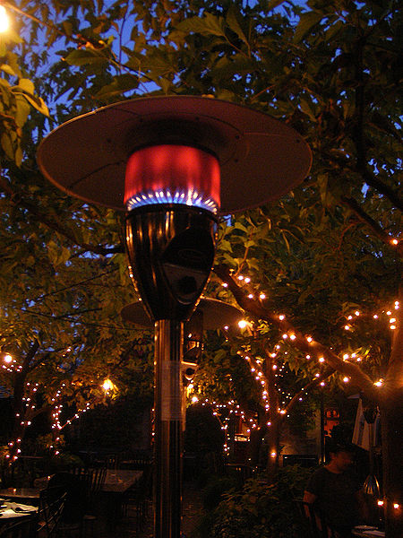
Radiation
Warm air rises, so how does the thermal energy get to you, standing BELOW this heater?
Radiation is heat transfer due to packets of energy that can travel through many substances, including empty space.
Most heat transfer occurs from radiation at high temperatures (like the flame in this patio heater).
Notes:
You may have seen these patio heaters outside of restaurants or in backyards. They are tall, so you do not accidentally bump into them and burn your head. Most people know that heat rises, so very little of the heat from the fire can come down to you via convection. Almost all of the heat transfer occurring here is via radiation.
Just like the other forms of heat transfer, anything above absolute zero produces thermal radiation—typically radiation that is in the IR (infrared) spectrum, meaning its wavelength is longer than red light and human eyes cannot see it, but hot objects like the patio heater flame also emit radiation in the form of visible light as well. You can definitely feel thermal radiation though, like when you stand under one of these heaters or near a fire. Here on Earth, most objects produce little thermal radiation, because their temperature is too low, something needs to have quite a high temperature before thermal radiation becomes noticeable.
The cause of thermal radiation comes from the previously discussed thermal jiggling. The hotter something is, the more jiggling, and when an electron is jiggled, it emits radiation.
Image source: 2007 Steve Parker on Flickr via Wikimedia Commons http://commons.wikimedia.org/wiki/File:Patio_heater.jpg

Slide 22

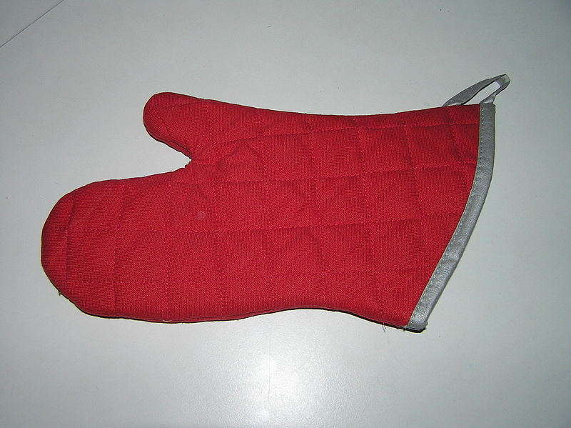
Insulation
Insulation is a material that slows heat transfer.
Almost all engineered products have insulation.
Can you think of more examples?
Notes:
Oven mitts protect your hands from gaining heat when touching hot pans. The can cozy protects your hand from losing heat to a cold drink. Both are insulators that slow heat transfer.
These insulating items work by slowing conduction (such as if you touch a hot pan, the oven mitt slows heat from conducting into your hand) and convection (if you leave a cold soda out on a hot day, the cozy prevents convection from the air to the soda). Some insulators even prevent radiation by blocking the path of photons (the little energy packets).
More insulation examples: the walls and roof of houses, multi-pane windows, beverage thermos, insulation around car engines to keep passengers cool, inside a jet engine, material on the outside of the space shuttle, plastic casing on wires, a sweater or jacket, refrigerator and oven walls, etc.
Image sources: (left) 2009 Lymantria, Wikimedia Commons http://commons.wikimedia.org/wiki/File:Baking_glove.jpg; (right) 2007 MarshallKe, Wikimedia Commons http://commons.wikimedia.org/wiki/File:Coozie1.jpg

Slide 23
Review
Heat: A form of energy transferred by a difference in temperature.
Heat flows from ______________ to _______________.
Conduction: Heat transfer within or between solid objects.
Convection: Heat transfer to or from a gas or liquid.
Radiation: Heat transfer that can occur through empty space.
Insulation: Material that slows heat transfer.
Notes:
These are the key takeaways from this portion of the lesson.
Heat flows from HOT (or higher temperature) to COLD (or lower temperature).

