Slide 1
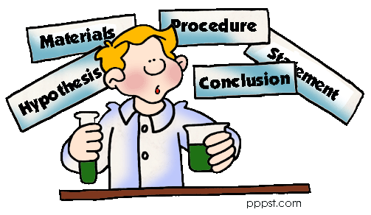
The Scientific Method!

Slide 2
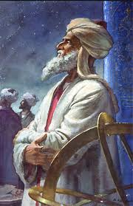
Who Invented the Scientific Method?
The credit of this important process usually is given to Western scientist Roger Bacon. However, the Muslims really invented it, perfected it, & presented it to the West.
Al-Biruni (d. 1050 CE), the Persian genius of his time wrote it down first.
He conducted precise
experiments on laws of gravity, momentum & motion using the Scientific Method before Roger Bacon ever did.

Slide 3
Step 1: State the Question “What is the Purpose?”
It seems obvious, but why is it that you are doing this particular experiment? What are you trying to discover? This is different then Step 3.

Slide 4
Step 2: Collect Data, Information & Do Research Use books, the Internet & primary/secondary resources. By finding more about your topic you know more about it & can explain it.

Slide 5
Step 3: Form a Hypothesis “Predict the outcome of the experiment or the problem” This is an educated guess because of the research you did.

Slide 6
Step 4: Test the Hypothesis with a Measurable Experiment or Activity “Develop a procedure or sequence of steps” remember it has to be measurable… weight, height, time, speed, temperature, etc.

Slide 7
Good experiments should have more than one variable. A variable is something that is not consistent or having a fixed pattern & is liable to change; there are two kinds dependent & independent.

Slide 8
Dependent: is the variable being tested in a scientific experiment and is “'dependent'’ on the independent variable.
Independent: is defined as the variable that is changed or controlled in a scientific experiment. It represents the cause or reason for an outcome; the manipulated “variable”.
Constant: is the part that doesn't change during the experiment.

Slide 9
Step 5: Observe, Analyze & Record Your Results By recording your results you can analyze them better. You should create charts and/or graphs. It’s your proof.

Slide 10
Step 6: Your Conclusion “Compare the Hypothesis to the experiment” were you right about your Hypothesis or were you wrong? Why? What could you do to get better results next time?

Slide 11
Listing your materials that you used is not a step in the Scientific Method, but it needs to be present.

Slide 12
Review: What are Six Steps in the Scientific Method?
#1. State the Question
#4. Test the Hypothesis
#5. Analysis & Record
#2. Collect Data & Information
#6. Conclusion
#3. Form the Hypothesis
#7. List of Materials & References

