Slide 1
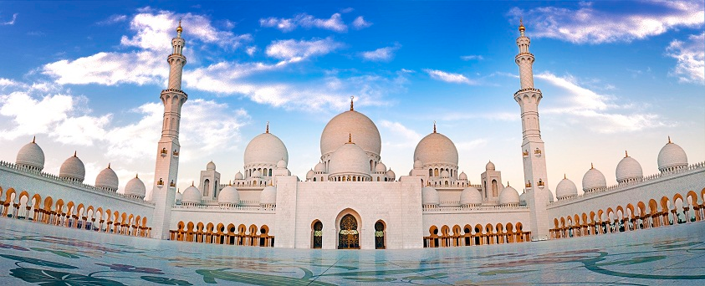
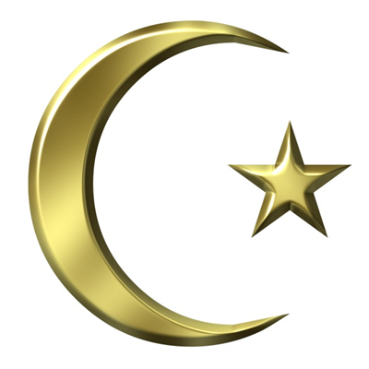
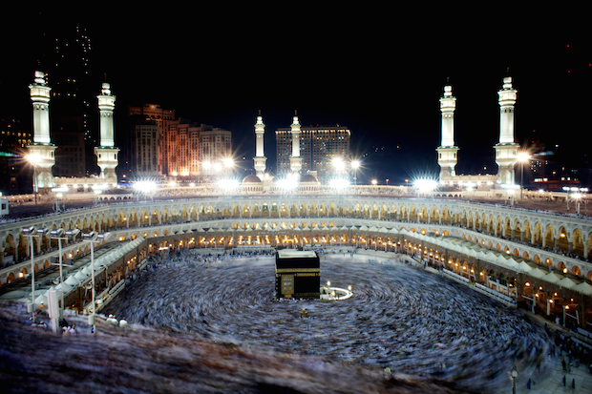
Islam

Slide 2
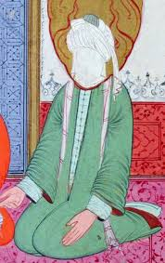
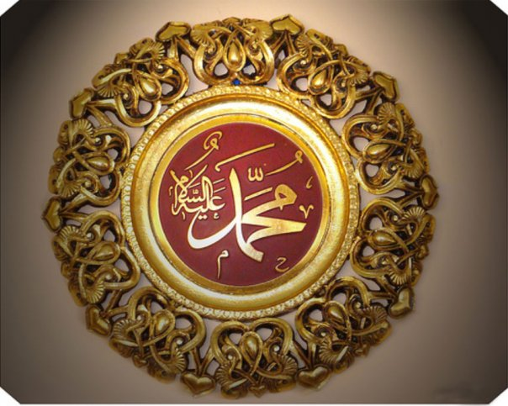
Founder
Muhammad

Slide 3
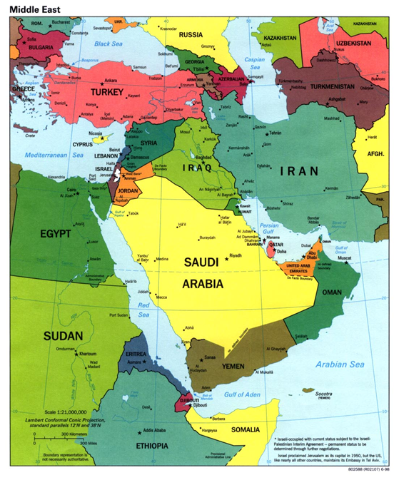

Where/ When it Began
Mecca, Saudi Arabia
Around 610 C.E.

Slide 4
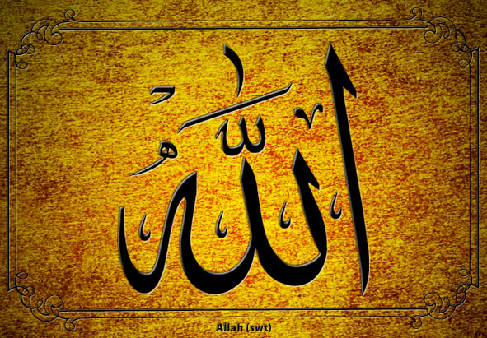
Supreme Being/ God
Allah, God

Slide 5
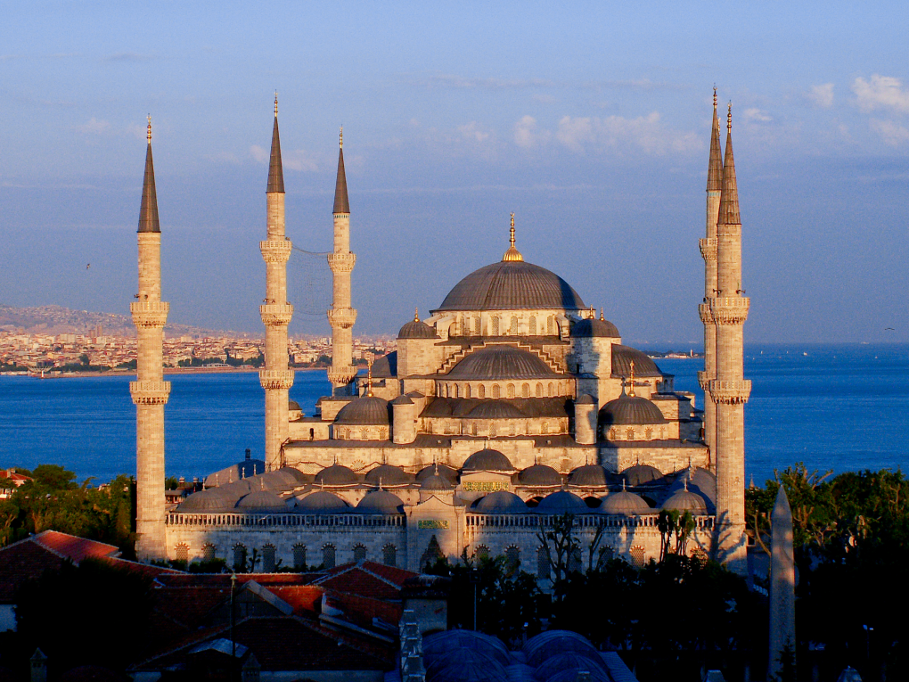
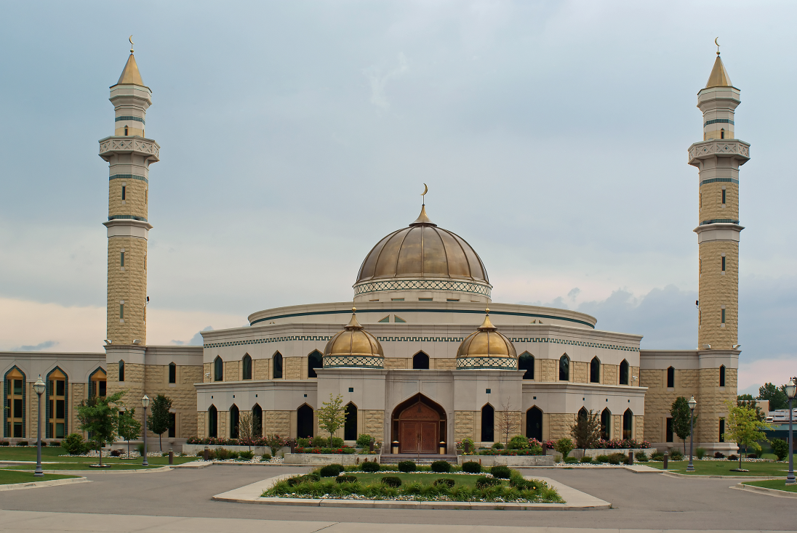
Place of Worship
Mosque

Slide 6
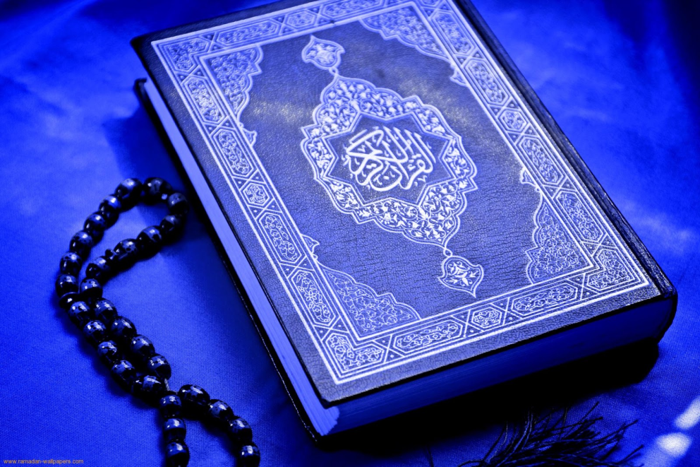
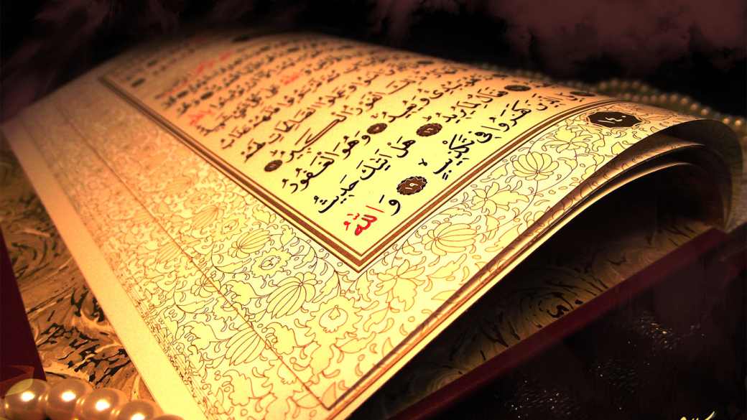
Sacred Books/ Texts
Qur’an
Hadiths

Slide 7

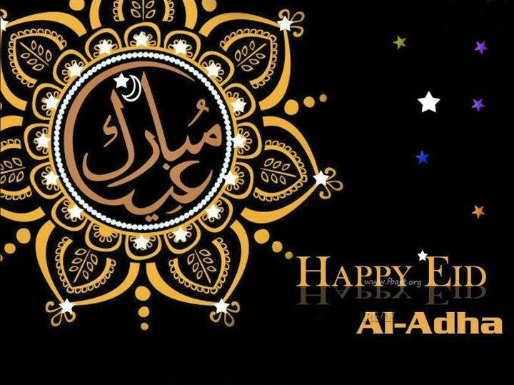
Holy Days
Ramadan
  9th month in Islamic calendar
  Fast from sunrise to sunset
Eid al-Fitr
  Celebrates end of Ramadan
Eid al-Adha
  Celebration after Hajj

Slide 8
Basic Beliefs
Monotheism
Muhammad is Allah’s messenger
5 Pillars
  Shahadah – Claim Allah is your God and Muhammad is his messenger
  Salat – Pray 5 times a day facing Mecca
  Zakat – Charity, give percentage to poor
  Siyam – Fast during Ramadan
  Hajj – Pilgrimage to Mecca once in lifetime
Treat others as equals, help the poor

Slide 9
