Slide 1
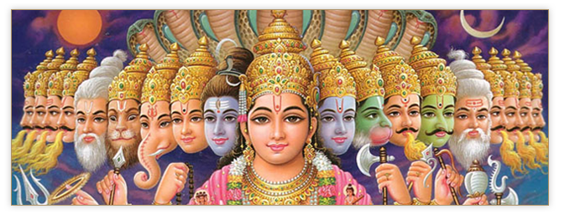
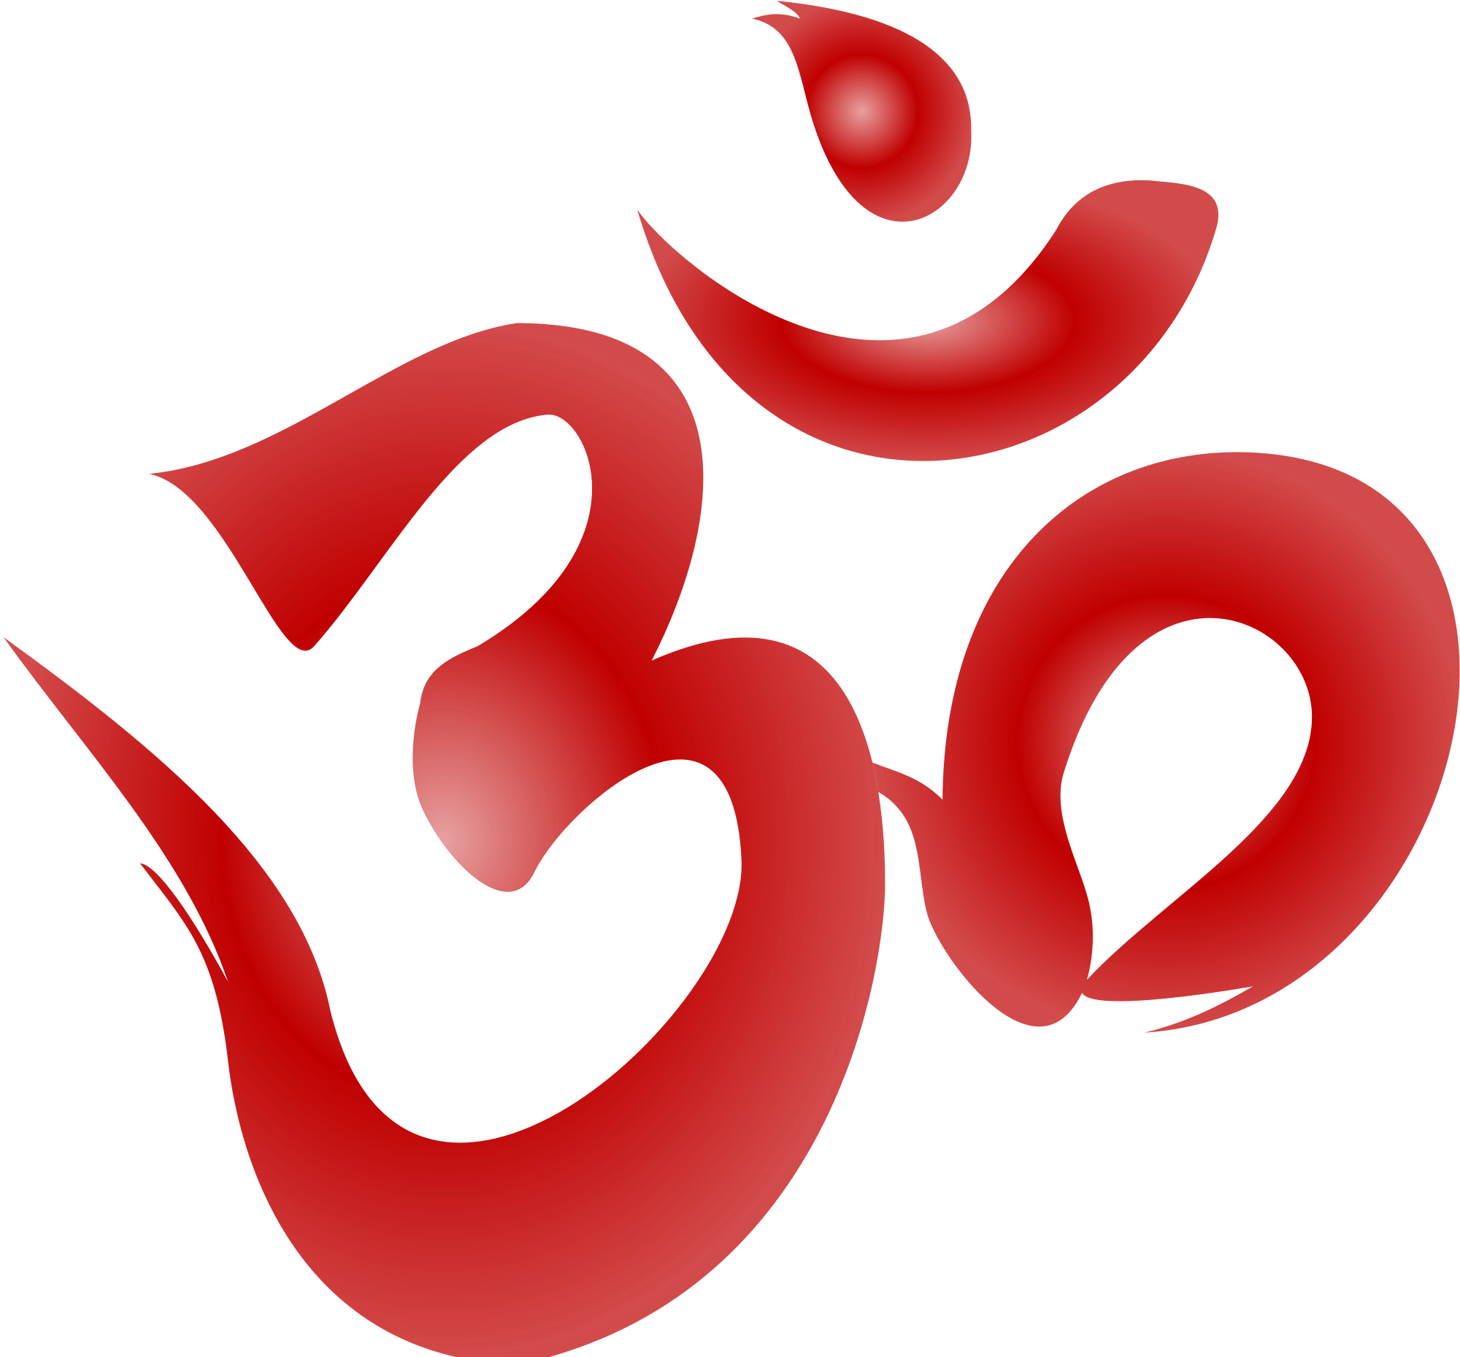
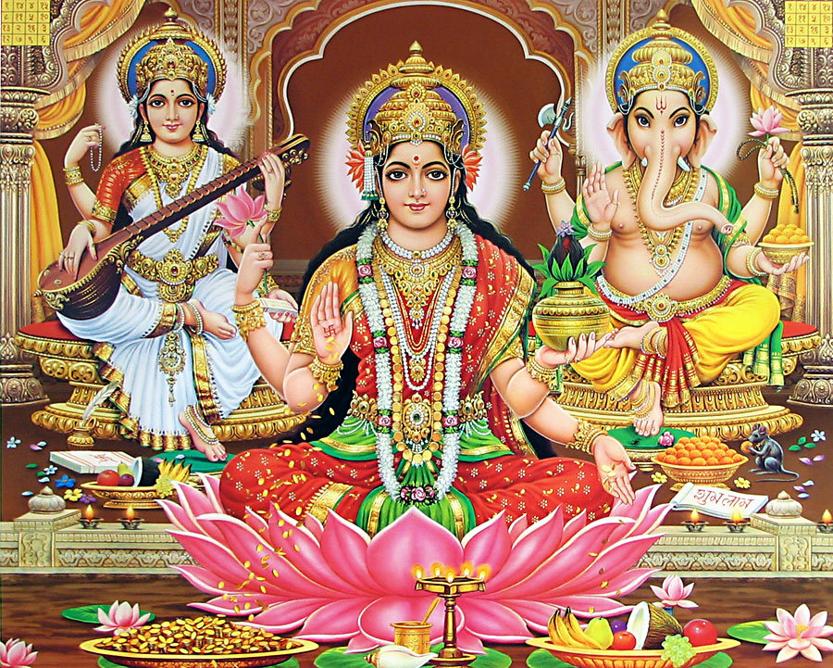
Hinduism

Slide 2
Origins of Hinduism (Sec. 2)
No single person founded Hinduism
A mix of old rituals and traditions from India
The Vedas are a collection of sacred texts, with songs, prayers, and teachings
Hinduism is very complex
Deities (gods and goddesses), and types of worship are different throughout India, and the world.

Slide 3
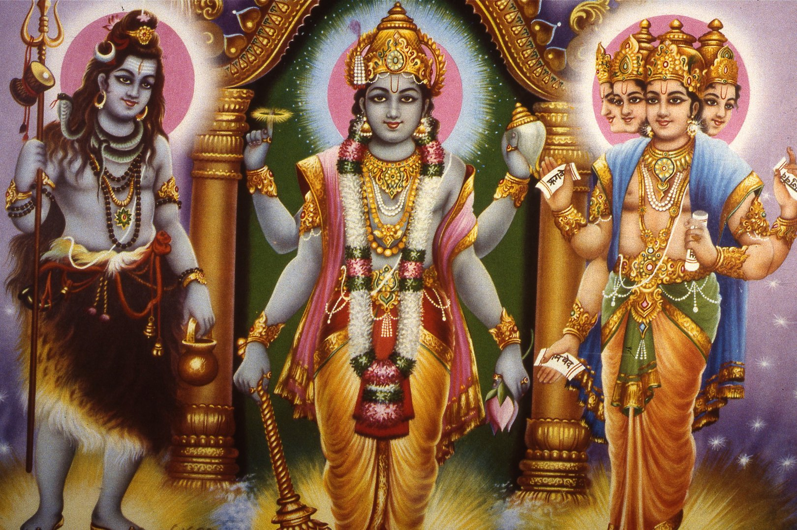
Founder
There is no one founder for Hinduism as it was not founded as a religion

Slide 4
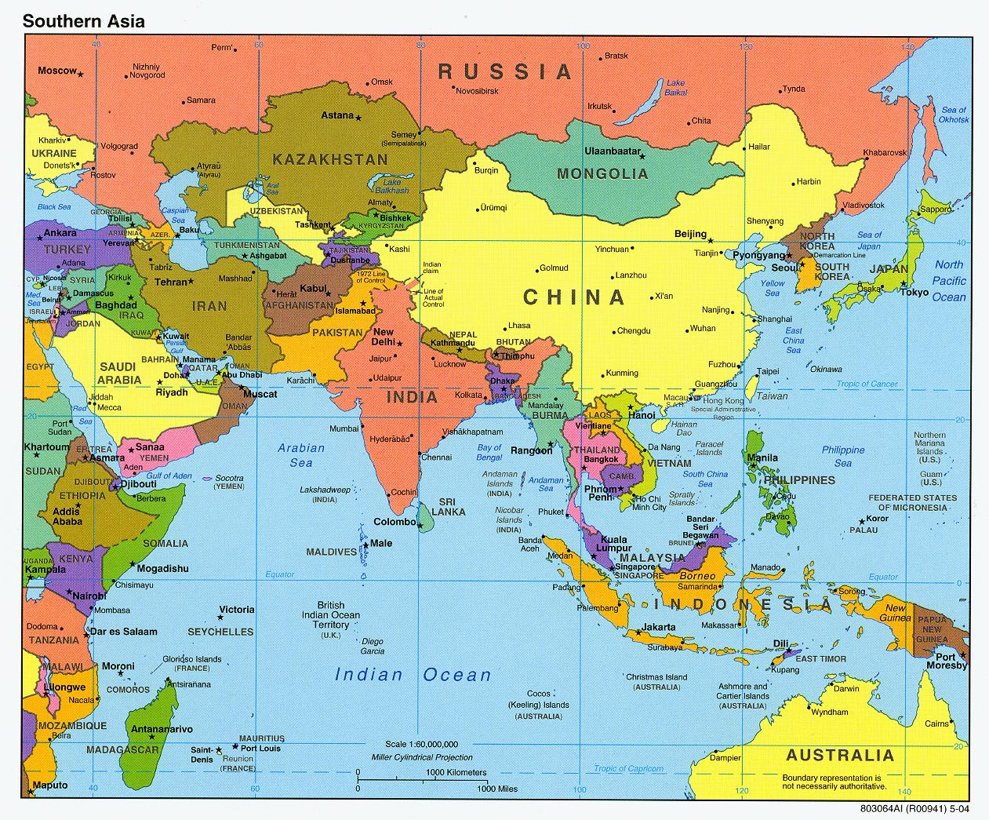
Where/When it Began
Started around 2000 B.C.E. though it can date its origins back to 10,000 B.C.E.
Began in India

Slide 5
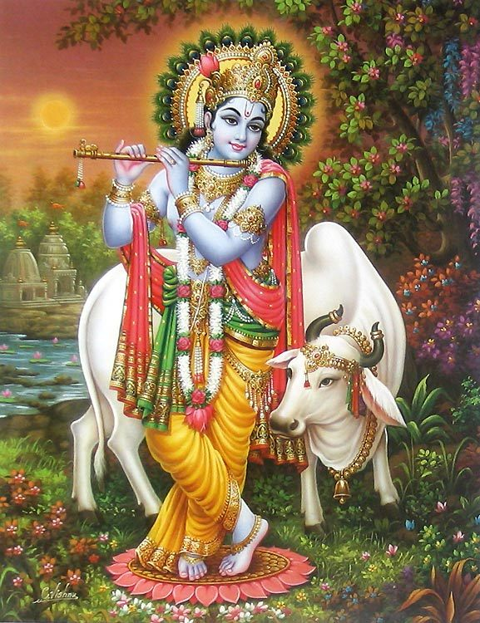
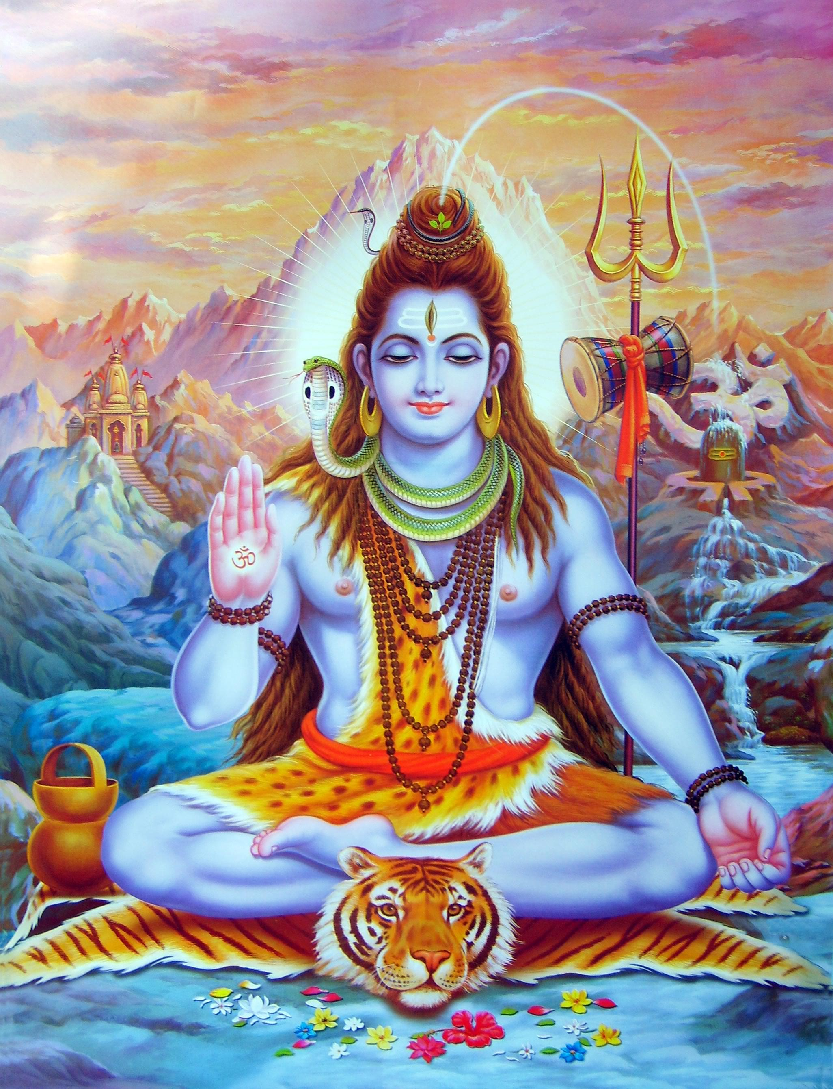
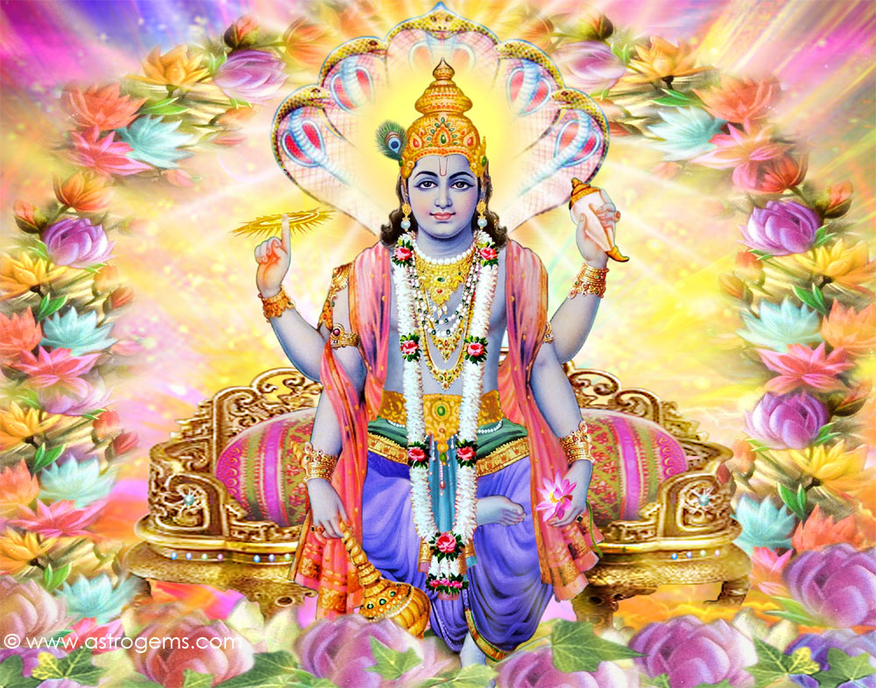
Supreme Being or God
Brahman: the universal spirit
Most Hindus believe in a diversity of Gods/Goddesses
Brahma, Vishnu, Shiva, Krishna

Slide 6
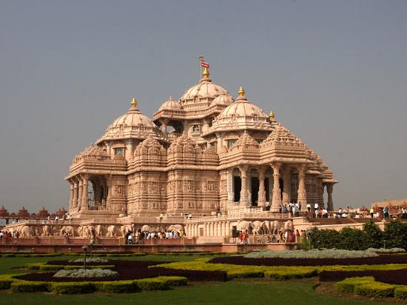
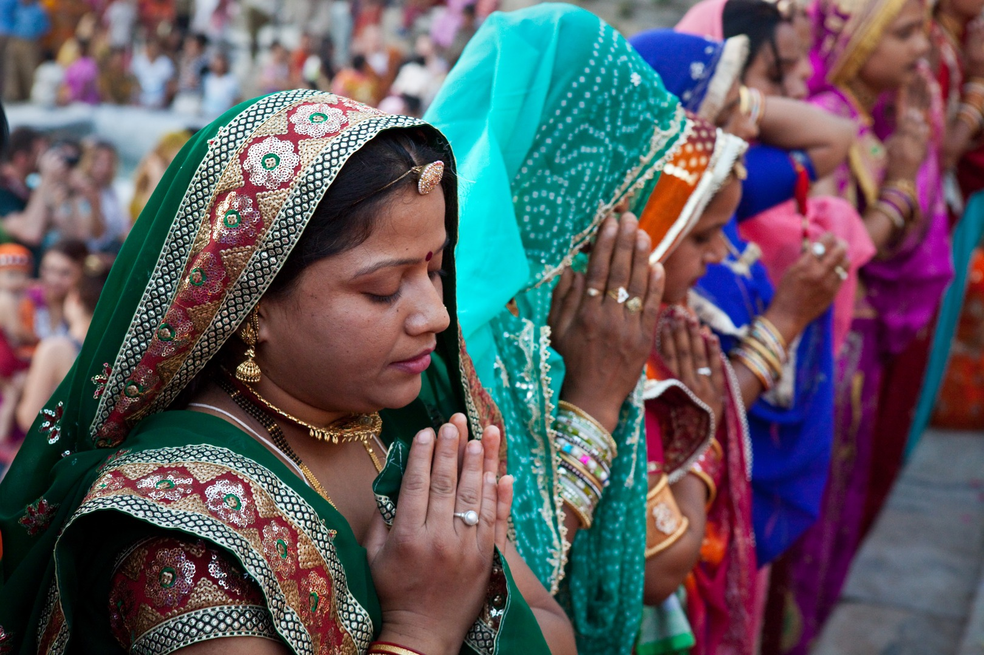
Place of Worship
Shrines and temples
However, Hindus can worship at home or in public

Slide 7
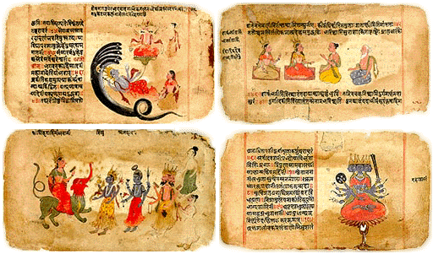
Sacred Book/Texts
The Vedas
The Ramayana
These are a collection of different texts

Slide 8
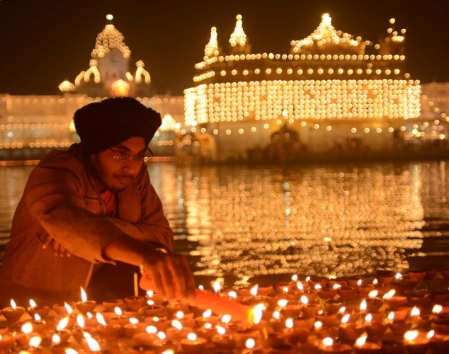
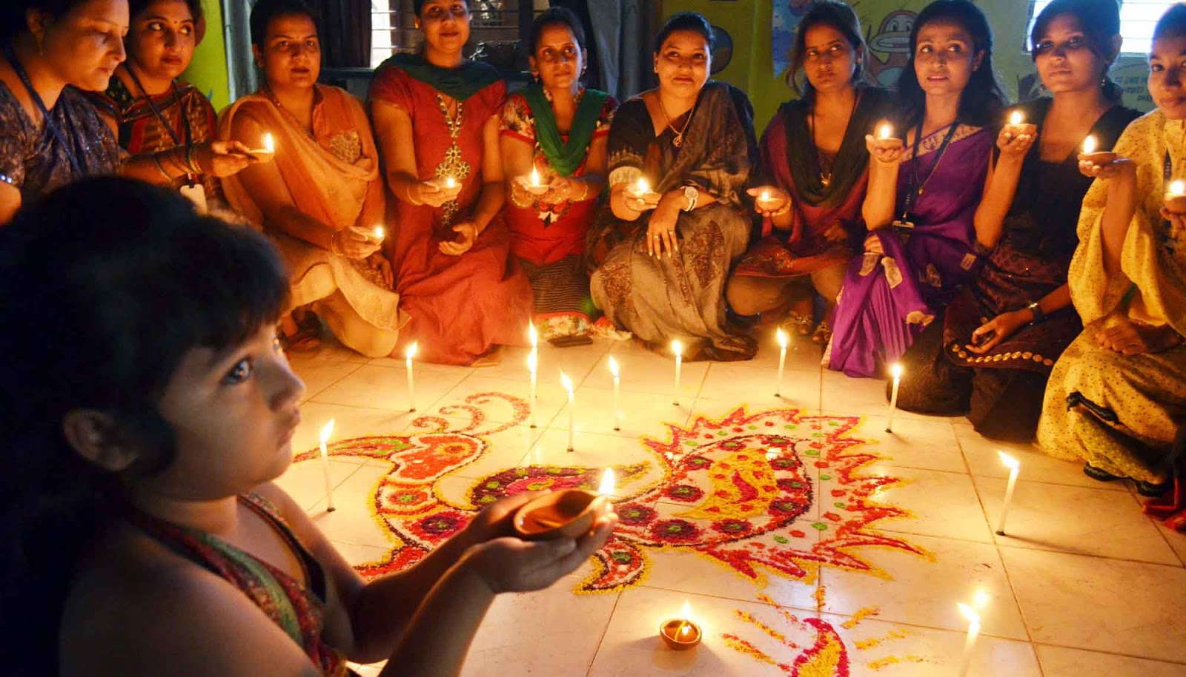
Holy Days
Divali (Diwali)
Festival of lights to celebrate New Year and the battle of good vs. evil

Slide 9
Basic Beliefs
Dharma
Law, duty, and obligation
Karma
Good and evil done in a past life determines your next life
Samsara
Continuous cycle of birth, death, and re-birth
Reincarnation
Belief that a person’s soul is reborn into a new body after death

