Slide 1
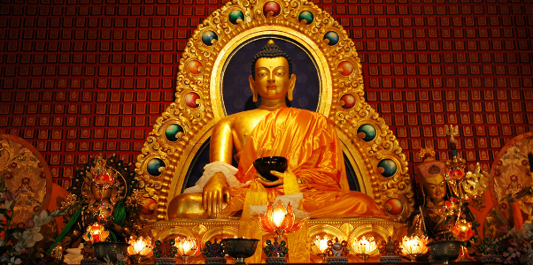
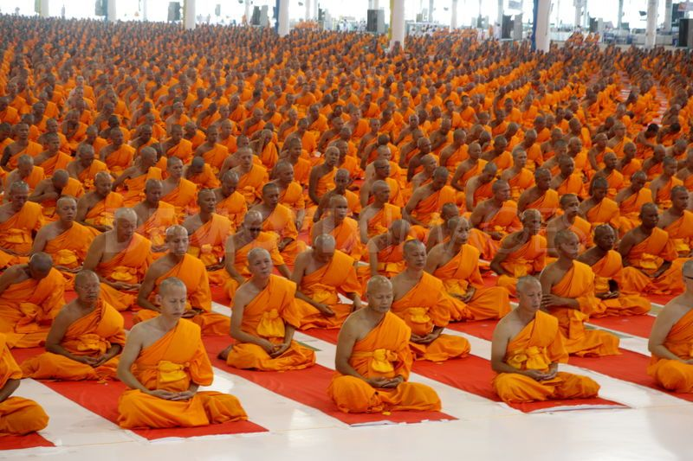
Buddhism

Slide 2
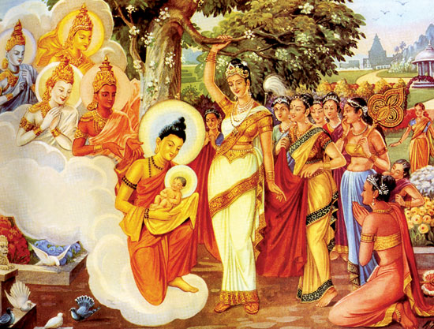
Founder
Prince Siddhartha Gautama
Below is Queen Maya holding Prince Siddhartha

Slide 3
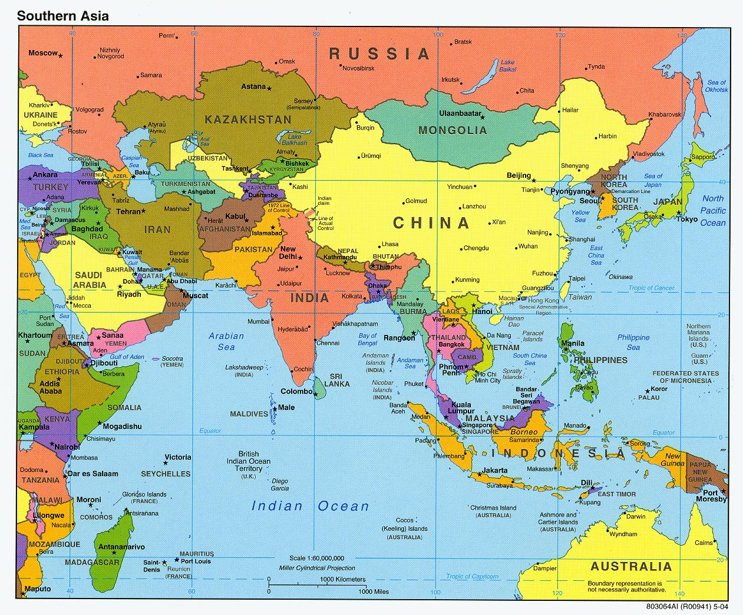
Where/When it Began
About 500 B.C.E.
Began in India

Slide 4
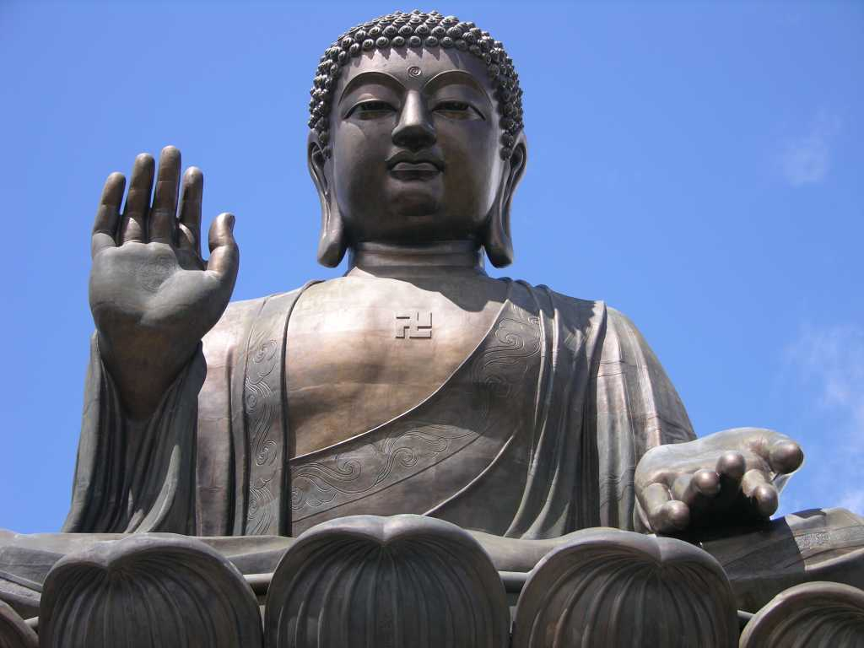
Supreme Being/ God
No God
However some variations believe in deities
The Buddha is their great teacher

Slide 5
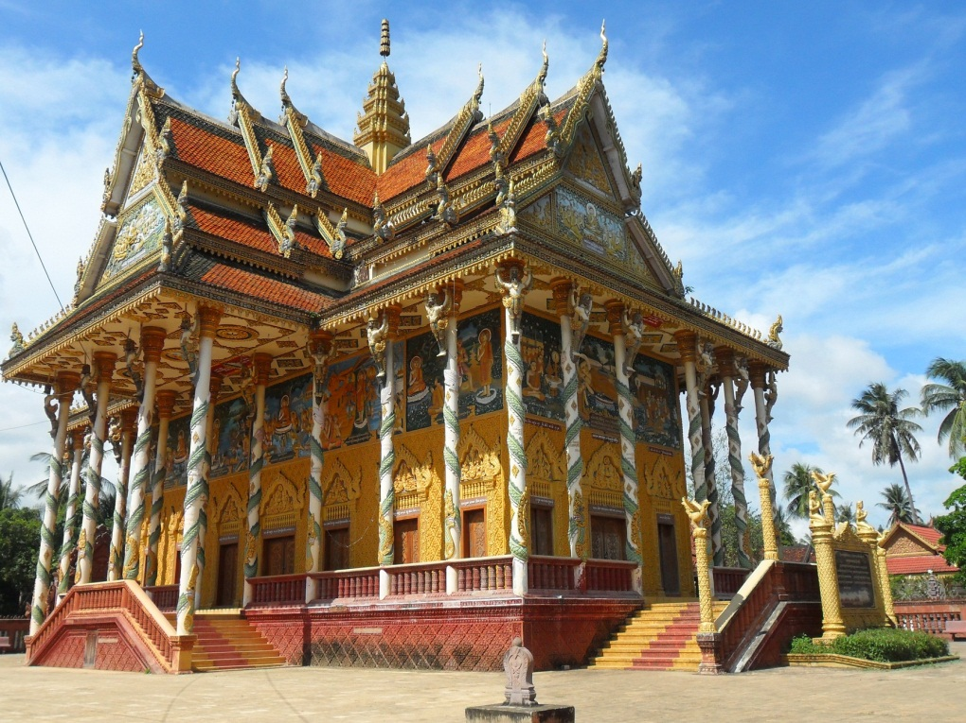
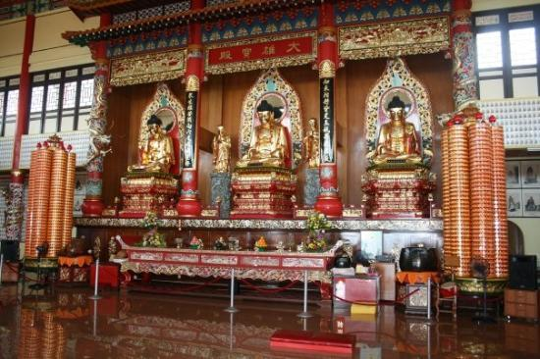
Place of Worship
Temples, homes, and nature
Practicing meditation to reach nirvana

Slide 6
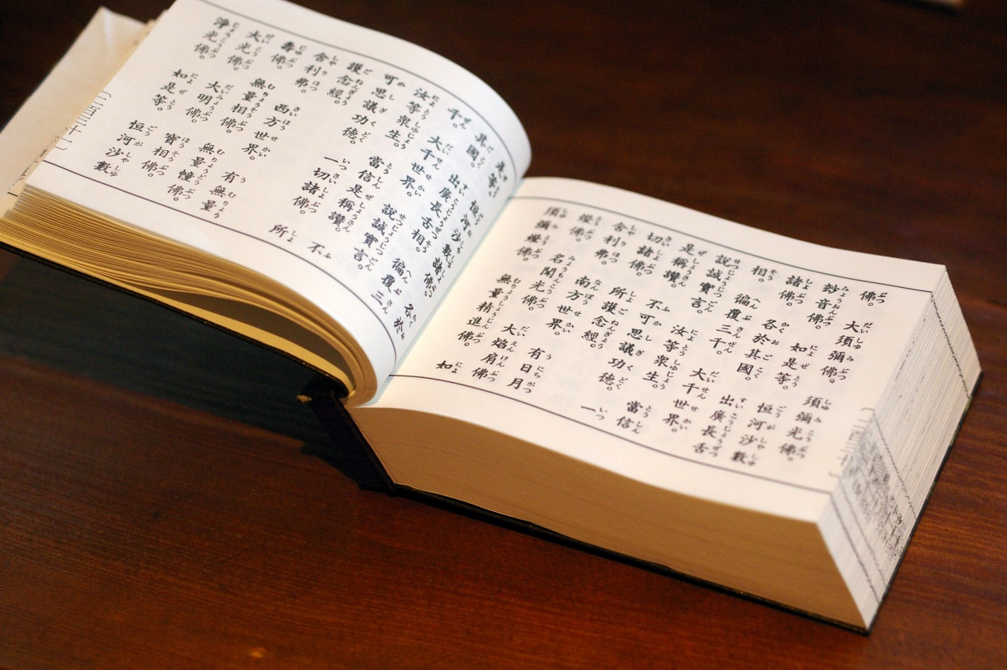
Sacred Books/ Texts
The Sutras
Believed to be the word of The Buddha

Slide 7
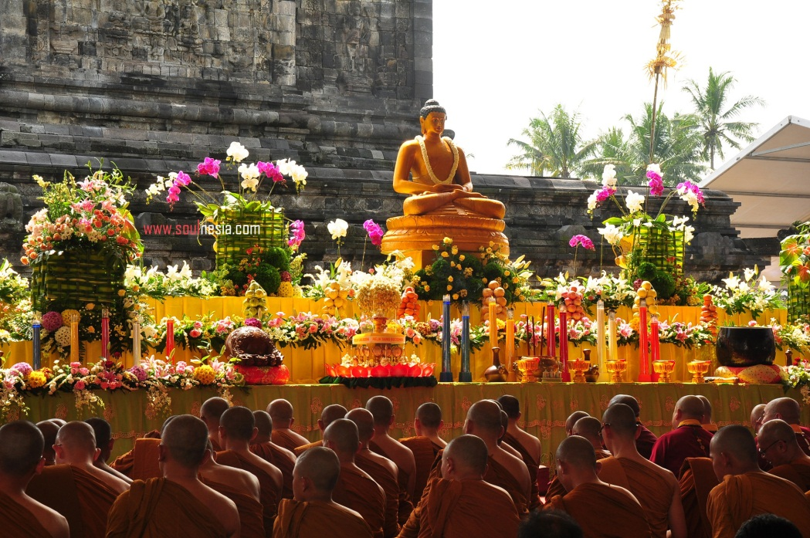
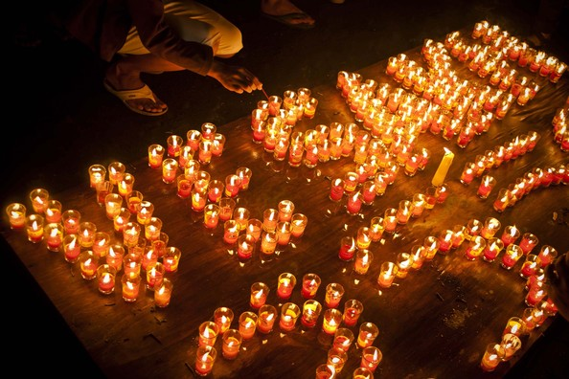
Holy Days
Vesak
Celebrate birth of Prince Siddhartha

Slide 8
Basic Beliefs
Nirvana and Enlightenment
Buddhists must follow the teachings of The Buddha to find inner peace, and discover universal truths
Four Noble Truths
Suffering is caused by wants or cravings, and to end that, you must follow the eightfold path
Eightfold Path
Follow an 8 step path to reach enlightenment, or inner peace

Slide 9
