Slide 1
Chapter 12: Using Energy & Heat

Slide 2
Lesson 1: Forms of Energy
The ability to do work or cause change is called what?
You can think of work, then, as the transfer of energy.

Slide 3
There are two kinds of energy & they are what?
KINETIC & POTENTIAL ENERGY
The energy of motion is called____________ energy, it increases when velocity increases. Energy that is stored & held in readiness is called ____________ energy.
KINETIC
POTENTIAL

Slide 4
If Force is measured in Newton’s; what is Energy measured in then?
JOULES (J)

Slide 5
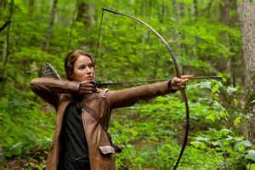
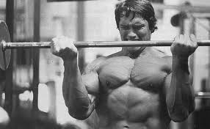
There are two kinds of Potential Energy and they are what?
ELASTIC POTENTIAL ENERGY & GRAVITATIONAL POTENTIAL ENERGY
ELASTIC ENERGY FROM
THE BOW
GRAVITATIONAL ENERGY FROM LIFTING SOMETHING OFF
THE GROUND

Slide 6
The potential energy associated with objects that can be stretched or compressed are called what? You can give a different type of potential energy to an object when you lift it. Potential energy that depends on height is called what?
ELASTIC ENERGY
GRAVITATIONAL ENERGY

Slide 7
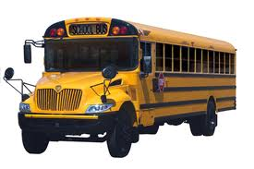
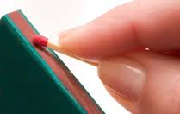
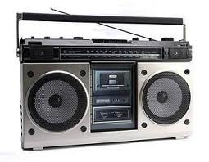
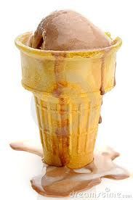
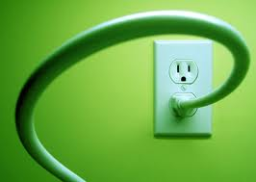
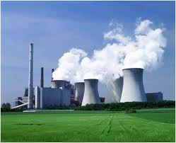
There are six different main kinds of energy & they are what?
1. MECHANICAL ENERGY
3. CHEMICAL ENERGY
5. RADIANT ENERGY
2. THERMAL ENERGY
4. ELECTRICAL ENERGY
6. NUCLEAR ENERGY

Slide 8
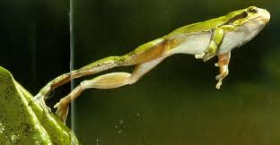
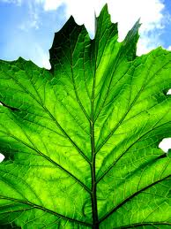
Energy associated with motion or position of an object is called what?
MECHANICAL ENERGY
Energy that is potential energy stored in chemical bonds that hold chemical bonds together is called what?
CHEMICAL ENERGY

Slide 9
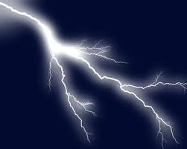
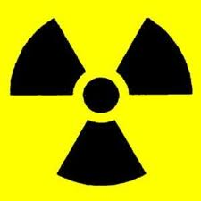
Energy that is moving electric charges that produce electricity is called what?
ELECTRICAL ENERGY
Energy stored in the nucleus of an atom & released during nuclear reactions is called what?
NUCLEAR ENERGY

Slide 10
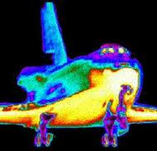
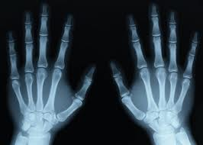
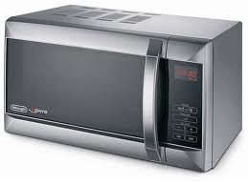
Energy that travels in waves such as visible light, ultraviolet radiation, microwaves & infrared radiation are called what?
RADIANT OR
ELECTROMAGNETIC ENERGY

Slide 11
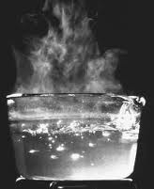
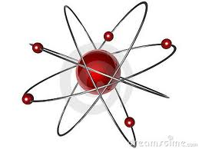
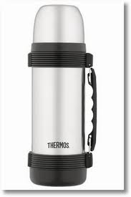
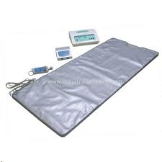
Energy that is made up of small particles, called atoms & molecules; the faster the movement of particles the warmer it becomes; this is what kind of energy?
THERMAL ENERGY

Slide 12
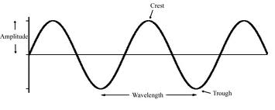
What is a disturbance that transfers energy from place to place? In science remember energy is defined as the ability to do work.
A WAVE

Slide 13
A disturbance that travels through a medium as a longitudinal wave & carries energy is called what?
A SOUND WAVE
Thus, sound energy is energy carried by sound waves.

Slide 14
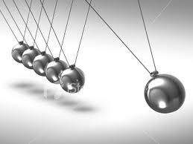
The Law of _______________ states that when one form of energy is converted to another, no energy is destroyed in the process; according to this law, energy cannot be created or destroyed.
Lesson 2: Energy Transfers & Transformations
CONSERVATION

Slide 15
When energy moves from one object to another without changing form what occurs?
AN ENERGY TRANSFER
The tennis ball racket transfers mechanical energy
to the tennis ball.

Slide 16
A change from one form of energy to another is called what?
ENERGY TRANSFORMATION OR CONVERSION
“Most forms of energy can be converted into any other form.”

Slide 17
What is the transfer of energy that occurs when force makes an object move in the direction of the force? It is only being done while the force is acting on the object.

Slide 18
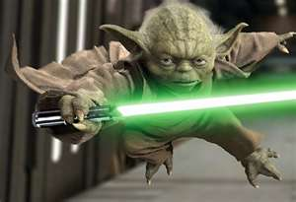
In Science, what is a push or a pull?
“MAY THE FORCE BE WITH YOU.”
FORCE

Slide 19
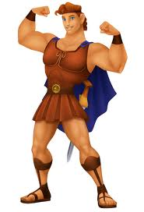
What is the rate
at which work is done or the amount of work done in a unit of time?
Powers,
Austin
Powers!

Slide 20
An ________________, such as car engine, is a system that exchanges matter or energy with the environment. A ________________ is a system that does not exchange matter or energy with the environment; currently they don’t exist.
OPEN SYSTEM
CLOSED SYSTEM

Slide 21
Are resources that are used faster than can not be replaced by natural processes is called what?
Are resources that can be replaced by natural process in a relatively short period of time are called what?
NON-RENEWABLE RESOURCES
RENEWABLE RESOURCES

Slide 22
What are the Five Main Renewable Resources?
1. SUN (SOLAR)
2. WIND
3. WATER (HYDROGEN)
4. GEOTHERMAL
5. BIOMASS

Slide 23
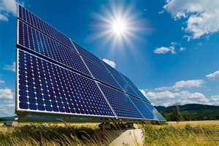
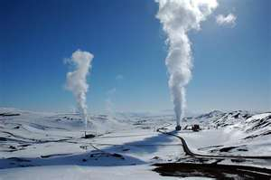
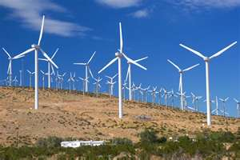
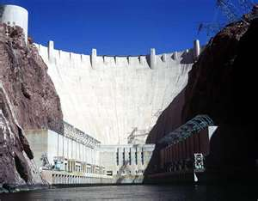
Examples of Renewable Resources are…

Slide 24
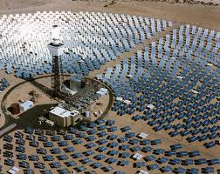
What type of renewable energy source is from the Sun?
SOLAR ENERGY
What are some disadvantages of
Solar Energy?
1. VERY EXPENSIVE $$ 2. ONLY WORKS IN DAYLIGHT
3. YOU NEED A LOT OF SOLAR PANELS

Slide 25
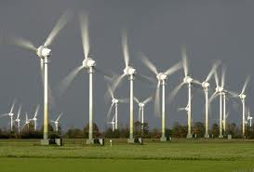
What type of renewable resource harnesses the air with a group of turbines that produce electricity?
WIND
What are disadvantages of Wind Power?
1. EXPENSIVE $$ 2. YOU NEED A LOT OF WIND TURBINES 3. ONLY WORKS WHEN THERE IS A WIND

Slide 26
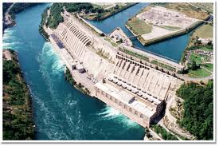
What renewable source produces electricity by flowing water?
HYDROELECTRIC POWER

Slide 27
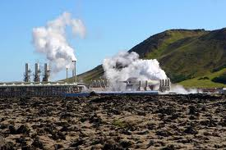
What renewable resource uses thermal energy from Earth’s interior?
GEOTHERMAL ENERGY
What country depends on Geothermal Energy as their main source of energy?
ICELAND

Slide 28
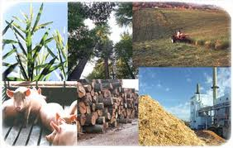
What renewable resource is energy produced by organic matter, such as wood, food scraps & alcohol? It also is the fastest growing renewable fuel in the U.S.
BIOMASS
ENERGY

Slide 29
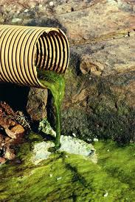
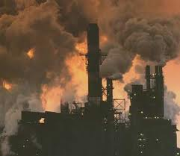
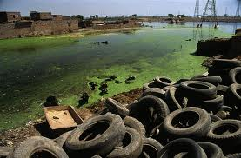
What are the two main advantages of renewable resources?
1. THEY ARE RENEWABLE & 2. GIVE OFF FAR LESS POLLUTION THAN FOSSIL FUELS!

Slide 30
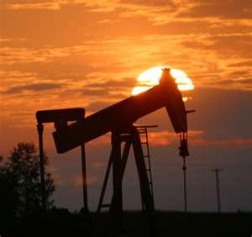
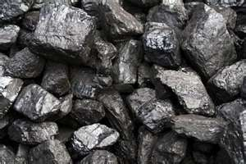
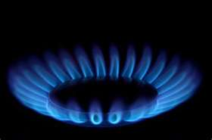
Example of Non-Renewable Resources are called Fossil Fuels; what are three of them?
COAL
OIL (PETROLEUM)
NATURAL GAS

Slide 31
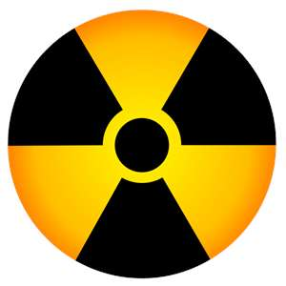
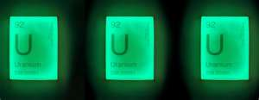
Nuclear Energy is Non-Renewable Resource energy released from atomic reactions; what element is needed in the process to split atoms for energy?
URANIUM (U)

Slide 32
Lesson 3: Particles in Motion
What is Kinetic Molecular Theory?
All matter is made of particles.
Particles are in constant, random motion.
Particles constantly collide with each other & with the walls of their container.

Slide 33
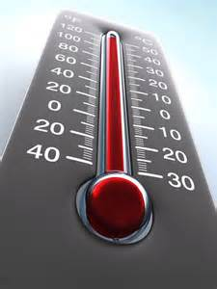
The measure of the average kinetic energy of the particles in a material is called what?
TEMPERATURE
Scientists use Kelvins (K),
& Celsius (°C).

Slide 34
The movement of thermal energy from a region of higher temperature to a region of lower temperature is called what?

Slide 35
What is the transfer of thermal energy by collisions between particles in matter?
CONDUCTION
The transfer of thermal energy by electromagnetic waves is called what?
RADIATION

Slide 36
The transfer of thermal energy by the movement of the particles from one part of a material to another is called what?
CONVECTION

Slide 37
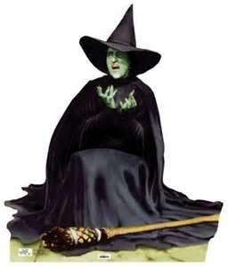
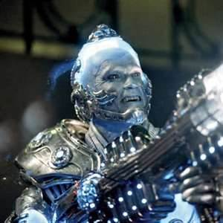
The change in state from a solid to a liquid is called what? The change of a state from a liquid to a solid is called what?
“I’M
MELTING!”
MELTING
FREEZING

Slide 38
The opposite of vaporization; where gas particles lose enough thermal energy to become a liquid is called?
CONDENSATION

Slide 39
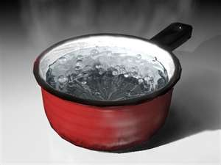
The change from liquid water into water vapor is called what? There are two kinds of vaporization and they are what?
VAPORIZATION
EVAPORATION &
BOILING (100°C/212°F)

Slide 40
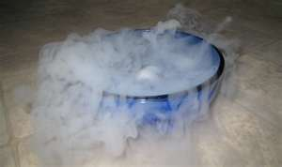
This occurs when the surface particles of a solid gain enough energy to become a gas.
SUBLIMATION
Dry Ice is an Example of Sublimation

Slide 41
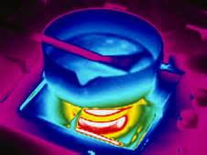
The metal that makes up the pan is a ____________________, a material in which thermal energy moves quickly. The material that makes up the pan’s handles is a __________________, a material in which thermal energy moves slowly.
THERMAL CONDUCTOR
THERMAL INSULATOR

