Slide 1
Chapter 2: The World in Spatial Terms

Slide 2
A map that shows a particular theme, like population, borders, landforms or other topics is what kind of map?
THEMATIC MAP

Slide 3
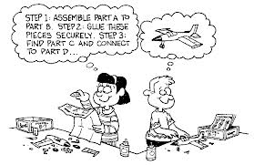
Where a place is located & its physical relationship to other places, people, or environments is called what?
SPATIAL
Which one of the children in this cartoon is thinking more in “spatial” terms?

Slide 4
The distance north or south (left & right) above/below the equator, measured in degrees are imaginary lines called what?
LATITUDE
The distance in degrees east or west (up & down) left/right to the prime meridian are imaginary lines called what?
LONGITUDE

Slide 5
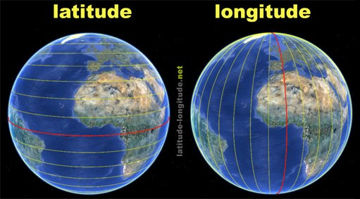

Slide 6
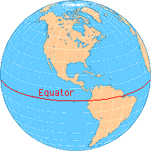
What is the imaginary line half-way between the North & South Pole that circles the Earth?
EQUATOR

Slide 7
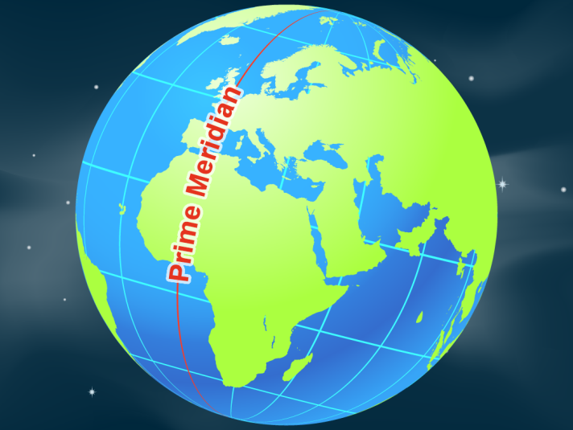
What is the imaginary line that makes a half circle from the North Pole to the South Pole, passing through Greenwich, England?
PRIME MERIDIAN

Slide 8
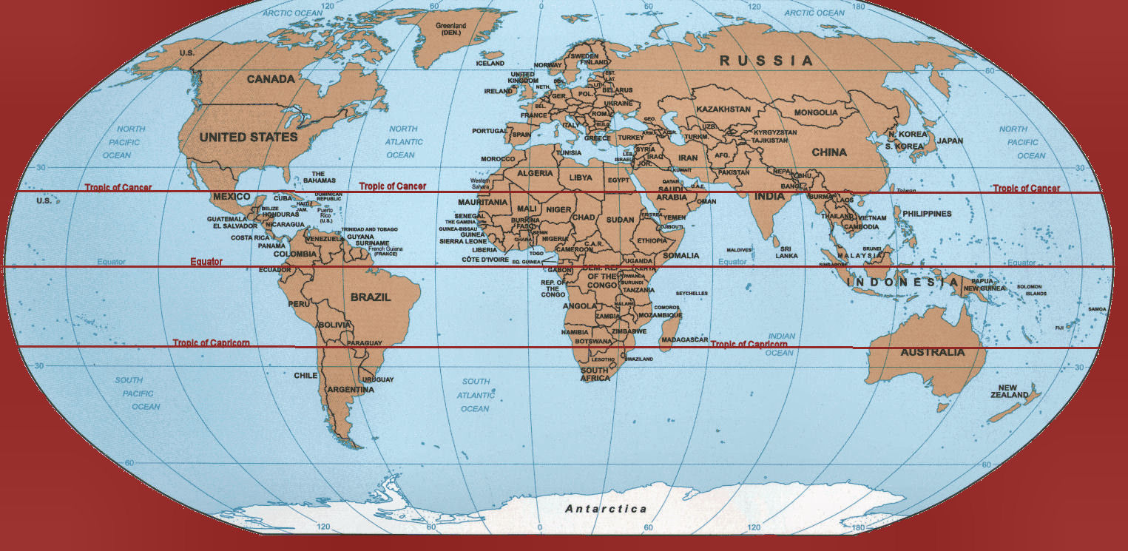
The ____________________ & the ____________________ each lie at 23.5° latitude; one is located at 23.5° north of the equator & runs through Mexico, the Bahamas, Egypt, Saudi Arabia & India; while the other lies at 23.5° south of the equator & runs through Australia & Chile.
TROPIC OF CANCER
TROPIC OF CAPRICORN

Slide 9
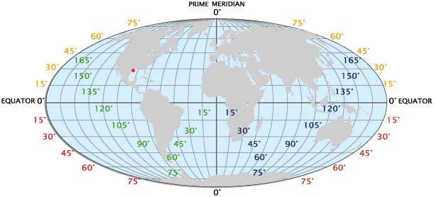
A set of numbers that together describe the exact location of something, such as a place on a map are called what?
DEGREES OR COORDINATES

Slide 10
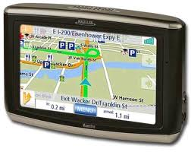
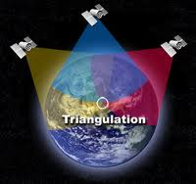
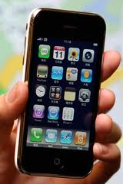
A system that uses a network of Earth orbiting satellites to pinpoint a specific location is called what?
GLOBAL POSITIONING SYSTEM (GPS)

Slide 11
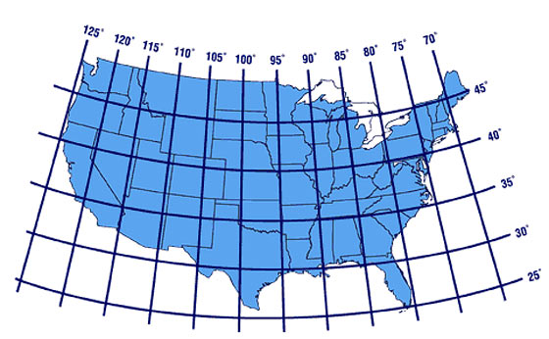
What is the city located in the U.S. with the coordinates 42°N & 83°W?
DEARBORN, MICHIGAN

Slide 12
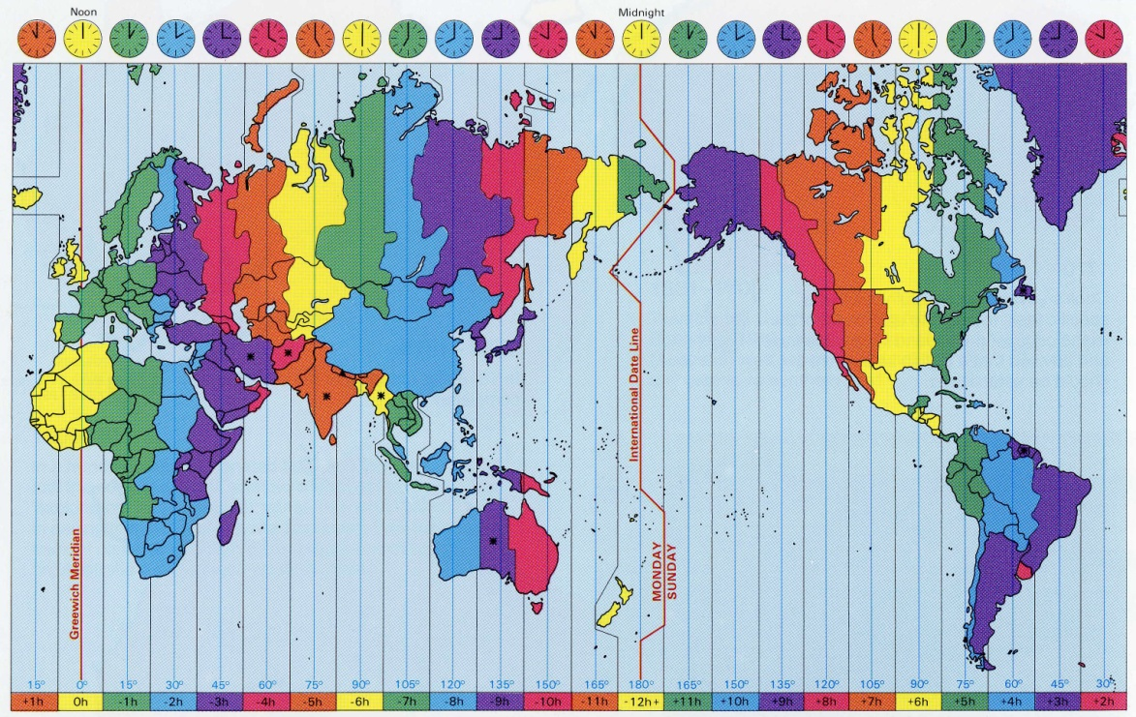
An area that uses the same clock time. Earth is divided into 24 standard ______________. In each zone, clocks are set to the area’s own hour & minute.
TIME ZONES
THE GREEN COLOR & WHERE MICHIGAN IS LOCATED IS CALLED EASTERN TIME

Slide 13
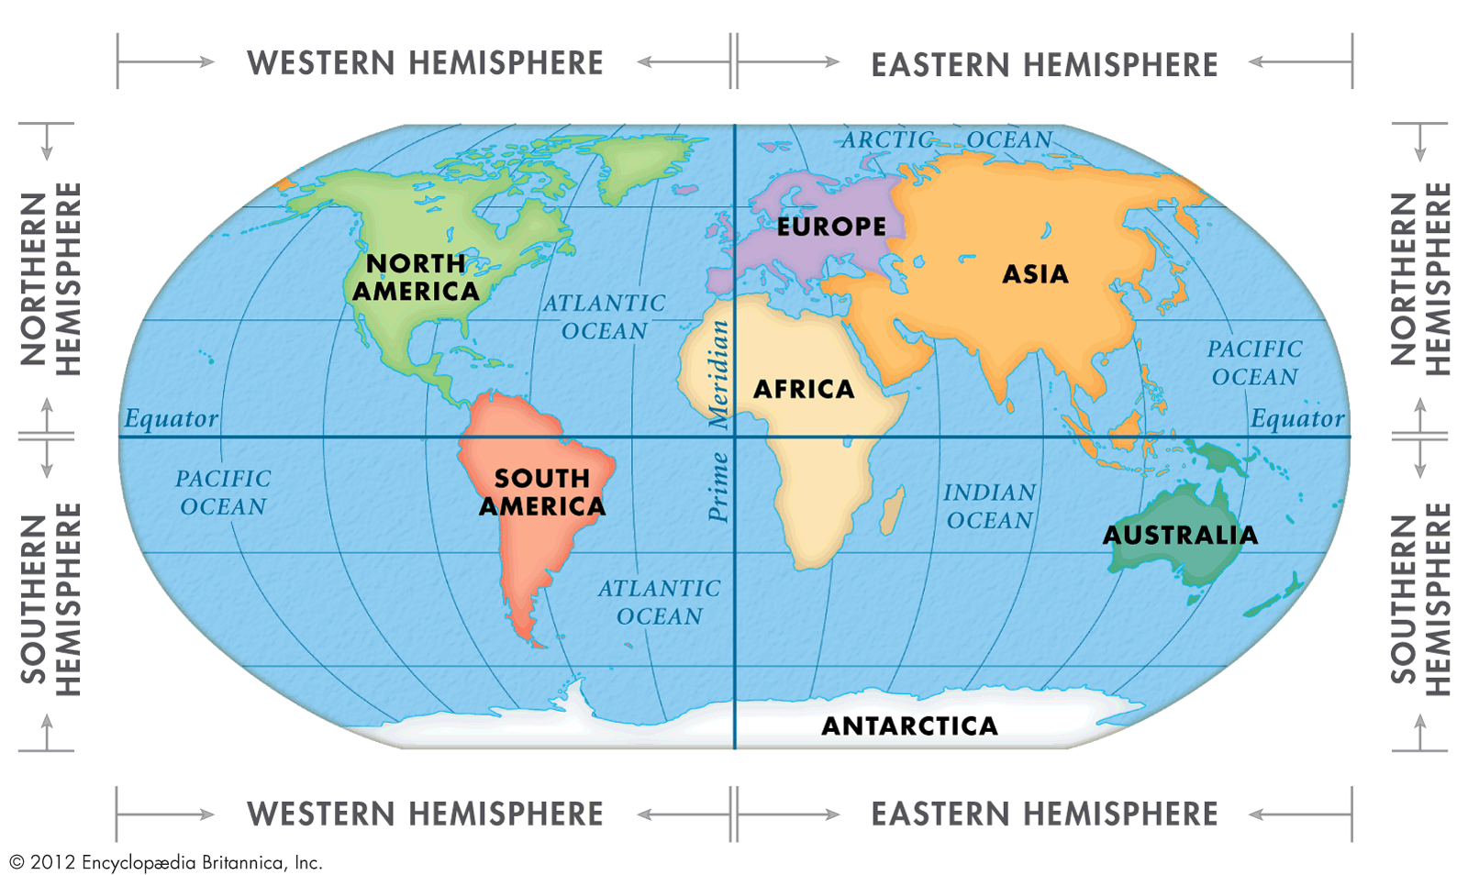
One half of a sphere. Earth can be divided into eastern & western or into northern or southern; these are known as what?
HEMISPHERE

Slide 14
One complete trip by Earth around the sun takes 365 ¼ days is know as its what?
REVOLUTION
The spinning motion of Earth around its axis which is 24 hours is called what?
ROTATION

Slide 15
Rotate | Revolve
SPIN OR TURN
GOES AROUND
TAKES 365 ¼ DAYS (1 YEAR)
TAKES 24 HOURS
CAUSES DAY & NIGHT
CAUSES SEASONS ALONG WITH THE TILT OF THE EARTH

Slide 16
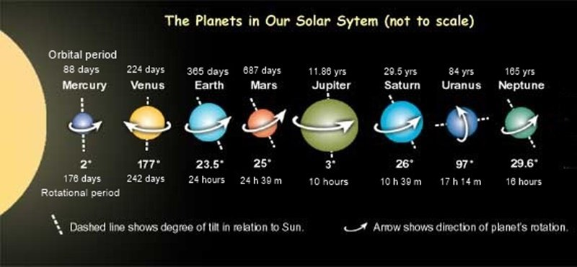
What planets have the fastest & slowest rotation & revolution?

Slide 17
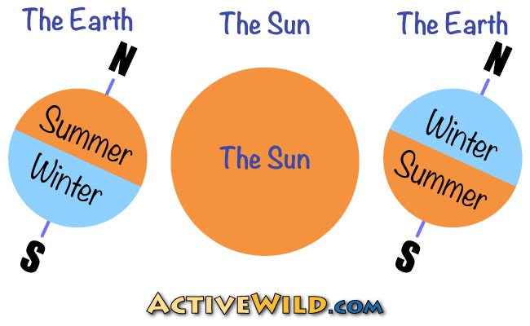
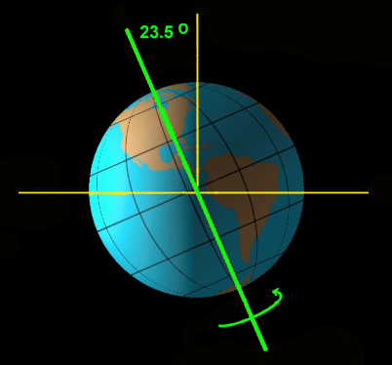
An imaginary line that runs from the North Pole to the South Pole through the center of the Earth is called what?
AXIS
This is the reason
for the different seasons.

Slide 18
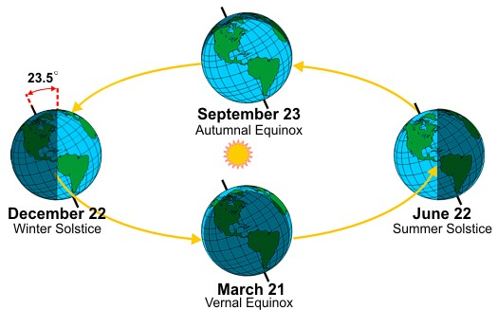

Slide 19
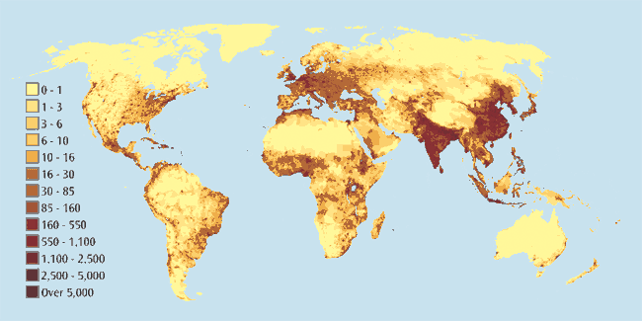
GLOBAL POPULATION MAP

Slide 20
CLIMATES | TYPES | CHARACTERISTICS | VEGETATION
TROPICAL | TROPICAL WET | RAINY ALL YEAR ROUND | BROADLEAF TREES
 | TROPICAL WET & DRY | HAS A RAINY SEASON | GRASSLANDS & SAVANNA
DRY | DESERT | LESS THAN 10 INCHES OF RAIN | SPECIALLY ADAPTED PLANTS
 | SEMI-ARID | UP TO 20 INCHES OF RAIN | GRASSLANDS CALLED STEPPE
MID-LATITUDE | MEDITERRANEAN | WET WINTER | PLANTS THAT HAVE ADAPTED TO A DRY SEASON IN THE SUMMER
 | MARINE WEST COAST | RAINY YEAR ROUND | MIXED FORESTS OF BROADLEAF & NEEDLE-LEAF TREES OR ONLY NEEDLE-LEAF TREES
 | HUMID SUBTROPICAL | LONG, HOT, HUMID SUMMERS
 | HUMID CONTINENTAL | WIDE RANGE OF SUMMER & WINTER TEMPERATURES | GRASSLANDS & SAVANNAS
HIGH LATITUDE | SUBARTIC | COLD DRY CLIMATE | SPECIALLY ADAPTED PLANTS
 | TUNDRA | PERMANENT ICE & SNOW
 | ICECAP |  | NONE
HIGHLAND | VARIES WITH LATITUDE, ELEVATION & CONTINENTAL LOCATION

Slide 21
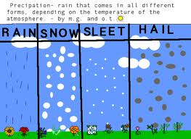
Falling water droplets in the form of rain, snow, sleet or hail is called what?
PRECIPITATION

Slide 22
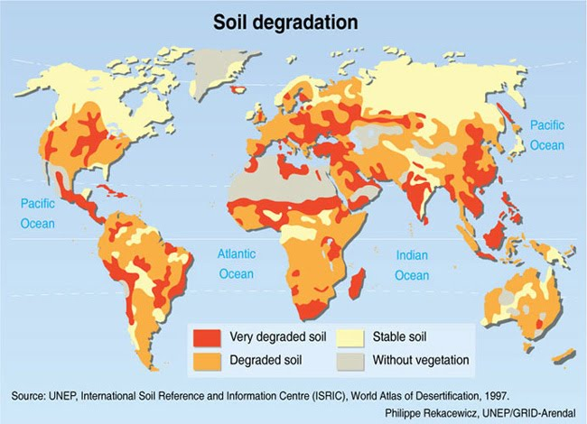
The process in which farmland becomes less productive because the land is degraded is called what?
DESERTIFICATION

Slide 23
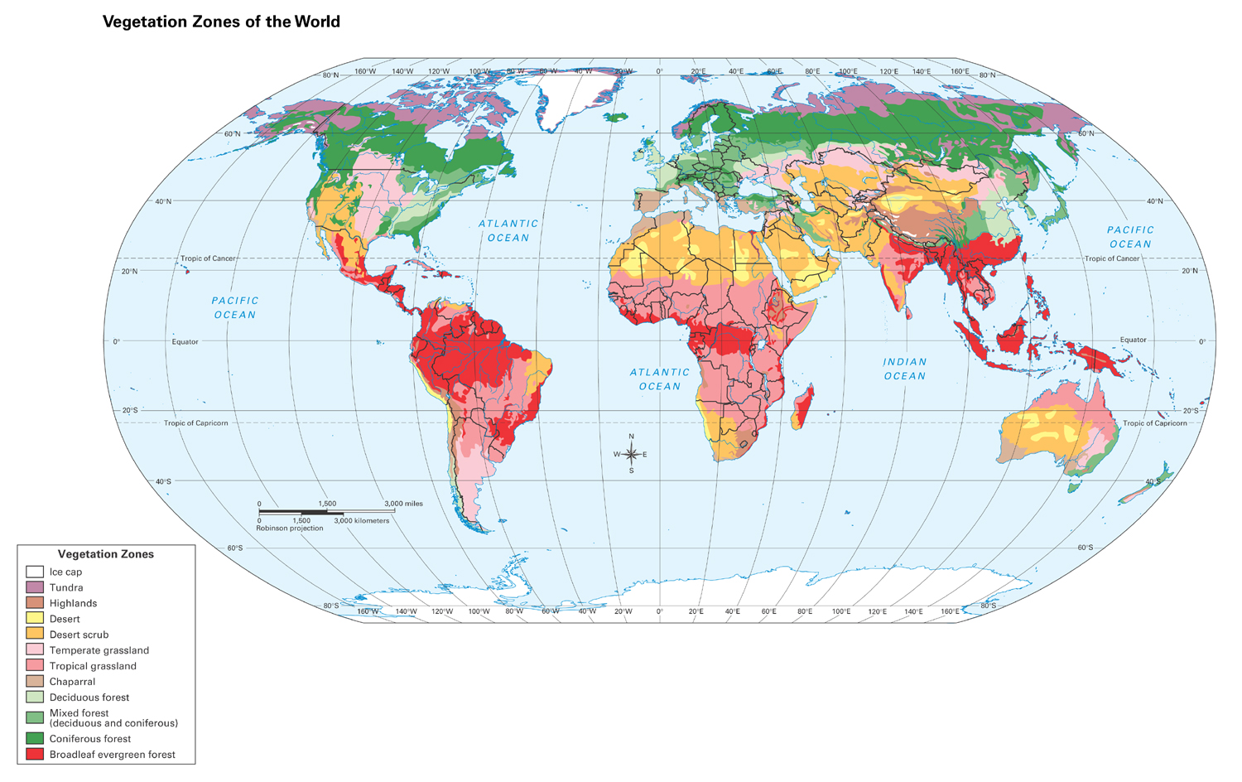
MIXED FOREST (DECIDUOUS & CONIFEROUS)

Slide 24
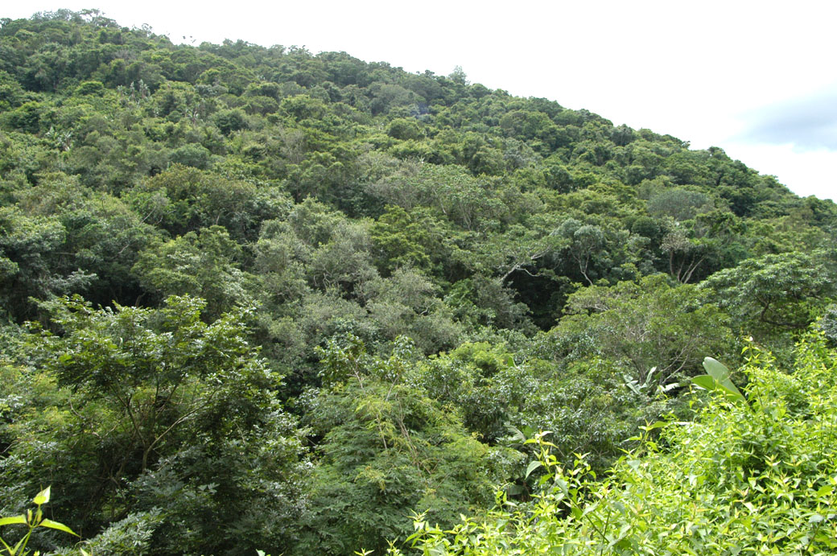
All the plants & trees in a particular area is called what?
VEGETATION

Slide 25
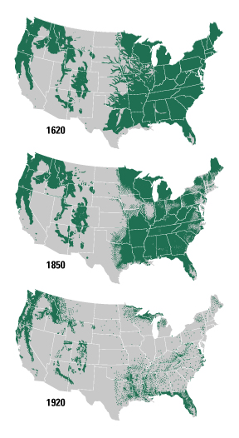
What is the cutting of large areas of forests for human activities such as buildings for businesses & residential is called what?
DEFORESTATION

