Slide 1
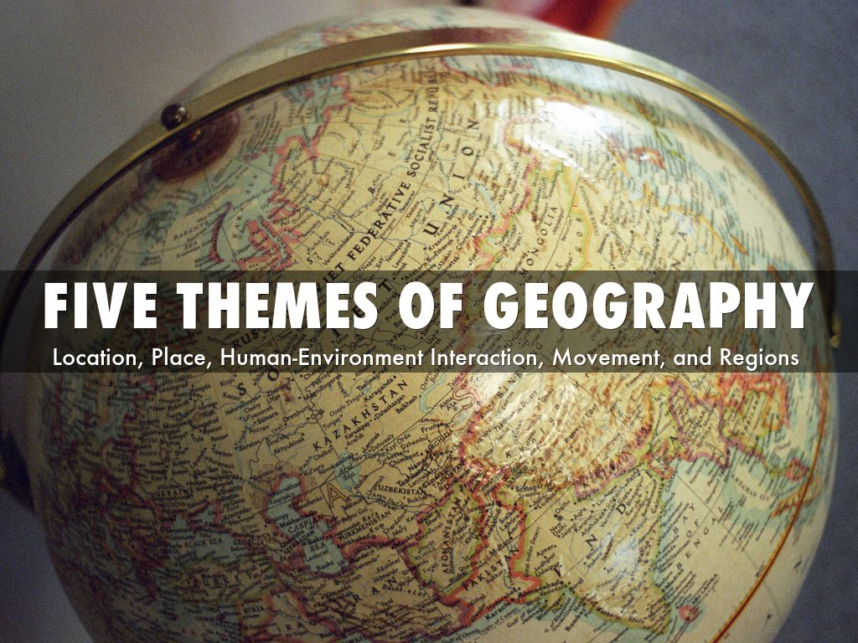

Slide 2
The 5 Themes & of Geography
What is the study of people, places & environments called?
GEOGRAPHY
The physical surroundings of a location is called what?
ENVIRONMENT

Slide 3
There are two types of geography: Physical & Human.
Physical Geography is the study of the natural characteristics of Earth; this includes the study of landforms, bodies of water, vegetation & climate.
Human Geography is the study of the ways people interact with the Earth such as culture, migration & population.

Slide 4
The 5 Themes of Geography are What?
1. MOVEMENT
2. REGION
3. HUMAN-ENVIRNOMENT
4. LOCATION
5. PLACE
MR. HELP

Slide 5
This means either an exact position using latitude or longitude, or a description of a places around it. It can relative or absolute.
LOCATION

Slide 6
This describes physical characteristics such as mountains or rivers, as well as human characteristics and the people who live there.
PLACE

Slide 7
Physical Characteristics—
Includes a description of such things as the mountains, rivers, beaches, topography, climate, and animal and plant life of a place. If a place is described as hot, sandy, fertile, or forested, these terms all paint a picture of the physical characteristics of the location.

Slide 8
Human Characteristics—
Includes the human-designed cultural features of a place. These features include land use, architectural styles, forms of livelihood, religious practices, political systems, common foods, local folklore, means of transportation, and methods of communication.

Slide 9
This has physical or human characteristics that unite them & make them different from or similar to other regions. The South or The Middle-East are examples.
REGION

Slide 10
____________ the shifting of people, goods, services & ideas changes places & regions & the people who live there.
Another main theme is when humans adapt to their surroundings & change elements.
MOVEMENT
HUMAN-ENVIRONMENT INTERACTION

