Slide 1
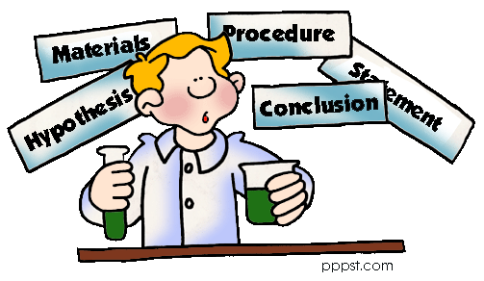
The Scientific Method

Slide 2
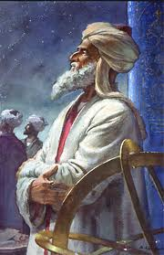
Who Invented the Scientific Method?
The credit of this important process usually is given to Western scientist Roger Bacon. However, the Muslims really invented it, perfected it, & presented it to the West.
Al-Biruni (d. 1050 CE), the Persian genius of his time wrote it down first.
He conducted precise
experiments on laws of gravity, momentum & motion using the Scientific Method before Roger Bacon ever did.

Slide 3


Step 1:
State the Question
“What is the Purpose?”
It seems obvious, but why is it that you are doing this particular experiment? What are you trying to discover? This is different then Step 3.

Slide 4
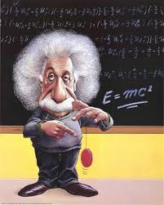

Step 2:
Collect Data,
Information & Do Research
Use books, the Internet & primary/secondary resources.
By finding more about your topic you know more about it & can explain it.

Slide 5


Step 3:
Form a Hypothesis or a Question
“Predict the outcome of the experiment or the problem”
This is an educated guess because of the research you did.

Slide 6


Step 4:
Test the
Hypothesis with a Measurable
Experiment or Activity
“Develop a procedure or sequence of steps” remember it has to be measurable… weight, height, time, speed, temperature, etc.

Slide 7
Good experiments should have more than one variable.
A variable is something that is not consistent or having a fixed pattern & is liable to change.

Slide 8


Step 5:
Observe, Analyze &
Record Your Results
By recording your results you can analyze them better. You should create charts and/or graphs. It’s your proof.

Slide 9


Step 6:
Your Conclusion
“Compare the
Hypothesis to the experiment” were you right about your Hypothesis or were you wrong? Why? What could you do to get better results next time?

Slide 10

Listing your materials that you used is not a step in the Scientific Method, but it needs to be present.

Slide 11

Review:
What are Six Steps in the Scientific Method?
#1. State the Question
#4. Test the Hypothesis
#5. Analysis & Record
#2. Collect Data & Information
#6. Conclusion
#3. Form the Hypothesis
#7. List of Materials & References

