Slide 1

6th Grade Social Studies
Unit 1, Lesson 2:
Geographic Inquiry
?
?
?
?
?
?

Slide 2
?
?
?
?
?
?
Ask geographic questions

Slide 3
?
?
?
?
?
?
Ask geographic questions | Ask where, what, why, and so what?

Slide 4
?
?
?
?
?
?
Acquire geographic information

Slide 5
?
?
?
?
?
?
Acquire geographic information | Use a variety of tools and sources such as maps, interviews, photographs, satellite images, textbooks, and websites.

Slide 6
?
?
?
?
?
?
Organize geographic Information

Slide 7
?
?
?
?
?
?
Organize geographic Information | Create maps, graphs, charts, diagrams, and tables. Develop oral or written summaries.

Slide 8
?
?
?
?
?
?
Analyze geographic Information

Slide 9
?
?
?
?
?
?
Analyze geographic Information | Identify, understand, explain, and analyze information. Look for patterns, relationships, and connections Make predictions and inferences.

Slide 10
?
?
?
?
?
?
Answer geographic questions

Slide 11
?
?
?
?
?
?
Answer geographic questions | Develop conclusions based on the data collected, organized, and analyzed. Present the conclusions in oral and written narratives.

Slide 12
Geographic Inquiry
?
?
?
?
?
?
An Example

Slide 13
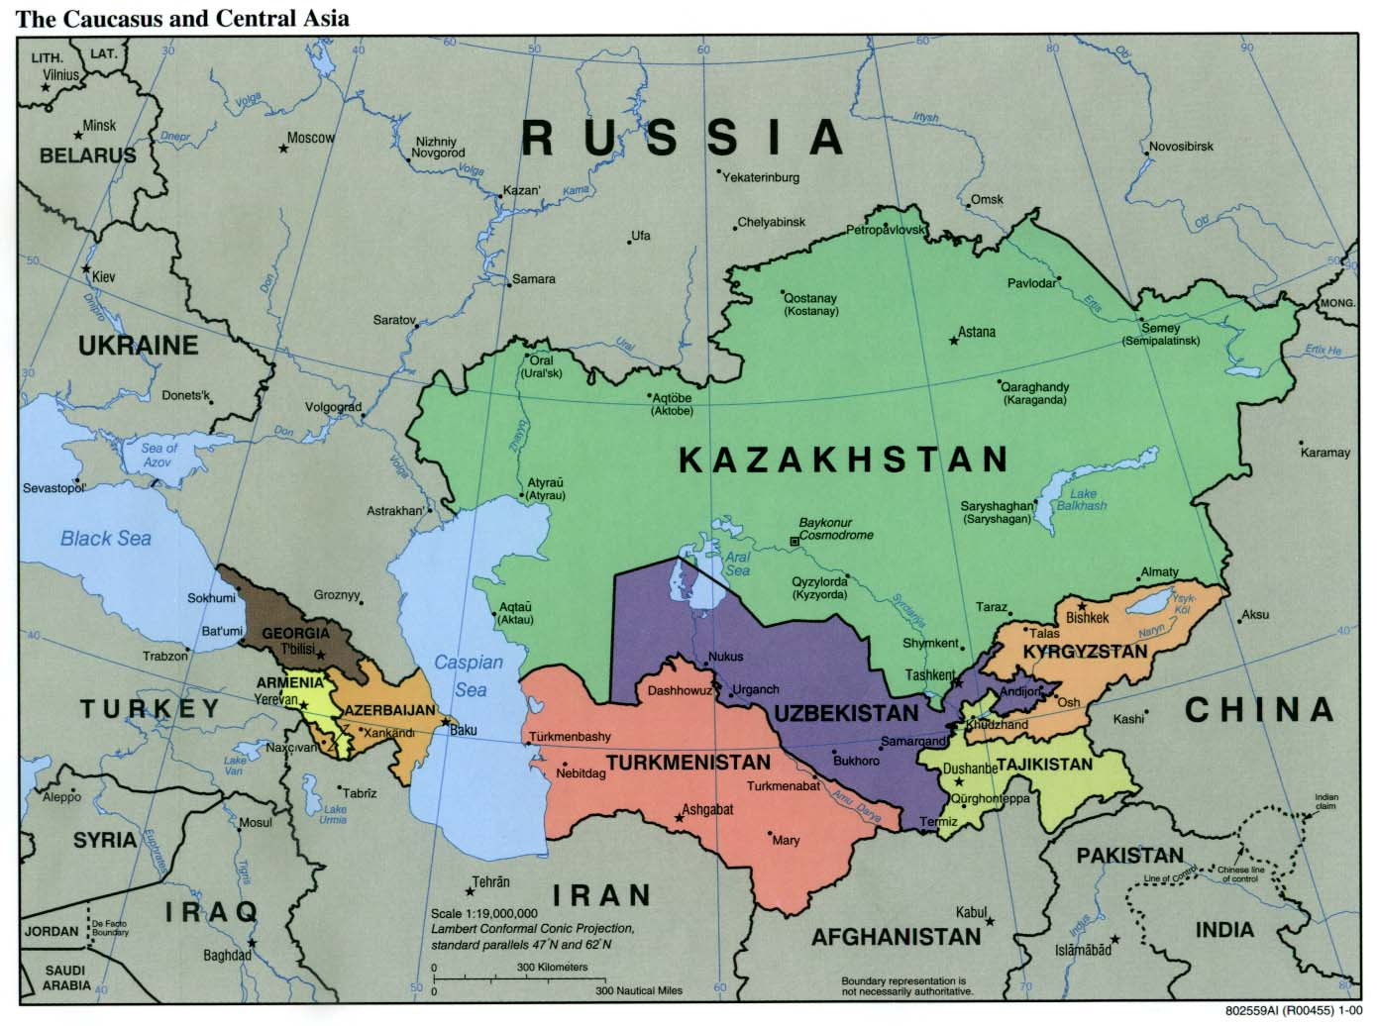
Location of the Aral Sea
Source: http://aquadoc.typepad.com/.a/6a00d8341bf80a53ef00e554db33ae8833-pi
Notes:
Map of the Aral Sea. 31 July 2012 <http://aquadoc.typepad.com/.a/6a00d8341bf80a53ef00e554db33ae8833-pi>.

Slide 14
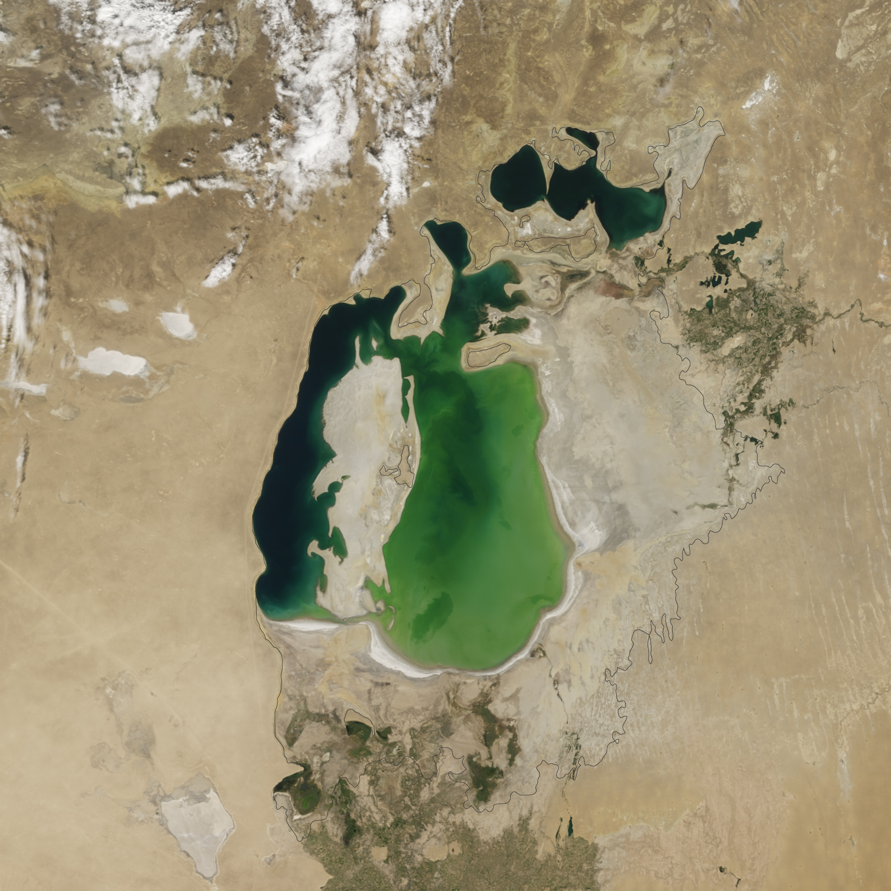
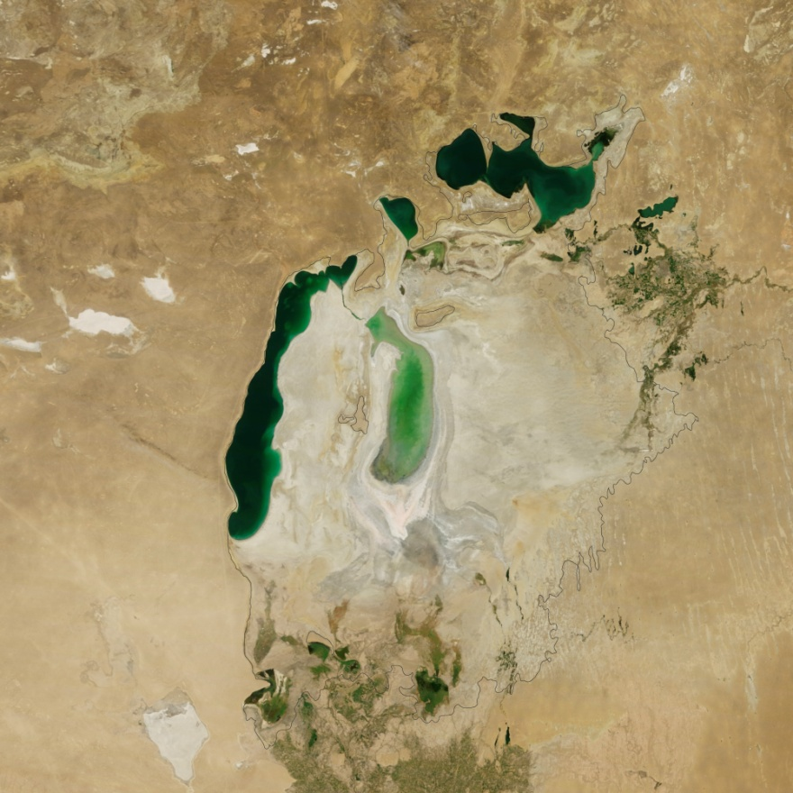
Photographs of the Aral Sea
2000
2012
Source: Photographs of the Aral Sea. http://meridian.aag.org/changingplanet/index.cfm?action=main.module&sectionID=1&moduleID=4&pageID=18
Notes:
Photographs of the Aral Sea. Association of American Geographers. 31 July 2012 <http://meridian.aag.org/changingplanet/index.cfm?action=main.module&sectionID=1&moduleID=4&pageID=18>.

Slide 15
?
?
?
?
?
?
Ask geographic questions

Slide 16
?
?
?
?
?
?
Ask geographic questions | What is causing the Aral Sea to dry up? What effect is this having on people and the environment?

Slide 17
?
?
?
?
?
?
What kind of geographic information could help answer these questions?

Slide 18
?
?
?
?
?
?
What kind of geographic information could help answer these questions? | Satellite images taken over time Photographs of the area taken at ground level Interviews with people who live in the area Water samples from the Aral Sea Different types of maps of the area Information regarding a similar problem with a body of water in a different part of the world

Slide 19
?
?
?
?
?
?
How could this information be organized?

Slide 20
?
?
?
?
?
?
How could this information be organized? | Create overlays of satellite images showing change over time Put water sample data into tables or graphs Create a written summary of interview data Draw diagrams showing how the size of the Sea has changed Create a map synthesizing the information from all the maps collected

Slide 21
?
?
?
?
?
?
How could this information be analyzed?

Slide 22
?
?
?
?
?
?
How could this information be analyzed? | Try to establish when the drying up began Compare the Aral Sea data with that of another body of water with a similar problem Identify potential causes of the problem that show up on maps or aerial photographs Study the kinds of chemicals that show up in the water samples Look for patterns that may exist in the interview data

Slide 23
?
?
?
?
?
?
Answer geographic questions

Slide 24
?
?
?
?
?
?
Answer geographic questions | Draw conclusions from the data and prepare a written report supporting the conclusions.

Slide 25
?
?
?
?
?
?
REVIEW
Write the FIVE steps of geographic inquiry in your Global Investigator’s Notebook.

Slide 26
?
?
?
?
?
?
REVIEW
Ask Geographic Questions
Acquire Geographic Information
Organize Geographic Information
Analyze Geographic Information
Answer Geographic Questions

Slide 27
Property of Oakland Schools
Copyright © 2010-2016 by Oakland Schools

