Slide 1
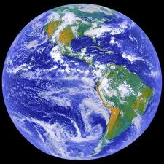
Chapter 1: What is Geography?

Slide 2
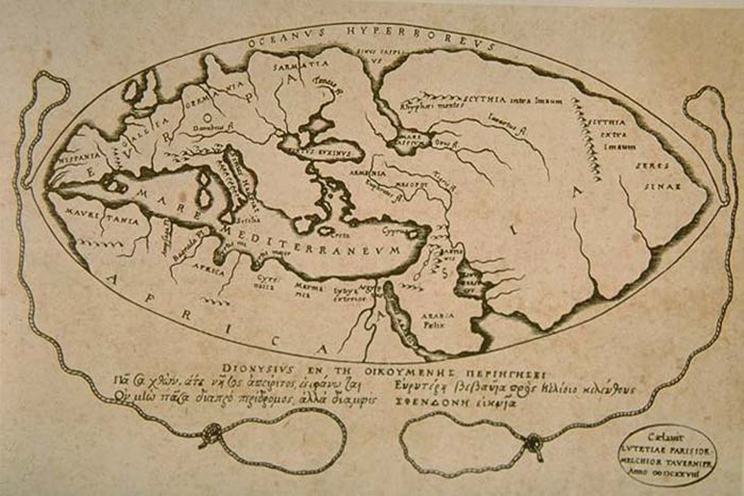
One of the oldest & first maps ever created… how was this done?

Slide 3
Lesson 1: Maps
Map Views
a.) map view: most maps are drawn this way; as if you were looking down on an area from the Earth’s surface.
b.) profile view: is a drawing that shows an object as though you were looking at it from the side.
Map Legends & Scales
a.) map legend: is a key that lists all the symbols used on the map so you can interpret the symbols.
b.) map scale: is the relationship between a distance on the map & the actual distance on the ground.

Slide 4
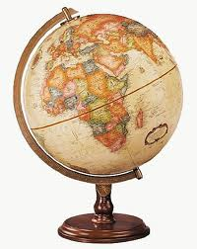
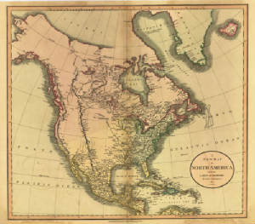
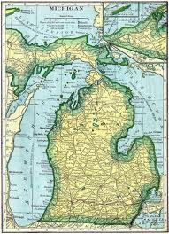
A model of the Earth in the shape of a sphere is called what?
GLOBE
A representation of a part of the Earth on a flat surface is called what?
MAP

Slide 5
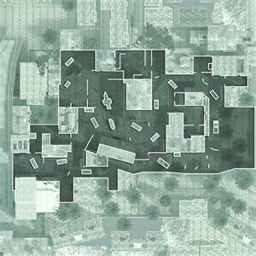
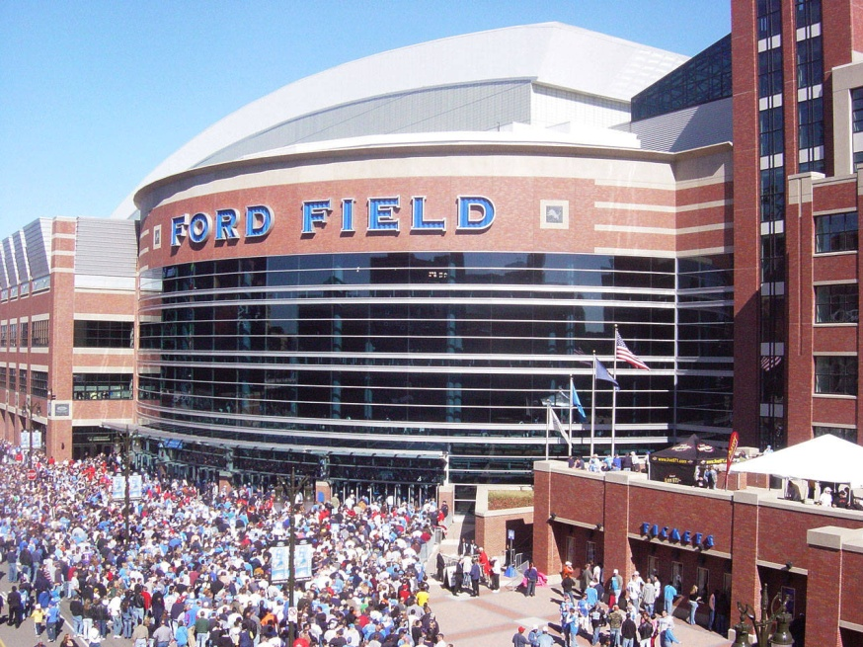
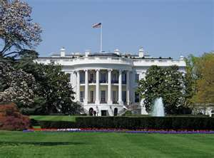
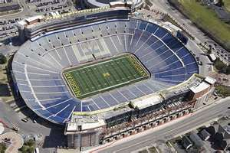
SIDE PROFILE VIEW
OVERHEAD MAP VIEW

Slide 6
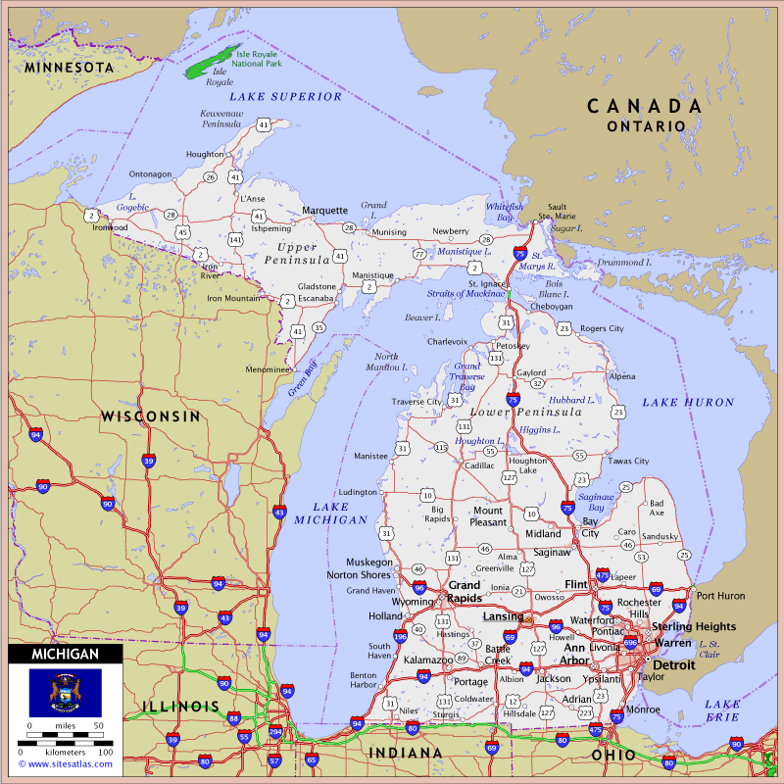
MAP OF THE STATE OF MICHIGAN
LEGEND/KEY

Slide 7
#1.________________: is a key that lists all the symbols used on the map so you can interpret the symbols. #2._________________: is a drawing that shows an object as though you were looking at it from the side. #3.________________: is the relationship between a distance on the map & the actual distance on the ground. #4.________________: most maps are drawn this way; as if you were looking down on an area from the Earth’s surface. #5.________________: a model of the Earth in the shape of a sphere. #6.________________: a representation of a part of the Earth on a flat surface.
MAP LEGEND
PROFILE SIDE VIEW
MAP SCALE
MAP ARIEL VIEW
GLOBE
MAP

Slide 8
III. A Grid System for Plotting Locations a.) longitude: is the distance in degrees east or west of the prime meridian (up & down). b.) latitude: is the distance in degrees north or south of the equator (right & left). c.) equator: an imaginary line halfway between the north and south pole that circles the Earth. d.) prime meridian: the imaginary line that makes a half circle from the north pole to the south pole, passing through Greenwich, England. e.) degree: is a 1/360 of the way around a full circle.

Slide 9
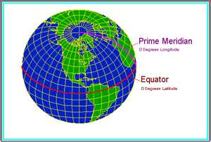
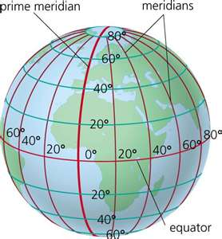

Slide 10
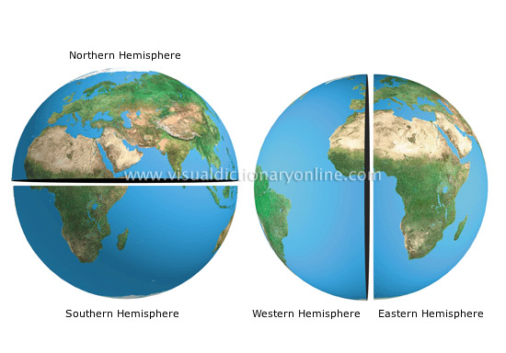
One half of the sphere that makes up the Earth’s surface.
HEMISPHERE

Slide 11
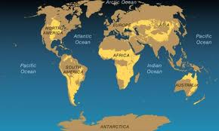
One of seven large landmasses on the Earth’s surface is called what?
CONTINENT

Slide 12
What are the Seven Continents?
NORTH AMERICA
SOUTH AMERICA
EUROPE
ASIA
AFRICA
AUSTRALIA
ANARTICA

Slide 13
The Four Oceans are What?
PACIFIC OCEAN ATLANTIC OCEAN INDIAN OCEAN ARTIC OCEAN
SOUTHERN OCEAN

