Slide 1
Chapter 14: Supranational Cooperation in the European Union

Slide 2
14.1 Introduction:
A supranational organization through which a number of European countries work together on shared issues is called what?
EUROPEAN UNION (EU)

Slide 3
As of 2018 the European Union (EU) has _____ member countries. The government of the European Union (EU) stands above the governments of its members & as a result, the EU has been able to remove many ___________ that once made travel among members difficult.
28
BARRIERS

Slide 4
A form of international cooperation in which countries give up some control of their affairs as they work together to achieve shared goals is a what?
SUPRANATIONAL COOPERATION

Slide 5
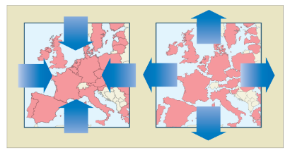
What forces work for & against supranational cooperation among nations?

Slide 6
14.2 The Geographic Setting:
A force that divides people & countries is a _______________ force & a ________________ is a force that unites peoples & countries; similar to push/pull factors.
CENTRIFUGAL
CENTRIPETAL

Slide 7
Known as the “Great War” or the “War to End All Wars”, which broke out in Europe between the Central Powers & the Allied Powers & was fought mainly on fronts, the U.S did not declare war on Germany until early 1918 was called what?
WORLD WAR I (1914-1918)

Slide 8
A war that involved most countries in the world. The two sides were known as the Axis Powers & the Allies. The U.S. did not declare war until December 7, 1941 with the bombing of Pearl Harbor by the Japanese; this was called what?
WORLD WAR II
(1939-1945)

Slide 9
A group of countries that acts as a single market, without trade barriers between member countries is known as what?
COMMON MARKET

Slide 10
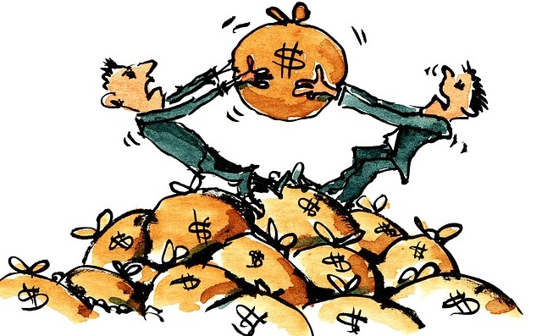
What is the flow of goods & services across national borders, with little or no government?
FREE TRADE
A tax on goods that cross country borders is called a what?
TARIFF

Slide 11
14.3 Economic Cooperation in the EU:
The bills & coins used as money in a particular country or group of countries such as the U.S. dollar, the Canadian loon & the Japanese yen is known as what?
CURRENCY

Slide 12
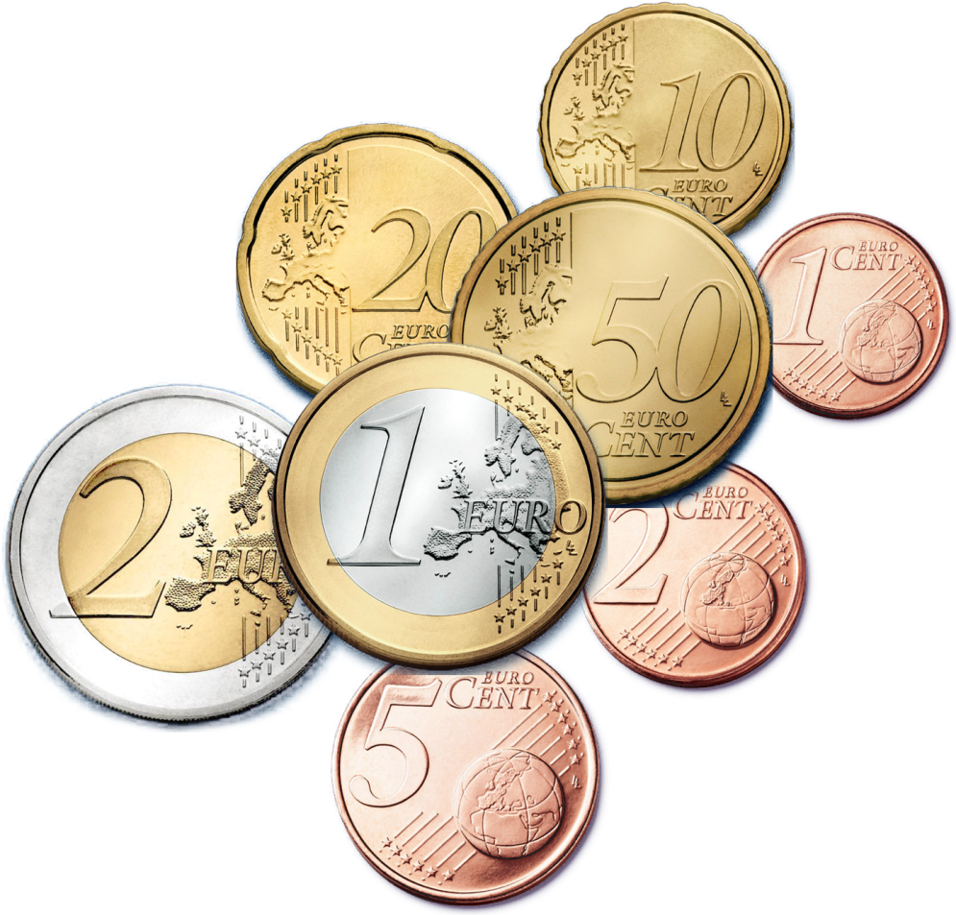
The unit of currency used in many countries of the European Union (EU) is what?
EURO
What do they use in England?, Japan,
Canada & Mexico?

Slide 13
A group of countries that work together to promote trade with one another is what?
TRADE BLOC

Slide 14
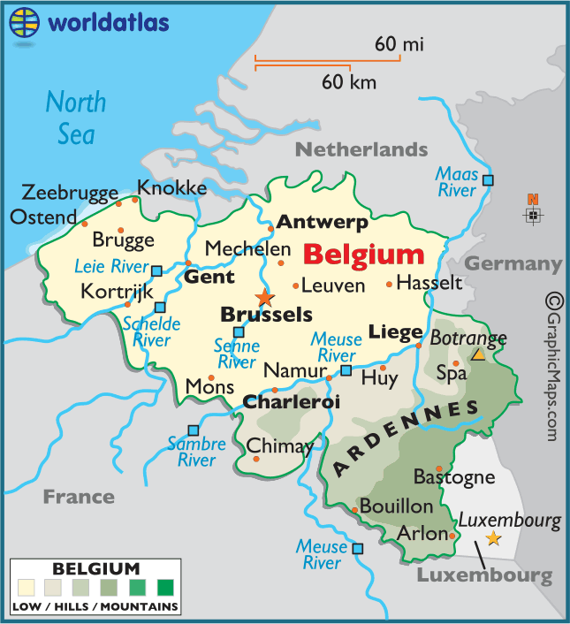
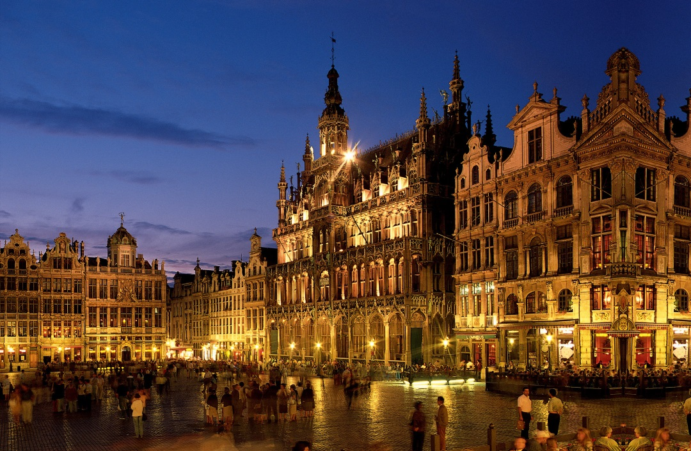
What city might some call the “capital” of Europe?
BRUSSELS, BELGIUM

Slide 15
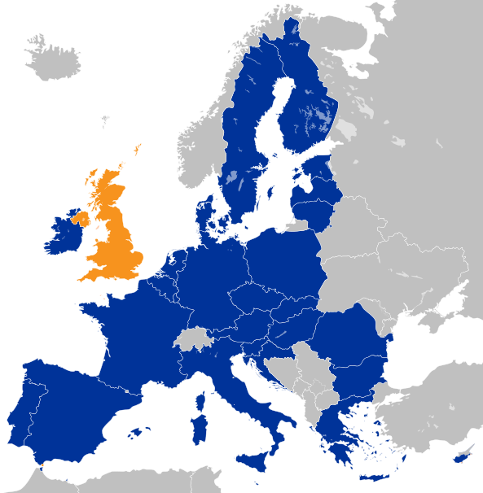
What is ?
Is the United Kingdom’s withdrawal from the European Union in March of 2019
Why might be the advantages & disadvantages? This referendum was only passed by 51.9%.

Slide 16
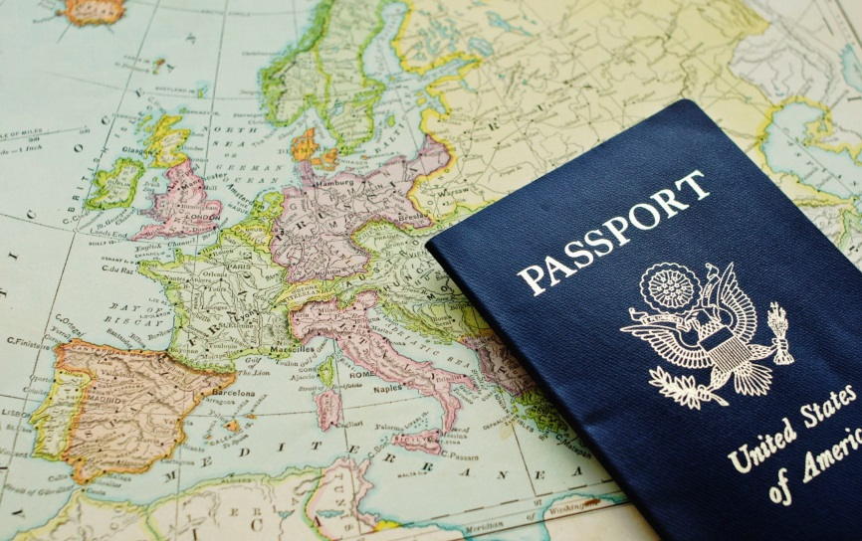
A formal document issued by an authorized official of a country to one of its citizens that is usually necessary for exit from & reentry into the country is called what?
PASSPORT

Slide 17
14.4 Political Cooperation in the EU:
How the EU Government Unites Europe | How the EU Government Divides Europe
1. Brings its members together to work on issues they all share | 1. Countries are expected to give up some power when it joins the EU
2. It encourages Europeans to think of themselves as citizens of Europe | 2. EU members don’t always agree with each other
3. Helps unite Europe by speaking with one voice for all of its members | 3. The growing size; with more countries and cultures, cooperation has become more difficult
4. EU members have more power in world affairs than any one European country would have by itself | 4. The idea of European citizenship has been hard for some Europeans to adjust to

Slide 18
14.5 Cultural Cooperation in the EU:
A feeling of belonging to a group that shares the same culture, or way of life is called what?
CULTURAL IDENTITY
A variety of a wide range of differences is called ____________.
DIVERSITY

Slide 19
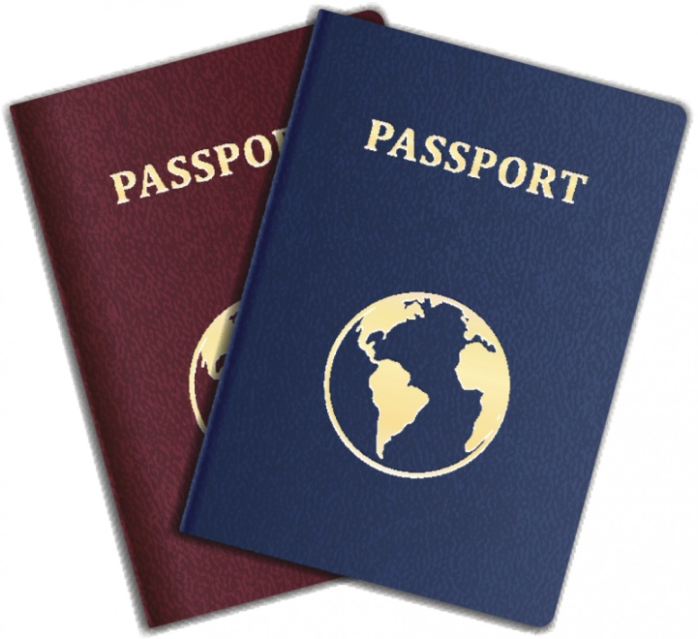
How the EU Promotes a European Culture | Forces Working Against a European Culture
Creation of common cultural symbols; such as its own flag & anthem | Many different languages are spoken with the EU making communication difficult
Support of many cultural programs across Europe | National pride & competition between countries
The EU chooses one or two cities to be a European Capital of Culture | Some cultural traditions get in the way of cooperation
The euro & EU passports make it travel within the EU easy

Slide 20
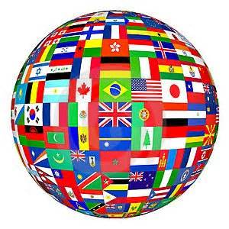
Keeping the Peace
When Governments negotiate & deal with each other in peace it is called what?
DIPLOMACY

Slide 21
14.6 Beginning to Think Globally:
The EU is the best example of supranational cooperation in the world today.

Slide 22
14.7 Global Connections:
1. What kinds of international organizations do countries join?
2. Are all international organizations like the EU?
3. What forces might work against supranational cooperation in the United Nations?

Slide 23
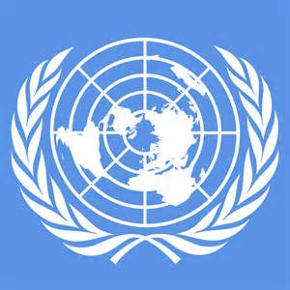
The most important international organization, in which representatives of the world’s countries can discuss international issues & voice concerns is the what?
UNITED NATIONS (UN)
UN’S main goals are settling disputes between countries & try to prevent wars.
The UN often send troops on peacekeeping missions & humanitarian aid.

Slide 24
Why We Need Government?
An organization set up to make & enforce rules for society is called what?
GOVERNMENT

Slide 25
A person who owes loyalty to a country & receives its protection is called a what?

Slide 26
10 TYPES OF GOVERNMENT
1. Democracy
2. Dictatorship
3. Oligarchy
4. Communism
5. Monarchy
6. Republic
7. Theocracy
8. Dynasty
9. Anarchy
10. Commonwealth

Slide 27
1. Democracy:
*Rule by citizens through elected officials.
*Rule is based on citizenship & voting.
*Majority rules; U.S. is an example.
2. Dictatorship:
*Rule by a single individual with
absolute power.
*Ruler controls the military
*Citizens have little power to change government; Syria, North Korea & Nazi Germany are examples.

Slide 28
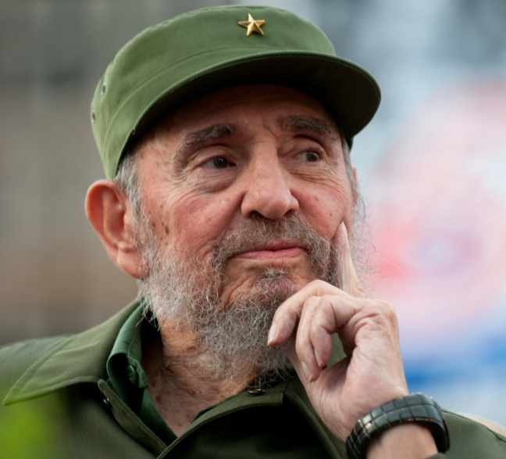
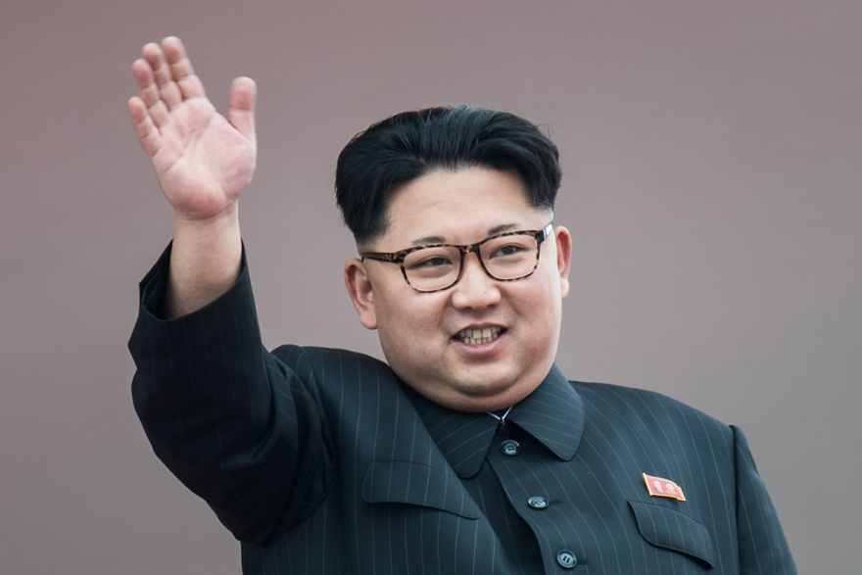
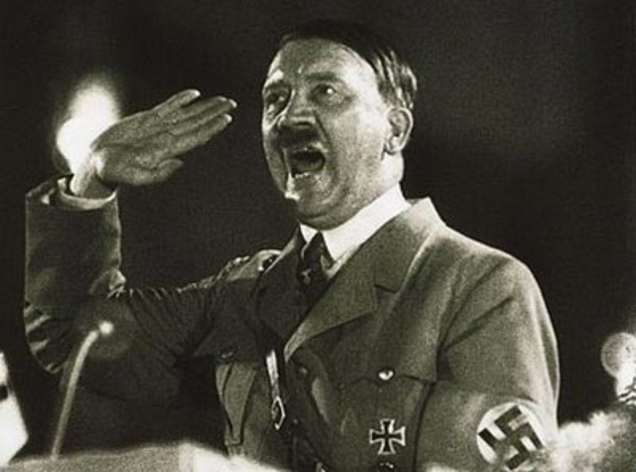
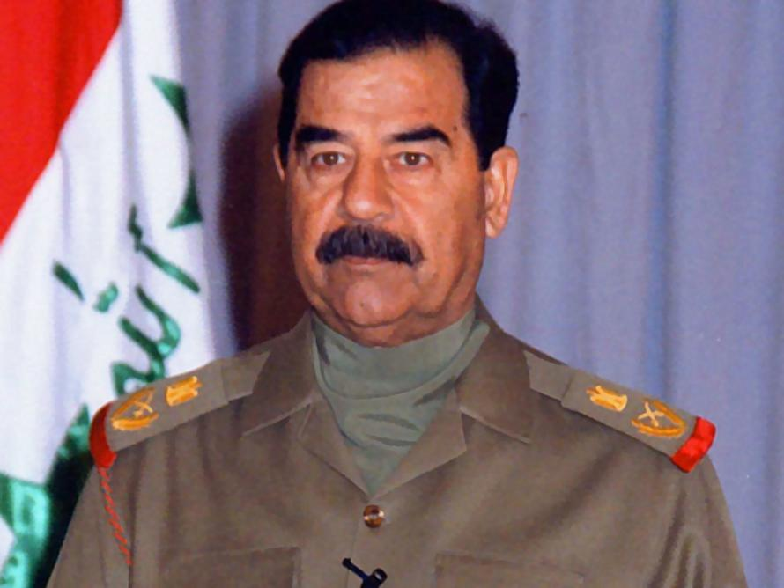
EXAMPLES OF DICTATORS

Slide 29
3. Oligarchy:
*Rule by small group of citizens.
*Rule is based on wealth or privilege.
*Ruling group controls military.
*Burma & Switzerland is an example.
4. Communism:
*Rule by the Communist Party on behalf of the people; China is an example.
*Government owns all economic goods
& services.
*Citizens have little power to change government & delegated careers.

Slide 30
5. Monarchy:
*Rule by King or Queen
*Rule is hereditary
*May share power through a constitution like United Kingdom, Belgium & Spain which are examples.
6. Republic:
*The people can vote directly on some issues, but the leaders they have chosen vote on debated issues on their behalf.

Slide 31
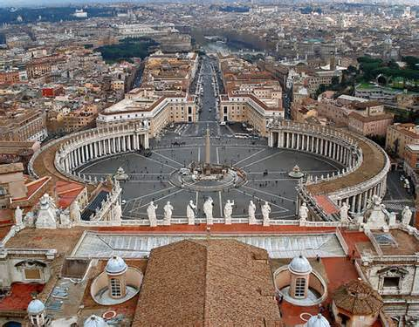
7. Theocracy:
*A country governed by religious laws; Vatican City is an example.
8. Dynasty:
*Line of hereditary rulers; ancient China is an example.

Slide 32
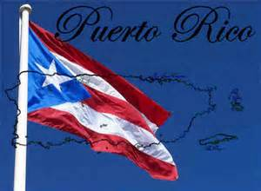
10. Commonwealth:
9. Anarchy:
*Having no
official government.
*Self-governing territory associated with another country. Puerto Rico is an example.

Slide 33
11. Junta:
*Military Dictatorship; Egypt & Myanmar are examples.

