Slide 1
The Digestion & Nervous System

Slide 2
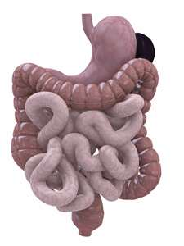
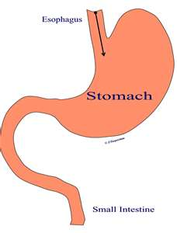
The process by which your body breaks down the food into small nutrient molecules is called what?
DIGESTION
There are two types of digestion: mechanical & chemical.

Slide 3
The process by which nutrient molecules pass through the wall of your digestive system into your blood is called what?
ABSORPTION

Slide 4
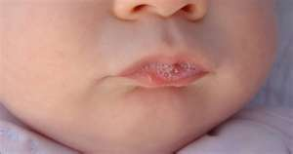
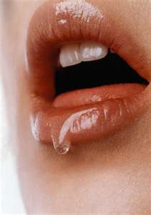
The enzyme fluid which is about 1 liter per day that is released when your mouth waters is called what?
ENZYME
An __________ is a protein that speeds up chemical reactions in the body.

Slide 5
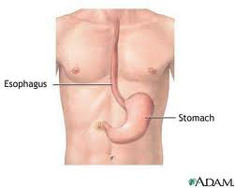
A flap of tissue that seals off the windpipe & prevents food from entering is called what? A muscular tube that connects the mouth to the stomach is called what?
EPIGLOTTIS
ESOPHAGUS

Slide 6
A thick, slippery substance produced by the body is called what? Involuntary waves of muscle contraction that keep food moving along in “one direction” through the digestive system is called what?
MUCUS
PERISTALSIS

Slide 7
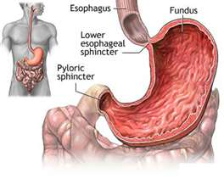
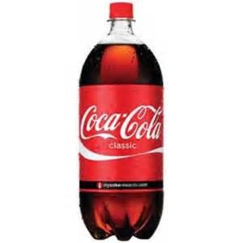
When food leaves the esophagus, it enters this, it is J-shaped, a muscular pouch located in the abdomen & this organ is called what?
STOMACH
An average adult’s stomach holds about 2 liters of food.

Slide 8
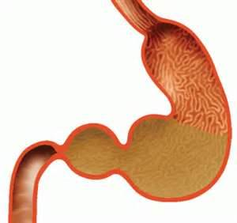
What is the liquid substance found in the stomach before passing through the pyloric valve & entering the rest of the digestion system?
CHYME

Slide 9
What is a digestive fluid, formed in the stomach? It is composed of hydrochloric acid & large quantities of potassium chloride & sodium chloride.
GASTRIC ACID
Your body produces a new stomach lining every 3 days!

Slide 10
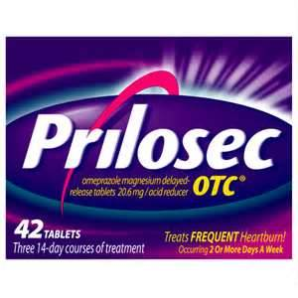
This occurs when stomach acids back up in the esophagus. The condition can be painful & can cause discomfort, since undigested or partially digested food can also move back up to the esophagus from the stomach, it is called what?
ACID REFLUX OR HEARTBURN

Slide 11
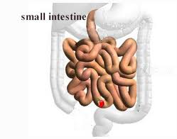
This organ is the part of the digestive system where most of the chemical digestion takes place. It is about 6 meters long & takes up two-thirds of the digestion system. What is it?
SMALL
INTESTINE

Slide 12
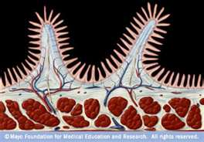
Tiny finger-shaped structures that cover the inner surface of the small intestines & provide a large surface area through which digested food is absorbed is called what?
VILLI

Slide 13
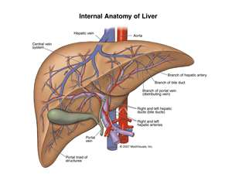
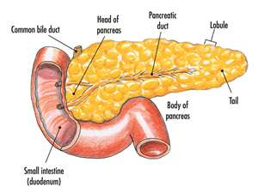
The ________ is located in the upper portion of the abdomen. It is the largest & heaviest organ inside the body; it breaks down substances & eliminates nitrogen from the body. It also produces ________; a substance that breaks up fat particles.
LIVER
BILE

Slide 14
Bile then flows from the liver into the ________________, this organ stores bile from the liver. The ___________ is a triangular organ that lies between the stomach & the first part of the small intestine; it produces enzymes that help break down starches, proteins, & fats.
GALLBLADDER
PANCREAS

Slide 15
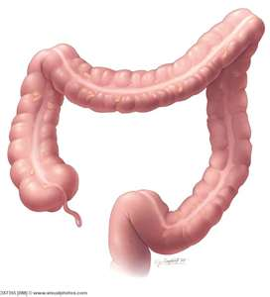
One of the last sections of the digestive system, where water is absorbed from food & the remaining material is eliminated from the body is an organ called what?
LARGE INTESTINES

Slide 16
The opening at the end of an organism’s digestive system through wastes exit is called what?
The large intestines ends in a short tube called the what? It is here where waste materials are compressed into a solid form.
RECTUM
ANUS

Slide 17
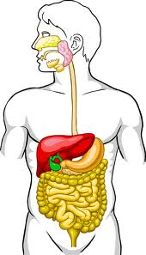
SALIVARY GLANDS
MOUTH & TONGUE
ESOPHAGUS
EPIGLOTTIS
LIVER
GALL BLADDER
STOMACH
LARGE INTESTINE
PANCREAS
SMALL INTESTINE
RECTUM
THE DIGESTION SYSTEM

Slide 18
NERVOUS
The __________ System receives information about what is happening both inside & outside your body. It also directs the way in which your body responds to this information. In addition this system helps maintain homeostasis.

Slide 19
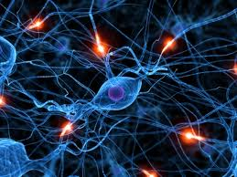
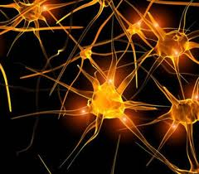
The cells that carry information through your nervous system are called __________, or nerve cells. The message that a neuron carries is called a _______________. The structure of a neuron enables it to carry nerve impulses.
NEURONS
NERVE IMPULSE

Slide 20
Any change or signal in the environment that can make an organism react is called what?
STIMULUS
RESPONSE
A __________ is what your body does in reaction to a stimulus. Automatic movements in response to a signal is called a ____________.
REFLEX

Slide 21
Each of your senses picks up a specific type of information about your environment; the sense organs change that information into nerve impulses & send the impulses to your brain. What are your major senses?
VISION, HEARING, SMELL, TASTE,
TOUCH & BALANCE

Slide 22
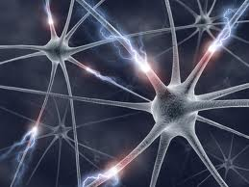
A bundle of nerve fibers is called what?
A NERVE
What are the three different kinds of neurons that are found in the body?
1. SENSORY NEURONS,
2. INTERNEURONS &
3. MOTOR NEURONS

Slide 23
A __________ Neuron picks up stimuli from the internal or external environment & converts each stimulus into a nerve impulse; your senses. An _______________ is a neuron that carries nerve impulses to another; they are inside you & a __________ Neuron sends an impulse to a muscle & the muscle contracts in response.
SENSORY
INTERNEURON
MOTOR

Slide 24
Your Nervous System has two divisions that work together which are called what?
CENTRAL NERVOUS SYSTEM & PERIPERAL NERVOUS SYSTEM

Slide 25
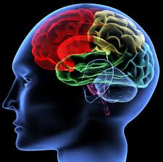
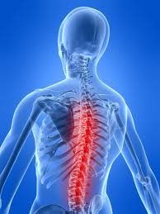
Which system is the control center of the body?
CENTRAL NERVOUS SYSTEM

Slide 26
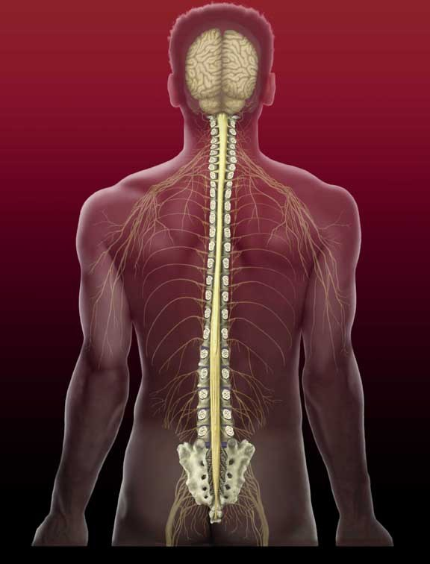
The __________, located in the skull, is the part of the central nervous system that controls most functions in the body. The _______________ is the thick column of the nerves that branch off in the peripheral nervous system.
BRAIN
SPINAL CORD

Slide 27
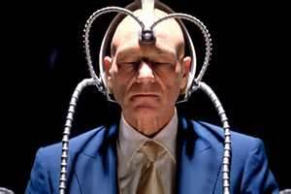
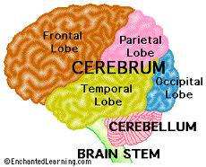
What part of the brain interprets input from the senses, controls the movement of skeletal muscles & carries out complex mental processes such as learning, remembering & making judgments?
CEREBRUM
(IT ALSO IS THE LARGEST PART OF THE BRAIN)

Slide 28
The second largest part of your brain coordinates the actions of your muscles & helps you keep your balance is called what?
CEREBELLUM
BRAINSTEM
The ____________, which lies between the cerebellum & the spinal cord, controls your body’s involuntary actions.

Slide 29
Which system consists of a network of nerves that branch out from the central nervous system & connect it to the rest of your body is called what?
PERIPHERAL
NERVOUS SYSTEM

Slide 30
The nerves of the peripheral nervous systems can be divided into what two groups?
SOMATIC NERVOUS SYSTEM & AUTOMATIC NERVOUS SYSTEM
The nerves of the Somatic Nervous System control voluntary actions & the nerves of the Automatic Nervous System control the involuntary actions.

Slide 31
What are the four types of memory?
1. SHORT TERM, 2. LONG TERM, 3. ANCESTROL & 4. ELDETIC (PHOTOGRAPHIC)

Slide 32
You have about ___________________ brain cells same as when you were born, but you can lose them by how?
100 BILLION
DRUG USE, ALCOHOL USE &/OR
HURTING YOUR HEAD

Slide 33
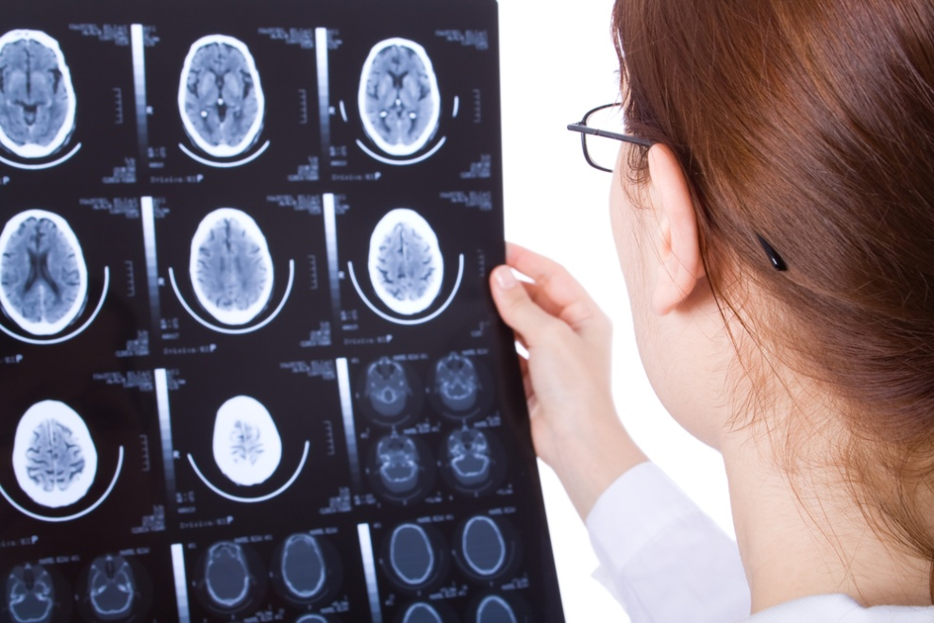
What kind of doctor would you see to treat your nervous system?
NEUROLOGIST

Slide 34
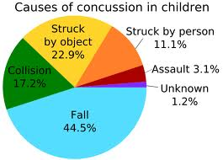
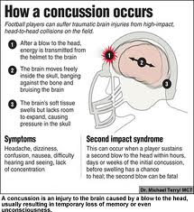
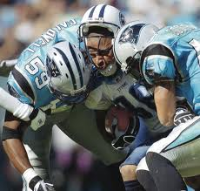
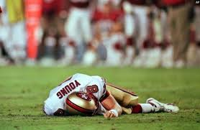
A ____________ is a bruise-like injury of the brain.
CONCUSSION

