Slide 1

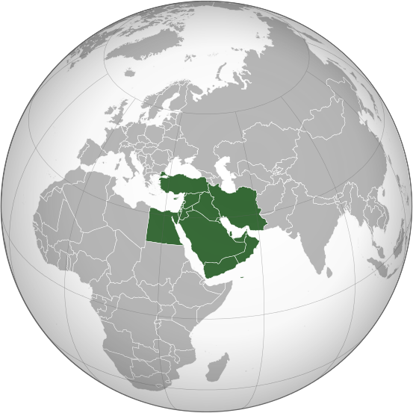
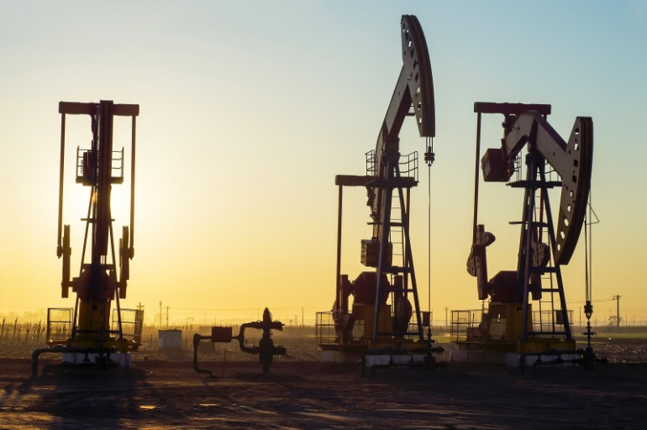
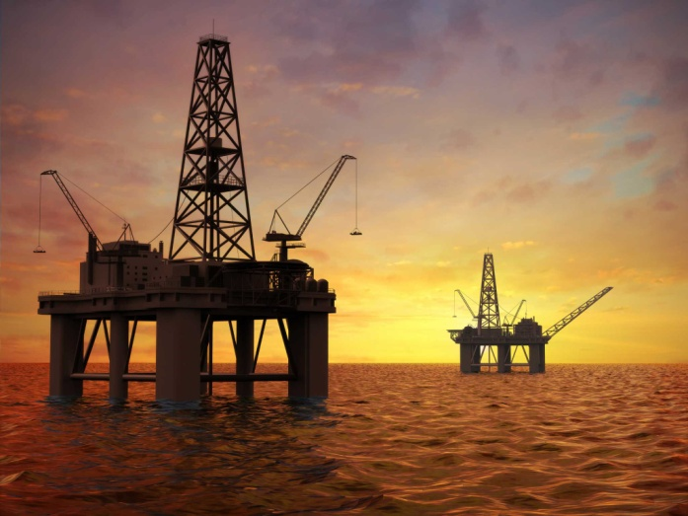
Chapter 24: Oil in Southwest Asia: How “Black Gold” Has Shaped a Region

Slide 2

Bell Work:
Who controls the world’s oil supplies?
How much oil is left on Earth? When do experts believe it will run-out?
MOST MIDDLE-EAST COUNTRIES (2/3), RUSSIA, UNITED STATES, CANADA, VENEZUELA & OPEC
1.5 TRILLION BARRELS, MOST ESTIMATE ABOUT 53-60 YEARS BEFORE THERE IS NO MORE OIL LEFT
How might having a valuable natural resource affect a region?

Slide 3
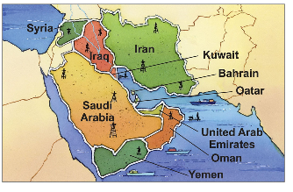
24.1 Introduction:
Essential Question: How might having a valuable natural resource affect a region?
THE MIDDLE-EAST HAS SOME OF THE MOST OIL-RICHEST COUNTRIES IN THE WORLD. THEY EXPORT MILLIONS OF BARRELS OF OIL EACH YEAR. THE SALE OF THIS VALUABLE NATURAL RESOURCE HAS CHANGED LIFE IN THESE COUNTRIES DRAMITICALLY.

Slide 4
What are seven states that belong to the United Arab Emirates (UAE)?
AJMAN, ABU DHABI (capital), FUJAIRAH, RAS AL-KHAIMAH, SHARJAH, DUBAI & UMM AL-QUWAIN
A ________ is a political unit that controls a particular territory.
STATE

Slide 5
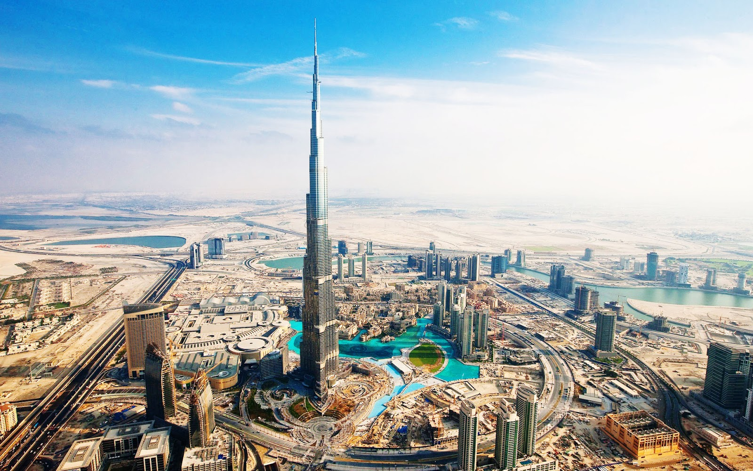
DUBAI HAS THE TALLEST STRUCTURE IN THE WORLD BURJ KHALIFA (DUBAI TOWER) AT 2,722 FEET!

Slide 6
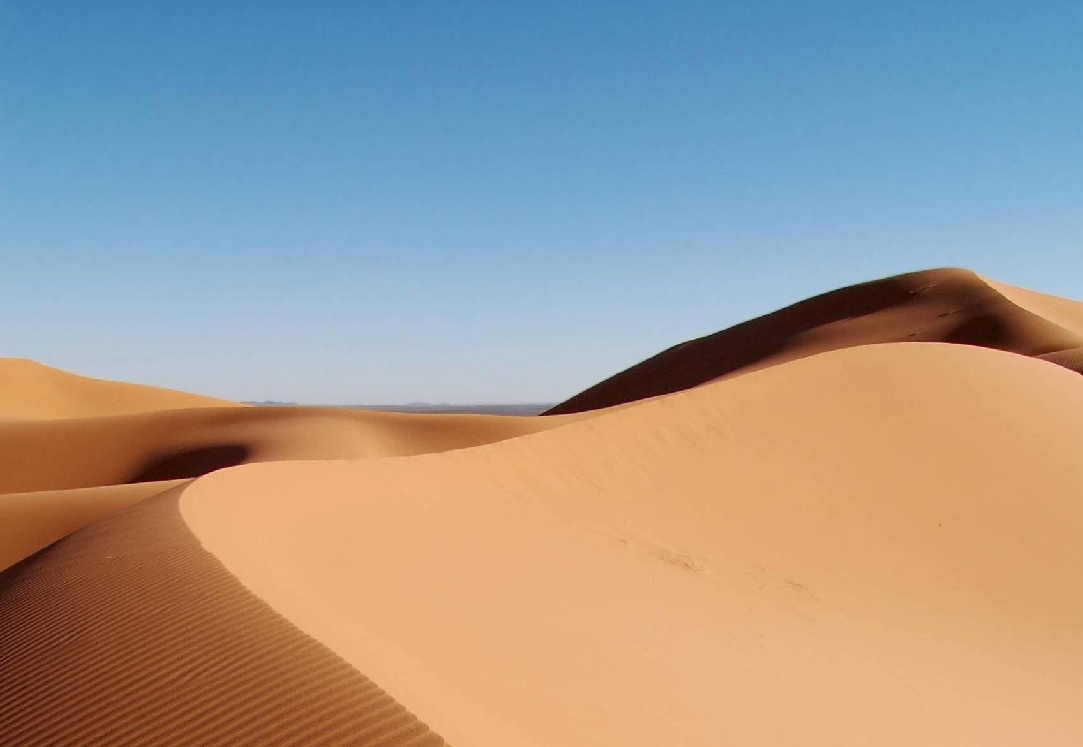
A person who wanders from place to place is a what?
NOMAD
A geographic region with too little rainfall to support much plant life is known as what?
DESERT

Slide 7
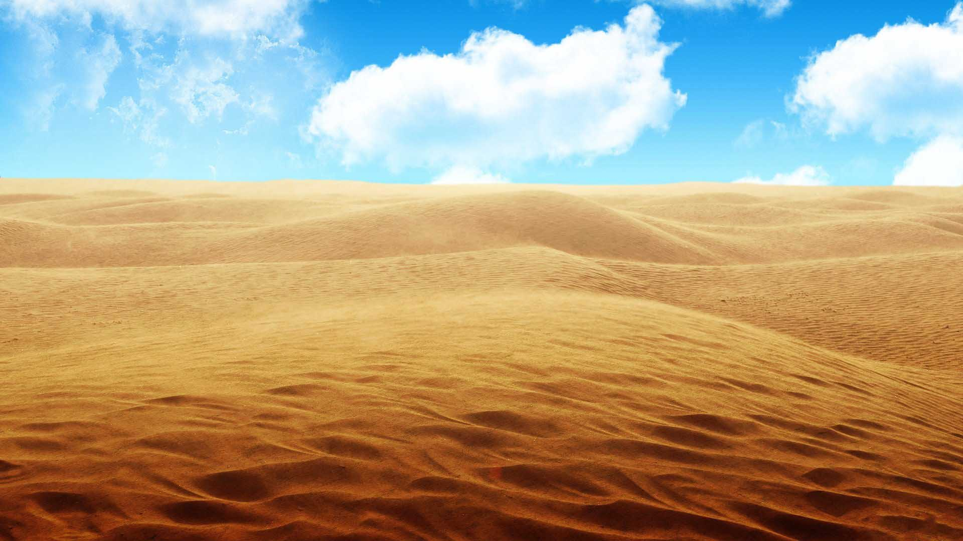
The largest desert in the Middle-East is what?
ARABIAN DESERT

Slide 8
What is oil that has been discovered but remains unused in the ground?
OIL RESERVES
An area defined by one or more natural or cultural characteristics that set it apart from other areas is a what?
REGION

Slide 9
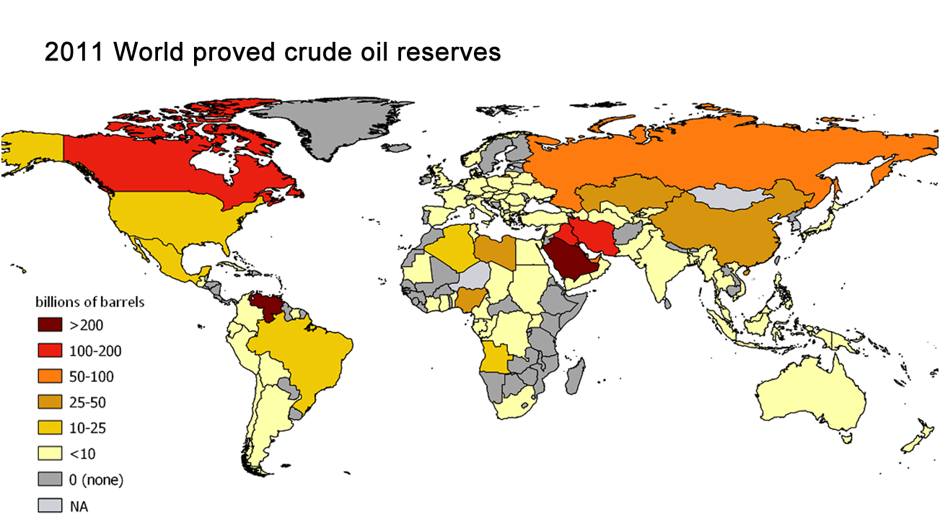
______________ reserves have a 90% chance of oil being extracted while _____________ reserves belief oil is available, but extraction is uncertain.
PROVEN
UNPROVEN

Slide 10
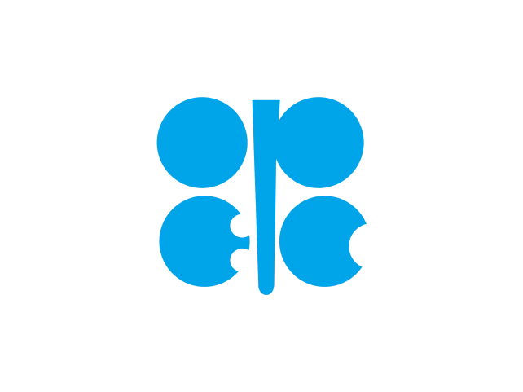
The Organization of the Petroleum Exporting Countries (OPEC) was founded in Baghdad, Iraq, in 1960 to help control the world’s oil supplies.
Current members are Algeria, Angola, Ecuador, Equatorial Guinea, Gabon, Iran, Iraq, Kuwait, Libya, Nigeria, Qatar, Saudi Arabia, United Arab Emirates (UAE) & Venezuela (14 members).
https://www.youtube.com/watch?v=Uti2niW2BRA

Slide 11
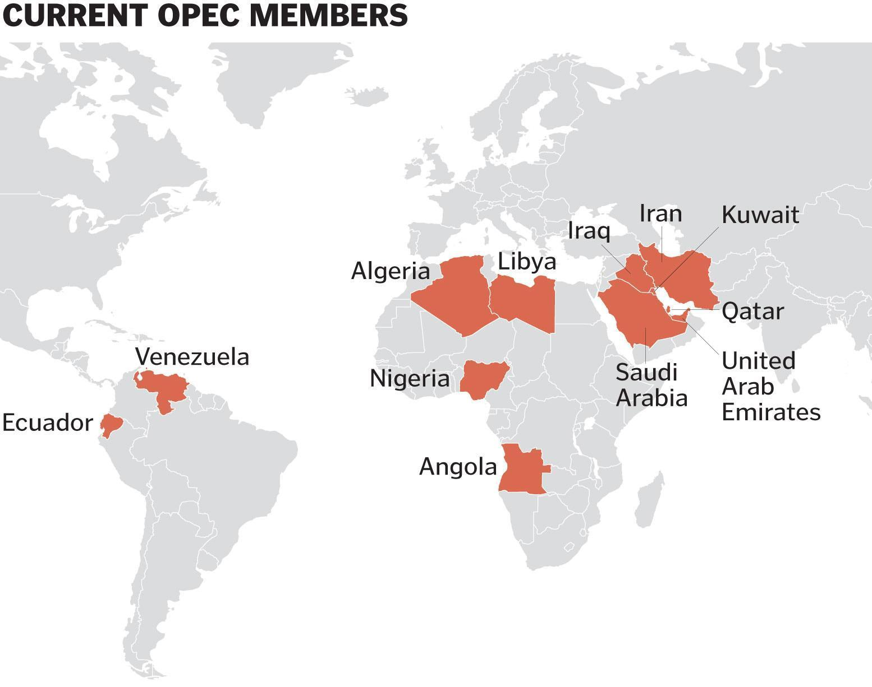
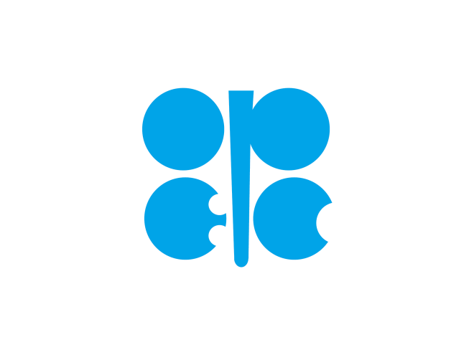

Slide 12
What is Fracking?
Fracking is the process of drilling down into the Earth before a high-pressure water mixture is directed at the rock to release the gas inside.
But why is it so controversial?

Slide 13
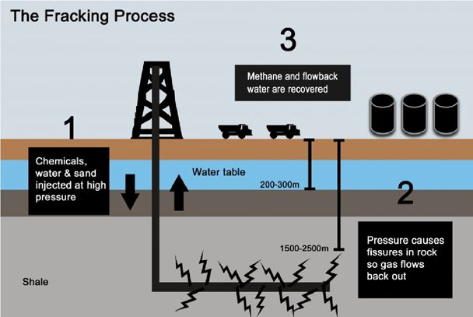
https://www.youtube.com/watch?v=LqdkqCj5xf8

Slide 14
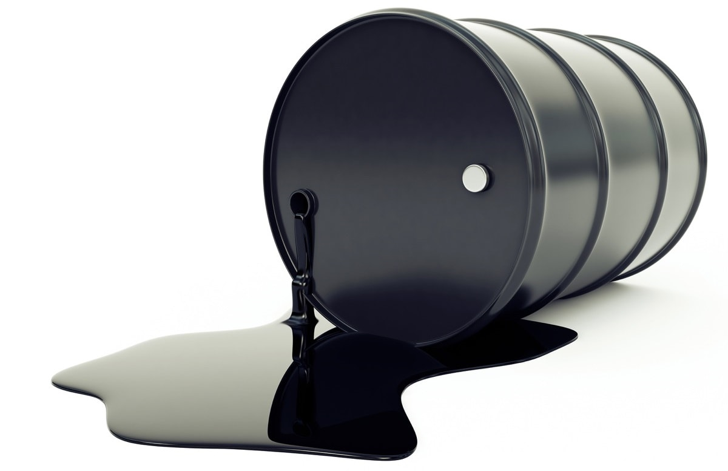
24.2 The Geographic Setting:
Petroleum as it comes out of the ground and before it has been refined or processed into useful products is called what?
CRUDE
OIL

Slide 15
What are the Requirements of a Developed Country?
BOTH BIRTH RATES & DEATH RATES ARE LOW
MORE URBAN & INDUSTRIAL, LESS ARGRICULUTURAL
HIGHER LIFE EXPECTACY
MORE MONEY, MORE EDUCATION & BETTER HEALTH CARE
THE U.S., JAPAN, UNITED KINGDOM, ITALY, & GERMANY

Slide 16
What are the Requirements for a Developing Country?
DEATH RATES HAVE DECREASED BUT BIRTH RATES REAMIN HIGH
IMPROVEMENTS IN EDUCATION & HEALTH CARE
BETTER FOOD PRODUCTION & DISTRUBUTION
MORE ADVANCEMENTS IN TECHNOLOGY
RAPID GROWTH OF URBANIZATION
CHINA, MEXICO, INDIA, IRAN & SAUDIA ARABIA ARE EXAMPLES

Slide 17
Are resources that are used faster than can not be replaced by natural processes is called what?
Are resources that can be replaced by natural process in a relatively short period of time are called what?
NON-RENEWABLE RESOURCES
RENEWABLE RESOURCES

Slide 18
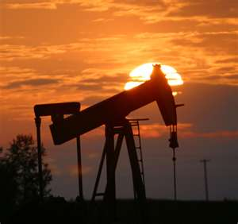
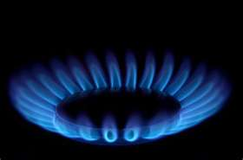
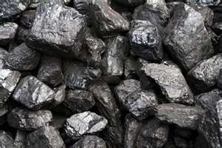
Examples of Non-Renewable Resources are called FOSSIL FUELS; what are the three of them?
COAL
OIL (53 BILLION BARRELS PER YEAR)
NATURAL GAS

Slide 19
What are the five main Renewable Resources?
1. SUN (SOLAR)
2. WATER (HYDROELECTRIC)
3. WIND
4. GEOTHERMAL
5. BIOMASS

Slide 20
A group of people in a country who share a unique culture and identity is a what?
ETHNIC GROUPS

Slide 21
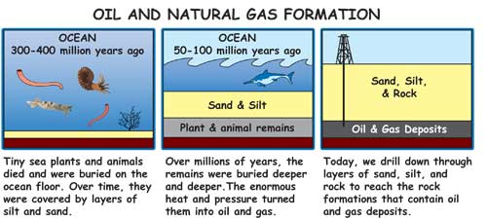
24.3 The Geology & Geography of Oil:
A type of rock that does not allow liquid or gas to flow through it is called what?
IMPERMABLE ROCK

Slide 22
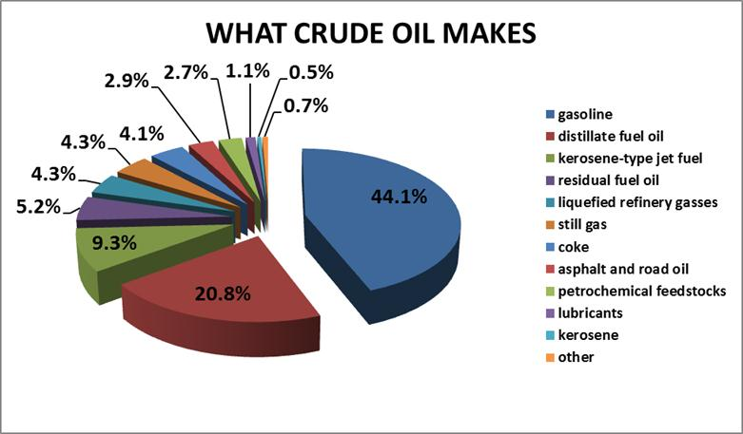

Slide 23
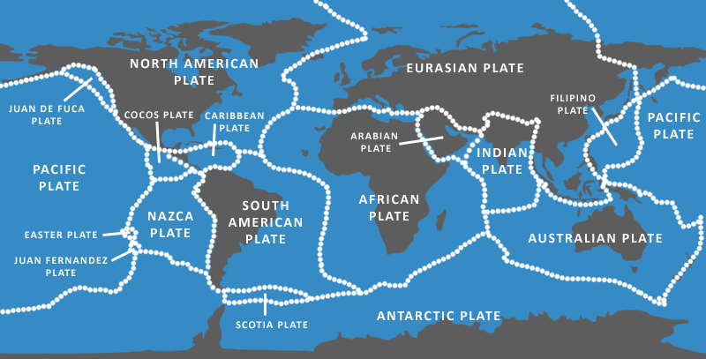
What theory states that the Earth’s surface is made of rigid slabs of rock that move with respect to each other?
PLATE TECTONICS

Slide 24
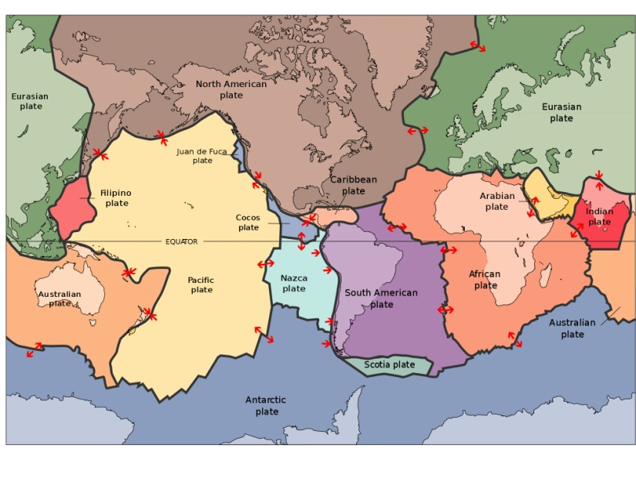
What is the tectonic plate that the Middle-East is located in?
What tectonic plate is Michigan in?
ARABIAN PLATE
NORTH AMERICA
PLATE

Slide 25
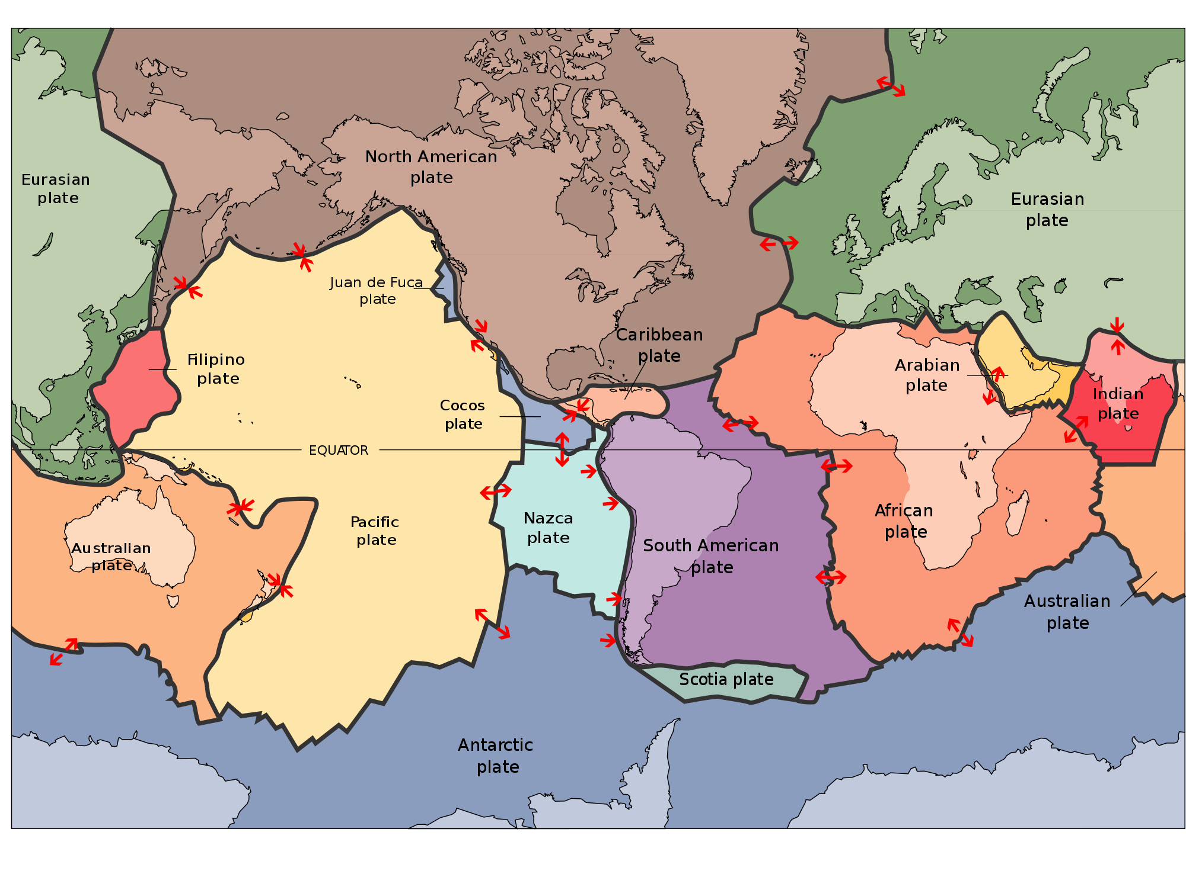

Slide 26
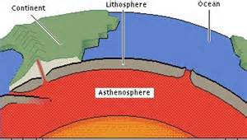
The cold & outermost rock layer is called what?
LITHOSPHERE

Slide 27
The way people or things are spread out over an area or a space; also the way resources, power, or goods are divided among people & groups is referred to as what?
DISTRIBUTION

Slide 28
Overall Countries with the Most Oil Reserves, 2013 | Southwest Asian Countries with the Most Oil Reserves, 2007
Venezuela | Saudi Arabia
Saudi Arabia | Iran
Canada | Iraq
Iran | Kuwait
Iraq | United Arab Emirates
Kuwait | Qatar
United Arab Emirates | Oman
Russia | Yemen
Libya | Syria
Nigeria | Bahrain

Slide 29
24.4 Oil Wealth & People’s Well-Being
The average age to which a person in a given population can expect to live; this varies from one country to another is known as what?
LIFE EXPECTANCY

Slide 30
Countries with the Highest Life Expectancies | Countries with the Lowest Life Expectancies
Japan -82.12 | Swaziland -31.99
Australia -81.63 | Angola -38.20
Canada -81.23 | Zambia -38.63
France -80.98 | Lesotho -40.38
Sweden -80.96 | Mozambique -41.18
Switzerland -80.85 | Sierra Leone -41.24
Israel -80.73 | Liberia -41.84
Iceland -80.67 | Djibouti -43.37
New Zealand -80.36 | Afghanistan -43.81
Italy -80.20 | Central African Republic -44.47
*United States -78.11

Slide 31
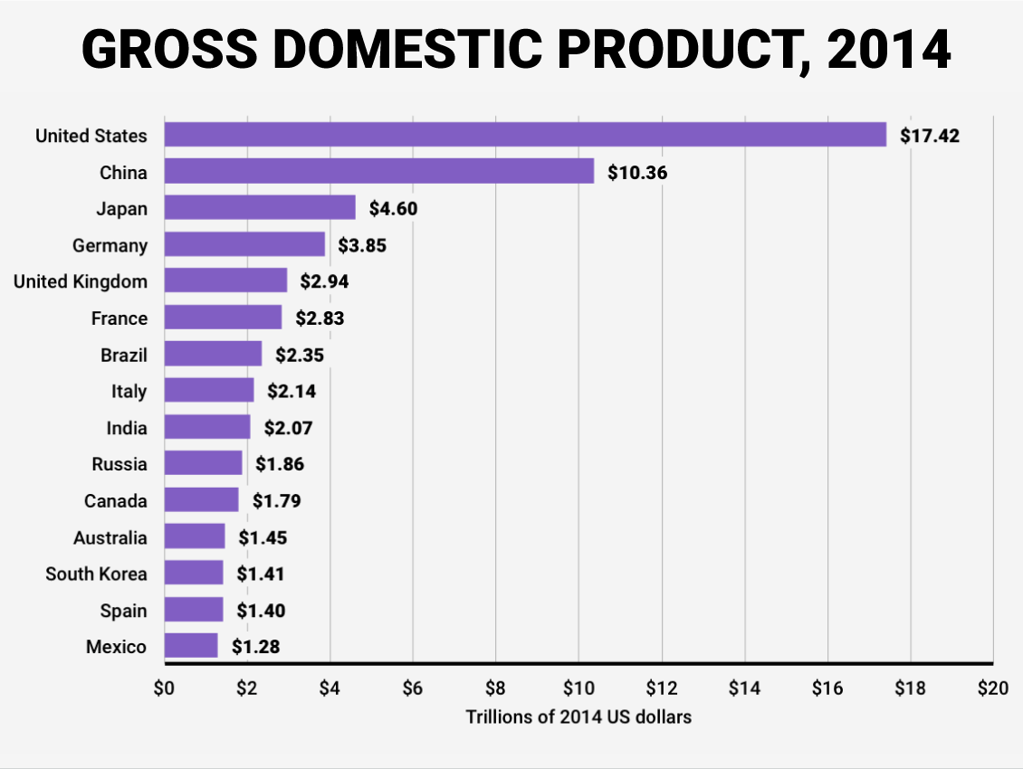
Total value of all the goods & services produced in a country in a year is called what?
GROSS DOMESTIC PRODUCT (GDP)

Slide 32
By or for each person a figure is calculated by dividing the total amount of something by the number of people in a place is known as what?
PER CAPITA

Slide 33
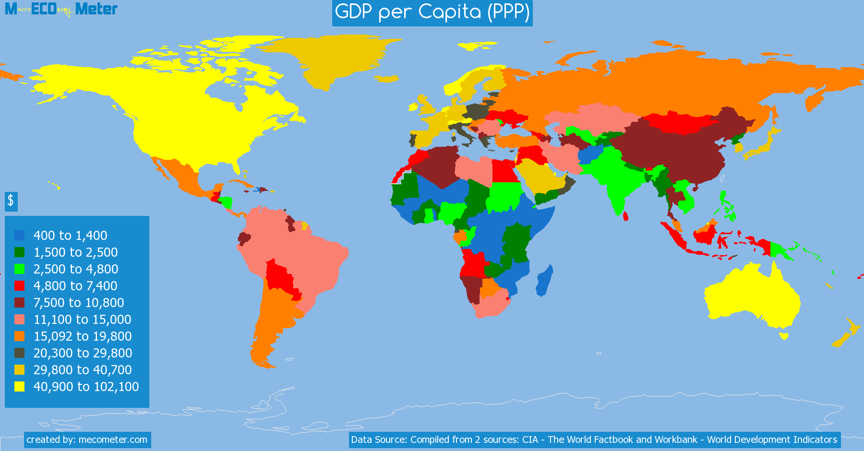
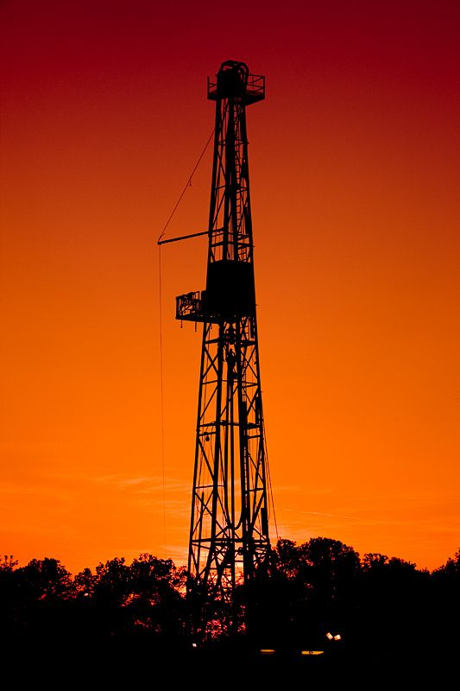
How does the GDP in the United States & Canada compare to the countries within the Middle-East?
What resource makes the Middle-East the most money? And is that money distributed evenly within all those countries?

Slide 34

Another tool to measure how well people are living is the United Nation’s Human Development Index (HDI); it looks at a country’s per capita GDP with other factors that reflect quality of life; such as life expectancy, education, health care & the infant mortality rate.

Slide 35
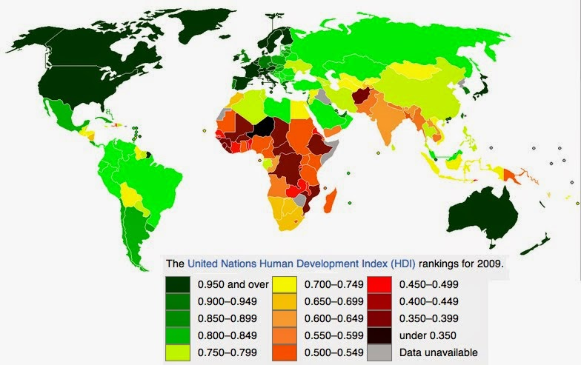


Slide 36
The number of infants (babies), out of every 1,000 babies born in a particular year who die before reaching age 1 is known as what?
INFANT MORTALITY RATE
Third Word Countries such as Afghanistan, Somalia, Nigeria & Sierra Leone have some of the highest infant mortality rates in the world.

Slide 37
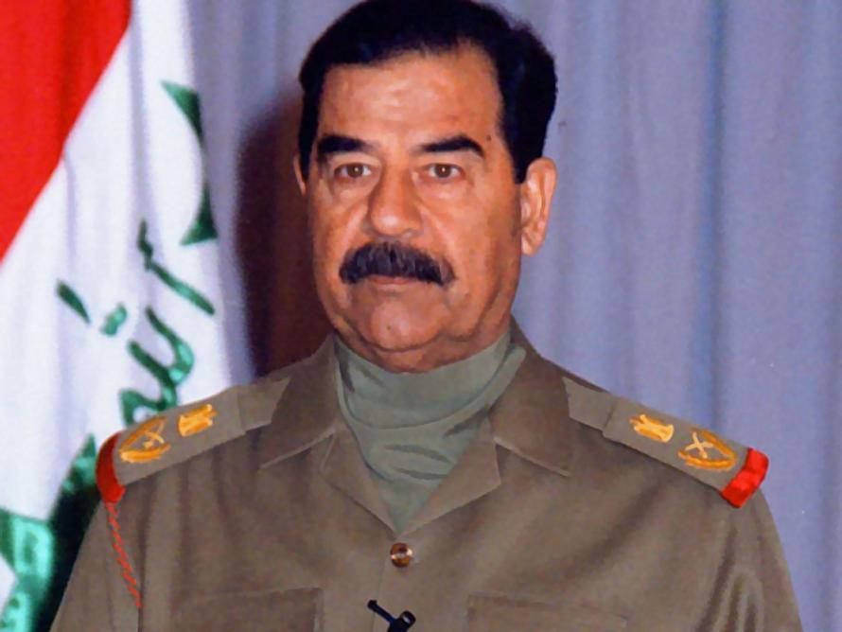
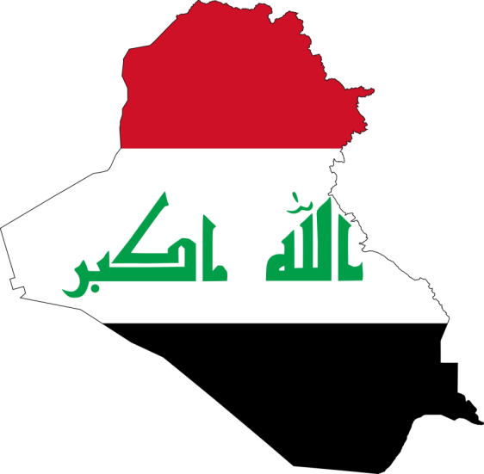
Iraq has the fifth-largest oil reserve in the world, but from 1979 to 2003, a dictator named _________________ controlled Iraq’s oil income & spent most of Iraq’s money building an army, buying weapons & fighting wars.
SADDAM HUSSEIN

Slide 38
24.5 The Price & Flow of Oil:
PERSIAN GULF WAR
The _____________________ (August 2, 1990-February 28, 1991), codenamed Operation Desert Shield for operations leading to the buildup of troops & defense of Saudi Arabia & Operation Desert Storm in its combat phase, was a war waged by coalition forces from ____ nations led by the U.S. against Iraq in response to Iraq's invasion of __________ by Saddam Hussein.
35
KUWAIT

Slide 39
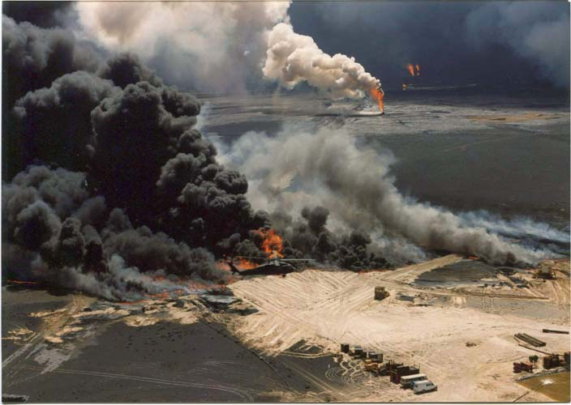

Slide 40
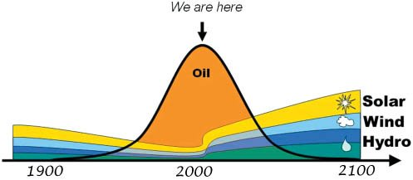
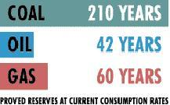
24.6 Beginning to Think Globally:
Eventually, the world will run out of oil, some countries are already meeting some of their needs with renewable resources such as what?

Slide 41
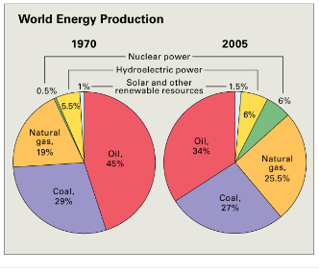
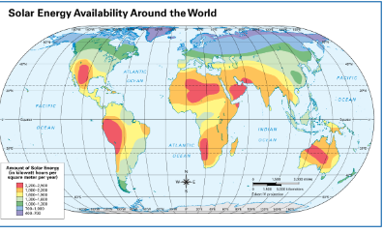
24.7 Global Connections:
What energy sources is the world using to meet most of the energy needs?

Slide 42
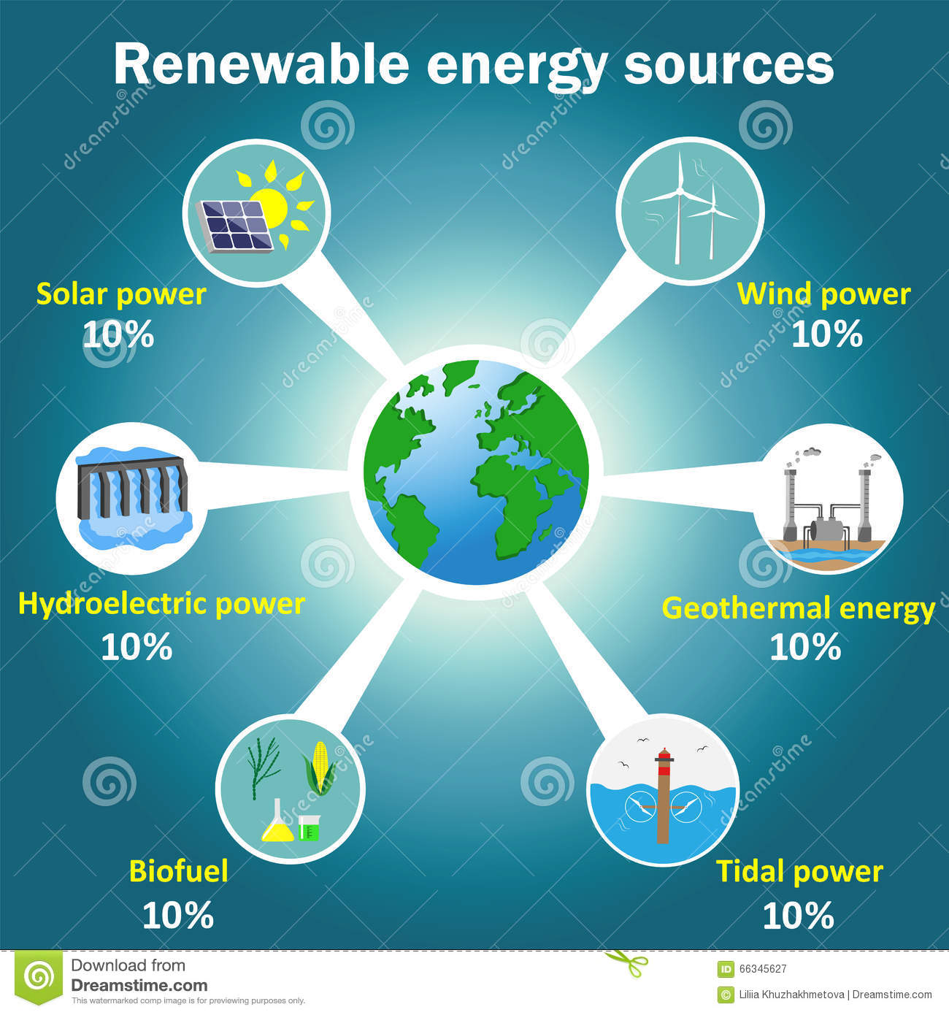
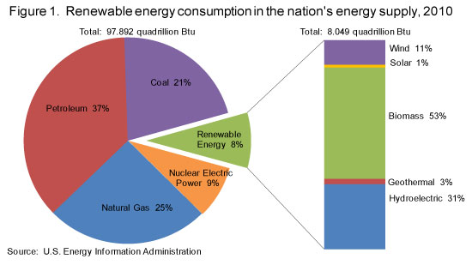
How might having renewable energy resources affect a region in the future?

Slide 43
