Slide 1
THE HUMAN BODY: The Skeletal & Muscular Organ Systems

Slide 2
The Skeletal System provides five major functions which are…
1. SHAPE & SUPPORT
2. ENABLES YOU TO MOVE 3. PROTECTS YOUR INTERNAL ORGANS 4. PRODUCES BLOOD CELLS & 5. STORES CERTAIN MATERIALS UNTIL YOUR BODY NEEDS THEM.

Slide 3
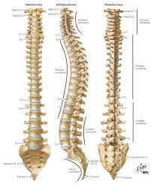
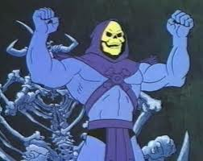
The 26 bones that make up the center of your back is called your what?
VERTEBRATE (BACKBONE)

Slide 4
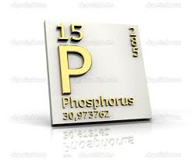
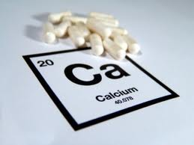
The word skeleton actually comes from a Greek word meaning “a dried body.” Bones are made up of two main minerals; which are what?

Slide 5
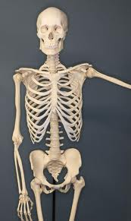
How Many Bones Does the Human Body Have?
Approximately 206 bones, however a new born has 275, as the human body grows the bones fuse together.

Slide 6
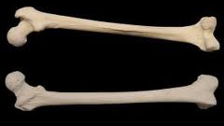
Of all 206 bones in the human body which one is the biggest?
FEMUR

Slide 7
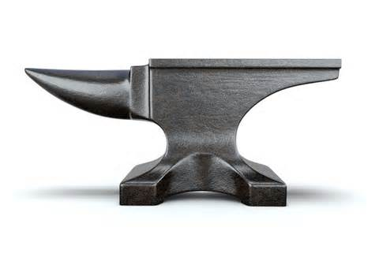
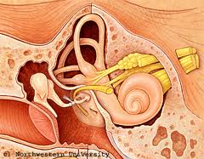
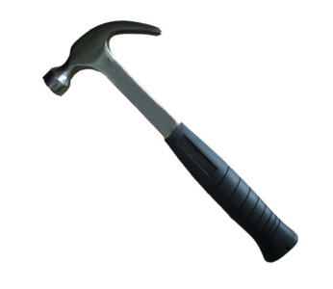
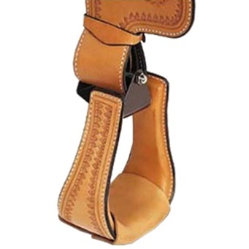
Behind the eardrum is an area called the middle-ear it contains the three smallest bones in the human body – the __________, the __________ & the __________.
ANVIL
HAMMER
STIRRUP
ANVIL
HAMMER
STIRRUP

Slide 8
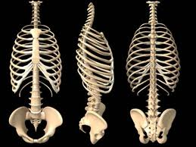
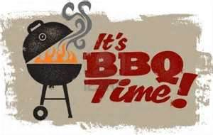
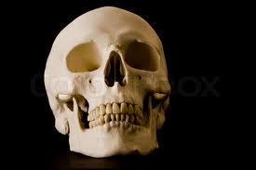
What bones protect the lungs & inner organs? What bone protects your brain?
RIBS
YOUR SKULL

Slide 9
The spaces in bones that contain a soft connective tissue called what?
MARROW
There are two types of marrow:
Red & Yellow.
Red Marrow produces Red Blood Cells & Yellow Marrow stores fat, which serves as an energy reserve.

Slide 10
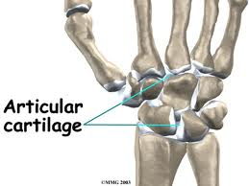
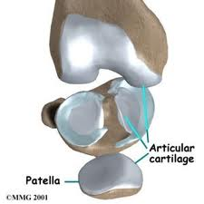
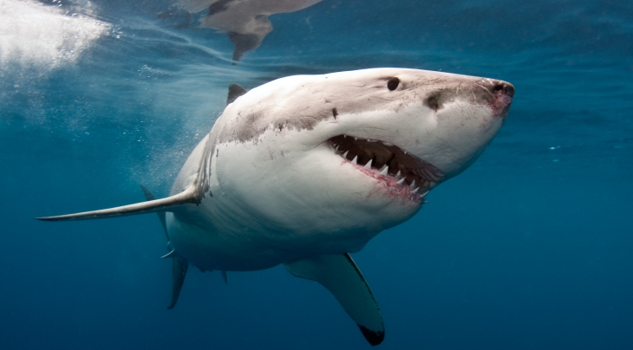
A connective tissue that is softer than bone, but flexible & strong is called what? To feel it touch your nose & ears.
CARTILAGE

Slide 11
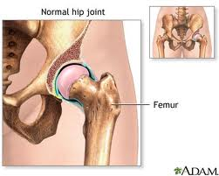
A place in the body where two bones come together & enable movement is a what?
JOINT
Movable joints allow the body to make a wide range of movements, there are four types of joints: ball-and-socket, pivot, hinge, & gliding.

Slide 12
Bones are organs that contain two types of tissue. _________________ is the hard outer layer of the bone. _______________ is the interior region of bone that contains many tiny holes.
COMPACT BONE
SPONGY BONE

Slide 13
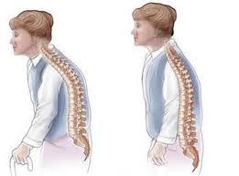
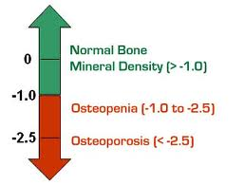
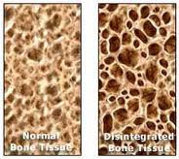
As people become older, their bones begin to lose some of the minerals they contain. Mineral lose can lead to _______________, a condition in which the body’s bones become weak & break easily.
OSTEOPOROSIS

Slide 14
There are a total about how many Muscles in the Human Body?
200?
…NOPE!
300?
…THAT’S NOT RIGHT EITHER.
HOW DOES 400 SOUND?
STILL A LITTLE SHORT.
“THERE IS ABOUT 600 MUSCLES IN THE BODY!!”

Slide 15
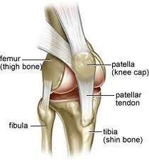
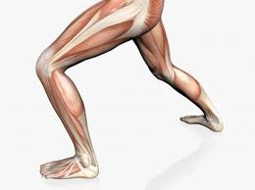
The bones in movable joints are held together by strong connective tissues called what?
LIGAMENTS

Slide 16
Muscles that are not under your conscious control are _______________ muscles & muscles that are under your control are called ___________ muscles.
INVOLUNTARY
VOLUNTARY
Your body has three types of muscle tissue & they are what?
1. SKELETAL MUSCLE, 2. SMOOTH MUSCLE, & 3. CARDIAC MUSCLE

Slide 17
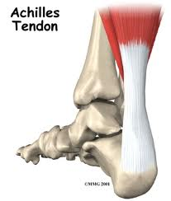
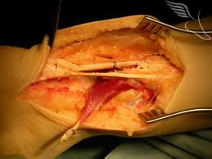
What is a strong connective tissue that attaches muscle to bone?
TENDON

Slide 18
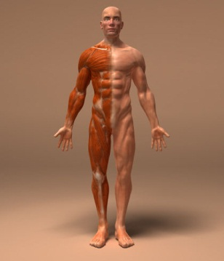
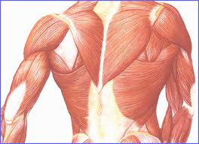
What type of voluntary muscles are attached to the bones of your skeleton? These muscles provide the force that moves your bones.
SKELETAL MUSCLES

Slide 19
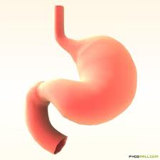
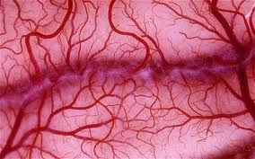
What type of involuntary muscles are inside many of the internal organs of the body, such as walls of the stomach & blood vessels?
SMOOTH MUSCLES

Slide 20
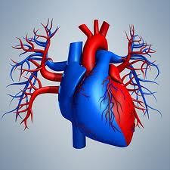
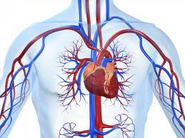
What type of involuntary muscle, is similar to smooth muscles but never gets tired & continuously has contractions?
CARDIAC MUSCLES

Slide 21
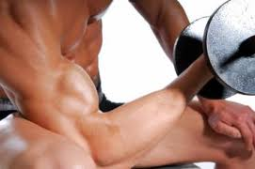
Muscles can only ____________ when they receive messages from the nervous system, not extend. While one muscle contracts, the other muscle in the pair returns to its original length or relaxes.
CONTRACT

