Slide 1
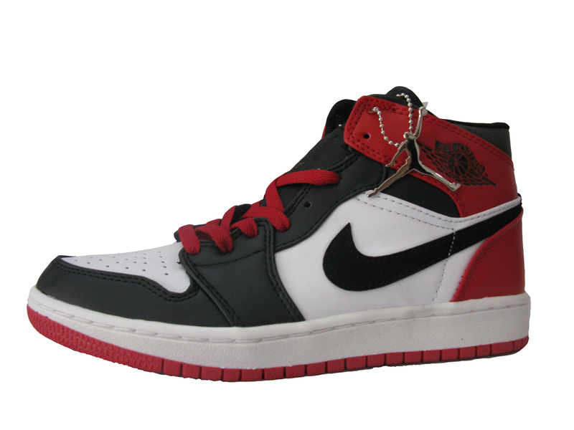
Chapter 32: The Global Sneaker-From Asia to Everywhere
WHY ARE SNEAKERS SO EXPENSIVE?
THE ORIGINAL AIR JORDAN I (1985)
$65.00
NOW WORTH AS MUCH AS $2,000

Slide 2
BELLWORK:
1. How many pairs of “sneakers” do you own?
2. What’s the most you ever paid for a pair of “sneakers”? What other necessary item could you have purchased instead?
3. Do you purchase “sneakers” because you NEED them or WANT them? Why do you buy certain name brands?
4. Describe the “sneaker” obsession in one word.
Watch the SNEAKERHEADS video & discuss.
5. How have America’s views about “sneakers” changed?

Slide 3
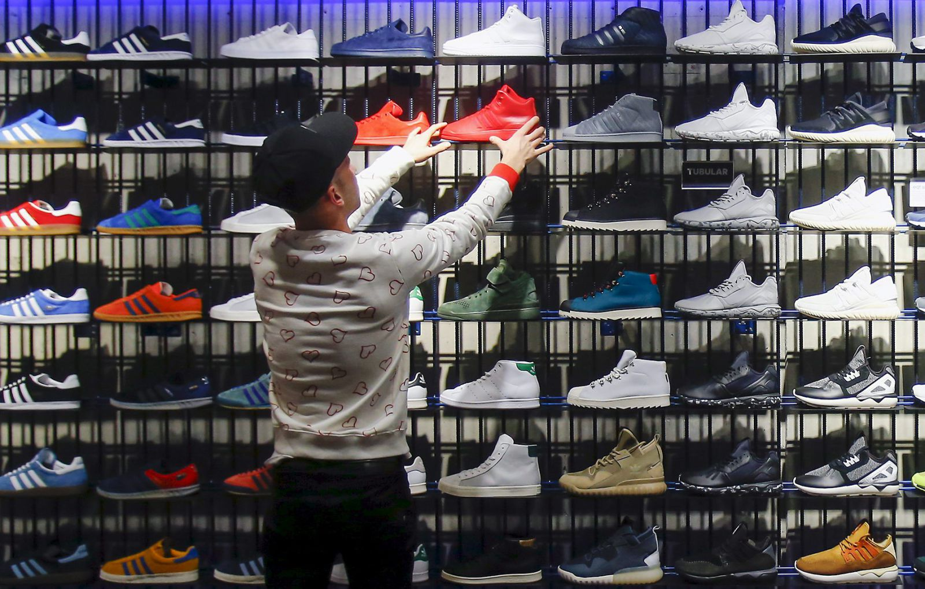
Essential Question:
What is globalization & how does it affect people & places?

Slide 4
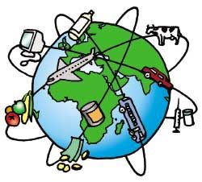
What is Globalization?
Discuss with your elbow partner the meaning of globalization. Be prepared to share your definition.

Slide 5
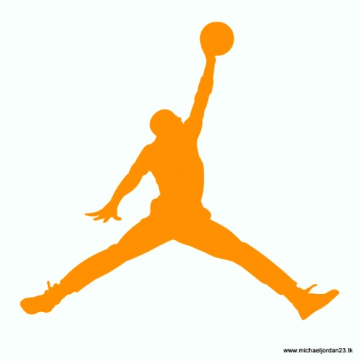
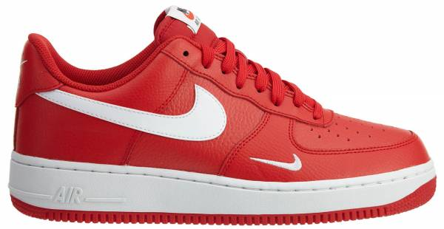
Globalization: the development of a global, or worldwide, society. In a global society, people, money, information & goods flow fairly freely across national borders.
In this chapter you will look at one common manufactured
product that has become globalized….
Watch the Globalization Video:
THE SNEAKER!

Slide 6
What is globalization & how does it affect people & places?
Americans buy goods from all over the world because of globalization; this is the development of a global, or worldwide, society in which people, money, information & goods flow fairly across national borders.
Can you think of any products that have global appeal?

Slide 7
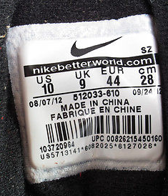
Partner Read 32.1 Introduction
Page 455.
How has manufacturing & the location changed over time?
2. What does this say about our world?
Working with your reading partner, create a T-Chart. List their brand/type of shoe & where it was made. Example: Nike sneakers – China, Timberland Boots – Dominican Republic, etc.
Go around the room & record the information
From other pairs onto your chart.
You have 7 minutes.

Slide 8
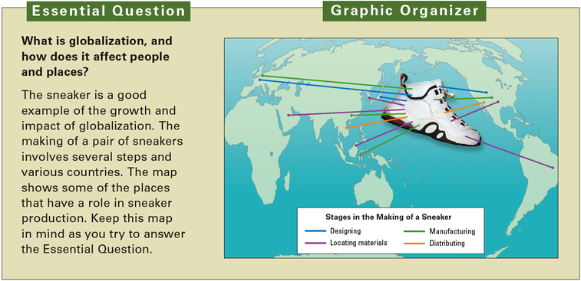
TIME’S UP!
1. How many products are from the U.S.?
2. How many are from Asia or other countries?
3. How might this affect people & places?
4. Share your thoughts and/or questions.
What do you notice? Does it support your T-Chart?

Slide 9
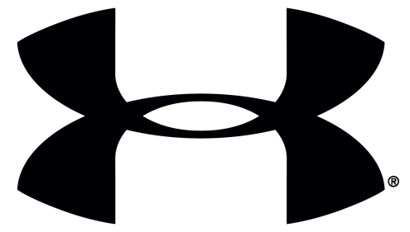
Can you name this iconic sneaker logos?

Slide 10
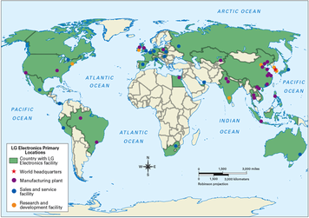
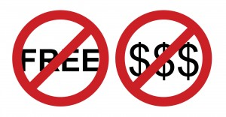
32.2 The Geographic Setting page 456
The region of the world, including countries like China, South Korea & Japan that have dominated in manufacturing & trade is ASIA!
The flow of goods and services across national borders with few
Government is called what?
FREETRADE
Trade is not actually free.
Countries impose taxes or
________ on goods imported.
Remember export vs. import?
TARIFFS

Slide 11
Create an illustrated dictionary for this chapter.
Do the Geoterms on p. 457 & add the terms tariffs, distribution, consumption & region.
Fold a sheet of loose leaf so that you have 4 squares
In each box write the term and create an illustration or symbol for the term
Write the definition of each term in your own words
Write a sentence that includes the term and the word “Asia” for the geoterms only.

Slide 12
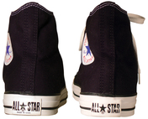
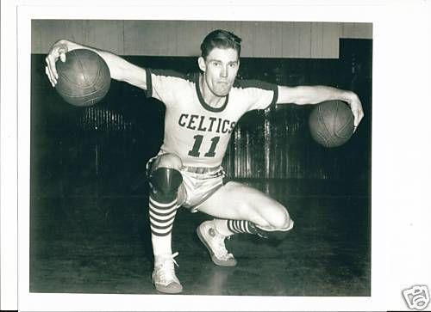
What’s the Difference? (page 456)
Share the story behind
Converse
Partner with someone that
has the same color top as you.
Partner read Section 2 & complete Section 32.2 of the interactive notes packet.

Slide 13
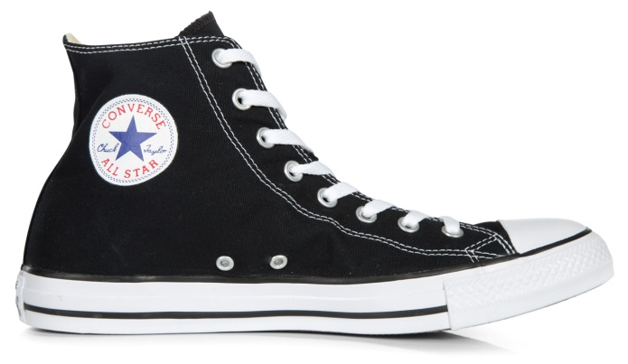
Converse Rubber Shoe Company & Chuck Taylor agreed to the first sneaker contract on June 14th, 1923. Taylor’s signature still remains on that iconic sneaker design 90 years later! The original shoe only cost $1.00. Since then, countless athletes, musicians & movie stars have worn “All-Stars.” It is estimated that 60% of all Americans will own at least one pair of “Chucks” in their lifetime.

Slide 14
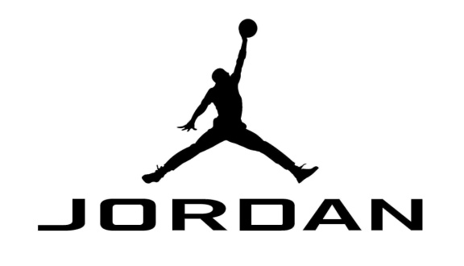
After some convincing from Nike CEO ,Phil Knight, Michael Jordan opted to sign with Nike instead of Adidas. In 1985 the Jordan I was released in red & black to match the Chicago Bulls uniform. The color scheme was banned by NBA Commissioner, David Stern, for failing to meet league uniform rules..

Slide 15
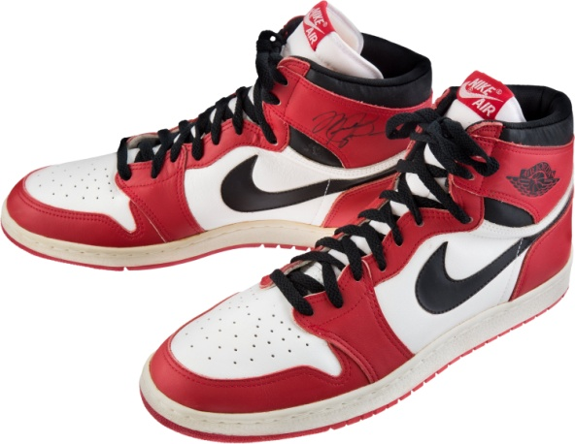
However, Jordan continued to wear the shoes during games & was consequently fined each time for doing so. Nike paid the fines for MJ, nicknamed the shoes “Banned” even crafted an endorsement strategy around the shoe banning. The Jordan I went on to sell over $130 million that season & MJ went on to become the greatest basketball player ever & the “Jumpman” logo is known around the globe.

Slide 16
How did Michael Jordan & Nike changed the sneaker industry?

Slide 17
Recently, University of Michigan became the first college football program ever to be outfitted by Nike's Jordan Brand subsidiary, exchanging the swoosh for the "Jumpman" logo in 2015. Michigan signed a record contract with Nike for a whopping 15-year deal worth $169 million -- the largest apparel deal for a college program ever!

Slide 18
In 2018, do you think Nike overpaid Michigan & was it worth it?

Slide 19
Globalization affects every country in the world, but what region is most involved?
ASIA
REGION
A ____________ is an area defined by one or more natural or cultural characteristics that set it apart from other areas.

Slide 20
What is the flow of goods & services across national borders, with little or no government?
FREE TRADE
A tax on goods that cross country borders is called a what?
TARIFF

Slide 21
In 1947, the United States & 22 other countries signed the General Agreement on Tariffs & Trade (GATT) .
They agreed to reduce tariffs & other trade barriers.
This led to the World Trade Organization (WTO) which also works to reduce trade barriers. By 2008 WTO had 153 member countries.
Today we have North American Free Trade Agreement (NAFTA).
Watch NAFTA explained.

Slide 22
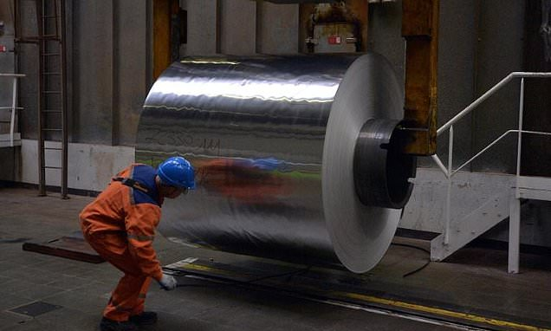
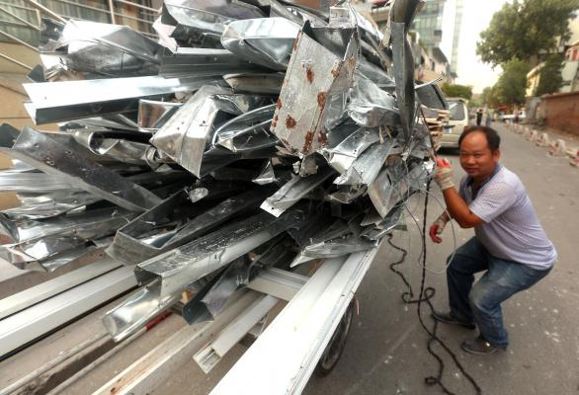
President Donald Trump recently announced a proposed 25% tariff on steel & a 10% tariff. What does this mean?
About one-third of the 100 million tons of steel used each year by American business is imported, while imports account for more than 90% of the 5.5 million tons of aluminum used by U.S. companies.

Slide 23
Total value of all the goods & services produced in a country in a year is called what? A product or resource sold to another country is called a what? A product or resource that comes into a country is called what?
GROSS DOMESTIC PRODUCT (GDP)
EXPORT
IMPORT

Slide 24
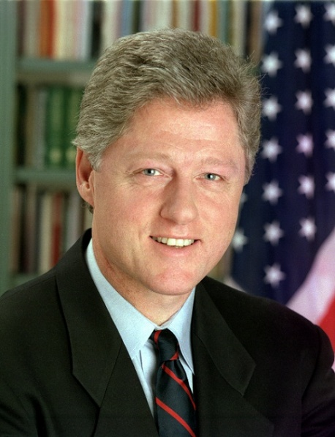
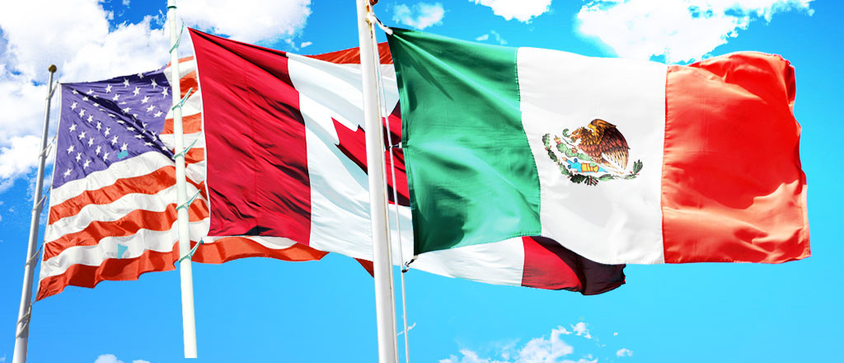
This was signed in 1992 promotes trade with Canada, United States & Mexico.
NORTH AMERICAN FREE TRADE AGREEMENT (NAFTA)

Slide 25
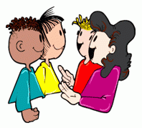
Firms that operate in more than one country are
called multinational corporations
Look at the map on page 457.
Discuss the questions below with your table partners.
Where is LG’s headquarters?
How many countries have LG facilities? List them.
Do you own any LG products?
How would your rate them?

Slide 26
LG is an example of a Multinational Corporation

Slide 27
A large company that has operations in more than one country is called what?
MULTINATIONAL CORPORATION
Nike, Inc., Apple, Google, Nintendo, Sony, Ford Motor Company, LG, Samsung, Uber & PepsiCo., are all examples.

Slide 28
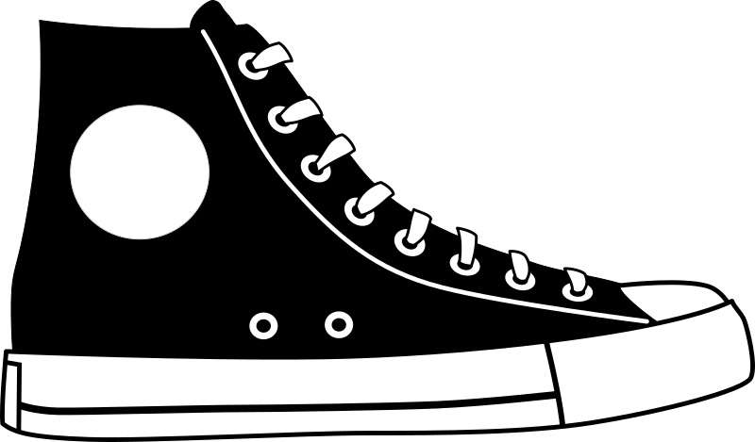
Globalization has brought growth to many developing
countries.
Trade between the United States & China is a good
Example of economic interdependence
Sneakers such as the Converse “Chuck All-Stars” were
once made in the U.S.
Now they are a part of a global process of design, raw
materials, manufacturing and distribution called
distribution

Slide 29
A condition in which countries have strong economic ties & depend on each other for resources, technology, trade & investment is what?
ECONOMIC
INTERDEPENCE

Slide 30
The way people or things are spread out over an area or a space; also the way resources, power, or goods are divided among people & groups is referred to as what?
DISTRIBUTION

Slide 31
The using up of goods & services; also the purchase and use of goods & services by consumers is what?
CONSUMPTION

Slide 33
32.3 Designing a Global Sneaker page 458
1. What are the many names for sneakers?
2. How & when did they become known as sneakers?
Read section 3 for yourself & complete the Interactive notes 32.3.
Watch Making Adidas video
Whole Class: Each student reads a sentence of 32.4 until done complete the interactive notes.

Slide 34
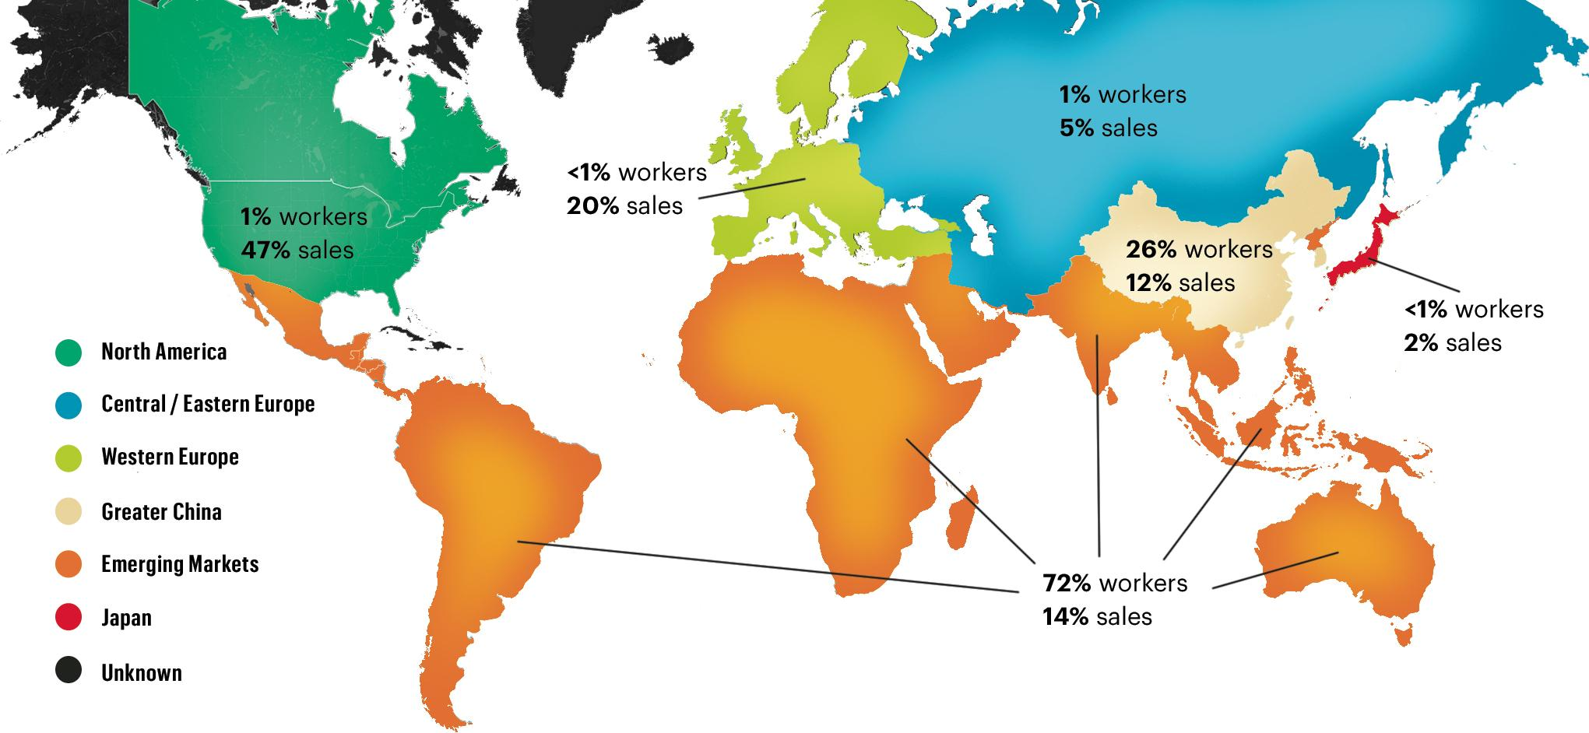
Where are Sneakers Manufactured?

Slide 35
A system that lets competition among business determine the price of products is called what?
FREE ENTERPRISE
A system in which businesses, industries & resources are privately owned is called what?
CAPITALISM

Slide 36
Supply & Demand: The most basic free enterprise principle, in which companies set prices that allow them to keep demand of the consumers high, while making the highest possible profit.

Slide 37
An investment by a person or company based in another country is called what?
FOREIGN
INVESTMENT

Slide 38
The Case for Globalization | The Case Against Globalization
Create new jobs Standard of living improves Companies that move production offshore can keep their costs low Countries that trade within one another improve their relationships & trust Allows us to share ideas, technology, music & art | Some countries lack laws to protect the environment such as dumping toxic wastes & releasing deadly fumes in the air Poor countries lack worker protection laws Low wages Child labor Working conditions in “sweatshops” are often unsafe, abusive & unhealthy Many Americans have lost their jobs

Slide 39
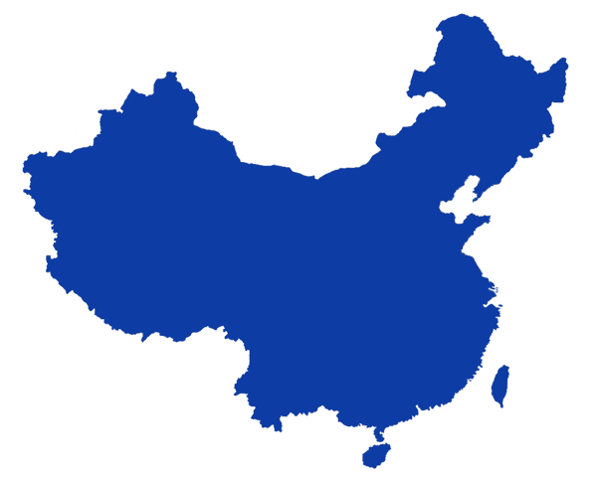
Which developed country has attracted the most investment money since 2007?
CHINA

Slide 40
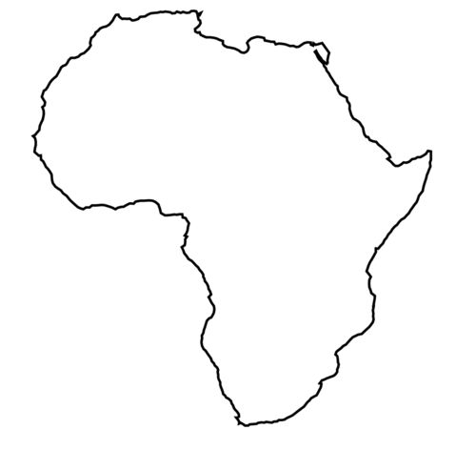
Which parts of the world attracted the least investment of money since 2007?
AFRICA

Slide 42
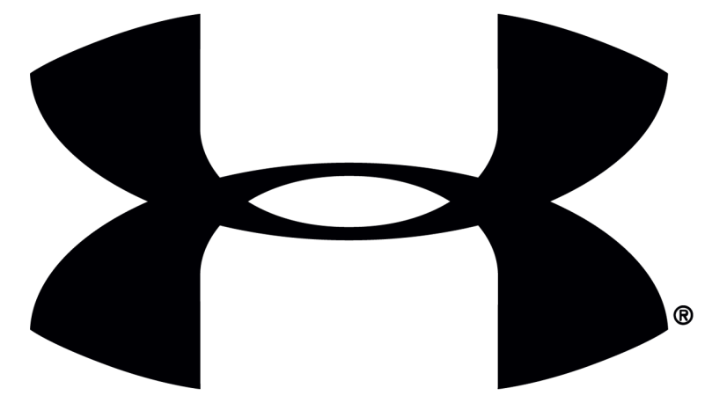
Golden State Warriors Stephen Curry got
$4 million a year from Under Armor for his endorsement which is almost twice the amount Nike offered him in 2015.

