Slide 1
Chapter 5: Urban Sprawl in North America: Where Will it End?

Slide 2
A developed area at the edge of a city that is mainly homes is called a what?
SUBURB
Developers create suburbs by buying up land outside a city & replace this open space with houses, shopping centers & office parks. Dearborn is one of many examples.

Slide 3
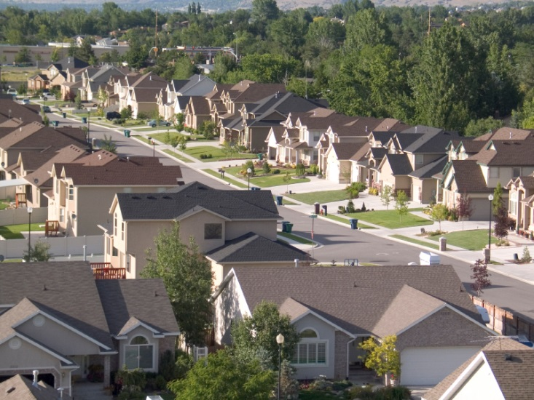

Slide 4
The rapid, often poorly planned spread of development from an urban area outward into rural areas is called a what?
URBAN SPRAWL
(MAJOR CITIES TEND TO GROW OR
SPREAD OUTWARD)

Slide 6
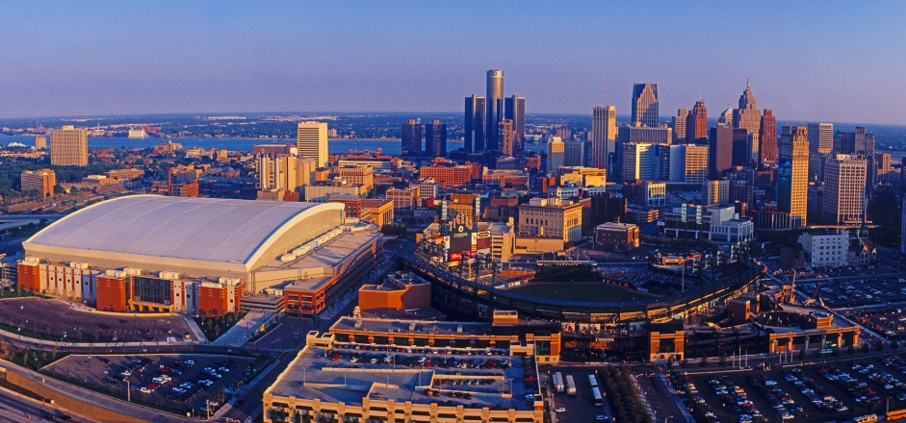
A major population center made up of a large city & the smaller suburbs & towns that surround it is called what?
METROPOLITAN AREA
Detroit, Los Angeles, New York, Toronto & Atlanta are cities are examples.

Slide 7
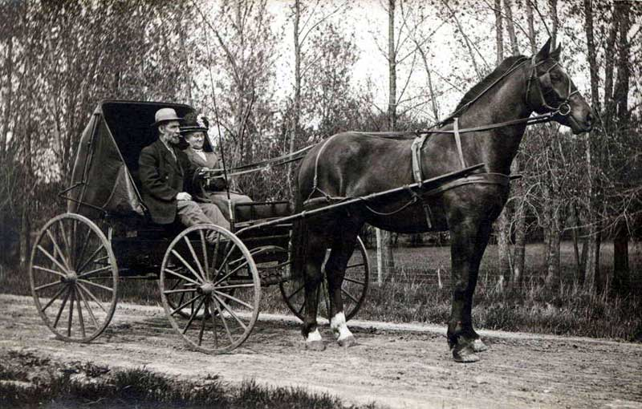
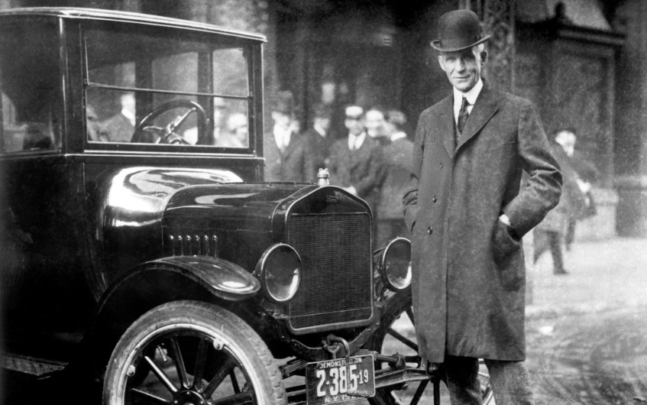
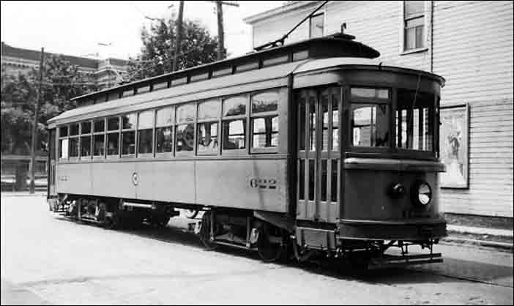
HORSE & BUGGY
STREETCAR
MODEL-T
AS CARS BECAME MORE COMMON, PEOPLE BEGAN TO BUILD NEW HOUSING AREAS FARTHER AWAY FROM THE URBAN CORE

Slide 8
The older part of a big city; often serves as the downtown or central business district of a city is called what?
URBAN CORE

Slide 9
The ring of a small towns & suburbs that surround a big city is known as a what?
URBAN FRINGE
Dearborn, Southfield, Hazel Park, Melvindale & Grosse Point are a few cities that surround Detroit.

Slide 10
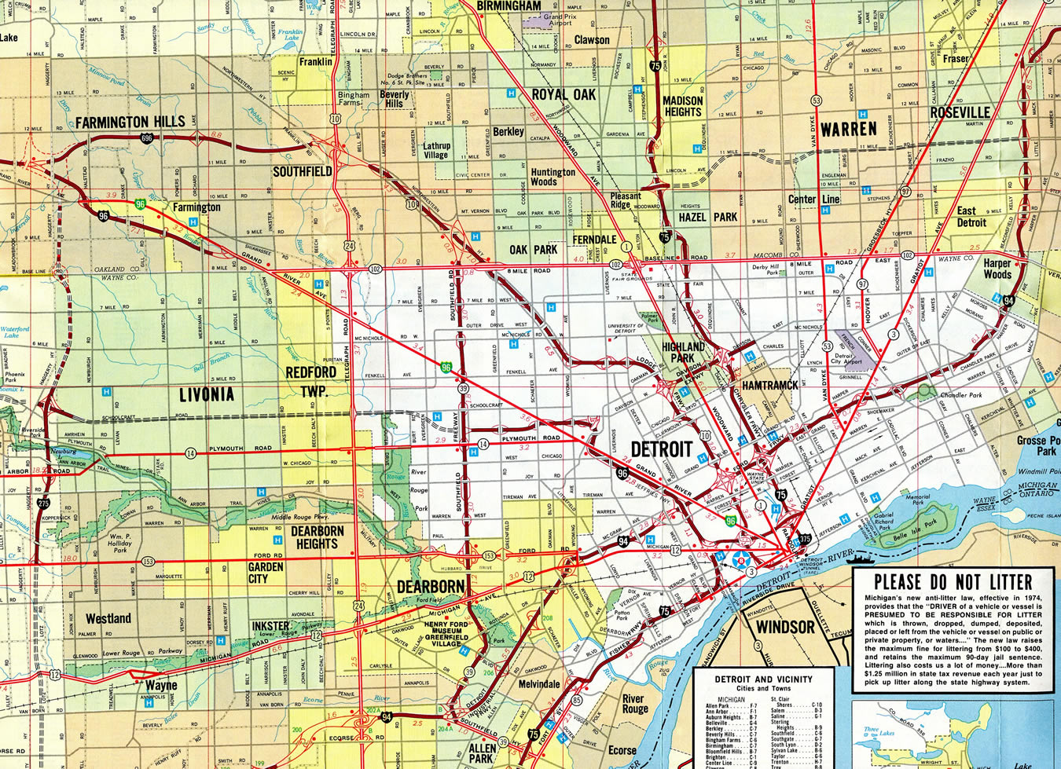

Slide 11
The small towns, farms & open spaces that lie just beyond a city’s suburbs & connected to cities by roads & highway is called the what?
RURAL
FRINGE

Slide 12
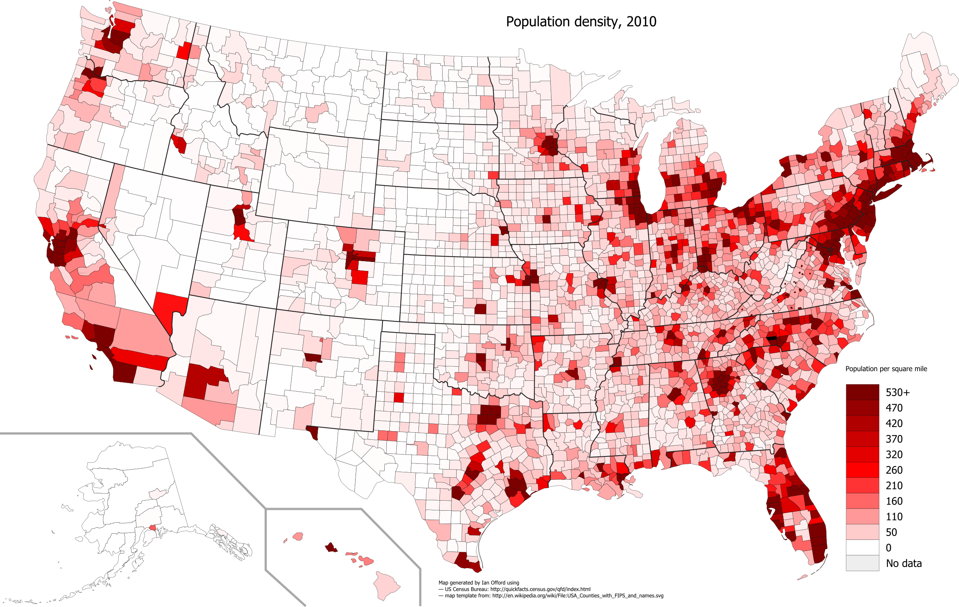

Slide 13
The natural environment in which a plant or animal lives is called its what?
HABITAT

Slide 14
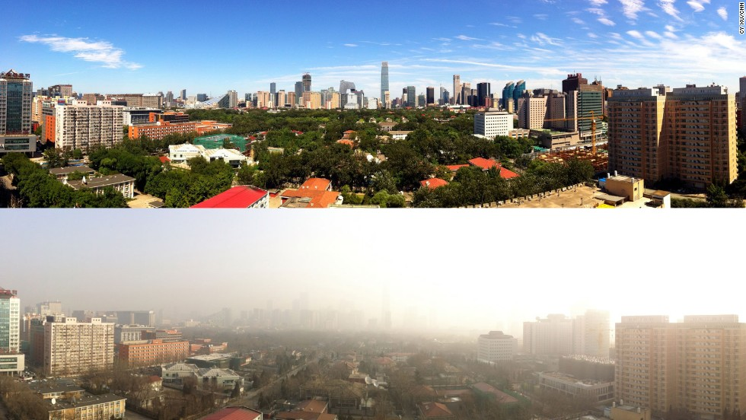
Damage to the natural environment caused by harmful substances is known as what?
POLLUTION
CHICAGO, ILLINOIS

Slide 15
Advantages of Urban Sprawl | Disadvantages of Urban Sprawl
*Land & building costs are cheaper *Houses then are more affordable *The belief is it is better to raise a family *More construction jobs *Helps local businesses *Taxes help fund roads, schools & other services | *Damage of the environment *Animal habitats are destroyed *Less trees & vegetation *More use of cars thus causing more air pollution *Taxes go up because of ongoing development within the city

Slide 16
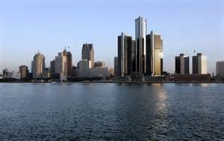
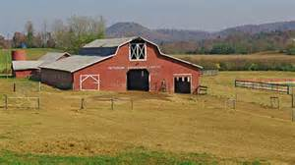
Urban vs. Rural
Relating to, or located in a city is called what?
Relating to the country or farming is called what?
URBAN
RURAL

Slide 17
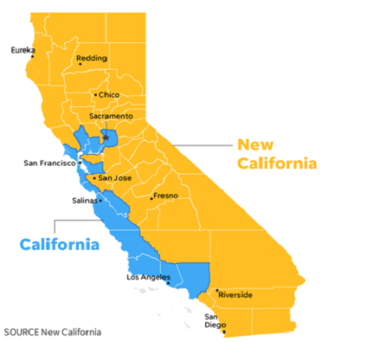
The state of California is currently creating legislation to make two separate states between the rural and the urban areas. Why is this?
TAXES ARE TOO HIGH IN THE RURAL

Slide 18
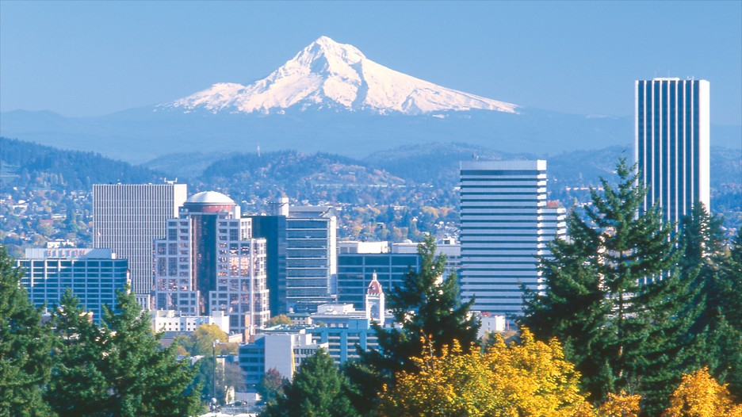
The ways in which people use a particular area of the Earth’s surface; for example, for farming, development or preservation is known as what?
LAND USE
Portland, Oregon became the first state to create a set of land use planning laws.

Slide 19
A creation of land use planning laws that promote an approach to land using planning to control sprawl by making better use of land that has already been developed is known as what?
SMART GROWTH

Slide 20
A legal border that separates an area where development is permitted from an area where development is forbidden is called what?
URBAN GROWTH BOUNDARY

Slide 21
A network of buses, trains & other vehicles used for moving passengers throughout a city is called what?
PUBLIC TRANSIT SYSTEM
NOT ONLY DOES THIS HELP WITH URBAN SPRAWL BUT ALSO DECREASES…
TRAFFIC, POLLUTION & GAS USAGE

Slide 22
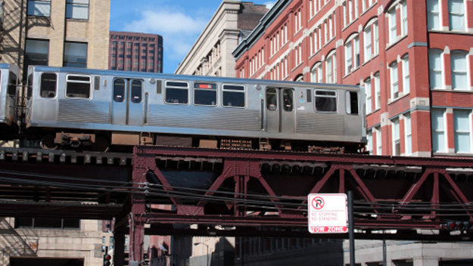
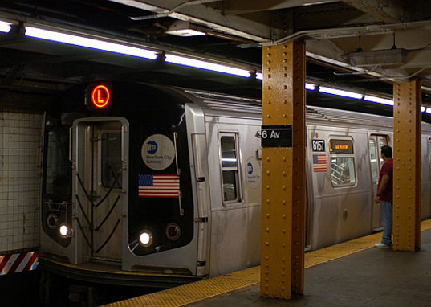
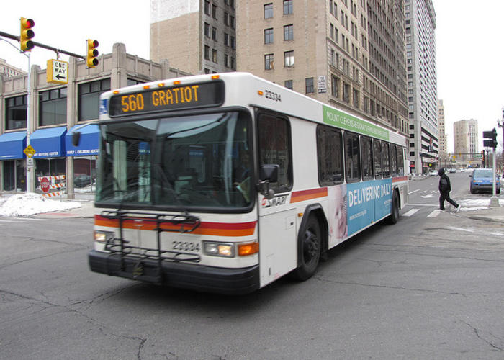
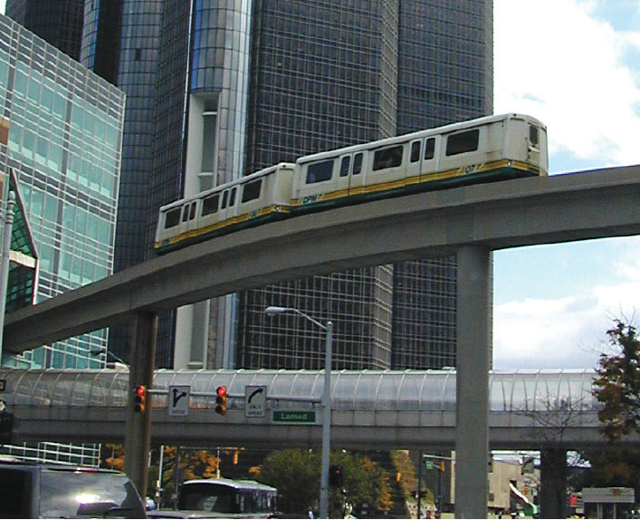
BUSES, MONORAILS, TRAINS & SUBWAYS ARE EXAMPLES OF PUBLIC TRANSIT SYSTEMS

Slide 23
Development that combines housing & businesses in one area is what?
MIXED-USE DEVELOPEMENT

Slide 24
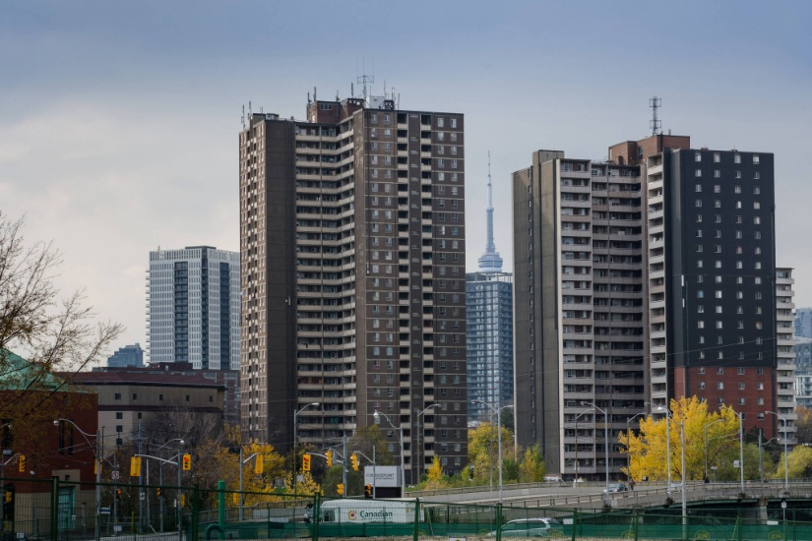
The process of filling in empty or run-down parts of a city with new development is called what?
INFILL
Building an apartment high-rise or shopping mall on an empty lot is an example of infill

Slide 25
An official plan lays out what kind of growth a city should encourage. New developments are to use mainly in-fill & mixed-use projects. Toronto, Canada is one city that did so (which controlled its growth & urban sprawl for a30 years.

Slide 26
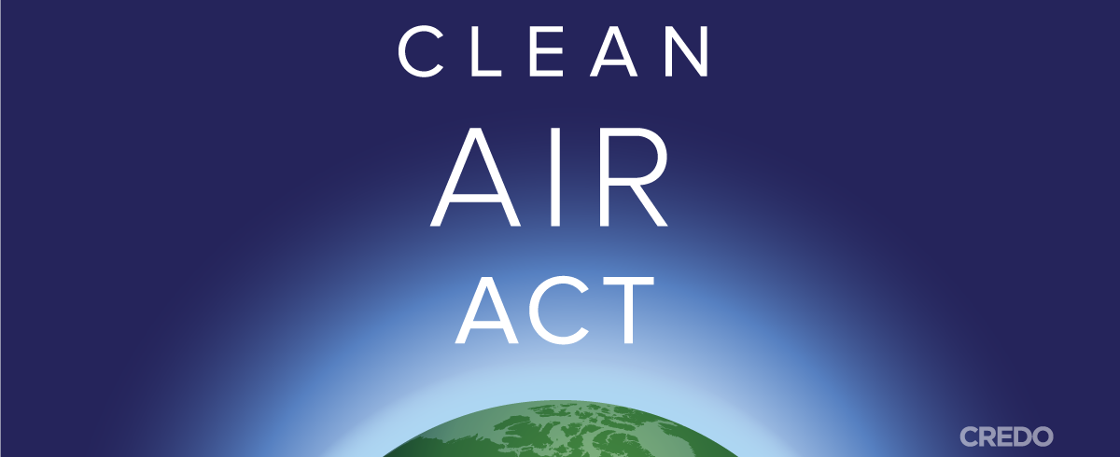
What is the Clean Air Act?
It is a U.S. federal law designed to control air pollution on a national level. It is one of the United States' first & most influential modern environmental laws & one of the most comprehensive air quality laws in the world.

Slide 27
Urban Sprawl looks different in different parts of the world depending on what?
POPULATION & MONEY
POOR COUNTRIES OFTEN HAVE LITTLE CONTROL OVER HOW THEIR CITIES GROW WHERE AS WEALTHY REGIONS TEND TO HAVE MORE LARGE CITIES & ARE MORE DEVELOPED

Slide 28
URBAN & RURAL WORLD POPULATIONS
WHAT DOES THIS GRAPH SHOW?

Slide 29
The number of people who live in a specified area is called what?
POPULATION
THE THREE MOST POPULATED CITIES IN THE UNITED STATES ARE…
1. NEW YORK, NY,
2. LOS ANGELES, CA, &
3. CHICAGO, IL

Slide 30
Why do you think urban sprawl is a hot issue & a worldwide problem? Remember urban sprawl moves outward & world population numbers are increasing.

