Slide 1
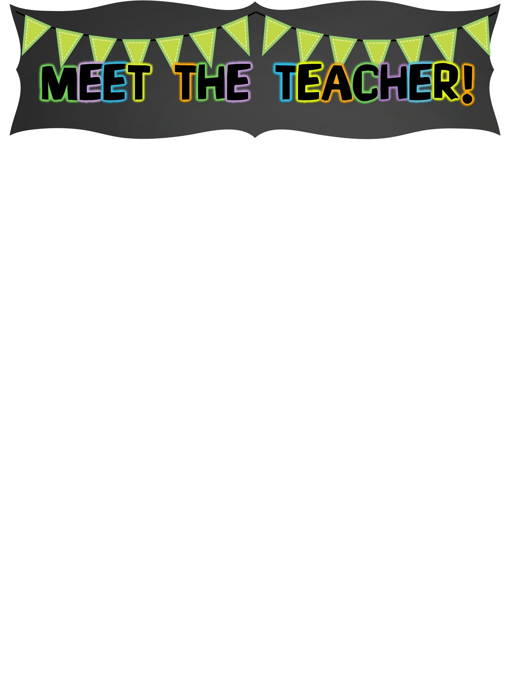
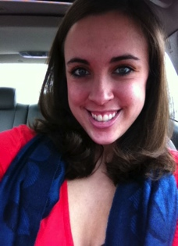




The Basics!
Hi! My Name is Mrs. Emily Kaltz! I will be your child’s 3rd Grade Teacher. I am so excited to be joining the Aviator Family at McCollough. While it is my first year here, I have taught 2nd and 3rd Grade for the past 7 years.
My Childhood!
I grew up in Dearborn, MI where I attended Howard Elementary for Kindergarten through 5th grade. I then attended Bryant Middle School for 6th-8th grade before graduating from Dearborn High School in 2005.
My Favorites!
My Education!
Food: Cheese Bread
Movie: Up
Author: Roald Dahl
Color: Yellow
Drink: Chai Tea Season: Fall
Sports: Football
Fast Food: Potbelly’s
Singer: Adele
Hobby: Acting & Singing
Subject: Math
Store: Target
Dessert: DQ Blizzards
Candy: Reese’s PB Cups
Restaurant: Mexican Fiesta
Flower: Hydrangeas
In May of 2009, I graduated with a Bachelors of Science in Elementary Education from the University of Michigan in Ann Arbor. I am currently working on my Master’s Degree in Special Education and my English as a Second Language Endorsement.
Contact Me!
Email: kaltze@dearbornschools.org
iBlog: http://iblog.dearbornschools.org/kaltz
Class Webpage: http://ekaltz.wix.com/kaltz
School Phone Number: (313) 827-1700
*You can also write a note in your child’s planner!

