Slide 1
Wednesday, January 31st
Bell Work:
1. Give 3 examples of Scarcity
2. Name the 4 factors of production
Review Section 1 main ideas.

Slide 2
Needs and Wants
Need – Basic essential for survival
  Food, Water, Shelter
Want – Something you would like to have but don’t necessary need it for survival.

Slide 3
TINSTAAFL
There
Is
No
Such
Thing
As
A
Free
Lunch

Slide 4
The idea that no matter what it is, if its free, it really isn’t. Someone-somewhere is paying for that.

Slide 5
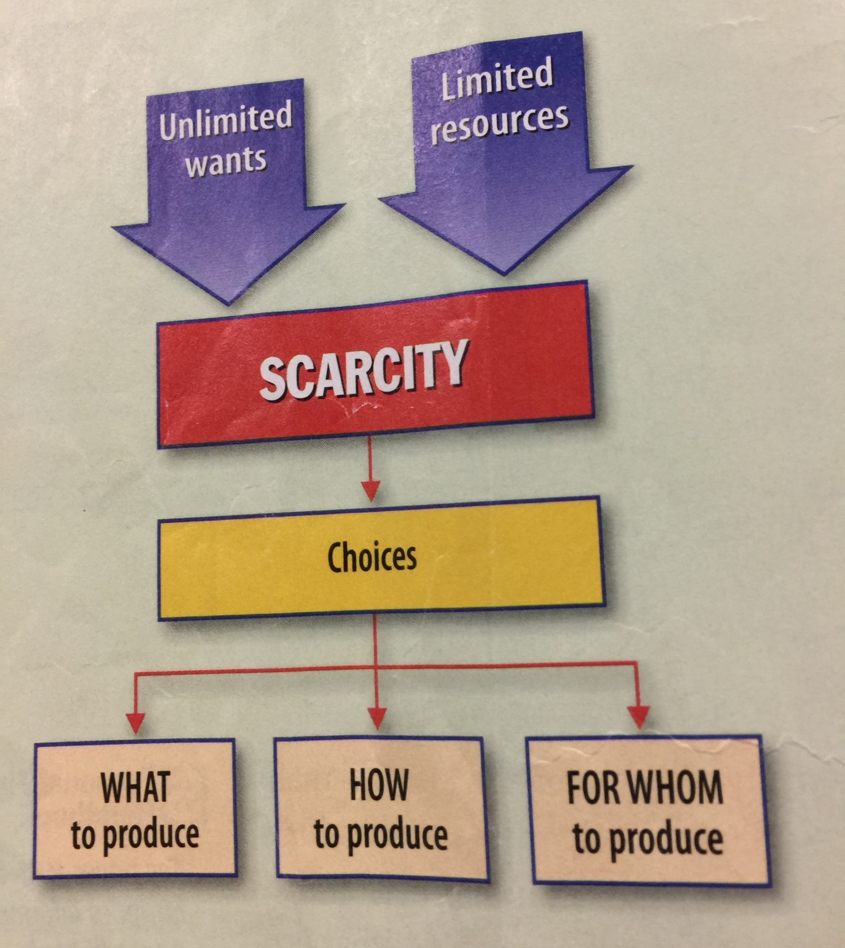

Slide 6
3 Basic Questions
Making Choices
What to Produce
  What are people going to buy
How to Produce
  Machine vs. Handmade
For WHOM to Produce
  Who will buy your goods, what is your market.

Slide 7
Factors of Production
Resources needed to produce things
1. Land
2. Capital
3. Labor
4. Entrepreneurs

Slide 8
Land
Any Natural Resource
  Can be actual land
  Minerals
  Water
  Wind
Thought of as Fixed or limited

Slide 9
Capital
Tools/equipment used in production

Slide 10
Labor
People who are in the work force
Factors that effect labor
  Immigration
  Birthrates
  War
  Famine/disease

Slide 11
Entrepreneurs
Risk takers who invest in the economy looking for profit.

Slide 12
Practice
Need – Stand up
Want – Sit down
Land – Stand up and raise right arm
Capital – Stand and look out the windows
Labor – Stand and turn back to the front of the room

Slide 13
Shelter
Need – Stand up
Want – Sit down
Land – Stand up and raise right arm
Capital – Stand and look out the windows
Labor – Stand and turn back to the front of the room

Slide 14
Car
Need – Stand up
Want – Sit down
Land – Stand up and raise right arm
Capital – Stand and look out the windows
Labor – Stand and turn back to the front of the room

Slide 15
Workers
Need – Stand up
Want – Sit down
Land – Stand up and raise right arm
Capital – Stand and look out the windows
Labor – Stand and turn back to the front of the room

Slide 16
Computer
Need – Stand up
Want – Sit down
Land – Stand up and raise right arm
Capital – Stand and look out the windows
Labor – Stand and turn back to the front of the room

Slide 17
IPhone
Need – Stand up
Want – Sit down
Land – Stand up and raise right arm
Capital – Stand and look out the windows
Labor – Stand and turn back to the front of the room

Slide 18
Machine
Need – Stand up
Want – Sit down
Land – Stand up and raise right arm
Capital – Stand and look out the windows
Labor – Stand and turn back to the front of the room

Slide 19
Clothing
Need – Stand up
Want – Sit down
Land – Stand up and raise right arm
Capital – Stand and look out the windows
Labor – Stand and turn back to the front of the room

Slide 20
River
Need – Stand up
Want – Sit down
Land – Stand up and raise right arm
Capital – Stand and look out the windows
Labor – Stand and turn back to the front of the room

Slide 21
Food
Need – Stand up
Want – Sit down
Land – Stand up and raise right arm
Capital – Stand and look out the windows
Labor – Stand and turn back to the front of the room

Slide 22
Waiter
Need – Stand up
Want – Sit down
Land – Stand up and raise right arm
Capital – Stand and look out the windows
Labor – Stand and turn back to the front of the room

Slide 23
Computer
Need – Stand up
Want – Sit down
Land – Stand up and raise right arm
Capital – Stand and look out the windows
Labor – Stand and turn back to the front of the room

Slide 24
Bulldozer
Need – Stand up
Want – Sit down
Land – Stand up and raise right arm
Capital – Stand and look out the windows
Labor – Stand and turn back to the front of the room

Slide 25
Wind
Need – Stand up
Want – Sit down
Land – Stand up and raise right arm
Capital – Stand and look out the windows
Labor – Stand and turn back to the front of the room

Slide 26
Copper
Need – Stand up
Want – Sit down
Land – Stand up and raise right arm
Capital – Stand and look out the windows
Labor – Stand and turn back to the front of the room

Slide 27
Education
Need – Stand up
Want – Sit down
Land – Stand up and raise right arm
Capital – Stand and look out the windows
Labor – Stand and turn back to the front of the room

Slide 28
Work
Pg. 10 Answer 2-7
Pg. 11Read about the Start of Under Armour. Answer questions 1 and 2.

