Slide 2
Create a Double Bubble Map comparing durable and nondurable goods

Slide 3
Value
Actual Dollars and Cents people are willing to pay.
Why are some things more “valuable” than others?
Discuss with your elbow partner.

Slide 4
Paradox of Value
Nonessential items have a higher value than essential items.
Water vs. Gold/diamonds/precious metals and stones

Slide 5
Utility
For something to have value it most also have utility.
It must be useful or provide satisfaction.
Not fixed or measurable.
Varys from one person to the next
Make a list of 3 items that are useful to you, but not your partner.

Slide 6
Joumaa, Labib (20085844) , Mansour, Ghadir (20091958)
Bazzi, Hassan (20052499) , Nasser, Saham (20063659)
Dakroub, Hussein (0581462) , Jaber, Mohamad (20052997)
Maatouk, Rania (20052104) , Fawaz, Reem (20052500)
Alnajjar, Zainab (20044224) , Alkarem, Zainab A (20054577)
Bazzi, Zeinab J (20079791) , Hassan, Yousef K (20076877)
Mohamed, Muna A (20102625) , Ghamlouch, Zeinab (20093889)
Hammad, Noor (0585172) , Abdelrahman, Adam R (20071660)
Chahrour, Eva (20043611) , Ajrouche, Mariam (20052075)
Nasser, Sahar I (20052107) , Altarjoman, Moustafa (20097668)
, Faraj, Hussien (20047352) Ajamy, Celine (20059232
Bazzi, Hussein A (20054547) , Hamade, Hadi A (0581889)
Chamas, Diana F (20055290) , Saad, Navine (20085446)
Shajrah, Sulaimaan (0578429) , Alhayani, Hussain S (20082513)
Kleit, Mouhamed (20098615) , Dia, Israa M (20098828)

Slide 7
Wealth
Tangible
Scarce
Useful
Transferable

Slide 8
Nations Wealth
All Tangible items
  Natural Resources
  Buildings, houses,
  Factories, Stores
  Furniture, clothing books, video games,
  ANYTHING THAT CAN BE EXCHANGED (bought and sold)
NOT SERVICES

Slide 9
Economic Growth
Nations total output of good and services increases.

Slide 10
Factor Market
Our place of work.
Where we Make the money we like to spend

Slide 11
Product Market
Stores, Malls
Places we (individuals) go to buy our goods and spend our Hard earned money

Slide 12
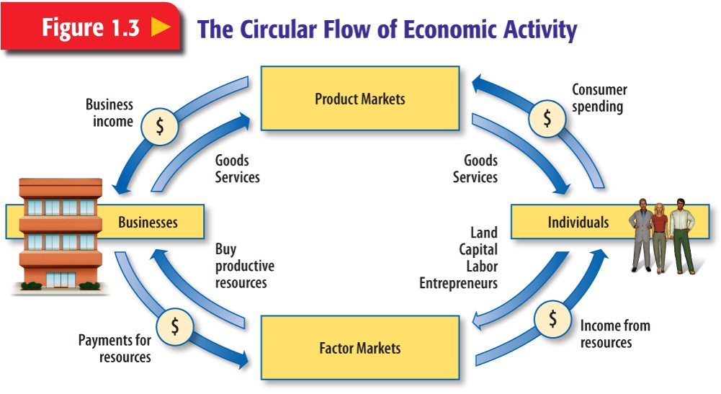

Slide 14
Productivity
Increase in production.
Ex. Make 20 Chairs a Day for a week then the next week make 25 Chairs a day.

Slide 15
Investing in Human Capital
Governments: Providing education, health care
Businesses: Training employees
Individuals: Education

Slide 16
Division of Labor and Specialization of Labor
Division of Labor
Specialization of Labor

Slide 17
Complete
Pg. 17
2-8

Slide 18
Adam Smith
Pg. 18
Read. Take notes on Adam Smith

