Slide 1
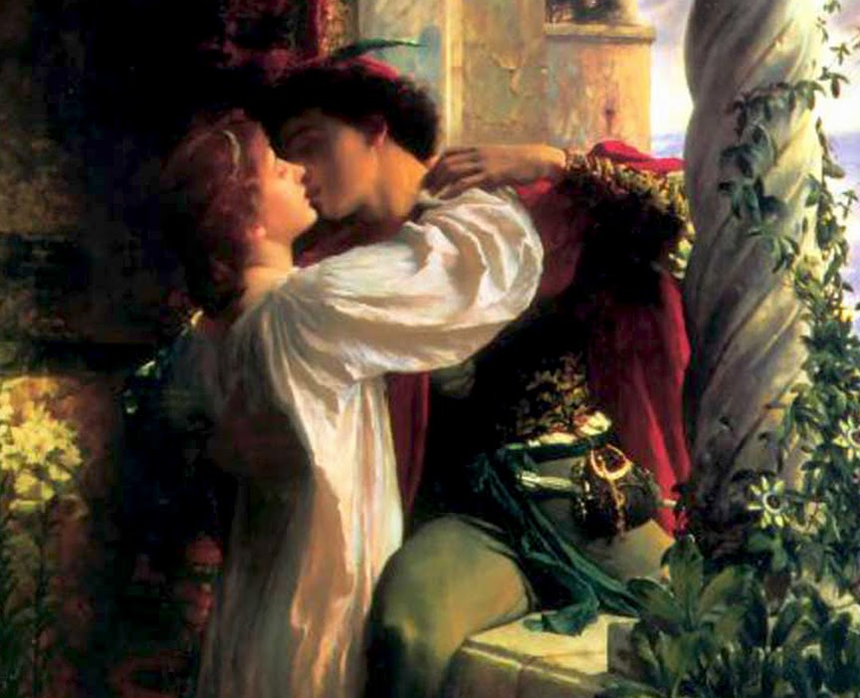

Slide 2
Whattya know?
Romeo and Juliet is Shakespeare’s most famous and most performed play. It has been adapted into many different forms, on screen and off.
What do you already know about Shakespeare’s famous tragedy?

Slide 3
What do you think?
Your life is controlled by the decisions you make.
Your life is controlled by destiny, or fate.
OR

Slide 4
What do you think?
People’s lives are predetermined. There is no escaping your destiny.

Slide 5
What do you think?
Your parents always know what is best for you.

Slide 6
What do you think?
Teenagers should tell their parents everything.

Slide 7
What do you think?
Parents have the right to approve or disapprove of their child’s choice of boyfriend or girlfriend.

Slide 8
What do you think?
A teenager’s first responsibility is to be loyal to his/her family.

Slide 9
What do you think?
Suicide is an honourable way to die.

Slide 10
What do you think?
Fourteen years old is too young to get married.

Slide 11
What do you think?
Love at first sight is possible.

Slide 12
What do you think?
“An eye for an eye” is a better motto to live by than “Turn the other cheek”.

