Slide 1
Bell Work
Monday 10/27
Turn to page 350 and answer the three “Geography Questions” located under the previewing main ideas section

Slide 2
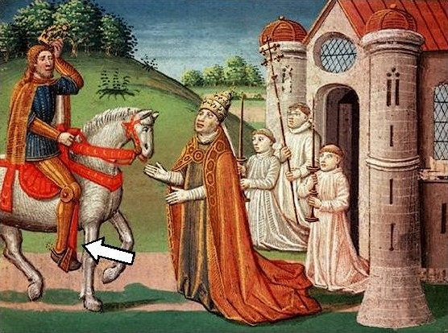
European Middle Ages
Chapter 13

Slide 3
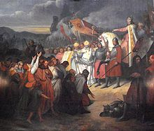
Section 1-Charlemagne Unites Germanic Kingdoms

Slide 4
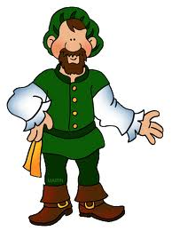
Invasion of Western Europe
Middle Ages- Spanned 500-1500 A.D.
Disruption of Trade-
  Merchants faced invasion from land and sea. Devastated Europe’s economy and left money scarce
Downfall of Cities-
  Cities became abandoned as centers of administration

Slide 5
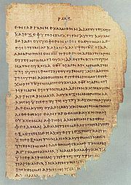
Invasion of Western Europe
Population Shifts-
  Cities collapsed = nobles and other citizens retreating to rural areas.
Decline of Learning-
  Germanic invaders couldn’t read or write so as result education decreased.
    No written language but strong oral tradition
  Greek language was nearly lost

Slide 6
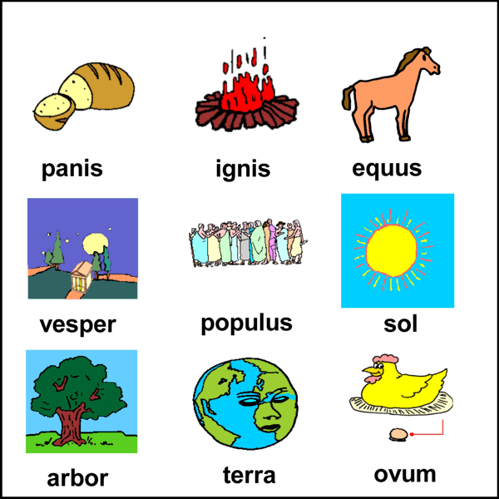
Invasion of Western Europe
Loss of Common Language-
  Pure Latin (although still the official language) was lost.
  By the 800’s the language spoken was a mix of Latin, French, Spanish, and other-Roman languages

Slide 7
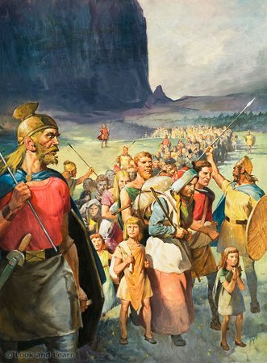
Germanic Kingdoms Emerge
Between 400-600 small Germanic kingdoms replaced Roman provinces
Changes in Government-
  Personal loyalty and family ties held Germanic society together
  Germanic people lived in small communities with unwritten rules and traditions

Slide 8
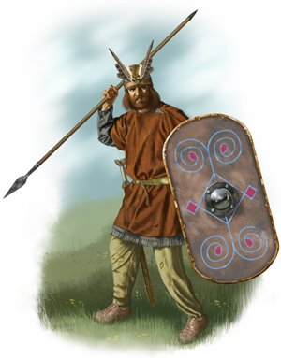
Germanic Kingdoms Emerge
Germanic Warriors-
  Pledged their loyalty to the chief
  Would fight to the death for their lord
  Saw it as disgrace to outlive the lord
  Felt no obligation to a king
  Would not pay taxes or obey a emperor they never met

Slide 9
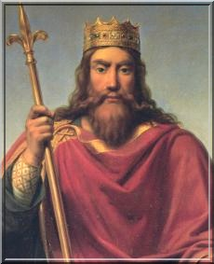
Germanic Kingdoms Emerge
Clovis Rules the Franks-
  Clovis was the leader of the Franks
    Brought Christianity to the region
    Church of Rome supported him
    By 511, Clovis had unified the Franks into one united kingdom

Slide 10
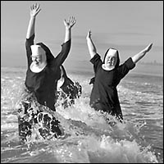
Germans Adopt Christianity
Politics played a key role in spreading Christianity.
By 600 The Church and Franks converted many Germanic people
Religious travelers often risked their lives bringing religious beliefs to other lands
Monasteries-
  Religious communities built by the Church
    Asked men to give up their possession and serve God
Nuns-Women who served God
  Lived in convents

Slide 11
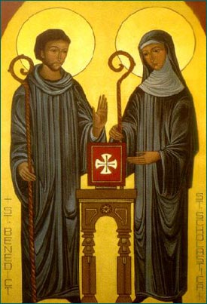
Germans Adopt Christianity
Benedict-
  Italian monk who wrote rules for living in a monasteries
Scholastica-
  Benedict’s sister
  Adopted his rules for women living in convents

Slide 12
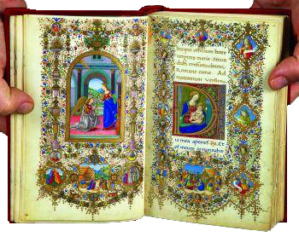
Germans Adopt Christianity
Monks and nuns-
  Devoted their lives to prayer and good works
  Opened schools
  Maintained libraries
  Copied books
Illuminated Manuscripts-
  Beautiful religious writings decorated with ornate pictures

Slide 13
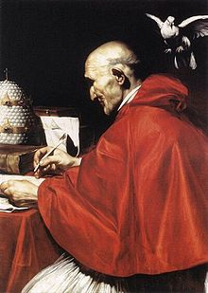
Germans Adopt Christianity
590-Gregory I becomes pope
  Under him the office of the pope expands
  Becomes secular (worldly) now involved in politics
Used Church Funds to-
  Raise an army
  Repair roads
  Help the poor

Slide 14
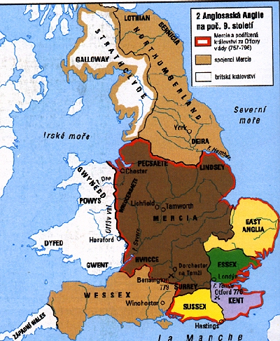
An Empire Evolves
Roman empire dissolved
  Small kingdoms sprang up
  England split into 7 kingdoms
  Gaul-Largest of the kingdoms
    Controlled by the Franks

Slide 15
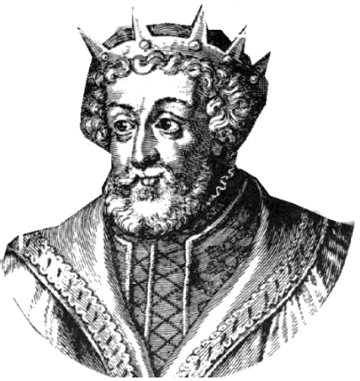
An Empire Evolves
Charles Martel Emerges-
  Major Domo-Mayor of the palace
    Most powerful person in the Frankish kingdom
  719-Charles Martel becomes major domo
    Nicknamed Charles “The Hammer”
    Extended the Franks reign North, South and East
    732-Battle of Tours- Defeated Muslim raiders in Spain
  Carolingian Dynasty-Ruled the Franks from 751 to 987

Slide 16
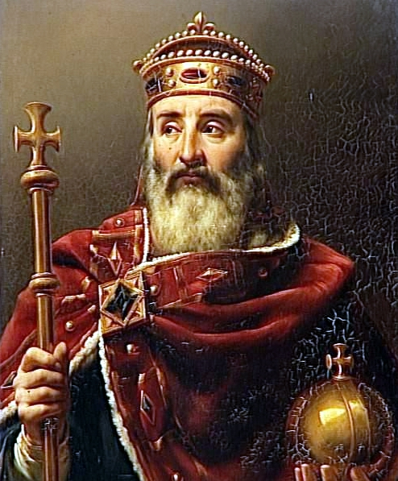
Charlemagne Becomes Empire
Charlemagne-
  Charles “The Great”
  Ruled the Franks from 771 to 813
  Tall man 6’4”

Slide 17
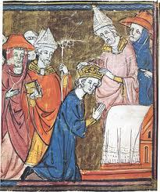
Charlemagne Becomes Empire
Charlemagne Extends the Franks Rule
  Ruled the greatest empire since Rome
  Conquered new lands to the south and east
  Spread Christianity
  Most powerful King in Western Europe
  800-Pope Leo III crowns him “Roman Emperor”
    Joined Germanic power and the Church

Slide 18
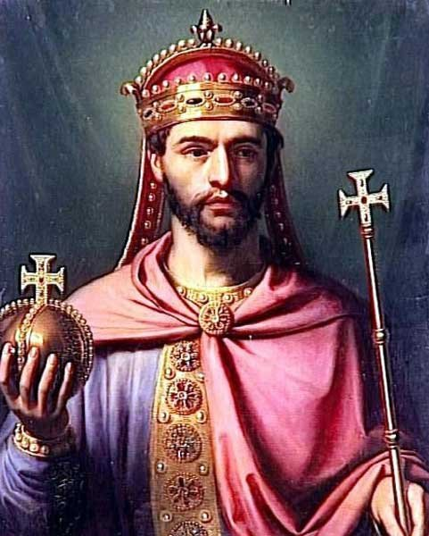
Charlemagne Becomes Empire
813-Charlemagne crowns his son Louis “The Pious” emperor
  Louis “The Pious”
    Very Religious Man
    Ineffective ruler
  Louis’ three sons
    Lothair, Charles the Bald, Louis the German
  Treaty of Verdun
    Divided Louis’ Kingdom among his three sons

Slide 19
Bell Work
Thursday 10/30
Look in your book beginning on page 358 and begin reading to find the answers
1.) What group invaded Europe in the 800’s?
2.) What would a lord give a vassal in exchange for military protection?
3.) What shape does the structure of Feudal Society look like?

Slide 20
Learning Targets
Chapter 13: Fotrmation of Western Europe
Learning Objective 2: Task 2 (10/30)
To learn this I will be able to…demonstrate my understanding of the structure/social classes located with the feudal system by diagramming the roles and responsibilities through creating guided notes

Slide 21
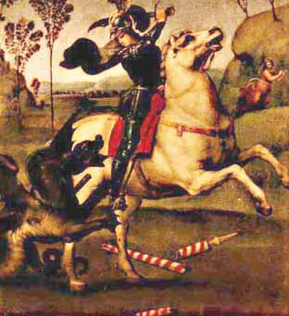
Section 2-Feudalism in Europe

Slide 22
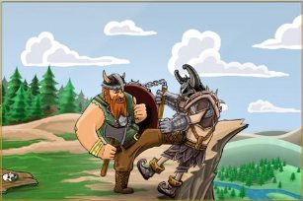
Invaders Attack Western Europe
Vikings Invade from the North
  Sailed from Scandinavia
  Known as Northmen or Norsemen
  Carried out their raids with swords and heavy wood shields
  Largest Viking ships carried 300 men

Slide 23
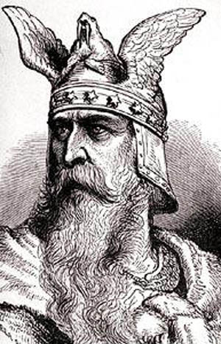
Invaders Attack Western Europe
Vikings Invade from the North (continued)
  Acted as warriors, traders, farmers and explorers
  Leif Ericson
    Viking explorer who reached North America 500 years before Columbus
  Vikings began accepting Christianity

Slide 24
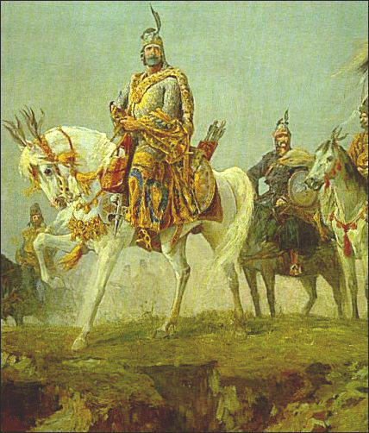
Invaders Attack Western Europe
Magyars and Muslims Attack from the East and South
  Magyars
    Nomadic people from Hungary
    Invaded from the east on horseback around 800
    Attacked villages and monasteries
    Took captives as slaves

Slide 25
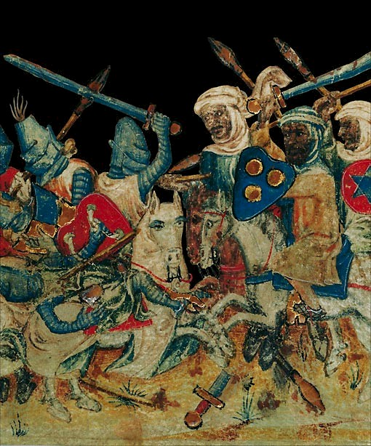
Invaders Attack Western Europe
Magyars and Muslims Attack from the East and South
  Muslims
    Struck from the south
    Originally wanted to settle Europe, later decided to plunder (rob people) as well
  As a result of Magyar and Muslim attacks people began to look for protection from local rulers

Slide 26
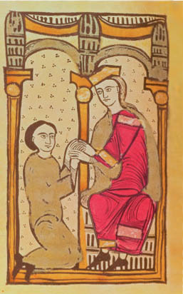
A New Social Order: Feudalism
Feudal System-A system of governing landholding based on rights and obligation
  Lord-Land Owner
  Fief-Land grant in exchange for military protection
  Vassal-Person receiving the fief

Slide 27
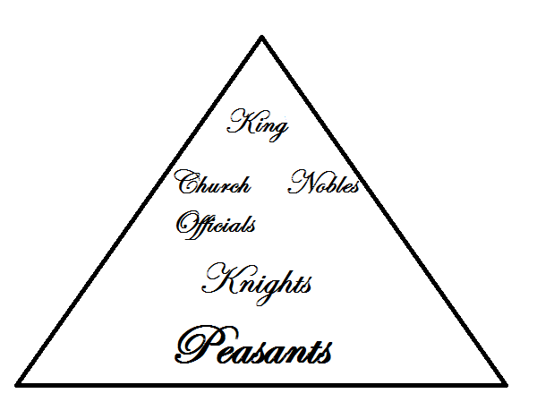
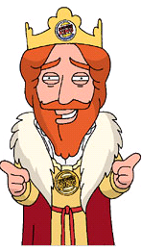
A New Social Order: Feudalism
The Feudal Pyramid-

Slide 28
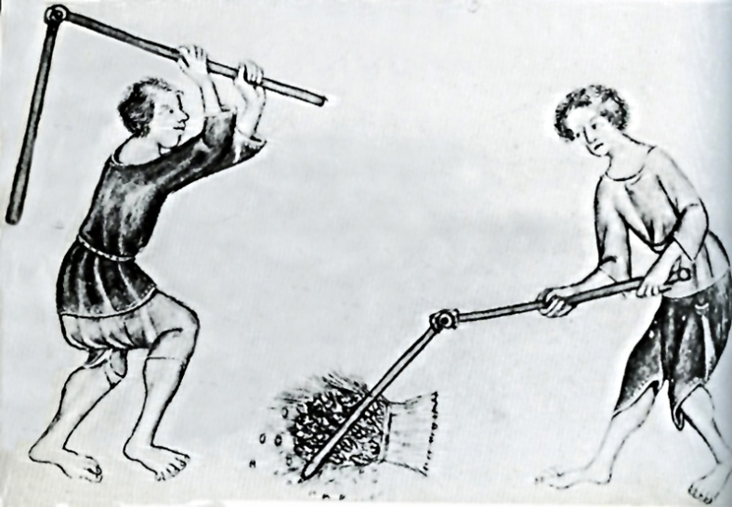
A New Social Order: Feudalism
Social Classes-
  Three Groups
    Those who fought (knights, nobles)
    Those who prayed (Priests, Nuns ect.)
    Those who worked (peasants)
  Serfs-People who could not lawfully leave where they were born

Slide 29
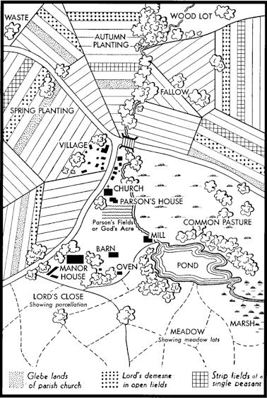
Manors: The Economic Side of Feudalism
Manor-The Lords Estate
  Lord would provide serfs with land and protection
  Serfs would work the land and maintain the estate
    Owed 2-3 days of work and a portion of their grain

Slide 30
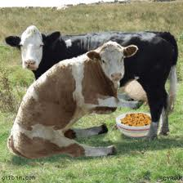
Manors: The Economic Side of Feudalism
Peasants on the manor-
  Rarely traveled more than 25 miles from the manor
  15-30 families lived on the manor
  Produced crops, milk, cheese, fuel, cloth, leather goods and lumber
  Purchased salt, iron and millstones (used for grinding grain)
Tithe-Church tax (10% of income)
Also paid grain and marriage tax

Slide 31
Bell Work
Monday 11/03
Look in your book beginning on page 358 and begin reading to find the answers
1.) What were the three social classes of the feudal system?
2.) What was unique about the average serfs living arrangements?
3.) What was a tithe and who received it?

Slide 32
Bell Work
Wednesday 11/05
Look in your book beginning on page 358 and begin reading to find the answers
1.) How were the Vikings different from earlier Germanic groups that invaded Europe?
2.) How was a manor militarily and economically sufficient during the Middle Ages?
3.) What advantages did a medieval manor provide to the serfs living on it?

Slide 33
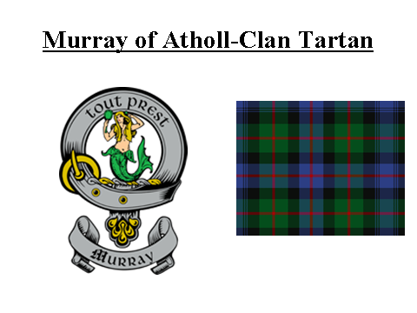

Slide 34
Bell Work
Thursday 11/06
Look in your guided notes for Chapter 13 Section 1 and 2 to find the answers
1.) What role did Benedict and Scholastica play in strengthening religious communities?
2.) After becoming Pope in 590 A.D. what did Gregory I use church funds to accomplish?
3.) What type of weapons did Vikings tend to carry with them on their conquests of Europe?

Slide 35
Bell Work
Friday 11/07
Look in your book beginning on page 364
to find the answers
1.) Why was it important for young boys to leave home and become knights?
2. Who normally lived inside of a medieval castle?
3. What were some of the themes of medieval literature?

Slide 36
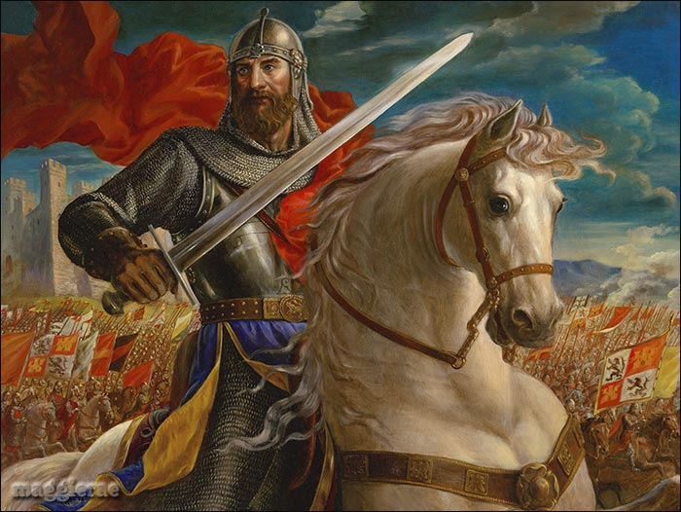
Section 3-The Age of Chivalry

Slide 37
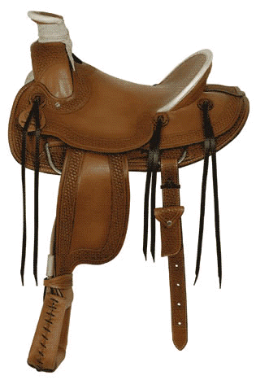
Knights: Warriors on Horseback
Technology of Warfare Changes-
  Leather saddles and stirrups allowed warriors to handle heavy weapons while fighting
  Mounted knights = most important part of the army

Slide 38
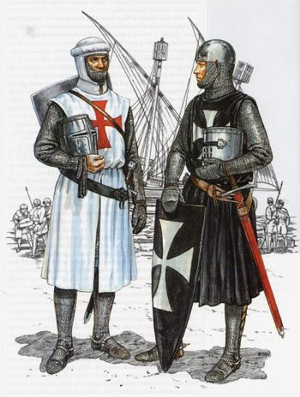
Knights: Warriors on Horseback
A Warriors Role-
  Feudal lords hired private armies of knights to protect their land
    40 days of service a year
  Traded protection for fiefs (land grants)
    Wealth allowed the knights to
      Devote their lives to war
      Buy weapons, armor, warhorses

Slide 39
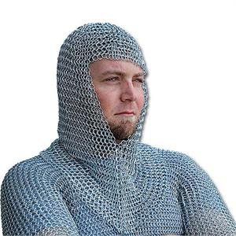
Knighthood and the Code of Chivalry
Chivalry-A complex set of ideals, in which a knight would fight bravely for three masters
  Earthly feudal lord
  Heavenly Lord
  His chosen lady
Qualities of an Ideal Knight-
  Loyal
  Brave
  Courteous

Slide 40
Chivalry
The Italian painter Paolo
Uccello captures the spirit of
the age of chivalry in this
painting, St. George and the
Dragon (c. 1455–1460).
According to myth, St. George rescues a captive princess by killing her captor, a dragon.
• The Knight St. George,
mounted on a horse and
dressed in armor, uses his
lance to attack the dragon.
• The Dragon The fierce looking dragon represents evil.
• The Princess The princess
remains out of the action as
her knight fights the dragon
on her behalf.
SKILLBUILDER:
Interpreting Visual Sources
In what way does this painting show the knights commitment to the code of chivalry ?

Slide 41
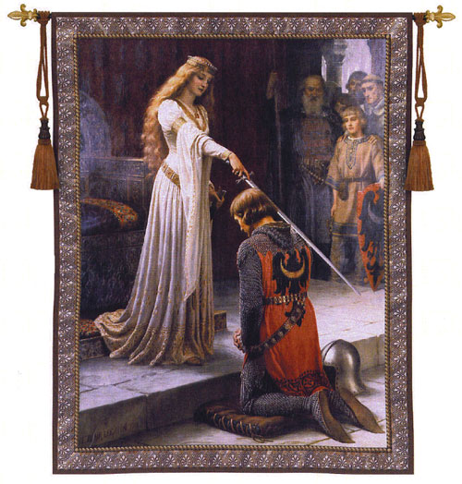
Knighthood and the Code of Chivalry
Knights Training-
  Age 7-Sent off to a castle became a page
  Age 14- Became a squire (knights servant)
  Age 21-Became a full-fledged knight
Tournaments-Staged battles for practice

Slide 42
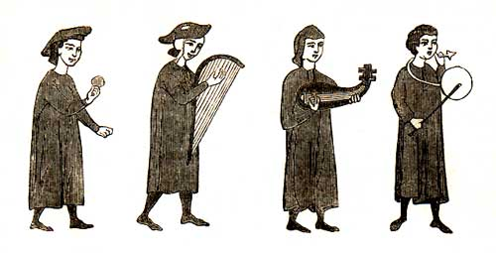
Literature of Chivalry
Epic Poems-
  They recounted a hero’s deeds and adventures
  Song of Roland-Earliest and most famous epic poem
Troubadours-Traveling Poet-Musicians
  Composed poems about the joys and sorrows of love

Slide 43
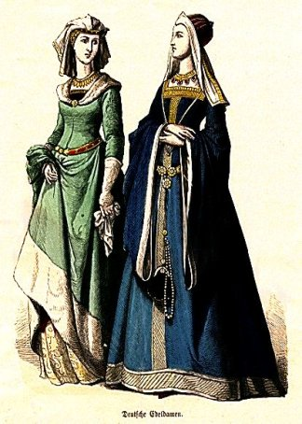
Women’s Role in Feudal Society
Women were seen as inferior to men
Noblewomen-
  Could inherit and estate from her husband
  Send knights to war
  Act as military commander when her husband was away
    Hurled rocks and shot arrows at attackers
  They were most often limited to activities around the home or convent

Slide 44
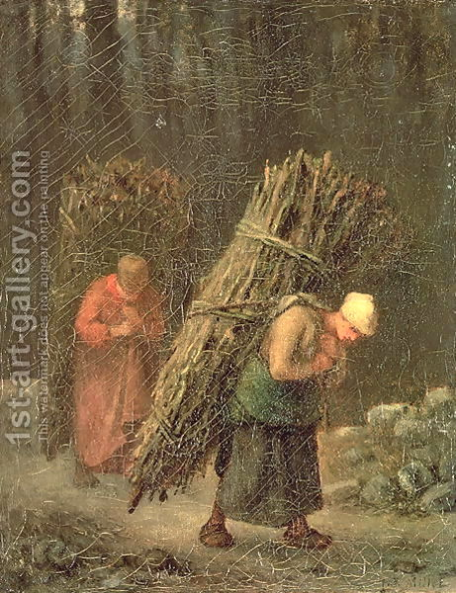
Women’s Role in Feudal Society
Peasant Women-
  Poor and powerless
  Performed endless labor
    In the home and fields
    Raised children
    Took care of families
  Poor girls learned house hold skills
  Rich girls were educated

Slide 45
Bell Work
Monday 11/10
Look in your book beginning on page 370
to find the answers
1.) What were some of the matters covered under canon law?
2.) How did Otto the Great make the crown stronger than the German nobles?
3.) Why did lay investiture cause problems between kings and popes?

Slide 46
Daily Objective-
  Content Objective:
    SWD analysis of the structure of the Catholic Church and its sphere of influence within the feudal system by categorizing the roles and responsibilities of the emperor and the pope through the use of student led guided notes
    SWD application of information regarding important political/historical figures, events and evidentiary text located in Chapter 13 Section 2 through compiling information designed to answer guided section questions
  Language Objective:
    Students will read and record information regarding the structure of the Catholic Church and its sphere of influence within the feudal system by categorizing the roles and responsibilities of the emperor and the pope through filling in teacher led guided notes
    Students will write answers to guided questions that require examination of the additional supporting resources/information located within Chapter 13 by completing guided section questions

Slide 47
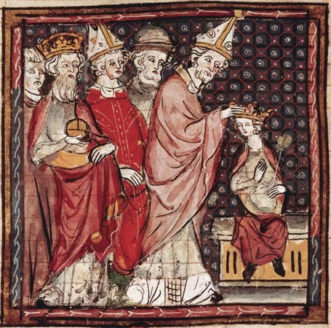
Section 4-The Power of the Church

Slide 48
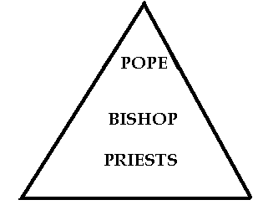
The Far Reaching Authority of the Church
Conflict between Church and State
  Pope Gelasius realized that a conflict could arise between the church and the state.
  He suggested that if the emperor and pope ruled their own areas they could share power
Structure of the Catholic Church

Slide 49
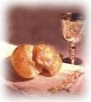
The Far Reaching Authority of the Church
Religion as a Unifying Force
  Feudalism and the manor system divided people
  The Church brought them together
Sacraments-Important religious ceremonies designed to help Christians achieve salvation
  Ex. Baptism = entrance into the Christian community
Canon Law-Church law governing marriage and other religious matters

Slide 50
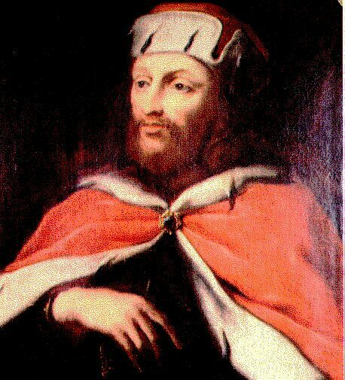
The Church and The Holy Roman Empire
Otto I Allies with the Church
  936-Otto “The Great” is crowned king of Germany
    Followed Charlemagne’s example and formed a close alliance with the church
    Used the Church to help limit the power of nobles
    Invaded Italy on behalf of the pope
    As a reward he was crowned emperor by the pope in 962 A.D.

Slide 51
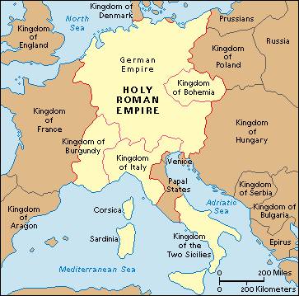
The Church and The Holy Roman Empire
Holy Roman Empire-
  German-Italian empire that became the strongest state in Europe

Slide 52
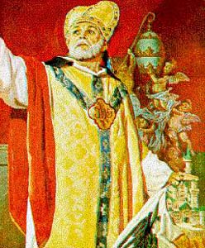
The Emperor Clashes with the Pope
Lay Investiture –A ceremony in which kings and nobles appointed church officials
1075-Pope Gregory VII banned Lay Investiture
Concordant of Worms-Compromise in which the Church alone could name bishops but the Emperor could veto the selection

Slide 53
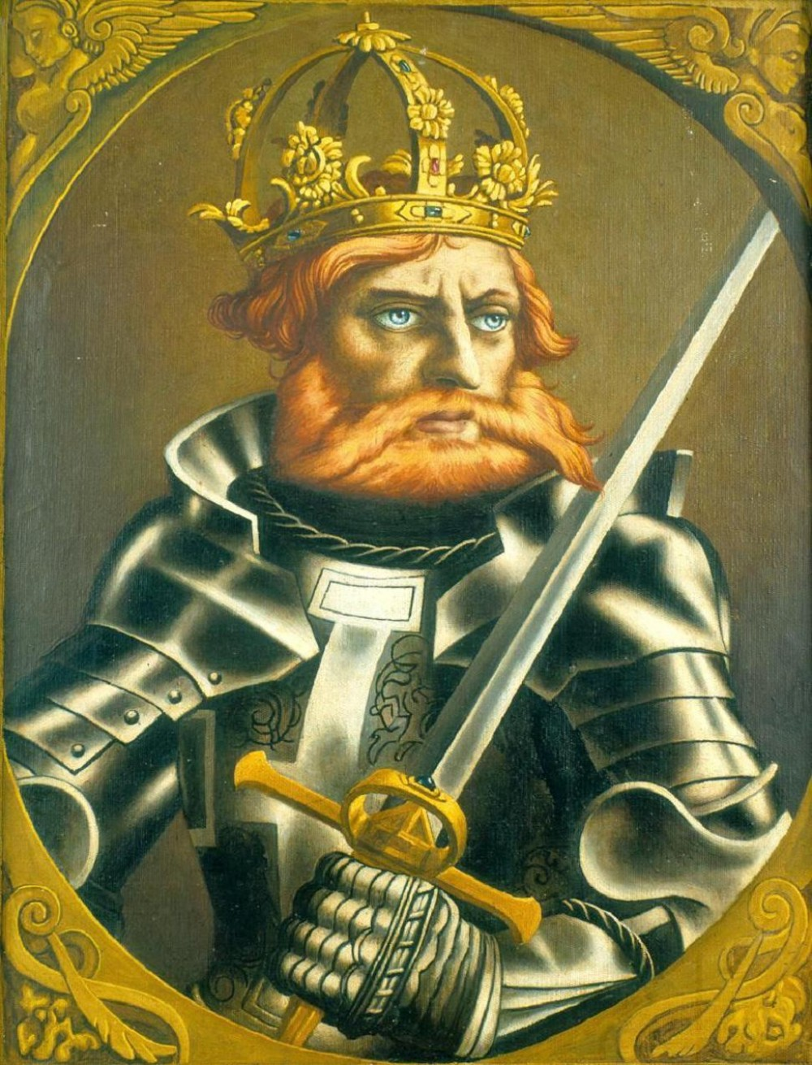
Disorder in the Empire
1152-Fredrick I was named German king
  Nicknamed “Barbarossa” for his red beard
  1st person to call his land the Holy Roman Empire
  Attacked wealthy Italian cities
    Italian merchants united against him in an attempt to remove him from power

Slide 54
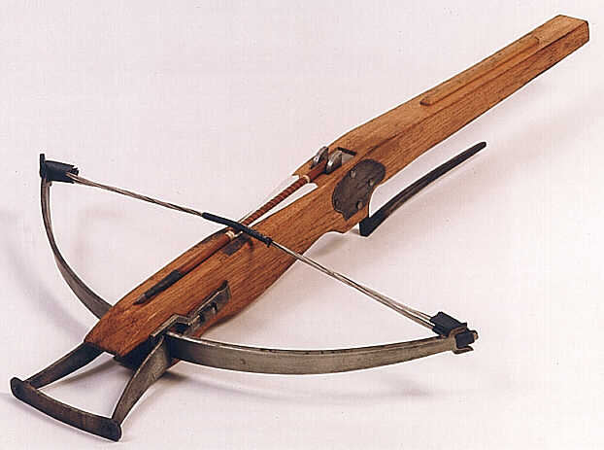
Disorder in the Empire
1176-Soldiers in the Lombard League faced off against Fredrick’s army at the Battle of Legnano
  For the 1st time in history merchants (or anyone for that matter) used cross bows to defeat feudal knights
  This humiliating defeat destroyed his influence over German princes

