Slide 1
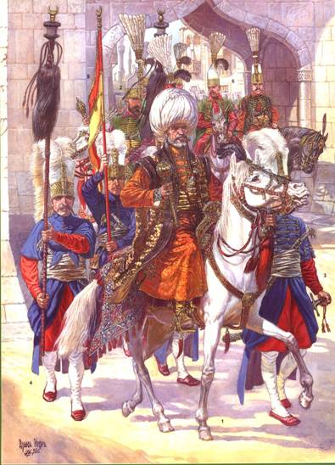
Section 1-The Ottomans Build a Vast Empire

Slide 2
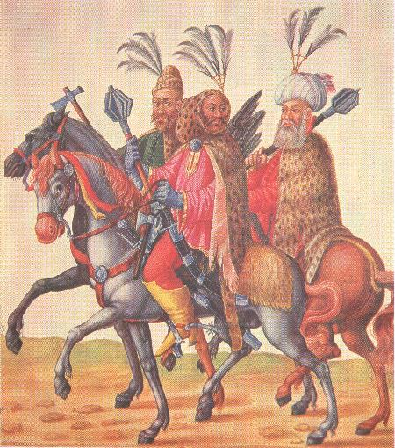
The Turks Move into Byzantium
Ghazis-Anatolian Turks who saw themselves as warriors for Islam
Ottomans-Followers of Osman who was considered the most successful of the ghazis
  Achieved military success with the aid of gun powder
  Some of the 1st people to use cannons

Slide 3
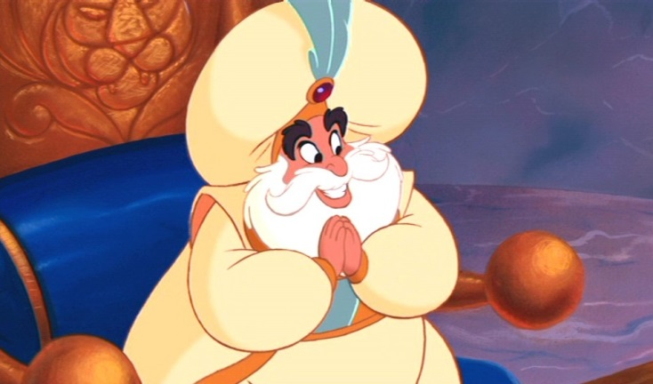
The Turks Move into Byzantium
Sultan-Meaning ‘overlord’ or “one with power”
Life under the Ottomans
  Used local officials appointed by the sultan to rule conquered areas
  Muslims served in the Turkish army and pay religious taxes
  Non-Muslims did not have to serve in the army but paid a small tax in return

Slide 4
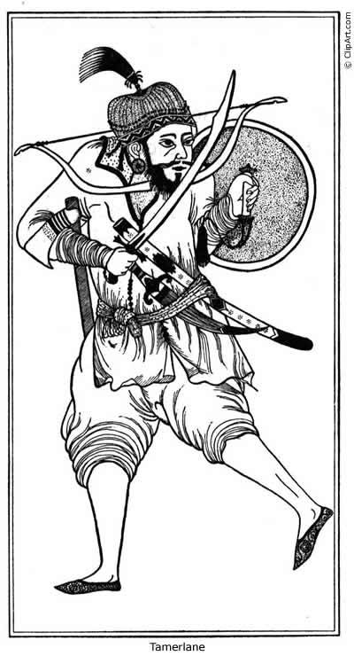
The Turks Move into Byzantium
Timur the Lame-
  Received the nickname after taking an arrow to the leg
  Burned Baghdad to the ground
  Crushed the Ottomans in the Battle of Ankara (1402)

Slide 5
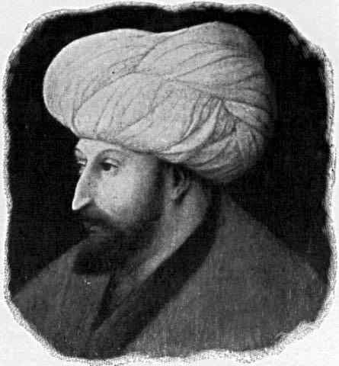
Powerful Sultans Spur Dramatic Expansion
Mehmed II-
  Nicknamed Mehmed the Conqueror
  Attacked Constantinople
    Fired a 1,200lb bolder out of a 26-foot gun and ships
    After conquering the city he renamed it Istanbul opened it up to Christians, Jews, Muslims, Turks and non-Turks

Slide 6
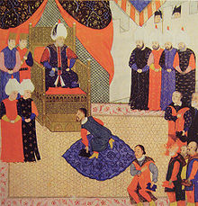
Powerful Sultans Spur Dramatic Expansion
Suleyman the Lawgiver-
  Studied poetry, history, geography, astronomy, mathematics and architecture
  B/c of Islamic law he was tolerant of other religions
  Supported art and literature

Slide 7
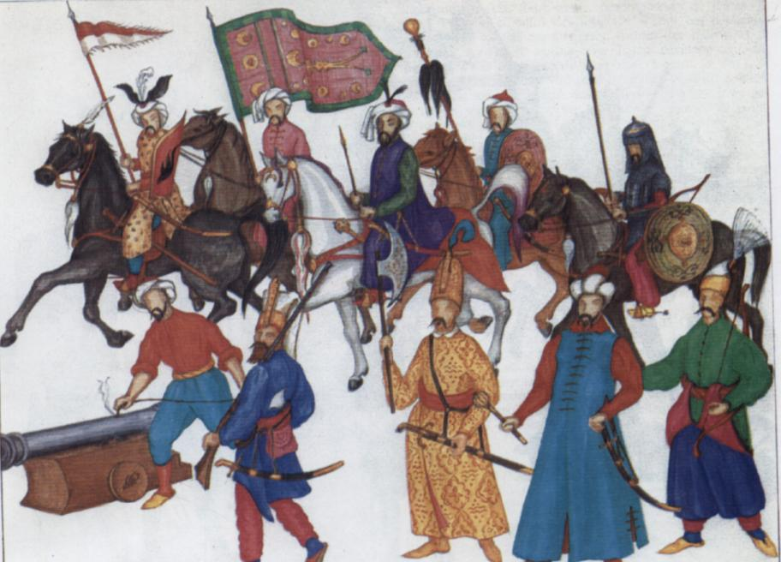
Powerful Sultans Spur Dramatic Expansion
Devshirme System-System where members of the sultan’s army were drafted from the Christian boys of conquered territories.
  Converted them to Islam and educated them
Janissaries-Elite force of 30,000 soldiers trained to be loyal only to the sultan.

Slide 8

During its height, the Ottoman Empire was one of the greatest empires in the world.
Your Assignment: Make an “Ottoman Newspaper”!!!

Slide 9
Directions
Read article and complete questions. Turn in for grade!
Partner Up – newspaper should have:
1. Draw a portrait of the Sultan, showing his roles in protecting the people against corruption 2. Comic Strip of how they created such a capable Gov’t and Military
3. Draw a diagram showing the role the Ottomans played in trade between Europe and Asia.

