Slide 1
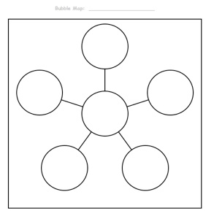
15 November 2016
Describe Ebola
Ebola
Any questions that you have about how and why Ebola is an epidemic

Slide 2
OBJECTIVES
Content Objectives
Students will demonstrate understanding of the effects of the Bubonic Plague, by comparing it to the Ebola epidemic using Give One – Get One.
Language Objectives
Students will read an article, write, and orally explain the connection between the Bubonic Plague and the Ebola epidemic in a summary paragraph and double-bubble map.

Slide 3
Give one, Get one
Fold the piece of paper in half.
Label Give One, Get One.
Brainstorm a list of all the things you already know about the topic and list under Give one only:
  What do you think you know about
  The Ebola epidemic?
Give One Get One
∙ ∙
∙ ∙
∙ ∙
∙ ∙
∙ ∙

Slide 4
Structured Note-taking
  Stand and find a partner sitting at another table.
  The shortest person starts:
  “Give one” of your ideas to your partner by saying it
  out loud. Your partner will copy your idea under the
  “Get one” column. Switch roles.
  Find a new partner and continue sharing your ideas.
  Return to your seat.

Slide 5
Ebola
GIST summarizing strategy
Read your assigned text:
2. Read once again and underline or pick out 10 words and/or concepts that are “most important” to understanding the text, and write it on your index card.
3. On the back of the same card write 3-5 summary statements using
as many of the listed words as possible.
4. Share your summary with your group, starting with the person who
has the most siblings.

Slide 6
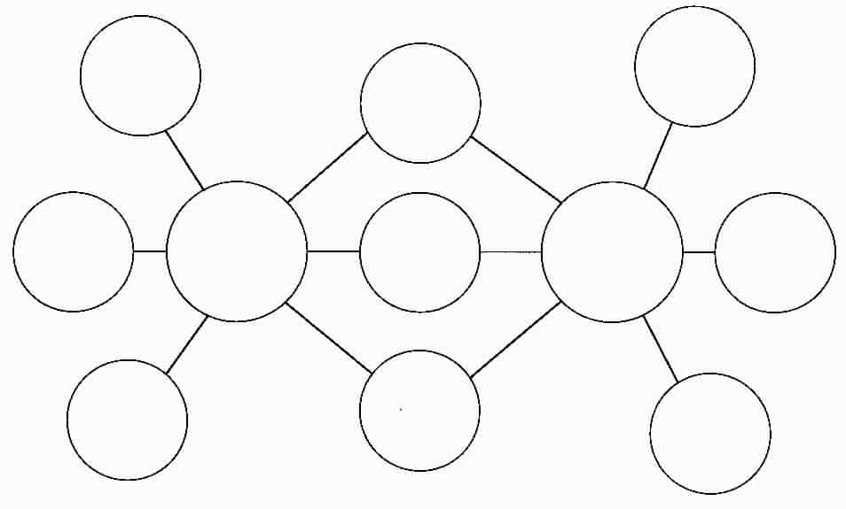
What are the differences and
Similarities of Ebola and Black Death
Double Bubble Map
Differences
Similarities
Differences
Ebola
Black Death
Why is this important to know

