Slide 1
6 October 2016
1.Can you elaborate on the reason why early Christians face persecution from the Romans?
2.Based on what you know, how would you explain how established church structure helped Christianity spread?

Slide 2
Content Objectives
Students will demonstrate understanding of the effects Christianity , by comparing it to Judaism by Give One – Get One and a double bubble map.
Language Objectives
Students will write, and orally explain the connection between the Christianity and Judaism in a double-bubble map and a summary paragraph .

Slide 3
Give one, Get one
Fold the piece of paper in half.
Label Give One, Get One.
Brainstorm a list of all the things you already know about the topic and list under Give one only:
  What do you think you know Christianity ?
Give One Get One
∙ ∙
∙ ∙
∙ ∙
∙ ∙
∙ ∙

Slide 4
Structured Note-taking
  Stand and find a partner sitting at another table.
  The shortest person starts:
  “Give one” of your ideas to your partner by saying it
  out loud. Your partner will copy your idea under the
  “Get one” column. Switch roles.
  Find a new partner and continue sharing your ideas.
  Return to your seat.

Slide 5
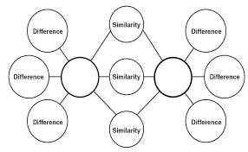
EQ: Compare and Contrast Judaism to Christianity
Christianity
Judaism
Frame of Reference: Prior Knowledge, Notes, Homework and Textbook

Slide 6
Write a 5 to 7 sentence summary elaborating on the similarity’s and differences of Judaism and Christianity.

