Slide 1
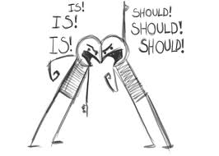
argument
Breaking Down the Argument

Slide 2

How Not to Argue…

Slide 3

Parts of an Argument
Claim—a statement that answers a question; a writer’s stance or position on an issue.
Evidence—the facts, examples, data, that support a claim.
  Reasoning—explanation that connects the claim to the evidence; provides a logical connection between the claim and evidence.
  Counterargument—the oppositions’ position on the topic.
  Refutation—The writer’s response to the counterargument.

Slide 4
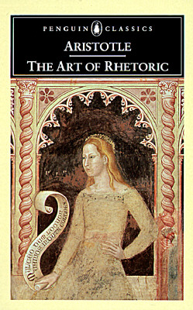
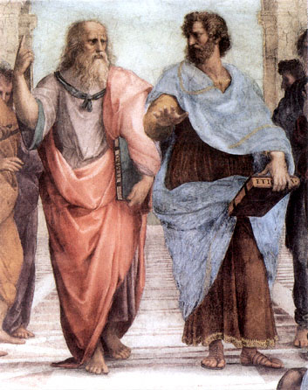
In approximately 300 B.C.E. Aristotle, who was a famous Greek philosopher, wrote a book entitled, “The Art of Rhetoric.” In his book, Aristotle identified the three methods of persuasion. He called them ethos, pathos and logos.
Aristotle
Plato
The Book

Slide 5
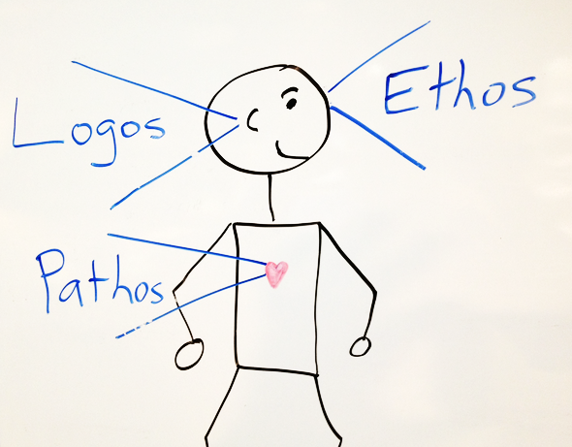
The appeals convince the audience in different ways:

Slide 6
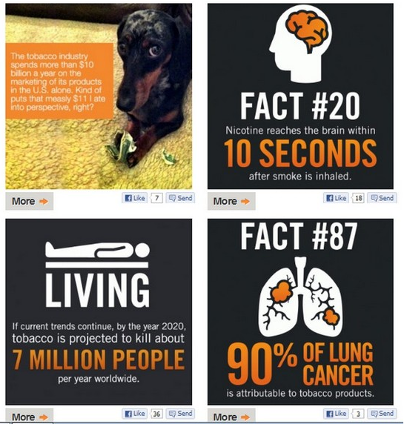
Appeals—LOGOS
Logos (Logical)—appeal to logic
  The argument is based on factual evidence (facts cannot be disputed)

Slide 7

Appeals—Pathos
Pathos (Emotional)—appeal to emotions: sympathy, patriotism, pride, anger, and other feelings based on values, beliefs, and motives.

Slide 8

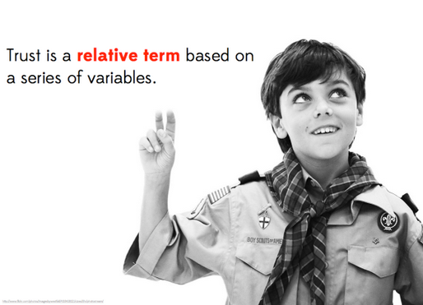
Appeals—ETHOS
“Character may almost be called the most effective means of persuasion.”—Aristotle
Ethos (Ethical)—appeal to character.
Does the author establish credibility/believability?

Slide 9
As you watch, what strategies are being used?
https://www.youtube.com/watch?v=jU7fhIO7DG0
Appeal to Character (Ethos): Mr. Peterson tries to connect with the audience by telling them that he has worked in honorable/good professions, “I've been a farmer, business man, a cop, a Marine during Vietnam.”
Appeal to Emotion (Pathos): Mr. Peterson tries to access the fear that voters have, “Here we are, losing three family farms a day. Illegals bused in the thousands, and Alabama’s unemployment at an all time high.”

Slide 10
As you watch, what strategies are being used?
https://www.youtube.com/watch?v=6HNKqffU3Cc
Appeal to Character (Ethos):
Appeal to Emotion (Pathos):

Slide 11
As you watch, what strategies are being used?
https://www.youtube.com/watch?v=tKQNXyofAF8
Appeal to Logos (Logic): “Every year Volvo subjects its cars to a race of doom, providing us with insight to help make our cars safer…for you.”
So, if Volvo spends so much time collecting data on how cars are effected in crashes, THEN it stands to reason that they are able to better engineer their cars for safety.

Slide 12
Practice
Let’s practice identifying appeals in an argument.
  The situation: You are arguing that there should be a law that prohibits drivers from using their cell phones while driving.
  On a piece a paper, write down some examples for each kind of appeal that could be used in this argument.

Slide 13
Practice
Appeals | Examples
Logical (Logos)
Emotional (Pathos)
Ethical (Expert)

Slide 14
Appeals | Examples
Logical | -Studies about dangers of cell phone use while driving -Studies on distraction -Studies on reaction times and multitasking -Studies the number of accidents caused from cell phone use -Driver safety manuals -Whether there are laws concerning cell phone use while driving
Emotional | -Personal stories of loss from accidents caused by cell phone use while driving -Especially examples involving children
Ethical | Using expert testimony: -Chief of Police -Paramedics -People in accidents caused by cell phone use while driving -Emergency responders -Your own experiences Using credible , reliable sources of information (Department of Revenue, Traffic Safety Commission, scientific studies, etc.) Addressing the opposition (including counterarguments) and refutations

