Slide 1

World Religions
Chapter 3-Section 2
Chapter 3 Section 4
Chapter 6-Section 3
Chapter 10

Slide 2
The Abrahamic Religions-Links Between Islam, Christianity and Judaism
Christians (God), Jews (Yahweh), and Muslims (Allah) all worship the same God
Jesus-
  Christianity- Son of God, God’s atonement for sin
  Judaism- Jesus was an ordinary Jewish man
  Islam- Jesus was a great prophet (born of a virgin birth but not he son of God)
Jew’s and Christian’s believe the Torah and New testament (Christians) were revealed by God
  Muslims believe that the Qur’an perfects these earlier revelations and is the final book as Muhammad is the final prophet
All three religions believe in a judgment day along with heaven and hell

Slide 3
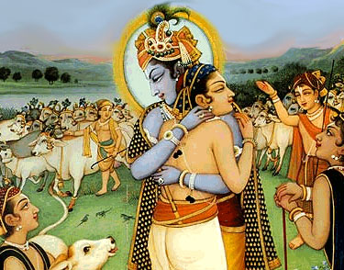
Hinduism and Buddhism Develop
Chapter 3-Section 2

Slide 4
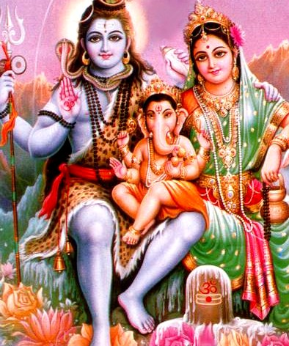
Hinduism Evolves Over Centuries
Origins-
  Hinduism-no one founder or single set of ideas
  See religion as a way of liberating the soul from illusions, disappointments, and everyday mistakes
  Upanishads-Written explanations of the Vedic hymns
  Moksha-Perfect understanding of all things

Slide 5

Hinduism Evolves Over Centuries
Beliefs-
  Atman- The individual soul
  Brahman-World soul (contain all Atmans)
    When one understands this relationship they are released from life
  Reincarnation- An individual’s soul is reborn until moksha is achieved

Slide 6

Hinduism Evolves Over Centuries
Karma-
  Good or bad deeds
    They follow you from one incarnation to the next

Slide 7
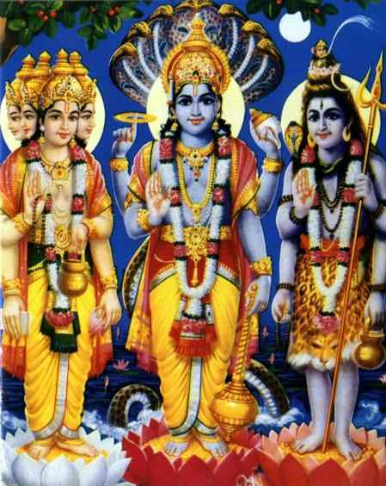
Hinduism Evolves Over Centuries
Brahma (world soul) has taken the personality of three gods over the last 2,500 years
  Brahma-The Creator
  Vishnu-The Protector
  Shiva-The Destroyer
Hindus are free to worship any god or no god at all

Slide 8
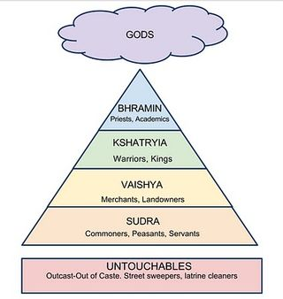
Hinduism Evolves Over Centuries
Hinduism and Society-
  Caste System-
    The better caste you were born into the better you were in a past life
    Only those men in the top three castes can achieve moksha in their present life
    Hindus turn to religion to help guide everyday decisions

Slide 9
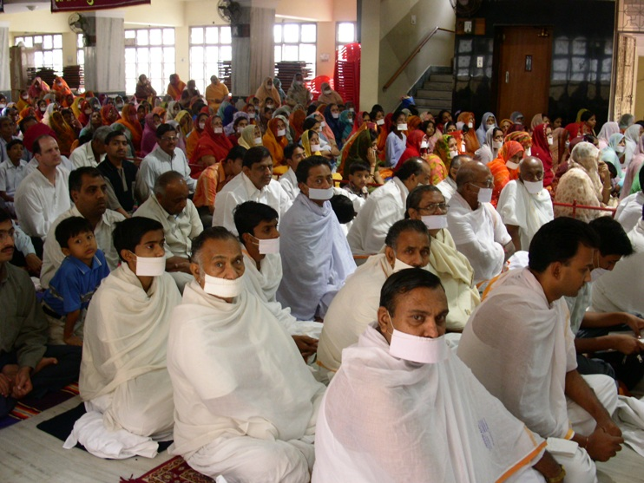
Hinduism Evolves Over Centuries
Jainism-
  Mahavira- Jainism’s founder
  Belief that everything in the universe has a soul
    So you can’t harm or kill anything
    About 5 million Jains in the world
      Almost all live in India

Slide 10
Hinduism Evolves Over Centuries
Jainism-
  Mahavira- Jainism’s founder
  Belief that everything in the universe has a soul
    So you can’t harm or kill anything
    About 5 million Jains in the world
      Almost all live in India

Slide 11

Buddha Seeks Enlightenment
Siddhartha Gautma- Founder of Buddhism
  Legend say if he
    Stayed Home= World Leader
    Left Home= Spiritual Leader
  To make sure he became both his dad isolated him in his palace

Slide 12

Buddha Seeks Enlightenment
The Four Noble Truths-
  Life is filled with suffering and sorrow
  The cause of all suffering is people’s selfish desire for temporary pleasure
  To end all suffering you must end all desires
  To overcome one’s desires and attain enlightenment one must follow the Eightfold path called the middle way (between desires and self-denial)

Slide 13

Buddha Seeks Enlightenment
The Eightfold Path
  Right View
  Right Thought
  Right Speech
  Right Behavior
  Right Livelihood
  Right Effort
  Right Mindfulness
  Right Meditation
If you follow the Eightfold path and you’ll reach Nirvana

Slide 14

Buddha Seeks Enlightenment
The Three Jewels of Buddhism
  Sangha (Religious Community)
  The Buddha
  Dharma (Religious Teachings)

Slide 15
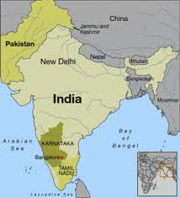
Buddha Seeks Enlightenment
Buddhism was founded in India but overtime became absorbed by Hinduism

