Slide 1
World Map Directions
You will need an outside resource to complete this assignment: use an Atlas book or Google search “Map of the World”
You need to complete each task exactly as it is described
Make sure you label all the parts of the map that I require: for tight spots on the map, use arrows that come out of the area and write the label by it
Materials needed:
  Atlas book or computer
  Colored Pencils ONLY to color
  Pen or Thin Marker for labeling

Slide 2
Label the following bodies of water using the pen/thin marker
Atlantic Ocean
Pacific Ocean
Indian Ocean
Artic Ocean
Mediterranean Sea
Red Sea
Caribbean Sea
North Sea
Black Sea
Red Sea

Slide 3
Label the following continents using the pen/thin marker
North America
South America
Africa
Europe
Asia
Australia
Antarctica

Slide 4
Label the following countries using the pen/thin marker and color each one: use different colors throughout
Saudi Arabia
India
China
Mongolia
Turkey
Germany
England/United Kingdom
Russia
France
Spain
Portugal
Italy
Austria
Hungary
Serbia
Mexico
United States
Brazil
West Indies
Haiti
Columbia
Venezuela
Japan
23 countries!

Slide 5
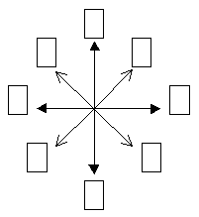
Draw the following in the lower left hand corner of the map
Draw the compass and label the eight parts If you don’t know them, look them up!

