Slide 1
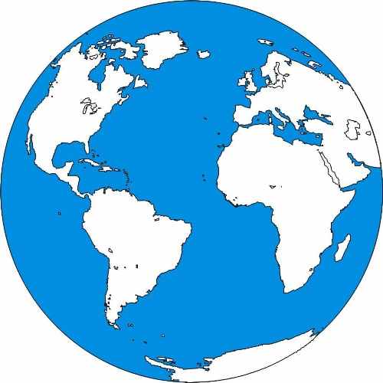

Slide 2
Five fundamental themes of geography
1) Location: the meaning of relative and absolute position on the earth's surface
Sample terms: Latitude and longitude, site and situation, direction, distance, scale
Skills: Map reading, identification
Questions: Where is ____? Where is ____ relative to where I am?

Slide 3
What is a Map
A Map is a picture of the world or a specific part of the world such as a country or state.
Unlike a Globe it is drawn on a flat surface.

Slide 4
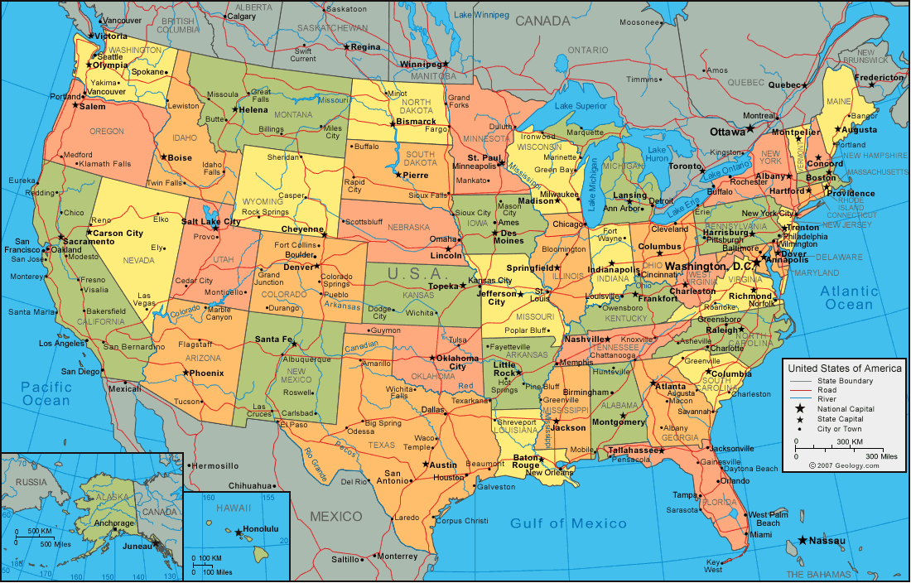
What is a Map
A map is a picture of a much larger piece of land
A map shows locations smaller than they actually are.
The distance between places are shorter too.

Slide 5
Answer this question on a sheet of paper with your name, date and hour.
How would you use a Map?

Slide 6
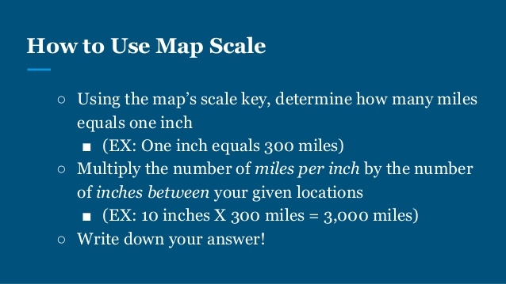
Maps are drawn to scale
This means the location on a map have the same proportions to the locations in real life.

Slide 7
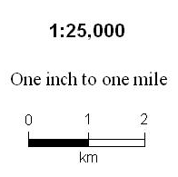
Map Scale
Map scale refers to the relationship (or ratio) between distance on a map and the corresponding distance on the ground. For example, on a 1:25,000 scale map, 1in on the map equals 1mile on the ground

Slide 8
Have you ever measured using a map scale?
Yes
Or
No

Slide 9

Latitude and Longitude
Help us locate exact places in the world.

Slide 10
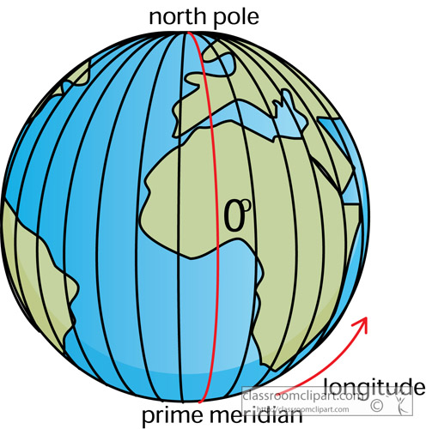
Longitude Lines
Think of the earth as a globe.
Trace your finger all the way around the globe, from bottom to top. You are tracing a line of longitude. There are 360 lines of longitude .
The lines run North and South or from top to bottom.

Slide 11
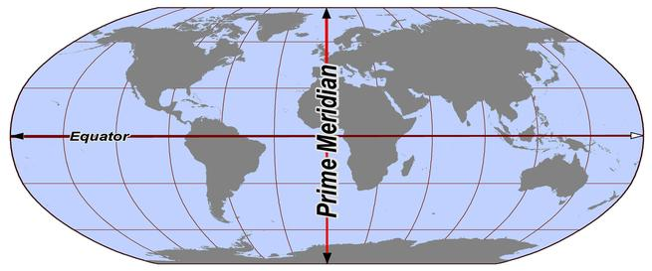
Prime Meridian
The Prime Meridian is a line of longitude . It is measured at 0 degrees of longitude.
It splits the world into two. The Western hemisphere and the Eastern hemisphere.

Slide 12
What Is the function of the Prime Meridian ?

Slide 13
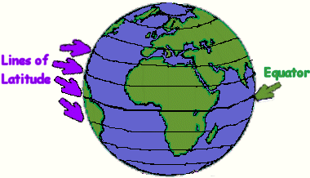
Latitude Lines
Think of the earth as a globe again.
Trace your finger around the globe from left to right.
You just traced a line of latitude.
There are 180 lines of latitude.
They run East to West or around the globe from side to side.

Slide 14
How is Latitude related to Longitude?

Slide 15
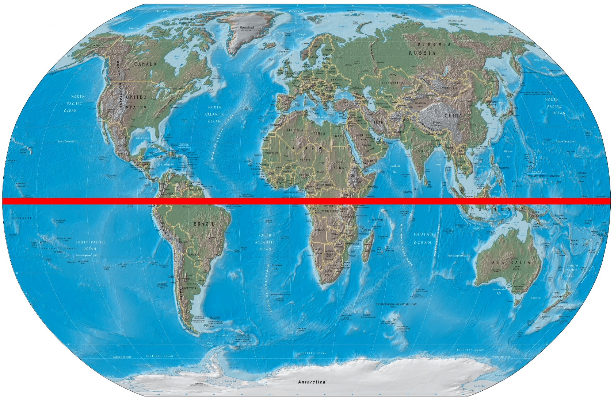
The Equator is a line of latitude .
It measures at 0 degrees of latitude.
Latitude and Longitude
help us find exact
Places on earth.
each place has its own
Set of coordinates
Dearborn
42.3223 N 83.1763 W

Slide 16
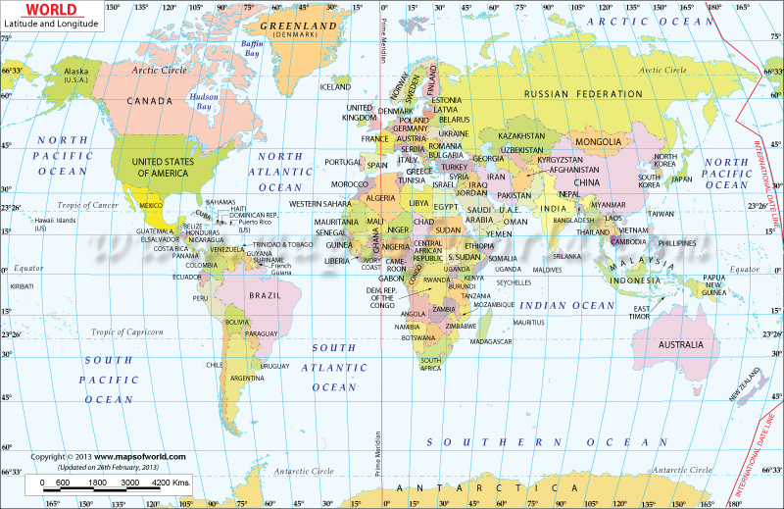

Slide 17
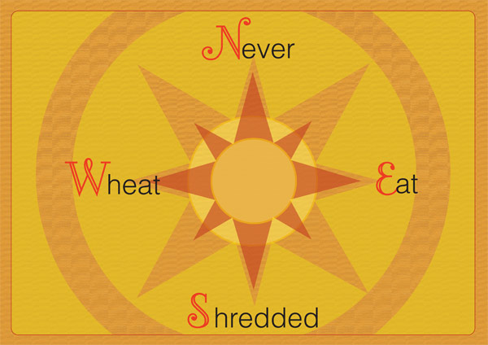

Slide 18
If you were to travel South from this classroom what road would you run into?

Slide 19
Relative and absolute location
Stand up!
Where were you born?
Where do you live?
Where’s the most beautiful place you’ve ever been?

