Slide 1
Patterns Day 2
Sept 27, 2019

Slide 2
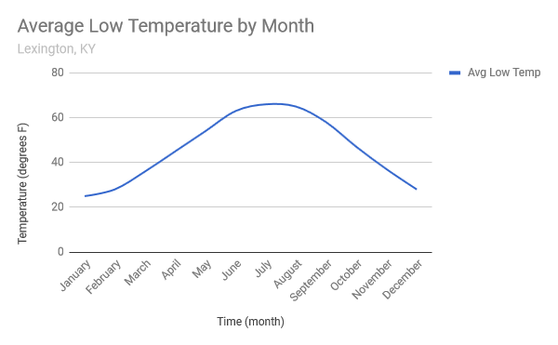
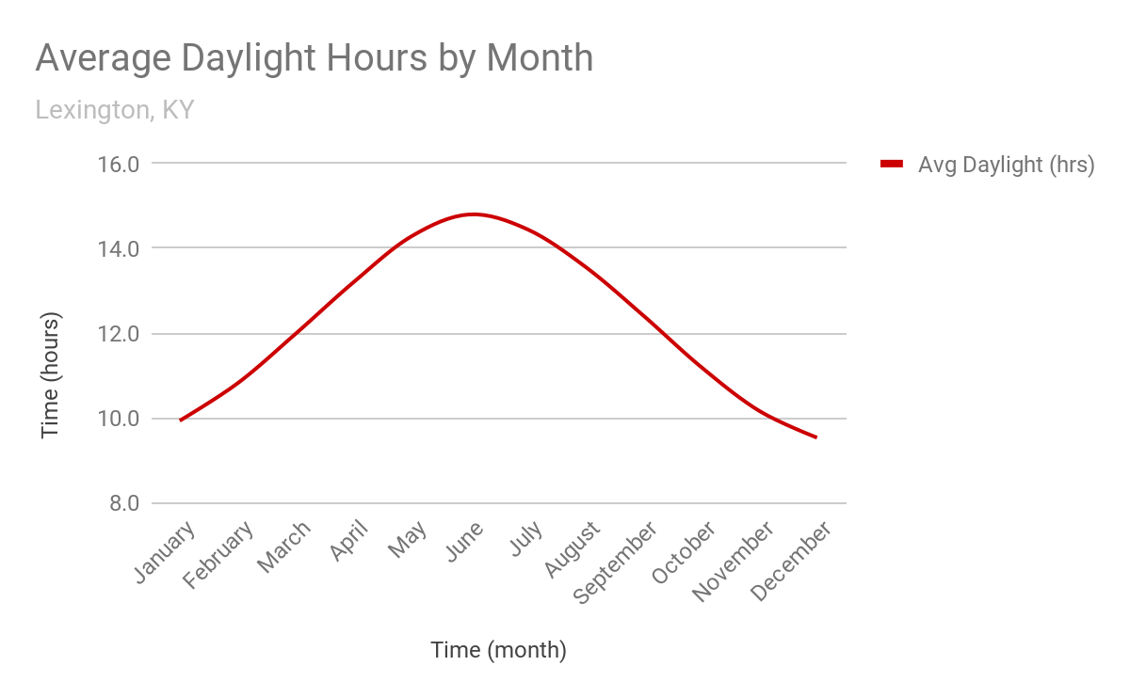
Comparing 2 Data on 1 Graph

Slide 3
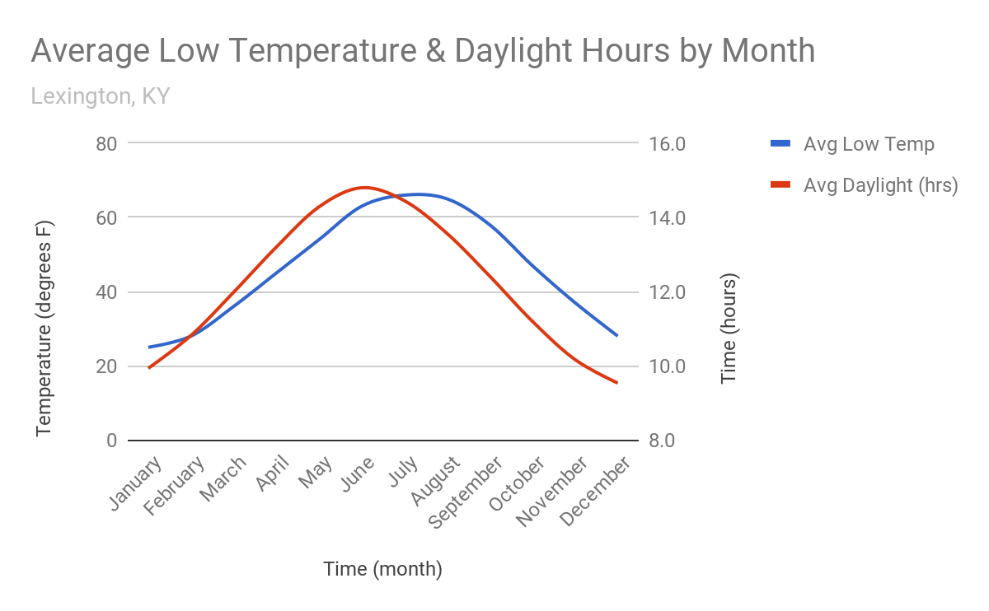
Comparing 2 Data on 1 Graph

Slide 4
Comparing 2 Data on 1 Graph
Both sets of data show up on one graph
Temperatures: Use the left side to plot each point with a blue pencil
Daylight hours: Use the right side to plot each point with a red pencil
Both data lines will overlap so you can see temperature AND daylight for each month at the same time.

Slide 5
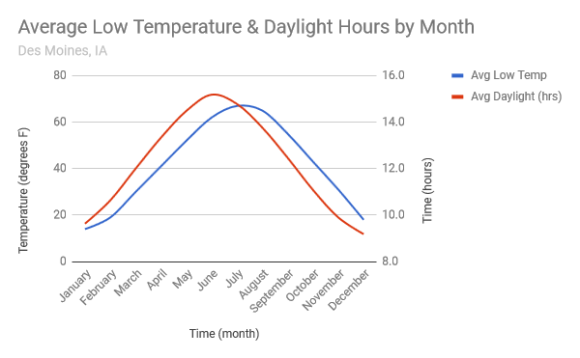
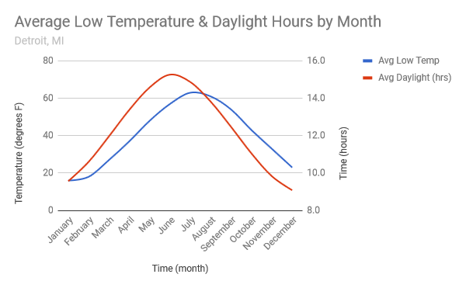
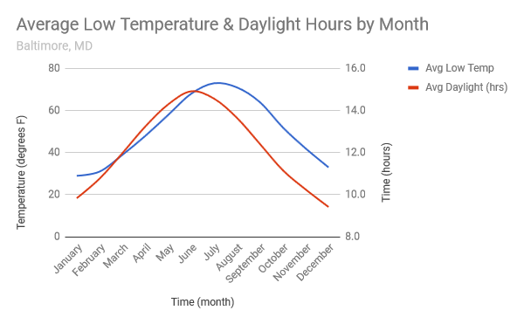
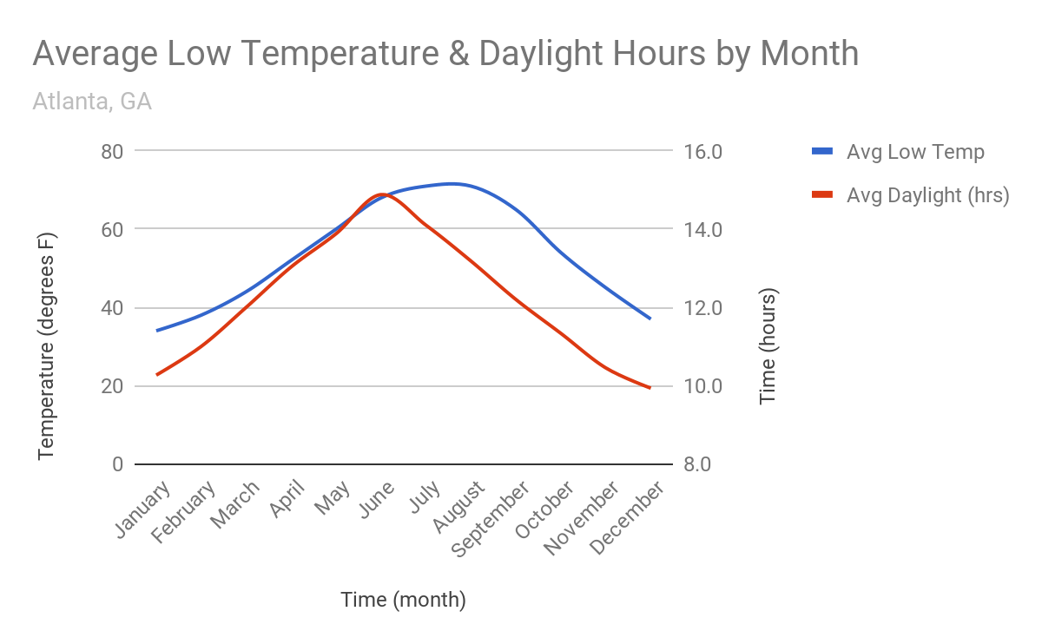
Use these graphs for question 4 on your paper.

