Slide 1
Patterns

Slide 2
Get out a piece of lined paper and set it up like this...
 | Patterns | Name 9-26-19 Hour Assign. #10

Slide 3
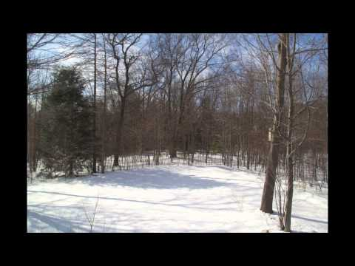
4 seasons in a Michigan backyard

Slide 4
Let’s Discuss...
Are there any repeated events you see in the video?
If the video kept going, what would happen next?
What would a graph of the temperatures look like?

Slide 5
On your paper...
Copy & answer the Essential Question.
 | Patterns | Name Date Hour Assign. #10
 | Essential Question: How can we make accurate predictions?
 | (Answer the question with your initial thoughts on the next line.)

Slide 6
 | Essential Question: How can we make accurate predictions?
Data Table | What observations can you make about the data in the tables?
 | Do you notice any patterns in the data?
 | (Copy & answer the questions on the next line.)

Slide 7
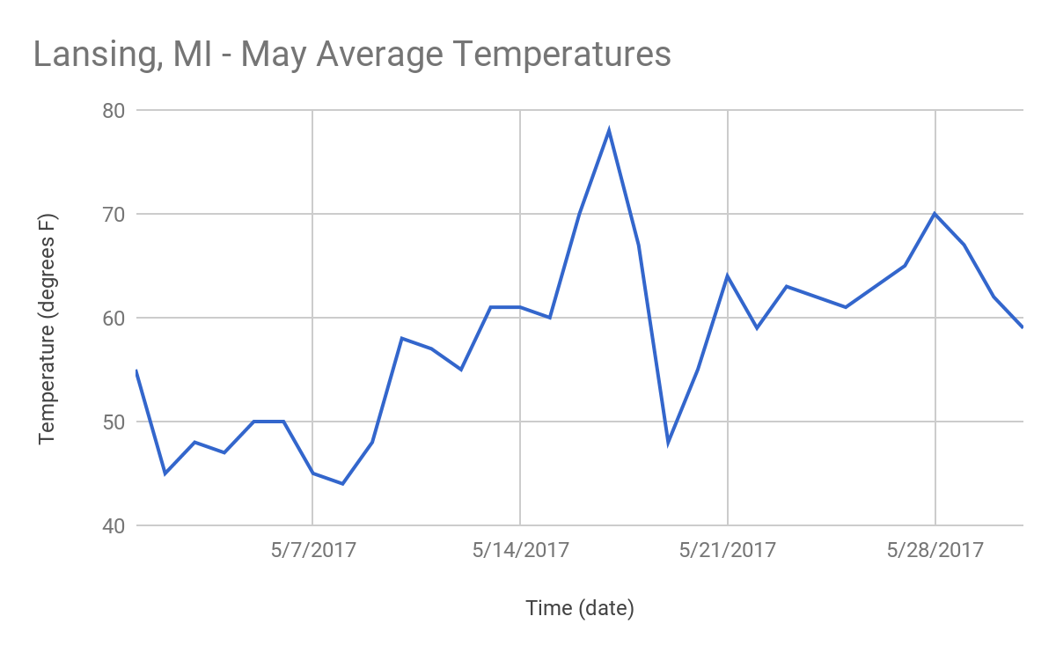
 | Do you notice any patterns in the data?
Data Graph | What observations can you make now?
 | Do you notice any patterns now?
 | (Copy & answer questions
 | on the next line.)

Slide 8
 | Do you notice any patterns now?
Predict | What would a graph of the average daily temps for June look like?
 | (Copy & draw a prediction on your paper.)
MAY
Your prediction = JUNE

Slide 9
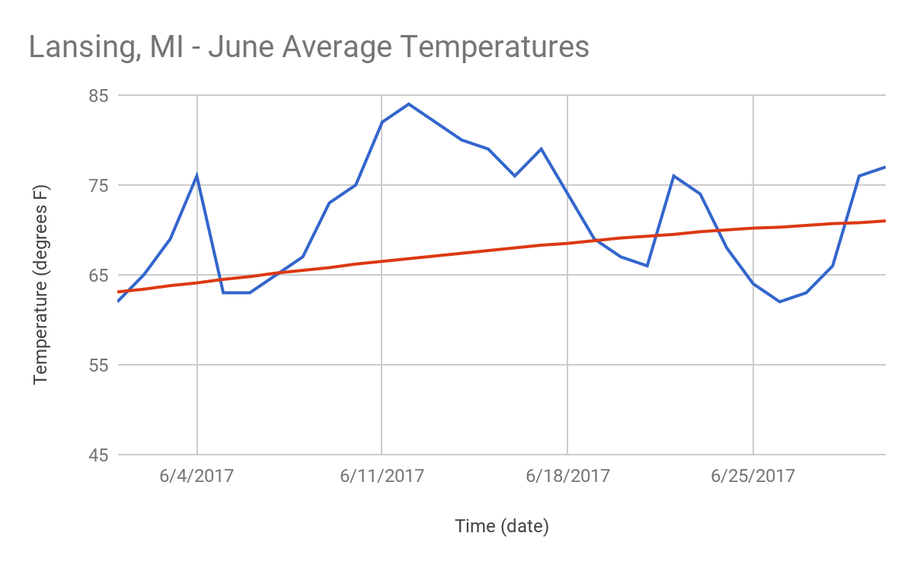
SHARE YOUR IDEAS
Turn and Talk for 2 minutes with your elbow partner, using the blue sentence stems.
How well did your prediction match the real data you see here?
“My data is similar to the pattern here because…”
“My data is different from the pattern here because…”

Slide 10
Watch the video again...
Predict | What would a graph of the average daily temps for June look like?
Compare | What trends do you see that are similar in the video and the graph?
 | (Copy & answer questions on the next line.)

Slide 11
Exit ticket on your paper… answer each question & turn in to the bin when complete.
Compare | What trends do you see that are similar in the video and the graph?
Exit Ticket | What can you call events that occur together regularly?
 | Which parts of the graph help you identify trends?
 | How can looking at data in different ways help reveal patterns?

