Slide 1
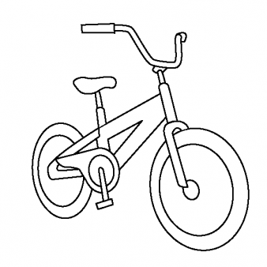
Bikes For Books!!! A reading contest for Dearborn Public Schools. Open to first – fifth graders!! March 12 – April 30
First 3 books read get you into a raffle for a bike.
Every book you read beyond the initial 3 gets you another ticket in the raffle.
The more books read the more chances you have to win!!!
We will raffle off a boys bike and a girls bike at every school!
Top 5 schools with the most books read will receive a assembly and magic show

