Slide 1
A Nation Divided
Ms. Ha
Chapter 22
Section 3

Slide 2
I. Working class goes to war
A. Draft
1. Selective Service System (WWI)
2. Forced into combat
3. Males
4. Ages: 18-26

Slide 3
5. Getting out of draft
a. Sympathetic doctors
b. Change residency
c. College deferment: sign up
d. 80% of soldiers: lower class
e. Poor whites and minorities

Slide 4
6. Women
a. 10,000 served
b. Mostly nurses
c. American Red
Cross

Slide 5
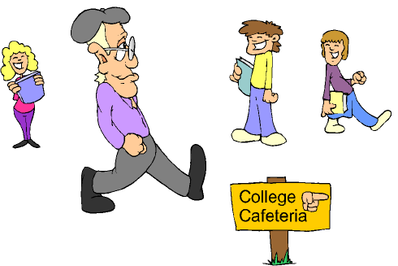
B. Opposition: college students
1. “New Left”: speak out
2. Campus Activism
a) U.S. “fundamental change”

Slide 6
b) SDS: Students for a
Democratic Society
1) Corporations ran America
2) Greater individual freedom

Slide 7
C. Reasons for resistance:
1. Vietnam: civil war, U.S. stay out
2. S. Vietnam: no better than N.V.
3. U.S. couldn’t police globe
4. Morally unjust

Slide 8
D. Government: 200,000 draft
dodgers
1. 4,000 imprisoned
2. 6 months to 5 years in jail
3. 10,000 fled to Canada

Slide 9
E. Doves v. Hawks
1. Doves: withdraw, peace
2. Hawks: stay, increase fighting
3. Protestors: “disloyal”
4. Americans 70%
5. “America-love it or leave it”

