Slide 1
Pearl Harbor
Dec. 7. 1941
Ms. Ha
Case Study

Slide 2
I. Hawaii
A. Island of Oahu
    1. Military Naval Base
    2. Pearl Harbor

Slide 3
B. Oahu: next to Honolulu

Slide 4
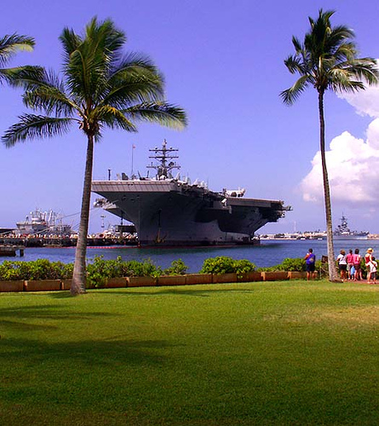
Pearl Harbor Today

Slide 5
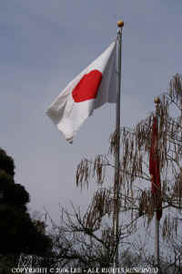
C. Japan attacked
Pearl Harbor
    1. No warning
    2. Morning of
    Dec. 7, 1941
    3. US was NOT
    at war

Slide 6
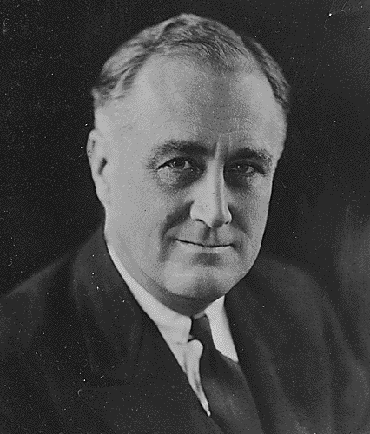
D. Franklin D. Roosevelt
1.
“Day that will live in infamy”

Slide 7
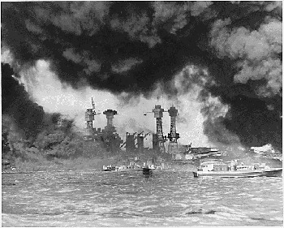
II. U.S. enters WWII
….this is our story…..

