Slide 1
Korematsu v. U.S. (1945)
Ms. Ha
Chapter 17

Slide 2
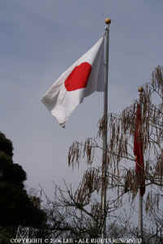
I. Attack on Pearl Harbor
A. December 7, 1941
  1. U.S. was not at war with Japan
  2. Isolationists

Slide 3
3. Oahu: next to Honolulu
U.S. Naval Base

Slide 4

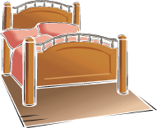
4. The Japanese:
“We woke a sleeping giant”

Slide 5
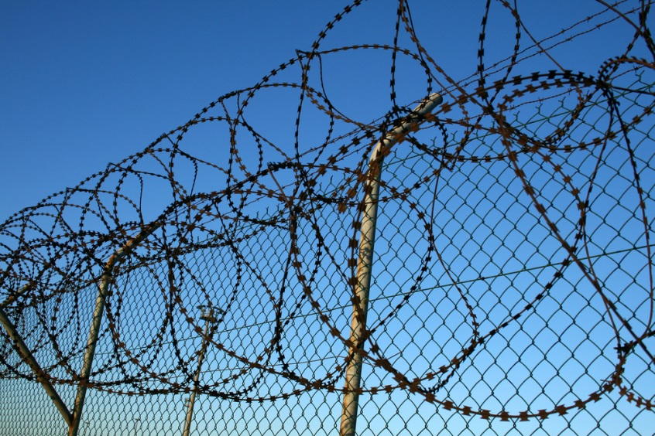
B. Franklin D. Roosevelt
  1. Executive Order 9066
  2. Aim: Japanese Americans

Slide 6
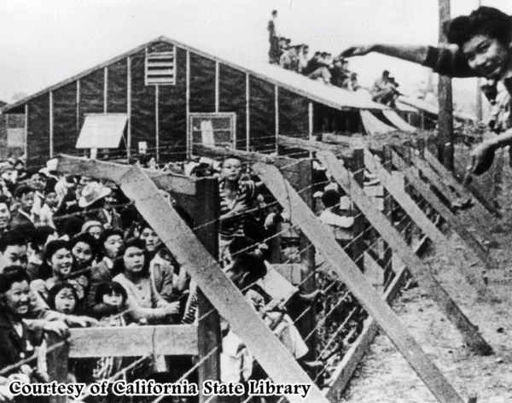
3. Manzanar Internment Camp
California

Slide 7
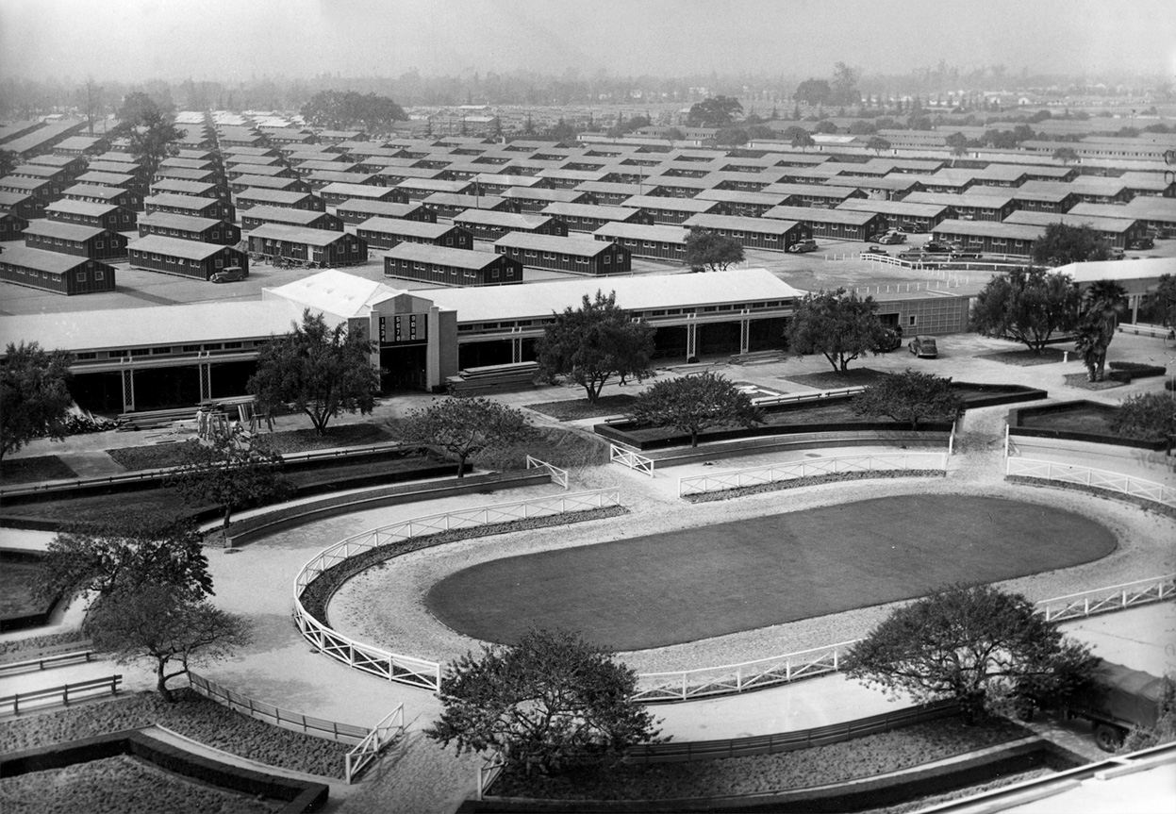
Converted Race Track: Camp

Slide 8
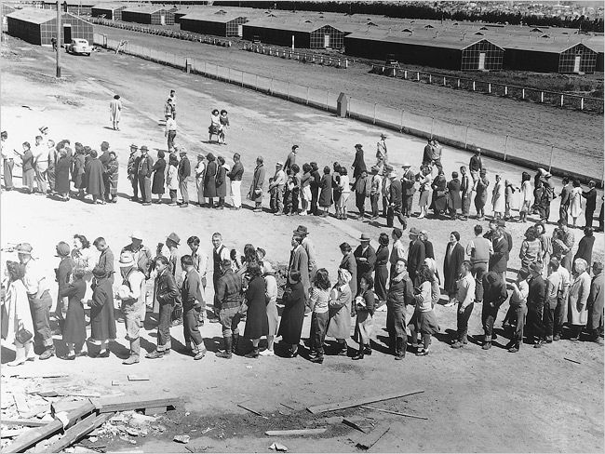
Inside a camp

Slide 9
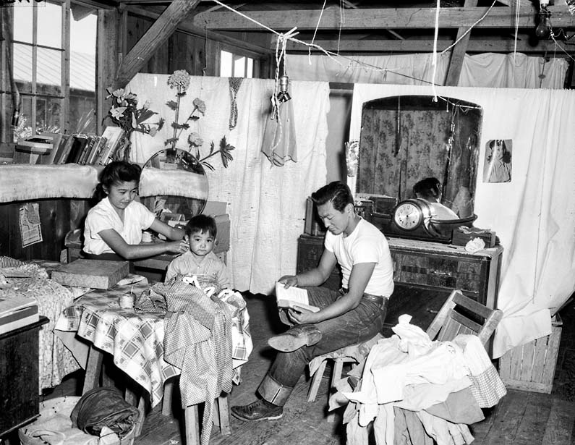
Inside a Barreck

Slide 10
II. Fred Korematsu
A. Refused to leave his home
  1. Convicted of defying military orders
  2. ACLU (American Civil Liberties Union)
  3. Appealed his case and lost

Slide 11
In June 1983, the Commission on Wartime Relocation and Internment of Civilians concluded that the decision to remove those people of Japanese ancestry to U.S. prison camps occurred because of “race prejudice, war hysteria, and a failure of political leadership.” Four decades after the Supreme Court decision, after a legal historian discovered evidence proving that U.S. intelligence agencies knew that Japanese American posed no military threat to the country during World War II, Korematsu's conviction was overturned.

Slide 12
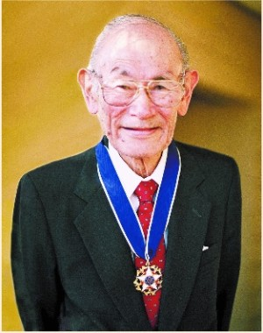
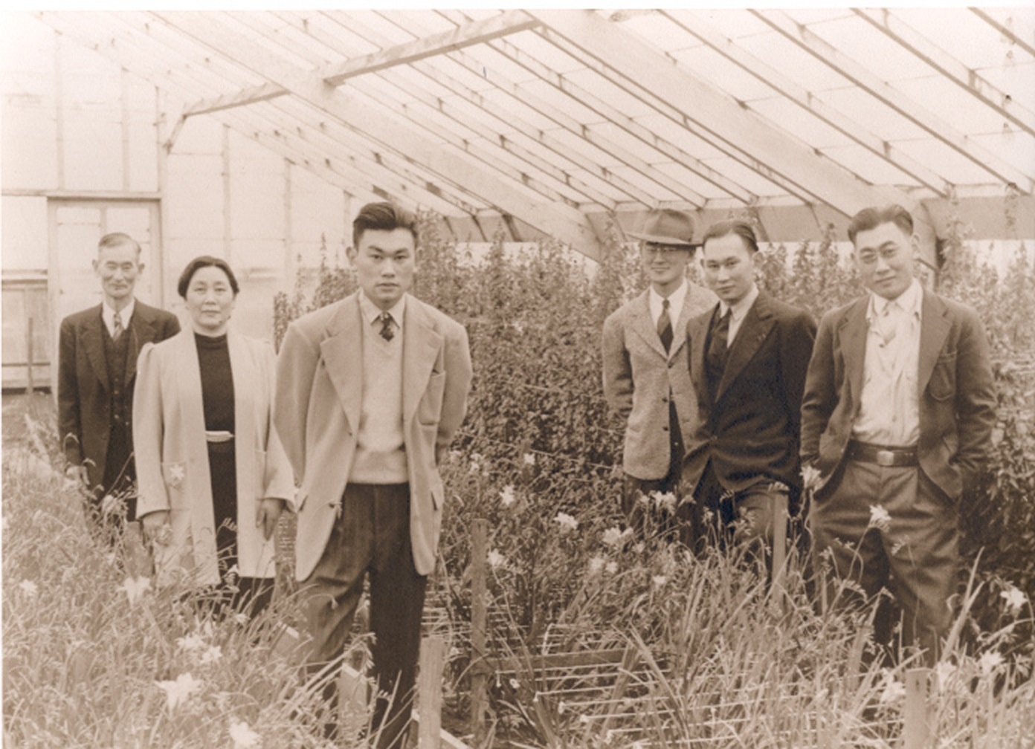
Fred & His Family

Slide 13
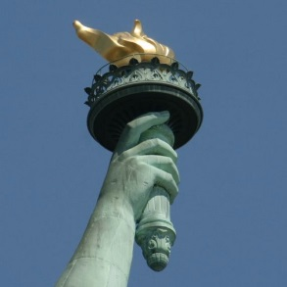
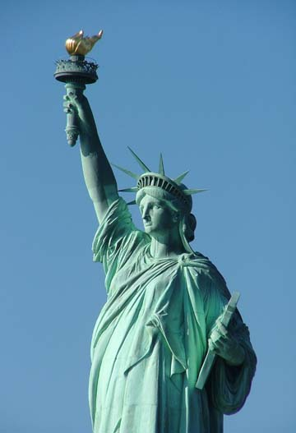
B. Presidential Medal of Freedom
1. January 15, 1998
2. President Clinton awards Fred Korematsu
3. 1988: Congress passed a law ordering
reparation payments to survivors
detained in camps

