Slide 1
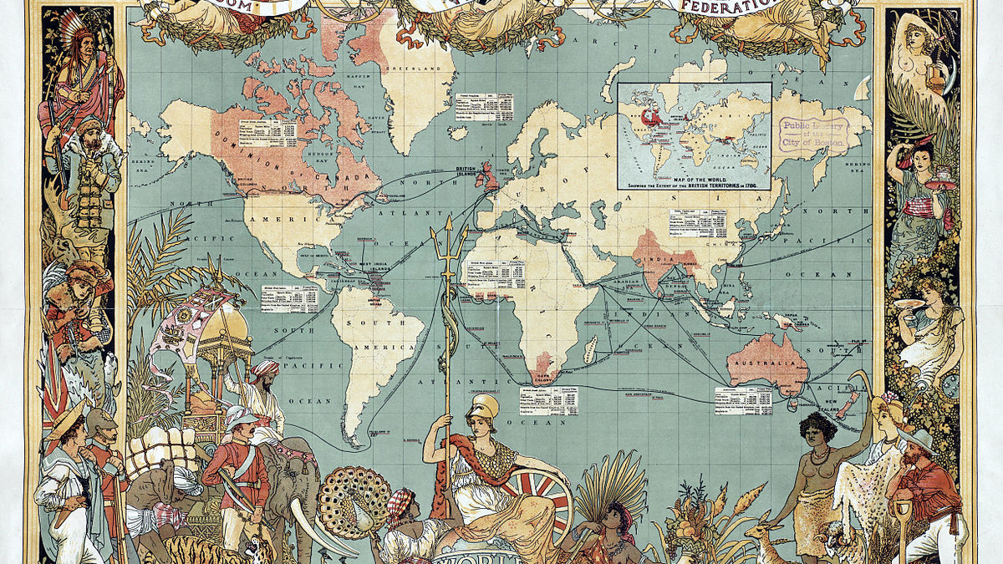
Nationalism & Colonization Day #2
Ms. Ha
This Photo by Unknown Author is licensed under CC BY-SA

Slide 2
I. Colonization: A. who was involved?
1. Great Britain
2. France
3. Spain
4. Japan
5. United States

Slide 3
b. nationalism
1. Defined as a love of one’s country
2.Nationalism swept
Europe in 1800s to early
1900sEurope in 1800s to early
1900s
This Photo by Unknown Author is licensed under CC BY-SA

Slide 4
II. Characteristics of Nationalism
1. A common language
2. One government
3. Shared common history
4. History education for citizens
5. Common culture

Slide 5
III. NATIONALISM Characteristics
A. What are the characteristics of
nationalism?
1. A common language: unites
people
2. Multilingual: multiple languages, people
still love their country

Slide 6
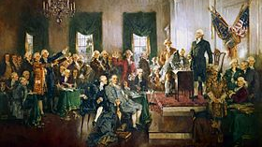
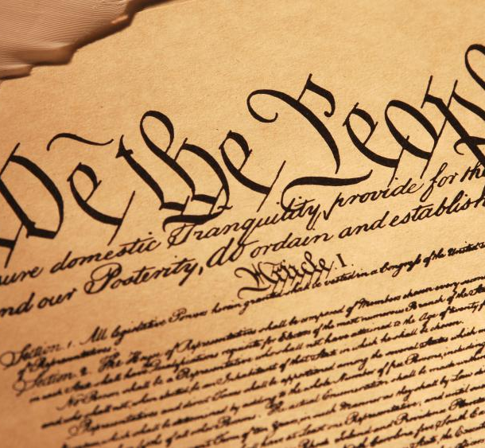
B. One government
1. United States: The US Constitution

Slide 7
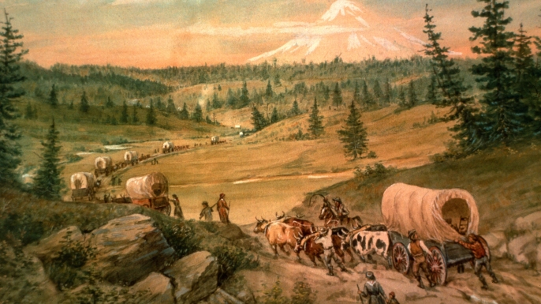
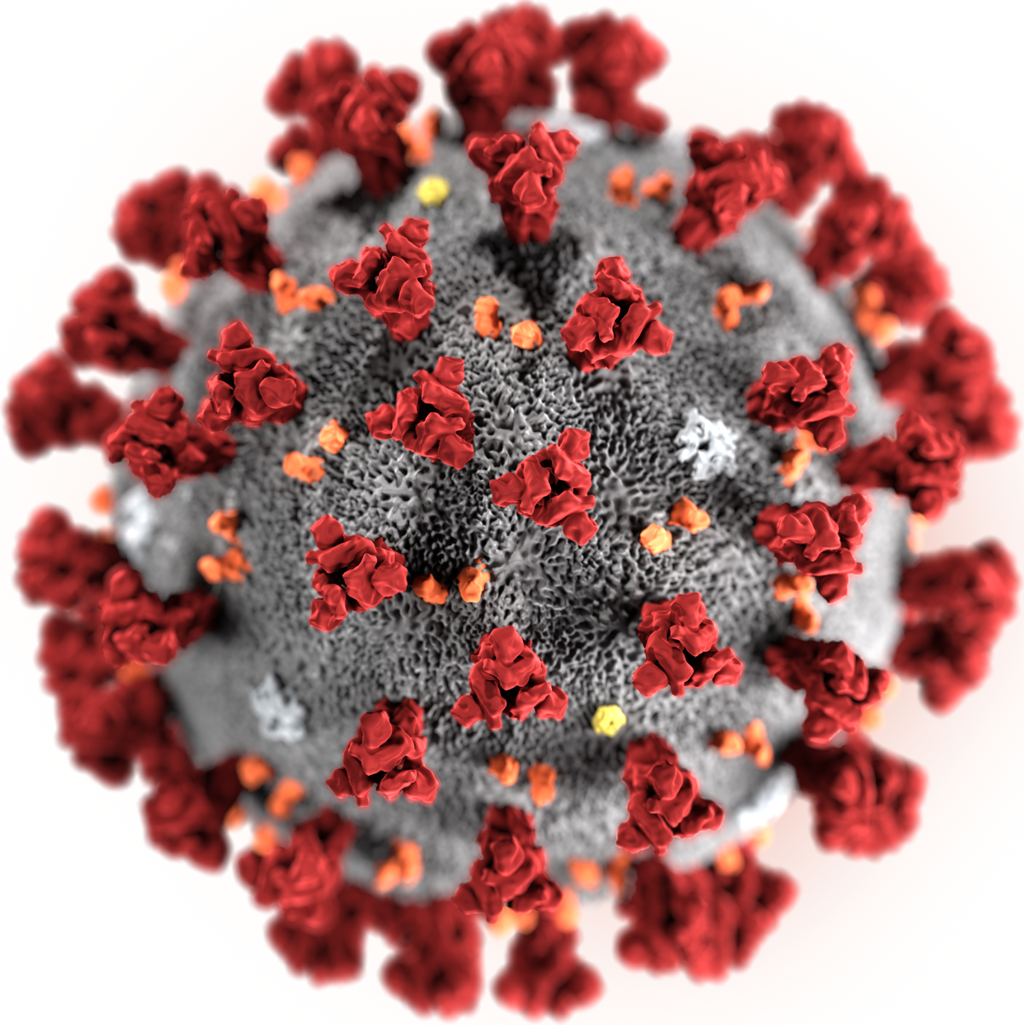
C. Common History
1. US
a) American Revolution
b) Civil War
c) Westward Expansion
d) Imperialism
e) World War I
f) Today: Covid-19
This Photo by Unknown Author is licensed under CC BY-SA

Slide 8
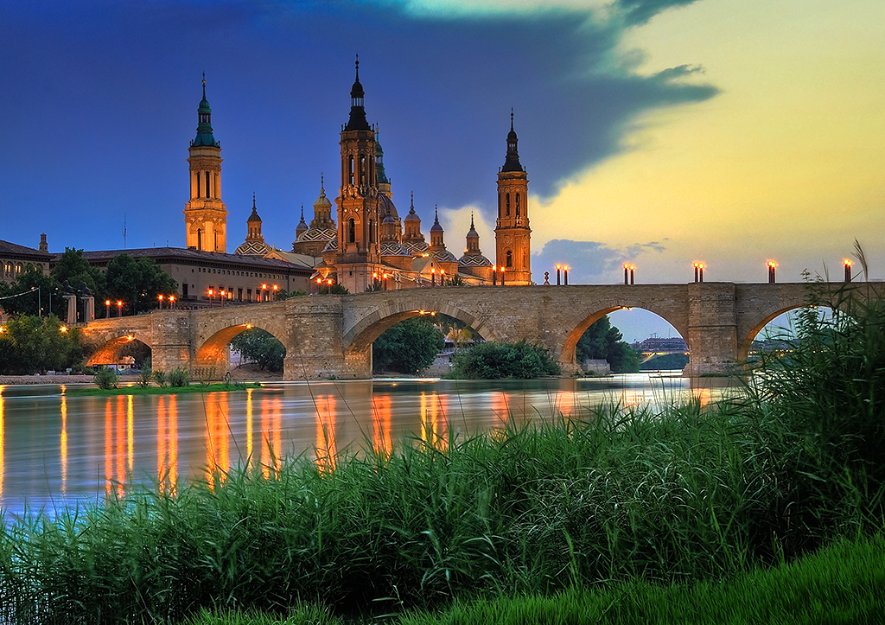
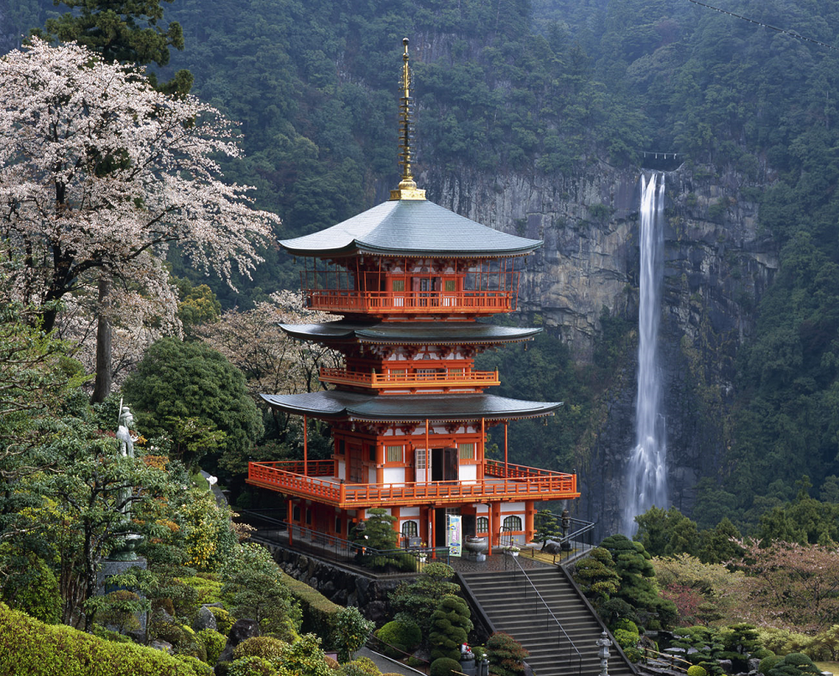
D. History Education
1. History Classes
a) US History
b) Great Britain: teaches their history
c) Spain: teaches their history
d) Japan: teachs their history

Slide 9
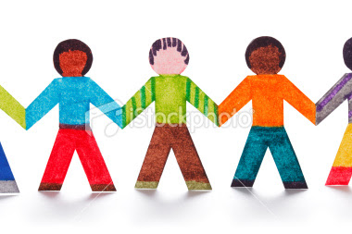
E. Common culture
1. Shared beliefs
2. Shared customs
3. Shared religion
4. Shared music
5. Shared way of life

