Slide 1
Inventions & Progress
Ch. 26
Section Four

Slide 2
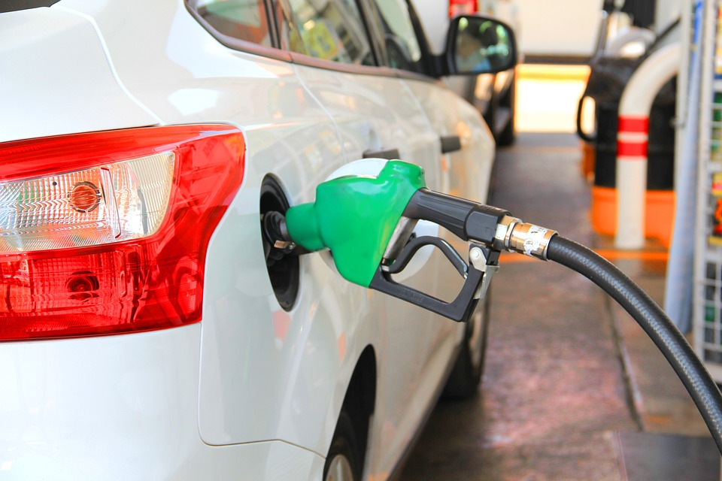
I. Inventions: improve life
A. 1800s: COAL & STEAM drove
machines
  1. New energy sources in the 1900s
  2. 1900s: Gasoline, made from oil
  3. 1900s: Electricity

Slide 3
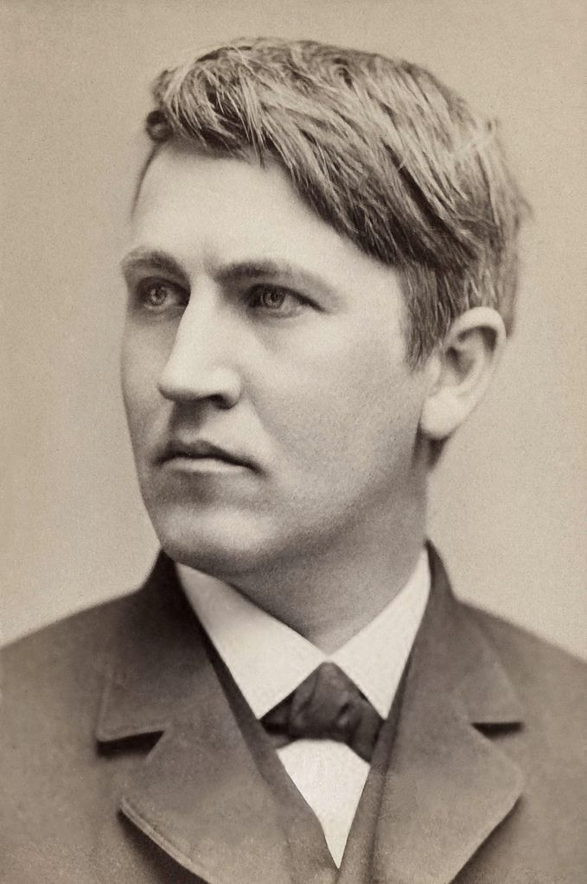
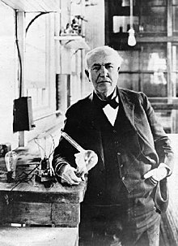
B. Thomas Alva Edison
  1. Patented over 1,000 inventions
    a. Light Bulb Filament
    b. Phonograph

Slide 4
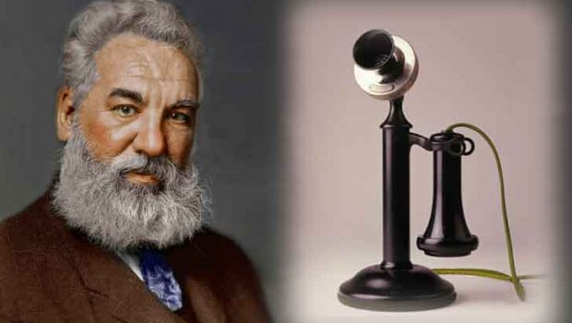
C. Alexander Graham Bell
  1. Invented the telephone

Slide 5
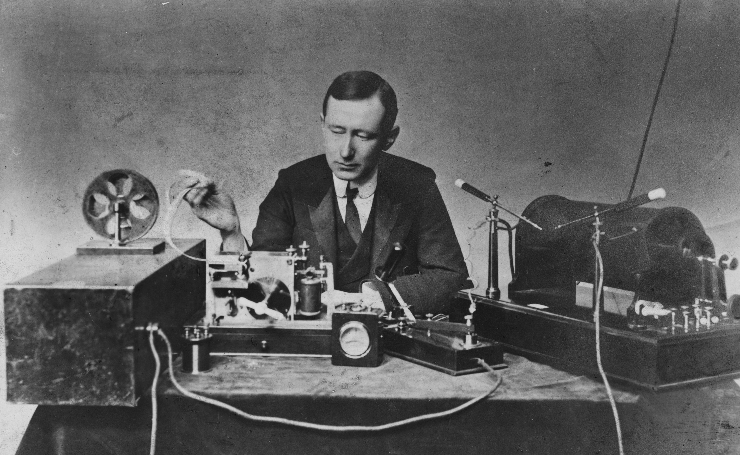
D. Guglielmo Marconi
  1. 1895
  2. First radio

Slide 6
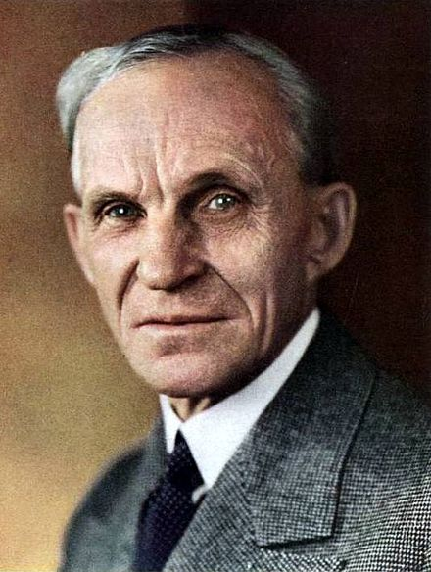

E. Henry Ford
  1. Used the Assembly Line
  2. Interchangeable parts (standard size)
  3. Made parts faster, therefore cheaper
  4. Automobile Industry
  5. Model T

Slide 7
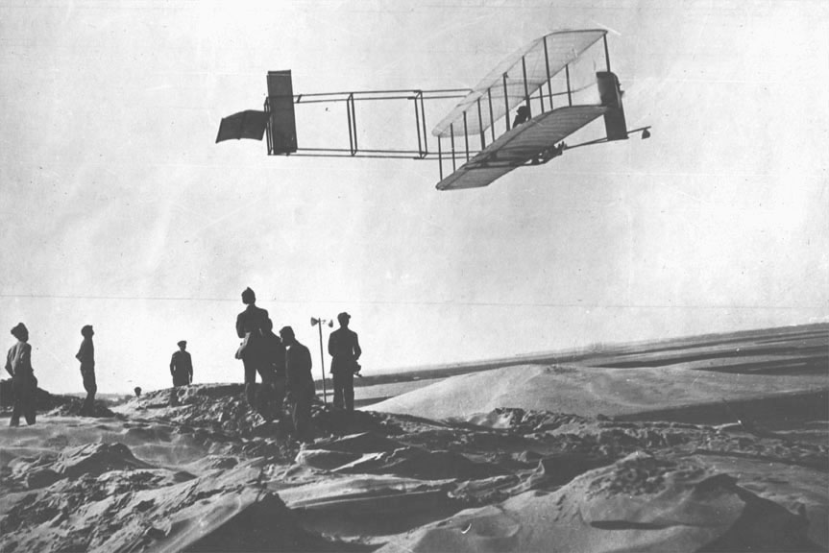
F. Wright Brothers Fly
  1. From Dayton, Ohio
  2. “Kitty Hawk”
  3. Dec. 17, 1903
  4. Longest flight 59 seconds

Slide 8

II. Medicine / Biology
A. Louis Pasteur
  1. Germ Theory of Disease
  2. Discovered bacteria
  3. Found heat killed bacteria
  4. PASTURIZATION: KILL GERMS IN
  LIQUIDS LIKE MILK

Slide 9
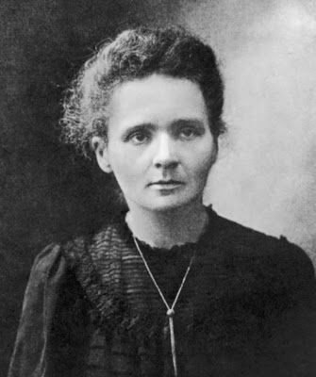
B. Marie Curie
  1. Studied radium & Polonium
  2. “Radioactivity”
  3. Won Nobel Piece Prize for physics
  4. Result: 1900 physicists worked on the
  atom

