Slide 1
The Civil War Begins
Ms. Ha
Chapter 26

Slide 2
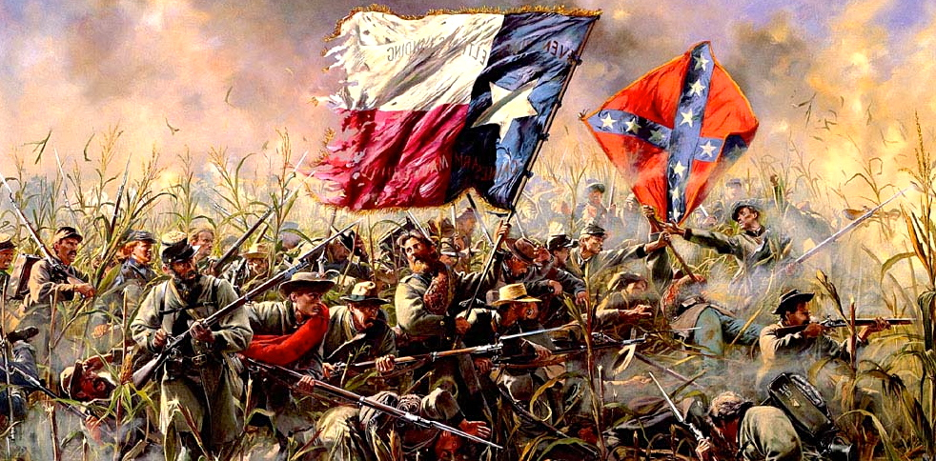
I. What is a Civil War?
A. Civil War
1. War on one’s own soil
2. North v. South

Slide 3
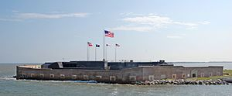
II. Civil War Begins
A. Fort Sumter
1. Island: South Carolina
2. Charleston Harbor
3. Union controlled
4. FIRST SHOT OF CIVIL WAR: fired by South on April 12, 1861

Slide 4
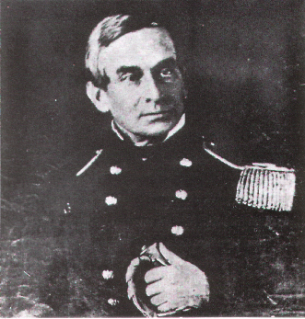
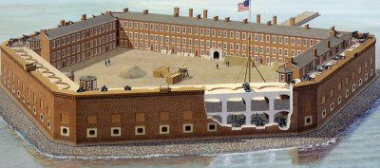
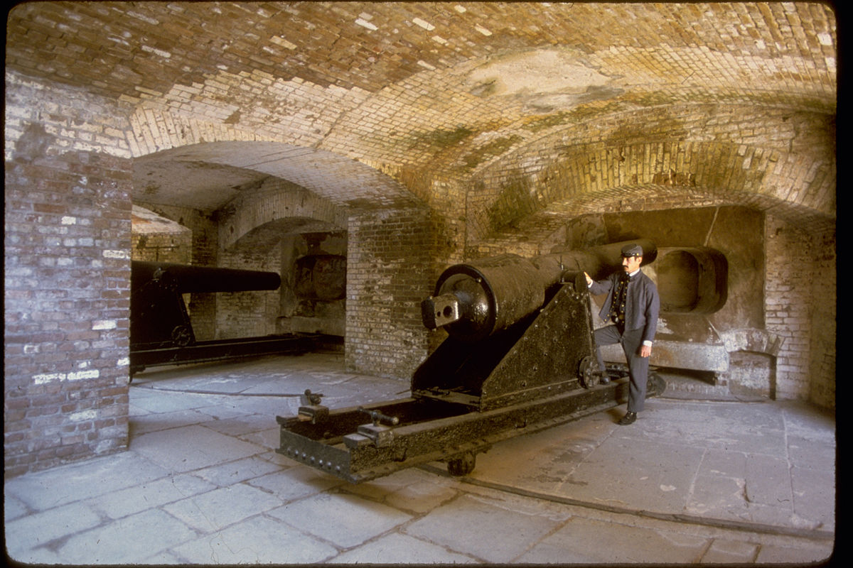
5. Union Major Robert Anderson
6. Surrendered on April 13, 1861
7. Fort Sumter fell / no deaths
8. United Northern people

Slide 5
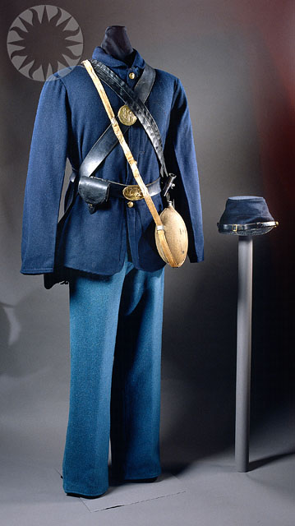
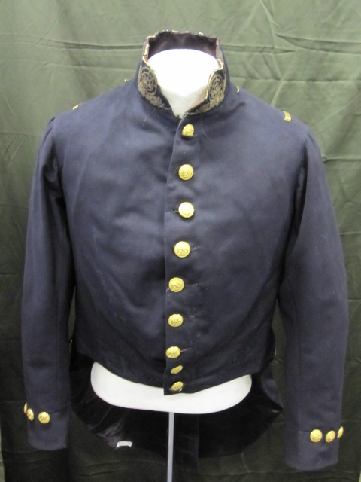
III. Union Divided
A. North B. South
1. Called the “Union” 1. Called the:“Confederacy” or the Yankees or Rebels
2. Wore: Blue 2. Wore: Grey

Slide 6
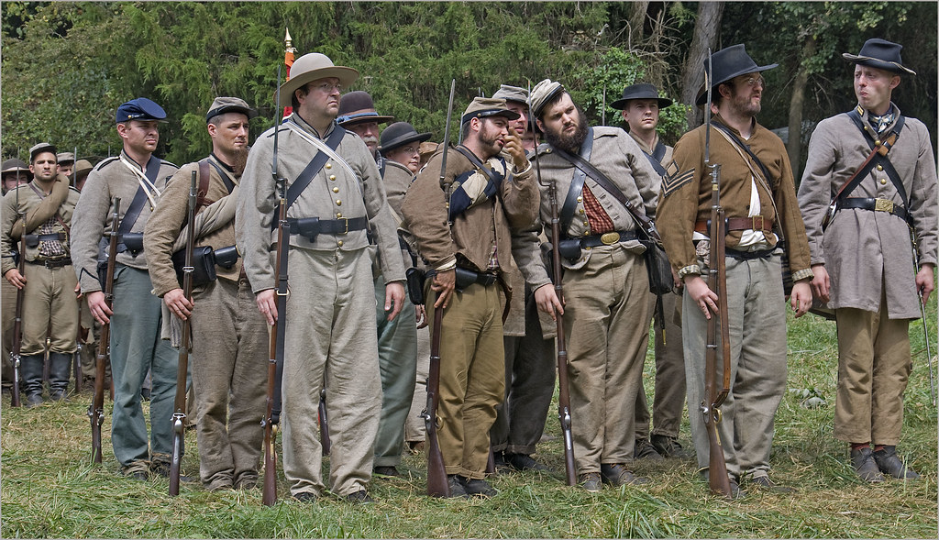
IV. Loyalty and Division
A. North: 23 states loyal
B. South: 11 succeeded
1. Virginia 6. Alabama 11. Florida
2. Arkansas 7. Mississippi
3. North Carolina 8. Tennessee
4. South Carolina 9. Texas
5. Georgia 10. Louisiana

Slide 7
V. Each Side had Advantages
A. North had more: B. South had more:
1) People & immigrants 1) More cotton: clothing
2) Factories 2) First-rate generals
3) More food 3) Highly motivated soldiers
4) Railroad Systems 4) “Home Court” advantage
5) Better medical care
6) Better shelter

Slide 8
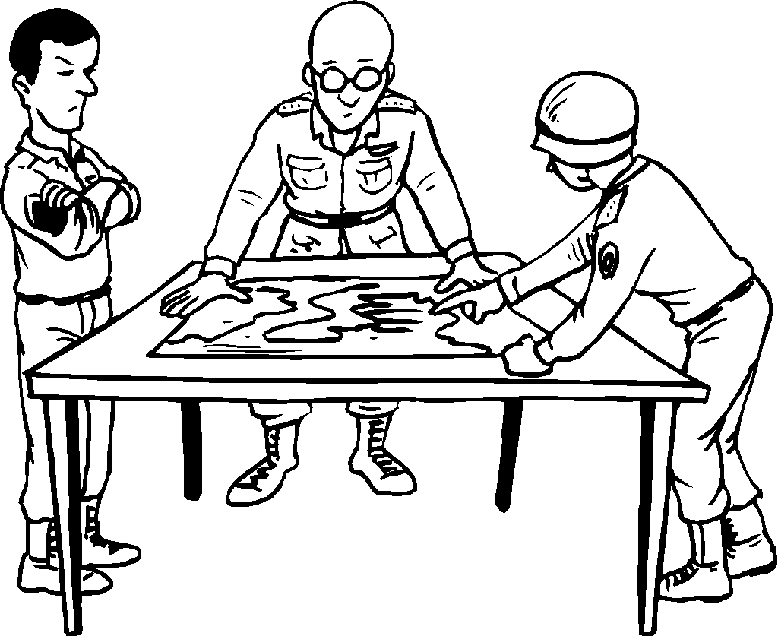
VI. Military Plans
A. The North: B. The South:
1. OFFENSIVE: go after 1. DEFENSIVE: fend off attacks
a) Blockade Southern ports a) Defense
b) Split Confederacy: use Mississippi River b) Attack: ONLY if an opportunity
c) Capture Confederate capital: Richmond VA

Slide 9
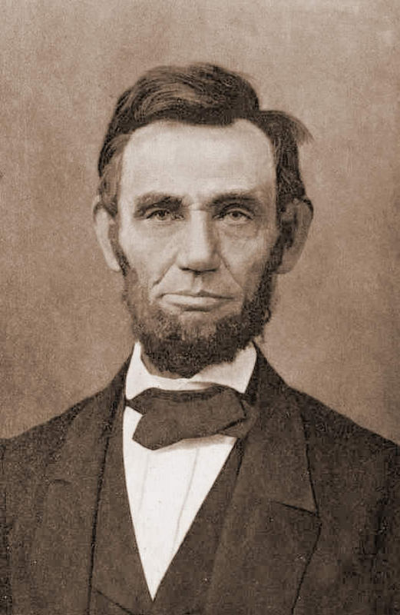
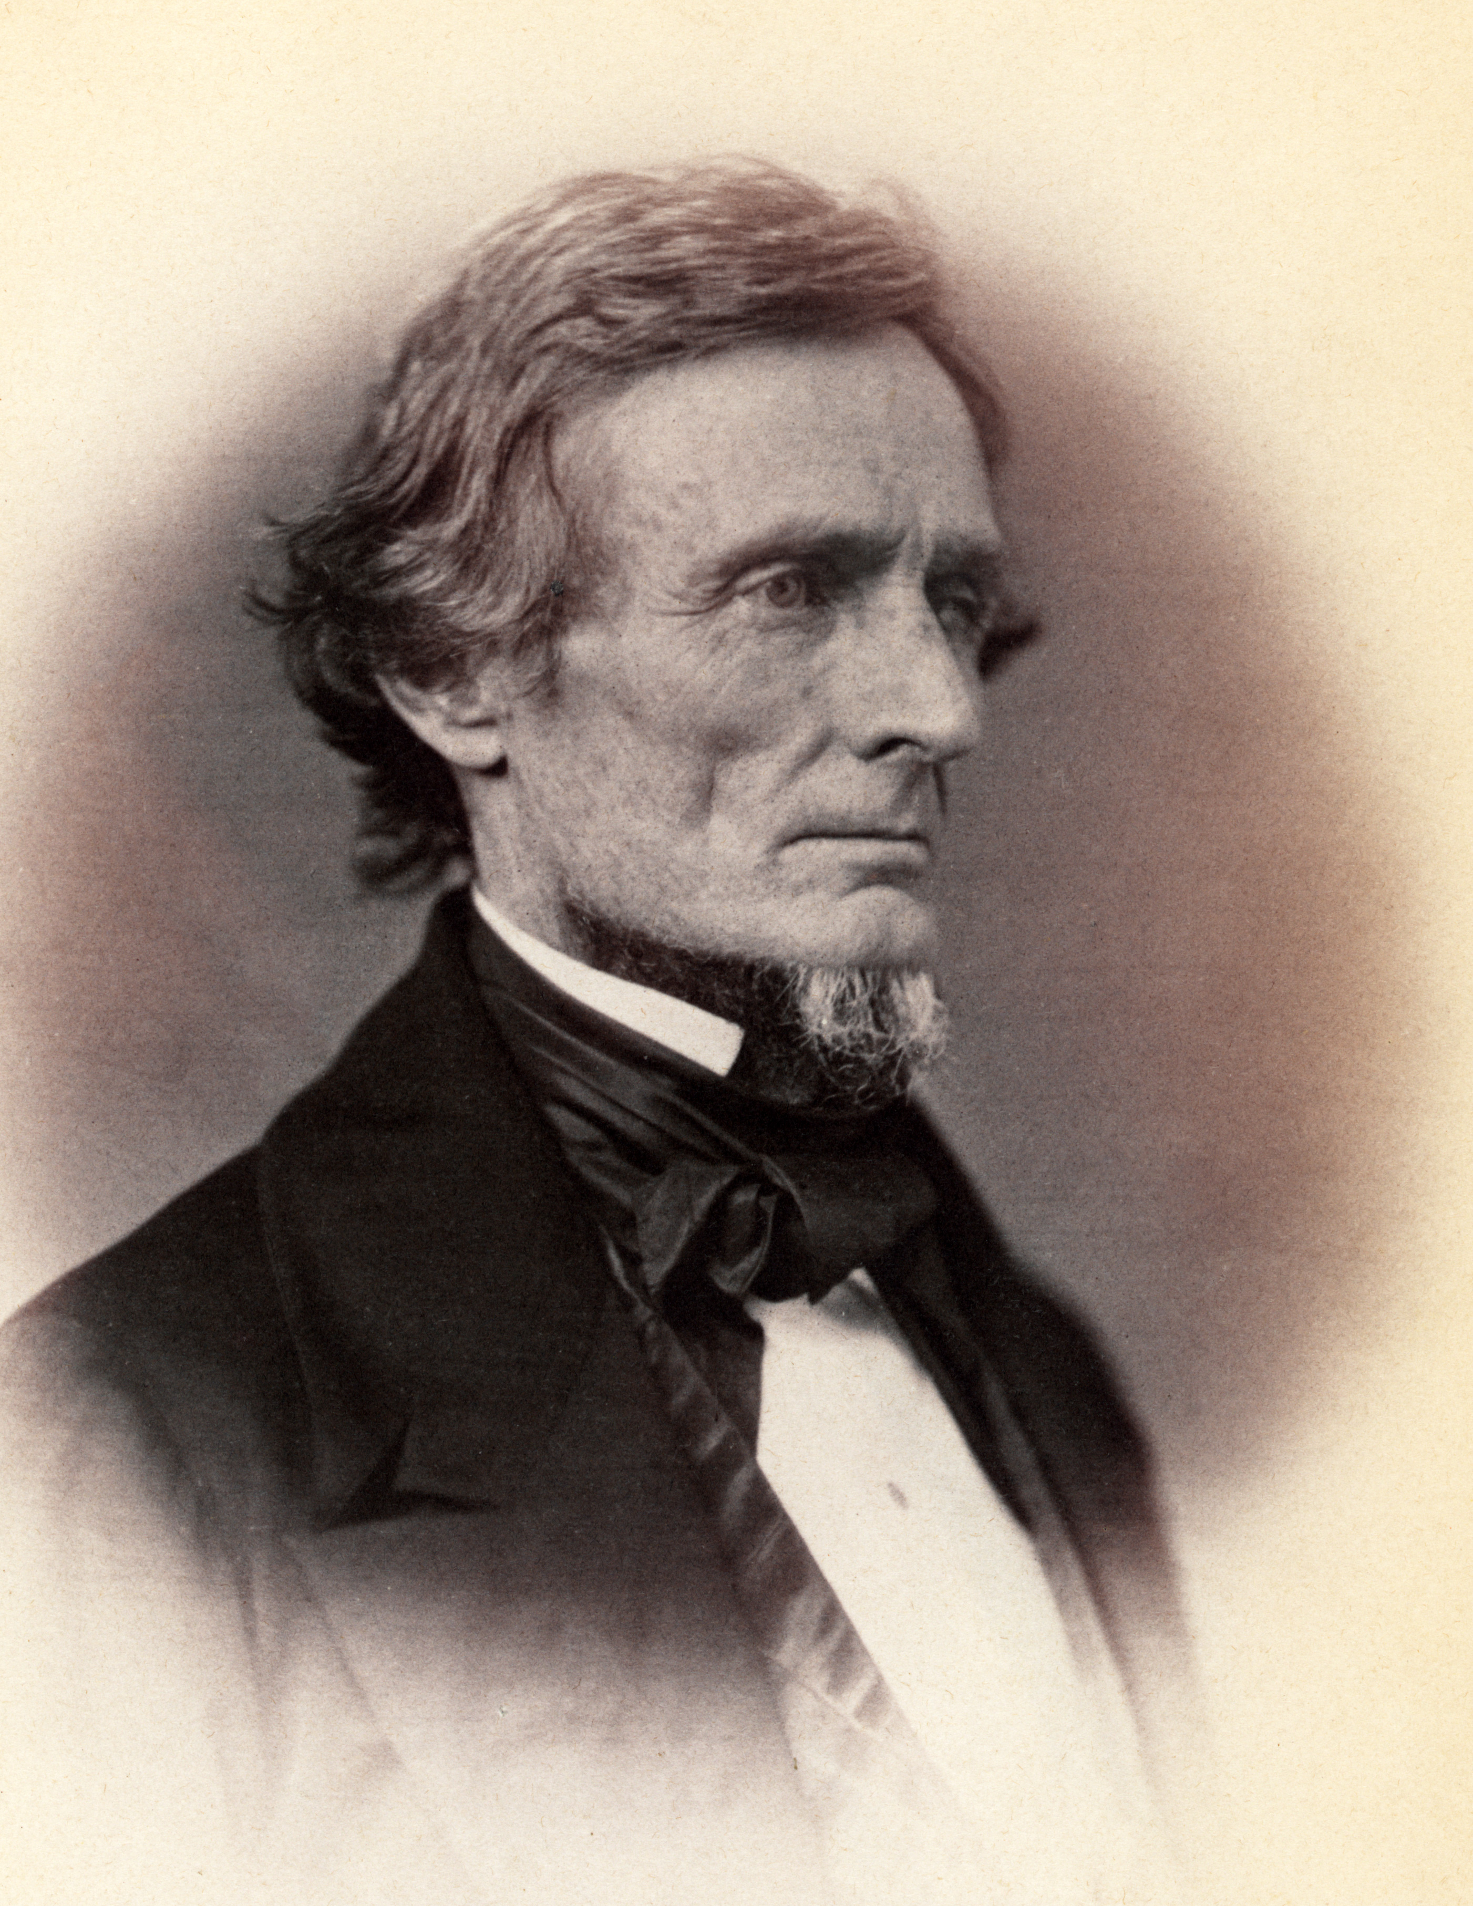
C. President Abe Lincoln:
1. Emancipation Proclamation: on January 1, 1863
2. Slaves were free in the South
3. Had to win the Civil War to make it happen
4. Southern President: Jefferson Davis

Slide 10
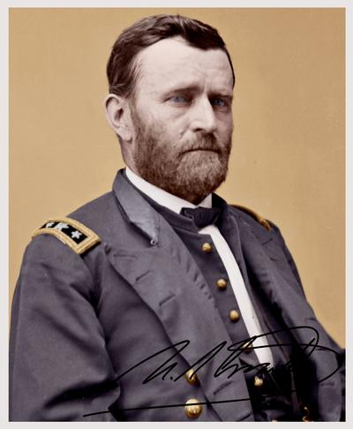
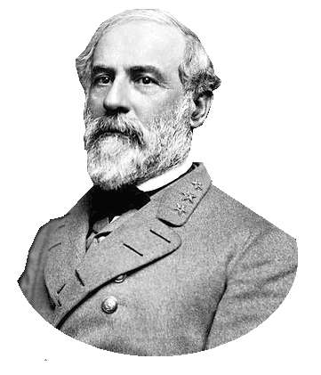
GRANT
D. Top Military Leaders:
1. North
2. Ulysses S. Grant
3. South LEE
4. Robert E. Lee

Slide 11
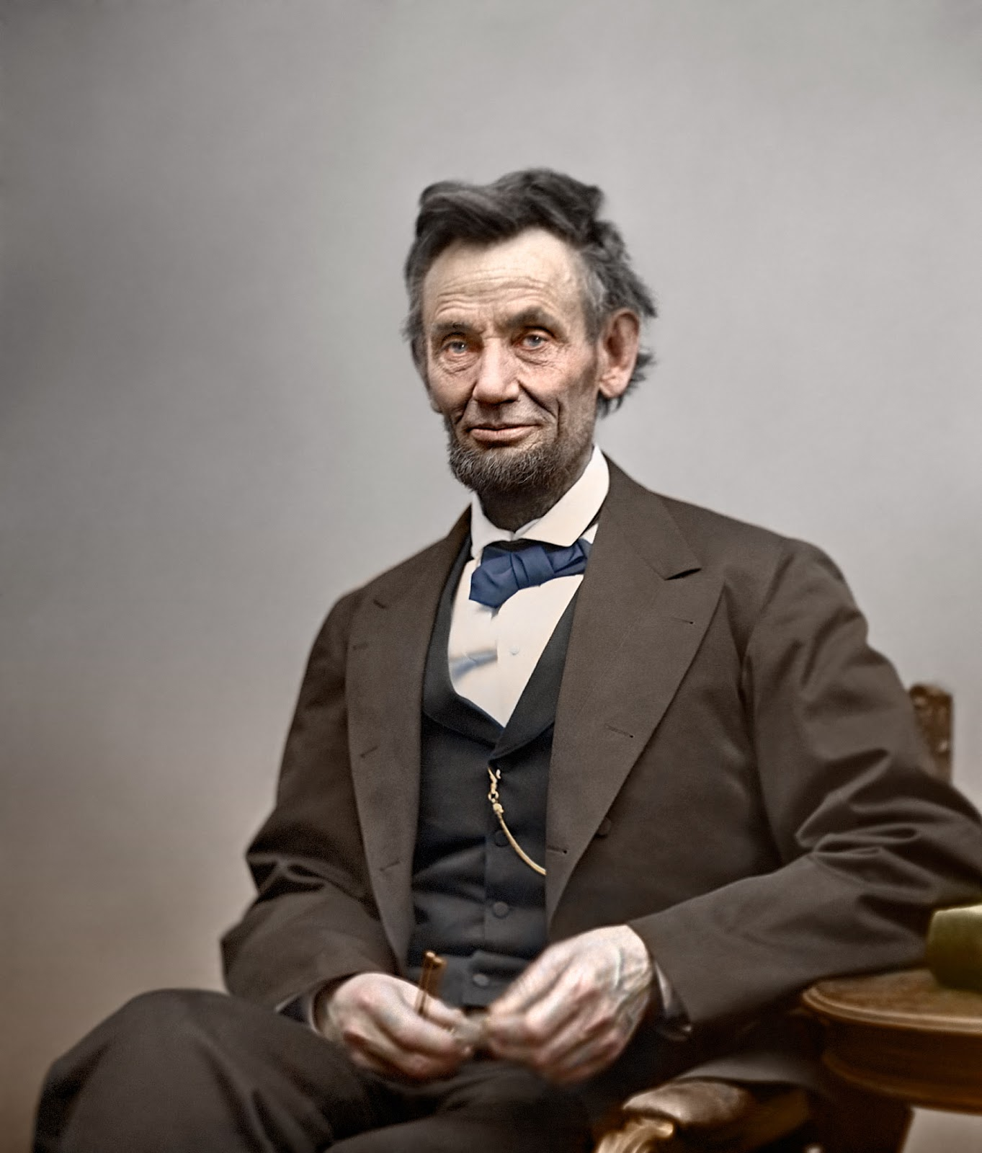
VII. Outcome
A. Brutal Civil War
1. NORTH or the UNION Won
2. President of the US: Abe Lincoln led the country
3. Years: 1861-1865
4. Death total: 618,222 men
a) (N) 360,222
b) (S) 258,000
5. Reconstruction: time period to bring the South “back in” to the North

Slide 12
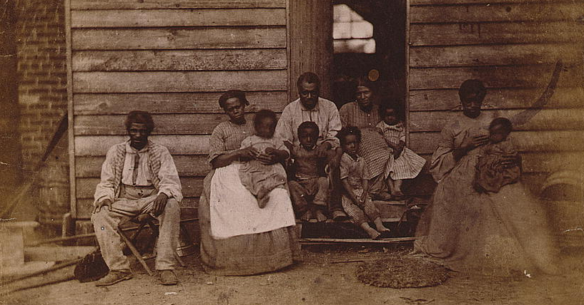
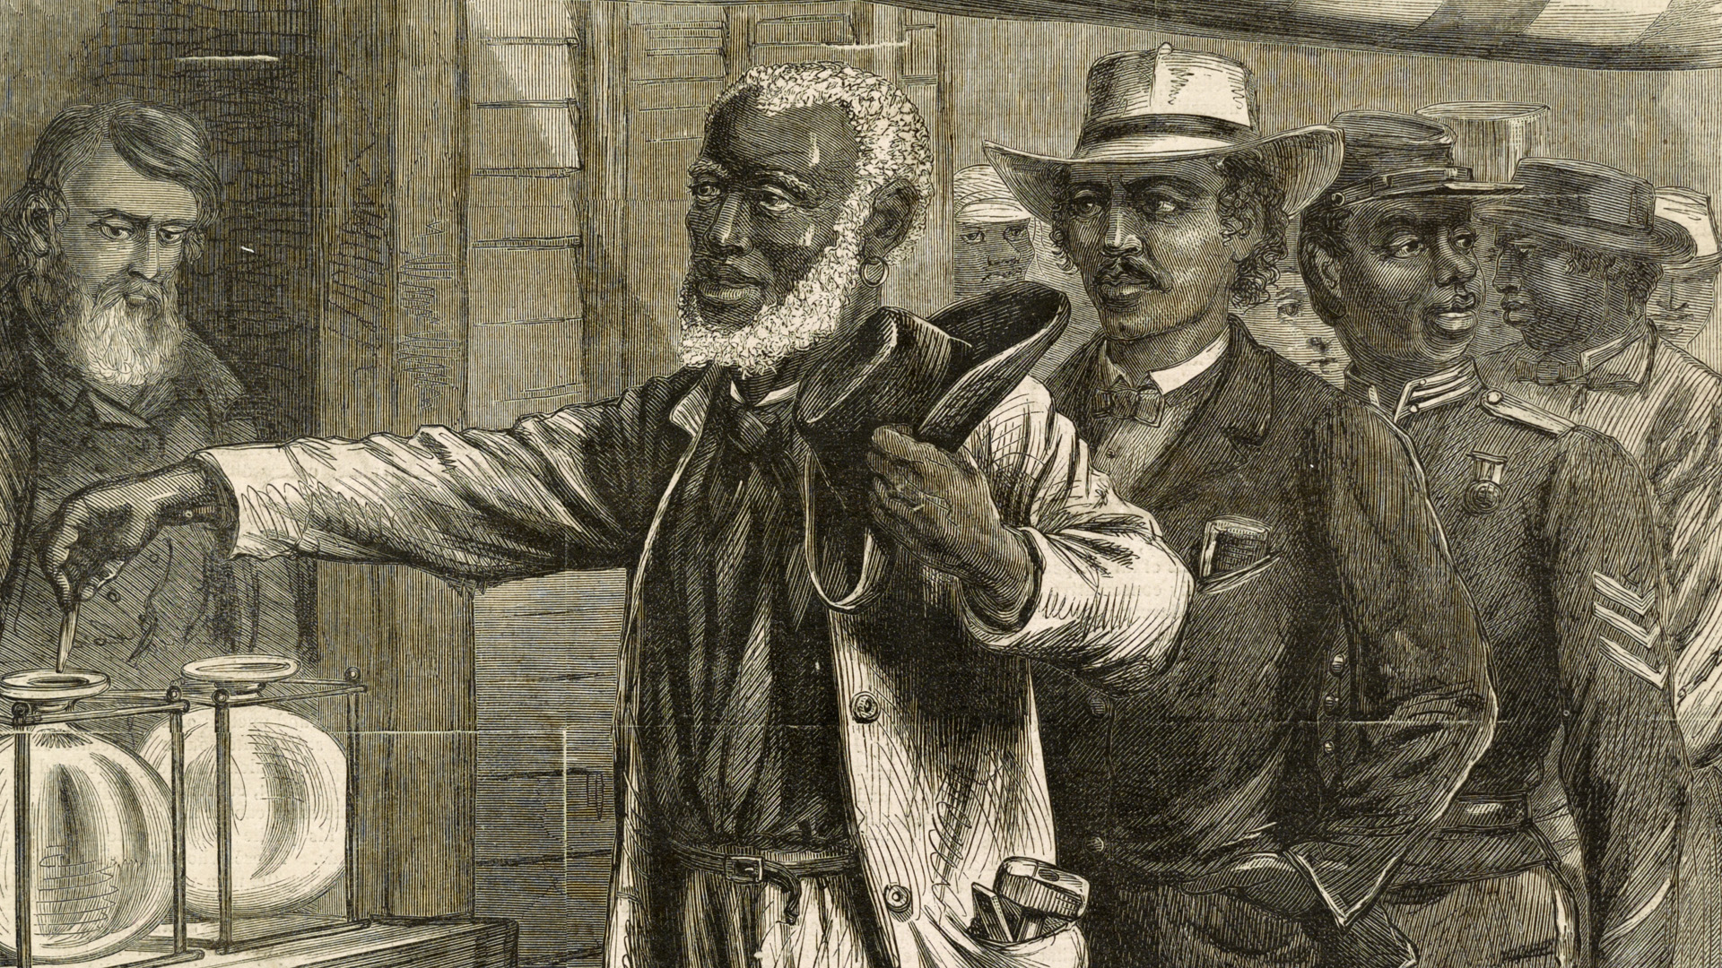
B. United States Amendments passed:
1. 13th Amendment: banned slavery in the United States
2. 14th Amendment: citizenship to all people born/naturalized &
equal protection under the law
3. 15th Amendment: blacks could now vote in elections in the US

