Slide 1
Spain: The rise & fall
Ms. Ha
Day #2

Slide 2
Content objectives:
1. SWBAT: explain why Spain became a
truly powerful nation.
2. SWBAT: explain why Spain’s political
and economic power was much
greater than England and
France.

Slide 3
Language objectives:
1. SWBAT: explain why Spain was so
powerful politically & economically.

Slide 4
I. Spain
A. Who were the Moors?
1. Nomads: invaded Spain
2. From northern Africa
3. In 700’s: Moors accepted Islam
4. Pushed over Pyrenees Mts. To
TOURS in A.D. 732
This Photo by Unknown Author is licensed under CC BY-SA

Slide 5
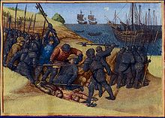
B. Who beat the Moors?
1. Franks
2. Moors settled in southern Spain
3. Built a civilization
4. Lasted over 800 years
This Photo by Unknown Author is licensed under CC BY-SA

Slide 6
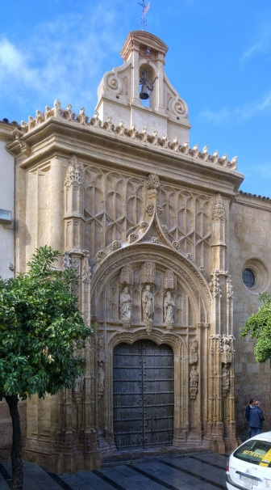
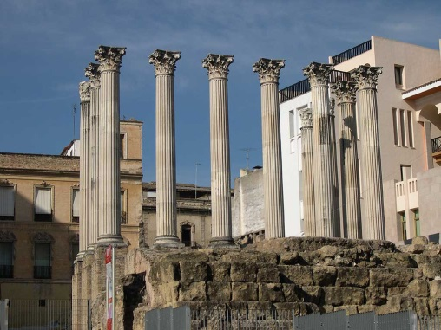
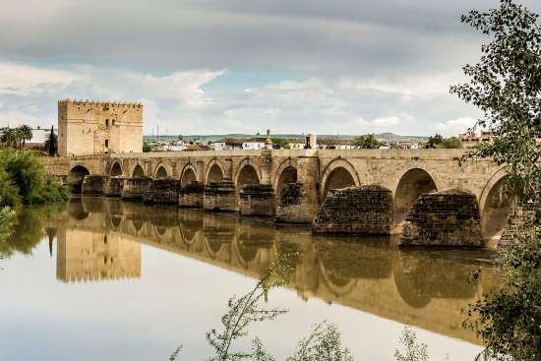
C. City of Cordoba
1. Great city
a) Over 1 million people lived there
b) Lamps lit the streets
c) Library: thousands of books from all over the world
d) Reintroduced: Greek & Roman learning into Europe
e) Studied geometry, astronomy, medicine and philosophy

Slide 8
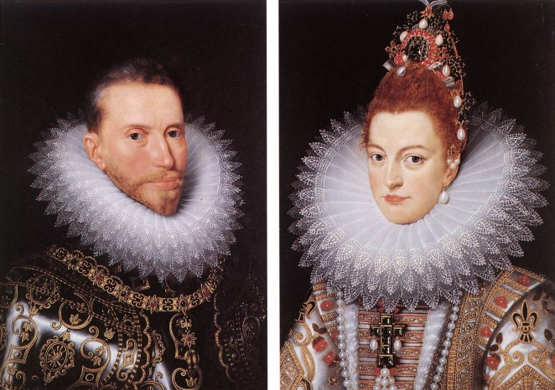
II. Changes in Spain
A. Four Christian Kingdoms
1. Strongest: Castile and Aragon
2. Marriage between Ferdinand (King of Aragon) &
Isabella (Castile) in 1469
3. Marriage: united much of Spain under two strong
rulers
4. Nobles: forced to accept their rule

Slide 9
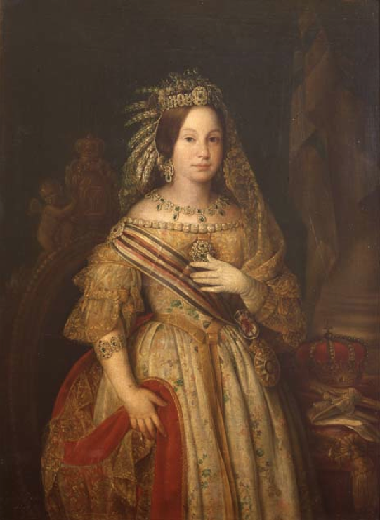
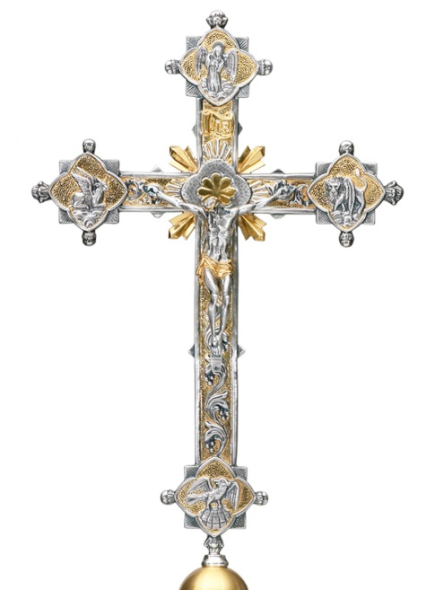
B. Isabella: wanted Spain an entire Catholic nation
1. 1482, attacked Granada, last of the Moorish
kingdoms
2. Surrendered
3. Moors and Jews convert or get out
4. Months later, furnished Columbus with three ships

Slide 10
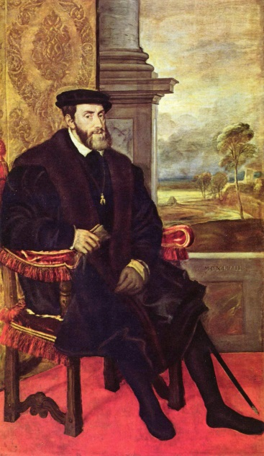
C. 1516: King Ferdinand died
1. Grandson: Charles next King
2. Also Grandson of the Holy Roman Emperor who
died in 1519
3. Took title Charles V, only 19 years old
4. Ruled one of largest empires in history

Slide 11
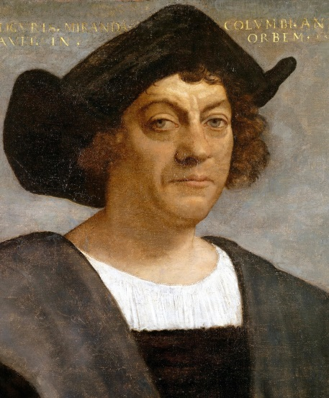
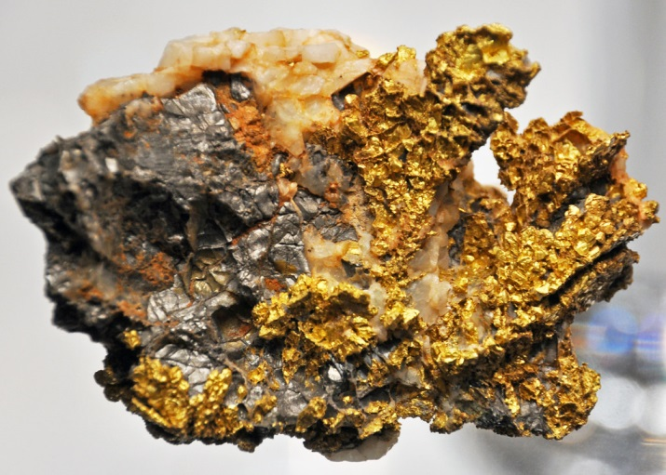
D. What did he rule over?
1. Hapsburg family
2. Land in France
3. Austria: from his grandfather
4. Half of Italy, Netherlands, Germany and Belgium
5. Controlled lands Columbus discovered
6. Gold and silver from America’s / wealthy $$

Slide 12
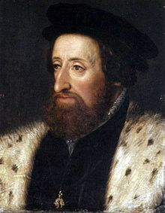
E. He retired in 1556
1. Power went to his brother: Ferdinand I.
2. Italy, Netherlands and nation of Spain went to his
son, Philip II
3. Went to a monastery and later died

