Slide 1
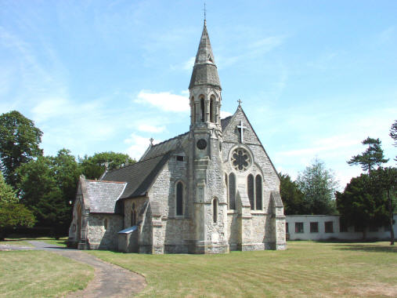
THE REFORMATION
Ms. Ha Day #1

Slide 2
CONTENT OBJECTIVES
1. SWBAT: explain why the Catholic Church was so powerful
coming out of the Middle Ages.
2. SWBAT: identify those that challenged the Church’s
authority and why they did it.

Slide 3
LANGUAGE OBJECTIVES
1. “I CAN” explain why the Church was so powerful coming
out of the Middle Ages through discussion and notes.
2. “I CAN” identify those who challenged the Catholic Church
and why they did it through discussion, notes and a
foldable.

Slide 4
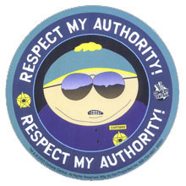
I. Background
A. The Middle Ages
1. Also known as “the Age of Faith”
2. Church was rich and powerful
3. Pope had more power than the Kings
4. 1300s-some challenged the authority,
or power, of the Church

Slide 5
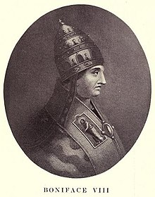
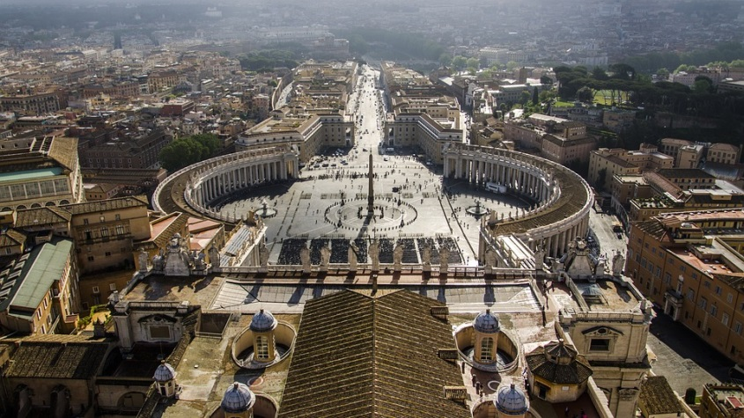
B. Who challenged the political power of the Church?
1. 1294: King Philip IV / France
2. He tried to tax the clergy / Pope said “NO”
3. 1303, king arrested Pope Boniface VIII-Italian
4. 1309, king appointed new French Pope: Clement V
5. New Pope moved from Vatican to Avignon, France
6. 70 years passed, Pope was back at Vatican

Slide 6
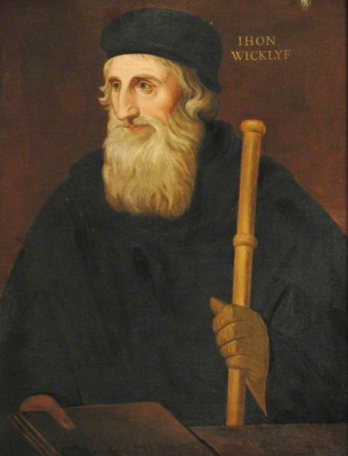
II. The Reformers
John Wycliffe
A. 1500s, some people challenged religious authority
1. People: reformers
2. REFORM: to change

Slide 7
B. John Wycliffe
1. Felt church had too much power & wealth
2. Translated Bible from Latin to English
3. Wanted common people to read it
4. His followers called “Poor Preachers.”
a) Interest Only: teach religion
b) Money was unimportant

Slide 8
C. John Huss
1. Reformer
2. Well-known scholar
3. Felt clergy-too worldly
4. Wanted them removed from church
5. Followers of Huss criticized church
6. Fear of religious and political rebellion

Slide 9
(do not copy this)

Slide 10
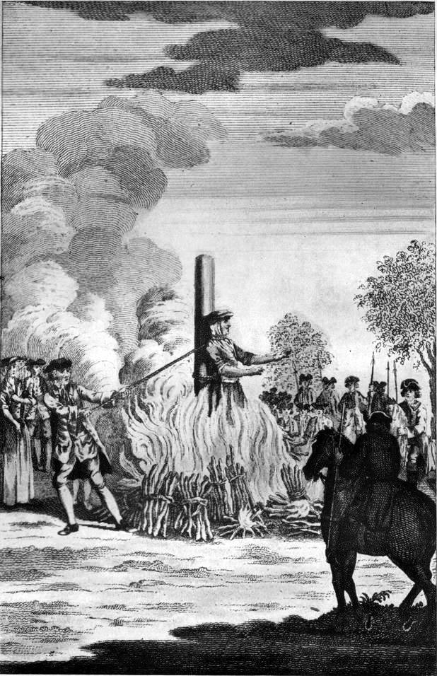
D. John Huss charged
1. HERETIC: a person who teaches a belief
that a religious leader
thinks is false
2. In 1415, Huss arrested and
was burned at the stake

